Slide 1
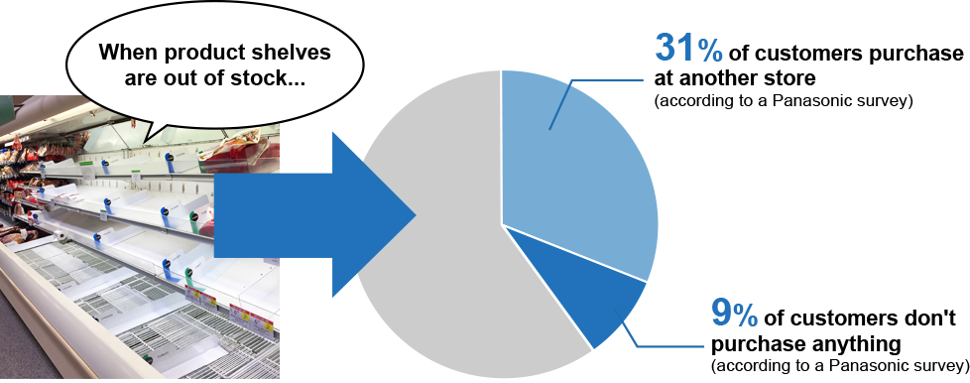
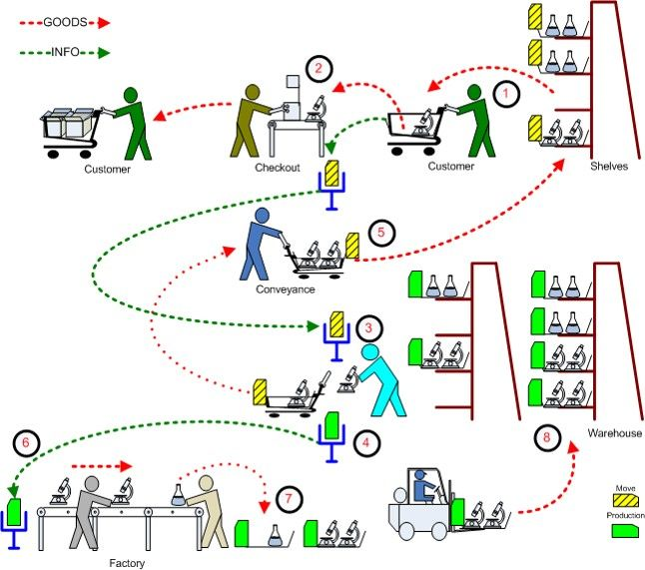




Problem Description
Realtime oos
customer acquisition and retention
Satisfaction and dis satifaction
What is OOS
Why do we solve it?
Realtime oos
Automatic Detection and Notification
The Out-of-Stock Detection System has a high level of detection accuracy thanks to Panasonic's original image recognition technology. If an item is out of stock, the staff will automatically be notified, together with the shelf position.
Demand Forecasting
Out-of-stock information and data on fast-selling items are learned by the Panasonic cloud system, which allows the system to forecast item demand.
Linking Electronic Shelf Labels The Out-of-Stock Detection System can be linked to Electronic Shelf Labels (ESL). This also enables the staff to recognize the names of out-of-stock items together with the geolocation information of the ESL management system.

Slide 2
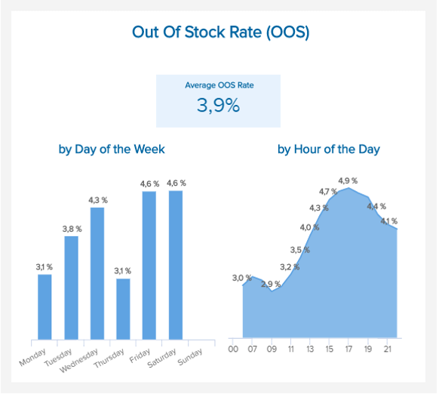
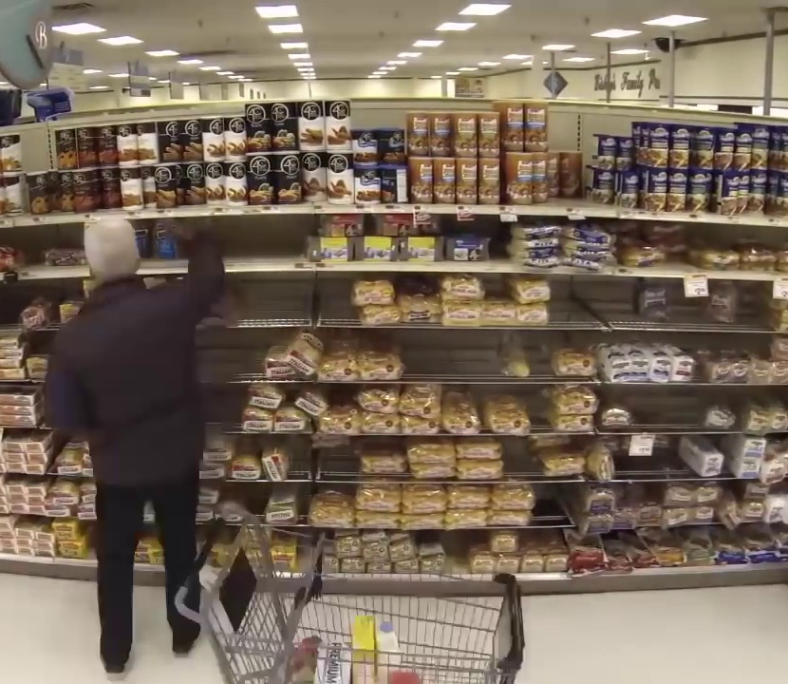
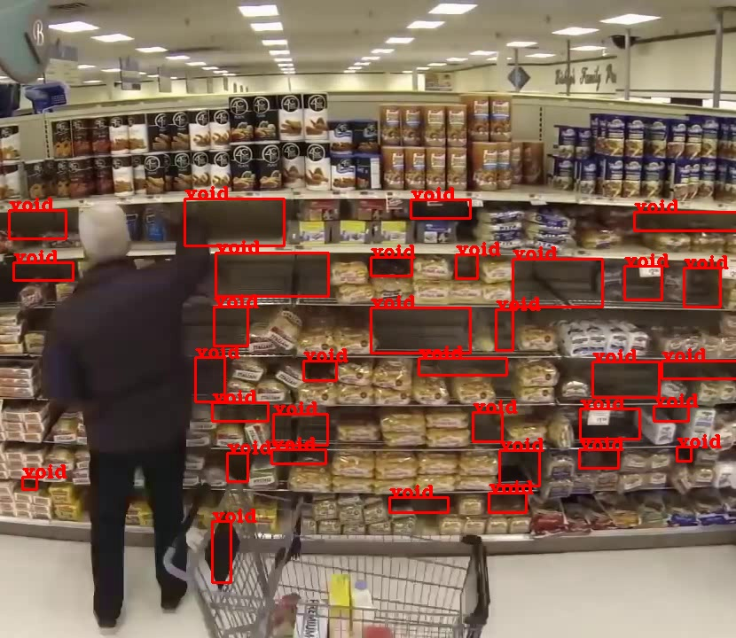
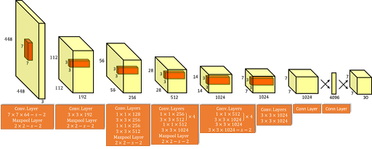
How we are solving the problem
Computer vision
Predictive Analytics
Input Frame
Fusion

Slide 3
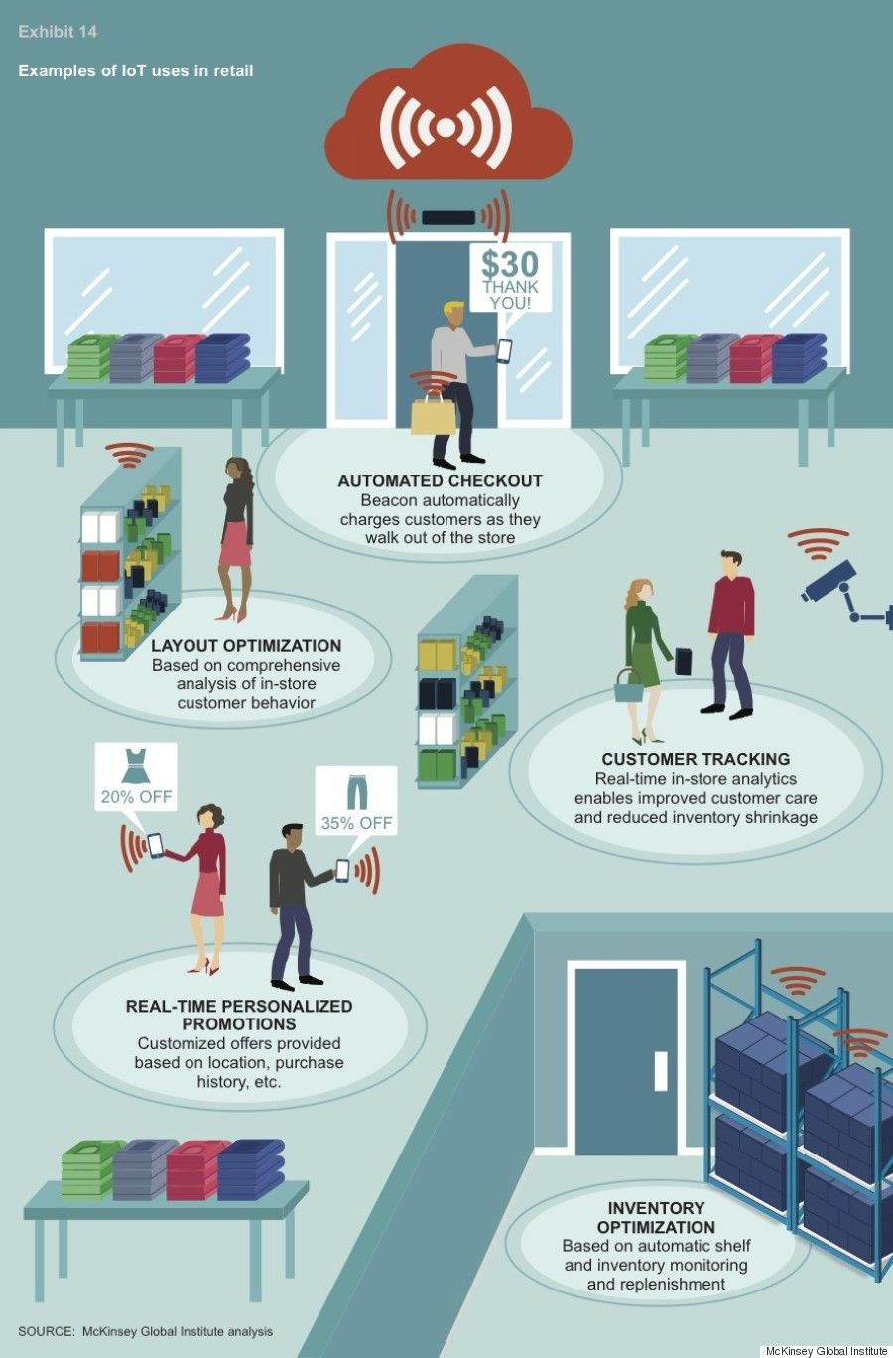
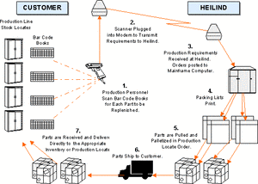
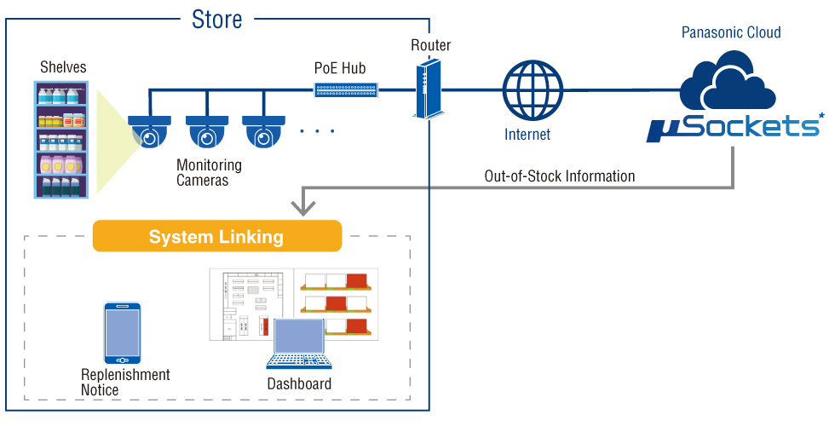
Solution Benefits/ Advantages suitable header
Using Open CV we created a Shelf health monitoring system to keep track of each row's health in real time.
https://panasonic.net/cns/invc/osd/

Slide 4
THANK YOU

