Slide 1
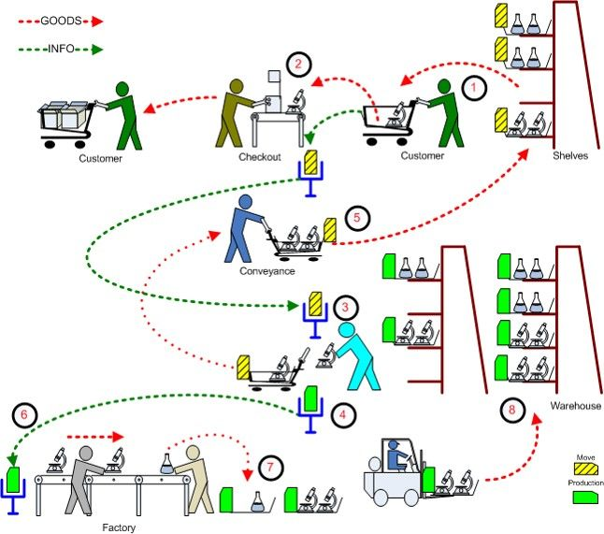
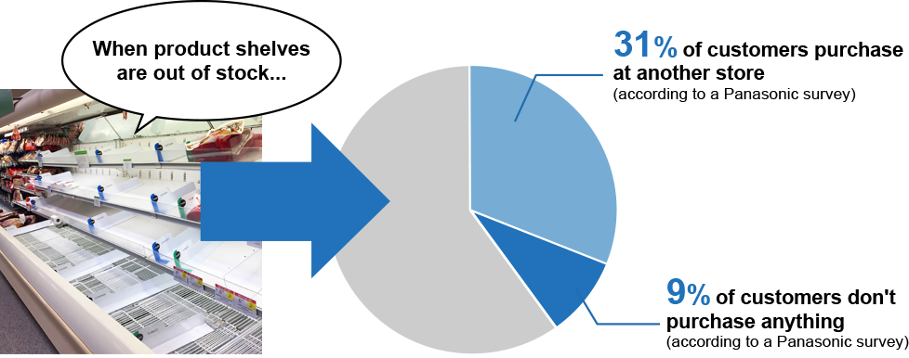
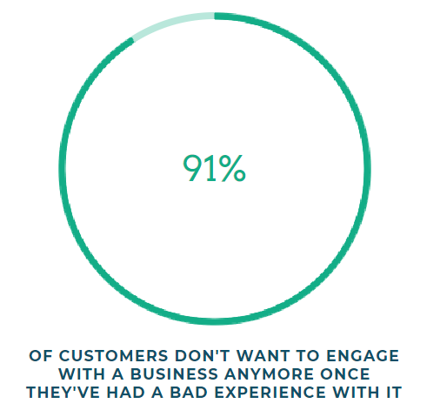
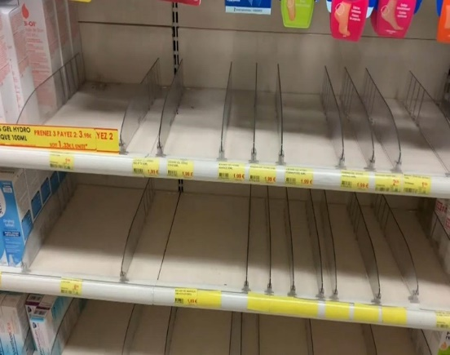

Problem Description
What is OOS?
Why do we solve it?
Defined as the unavailability of specific items or products on the shelf at the point of purchase when the customer is ready to buy.
There are 7 Major causes of OOS
Inaccurate data/Human error
Failure to re-order in a timely manner
Poor management of people, processes, and technology
Poor communication or relationships with your suppliers
Not enough working capital
Unexcepted surges in customer demand
Inadequate forecasting and reporting
OOS has been found one of the top influencing factors regarding customer dissatisfaction.
three-strikes-and-you’re-out pattern.
But it is not only money that is lost due to OOS situations.
Customer loyalty towards a brand or a store can be severely damaged.
Carefully planned promotions lose impact when the product isn’t available for purchase.
Extra time and resources become necessary for additional ordering and intensified auditing.
91% customers don’t come back if continuously 3 times they did not find the product they want in a store

Slide 2



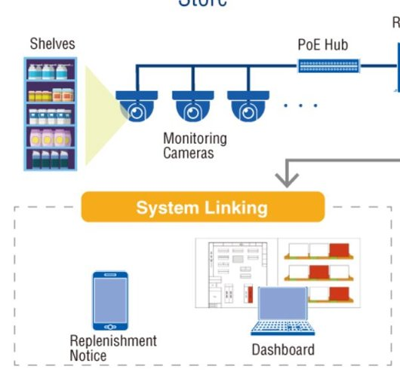

How we are solving the problem
Computer vision
Predictive Analytics
Historic transaction data of a store is needed to calculate hourly product sell rate.
As products can have different sell rate so variable thresholds are needed to trigger out of stock to store management.
Additional metrics are calculated over transaction data and thresholds are calculated by running a univariate analysis over them.
Tracking empty Voids in the shelf using Deep Learning and Computer Vision
Estimating the % heath of each row in the shelf based on continuously changing empty void areas.
Triggering a Replenish notification as soon as the shelf inventory level reaches the hourly selling/run rate.
Product - wise Hourly Sell Rate
Integration
Deep Learning And Computer Vision
Realtime analysis
Read video from camera
Apply Deeplearning model YOLO
Identify Void in shelf
Available product calculation based on void detected
Available product calculation based on void detected
Replenish Notification & dashboard
Computer vision
Trigger OOS to store management
Historical analysis
Transaction data reading
Identify fast moving objects
Calculating metrics for fast moving products
Calculate run rate matrix for 12*7(hour, day combination)
Triggered before OOS
Predictive Analysis

Slide 3
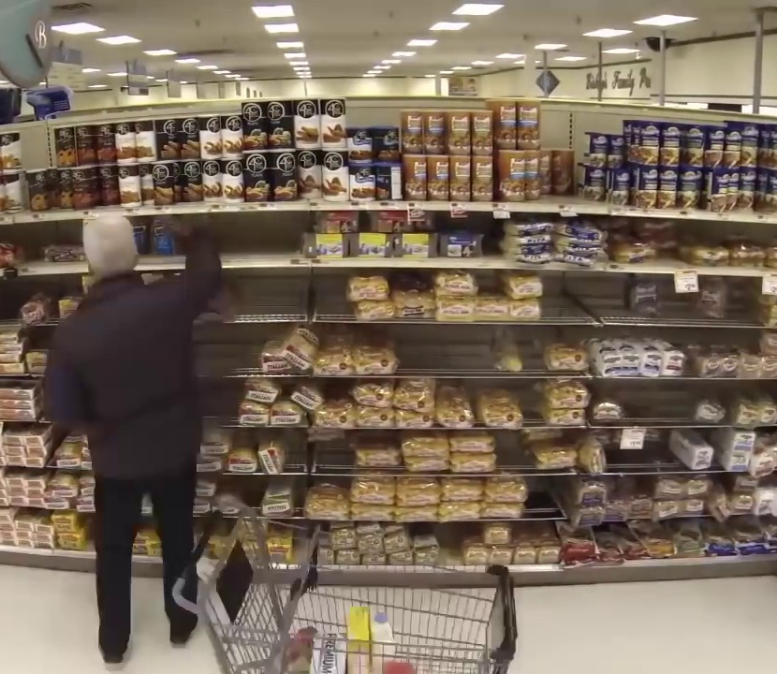
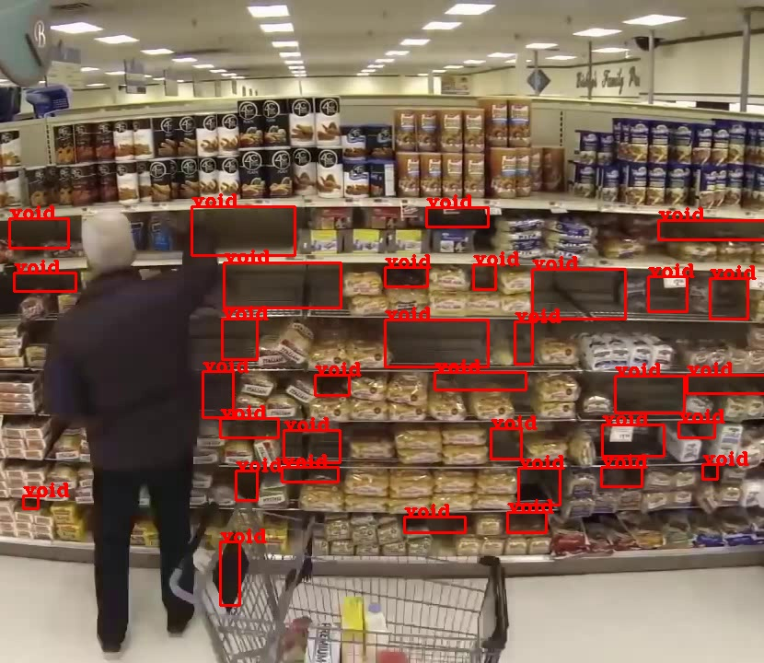
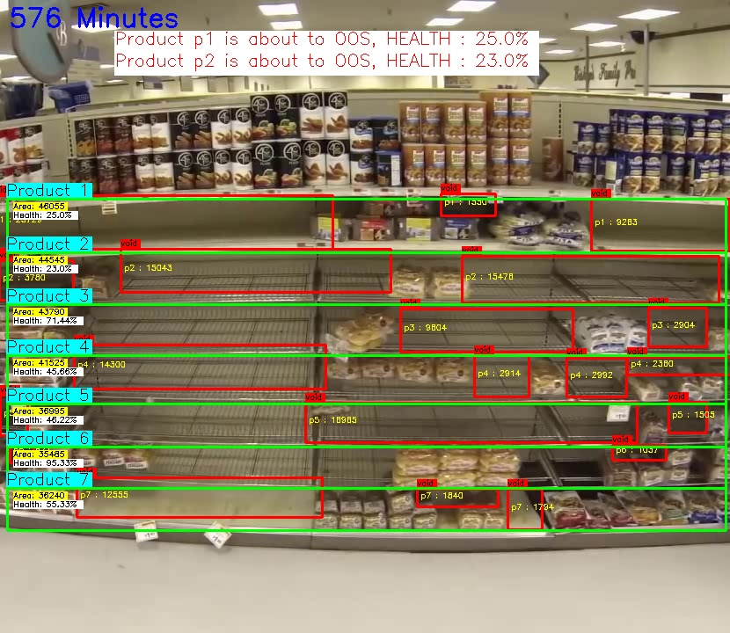
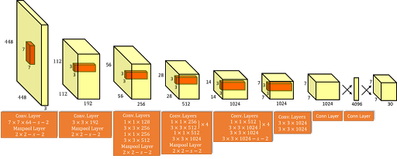
Model Training and Computer Vision Pipeline
Empty Void Detection
Shelf Health Monitoring
Using OpenCV we built a Virtual shelf structure with product mappings for each row.
We predict the voids and calculate the total empty area in terms of percentage and estimate Row Health.
Based on the selling rate of the products at that particular hour we trigger a notification to the staff for replenishment of inventories.
Our approach is focused on detecting empty voids in the shelf, for which we manually labeled empty voids in various shelf images and
trained a deep convolutional neural network (YOLO) to detect voids.
The network was trained on GPU till 4000 iterations till and took more than 4 hours in training.
Computer Vision
+
Custom Algorithms
YOLO
Input Frame
Output Frame with Detected voids
Shelf Tracking

Slide 4
Solution Impacts
Benefits
High availability of products increases the customer satisfaction
Improves the efficiency of retail store employees
Helps in identifying better product assortment in a store.
Helps to boost sales and prevents lost sales opportunities
With variable run rate & auto triggering solution manages staff efficiently
Eliminates the need to check shelves
Predictive model will help us in better stock and inventory management
Customer satisfaction attracts more customers and avoid customer fallback
Halts customer complaints due to out-of-stock items by keeping the shelves filled
Can be used a good real time recommendation engine by tracking the customer basket items

Slide 5
THANK YOU
Demo Link
https://www.youtube.com/watch?v=rsZbaxJYumU

