Slide 1
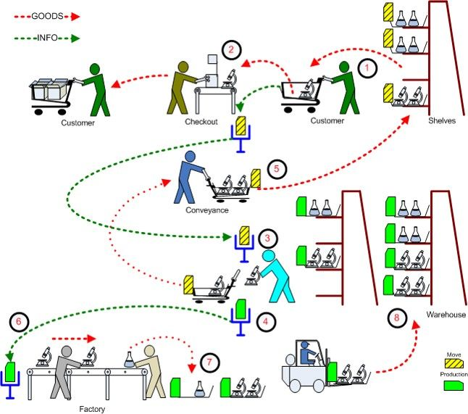
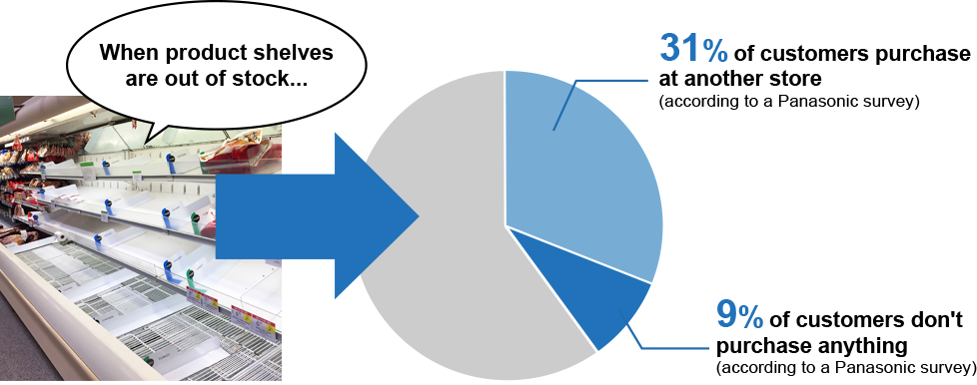

Problem Description
What is OOS
customer acquisition and retention
Satisfaction and dis satifaction
Why do we solve it?
Realtime oos

Slide 2
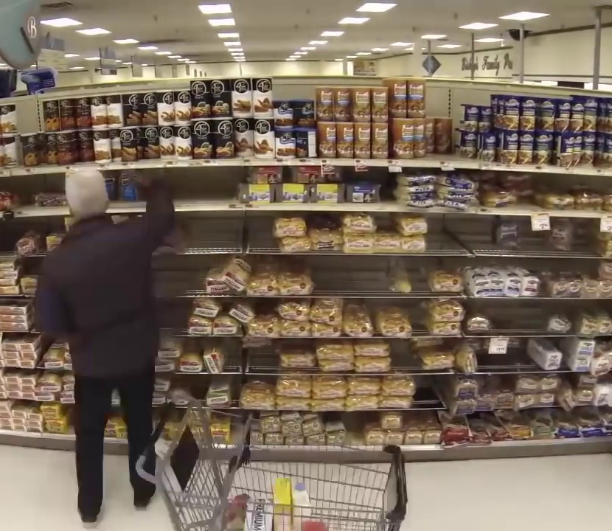
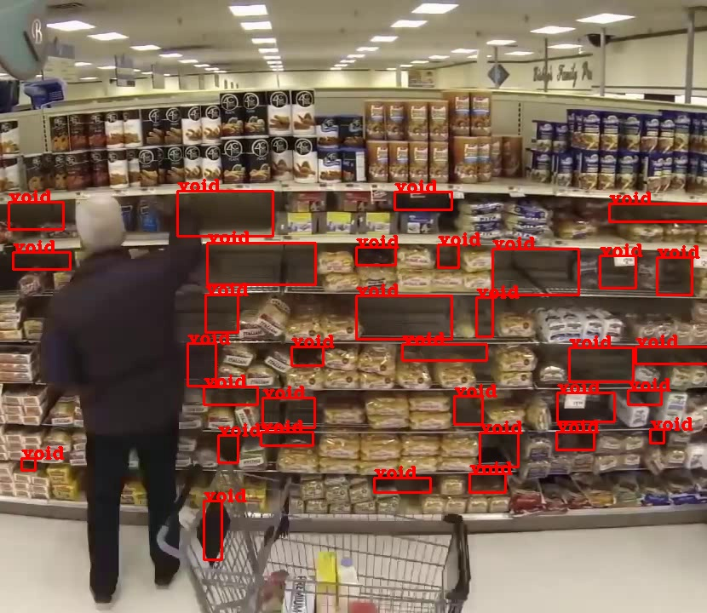
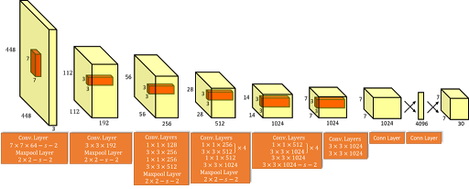
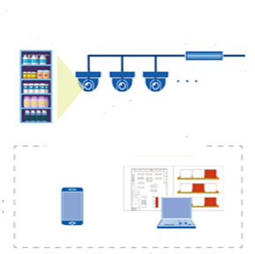
How we are solving the problem
Computer vision
Predictive Analytics
Input Frame
Integration
shelf
Realtime analysis
Read video from camera
Apply Deeplearning model YOLO
Identify Void in shelf
Available product calculation based on void detected
Available product calculation based on void detected
Computer vision
Monitoring cameras
Trigger OOS to store management
Replenish Notification & dashboard
Historical analysis
Transaction data reading
Identify fast moving objects
Calculating metrics for fast moving products
Calculate run rate matrix for 12*7(hour, day combination)
Predictive Analysis

Slide 3
Impact Analysis
Benefits
High availability of products increases the customer satisfaction
Store always assort the products for better experience and if we capture the customer density count on the aisle and check the buy rate of the product which will help us in better product assortment in store increasing the customer experience on longer run.
If we can add a device to track the customer items at the checkout counter we can make a good real-time recommendation engine suggesting customer what items he can purchase along with the basket items.
With variable run rate and auto triggering the solution manages the staff members efficiently reducing manual intervention in tracking of products in the shelf thus requiring them only when the products need to be replenished.
Predictive model will help us in better stock and inventory management.

Slide 4

THANK YOU

