Slide 1

Problem Description
Realtime oos
customer acquisition and retention
Satisfaction and dis satifaction
What is OOS
Why do we solve it?
Realtime oos

Slide 2
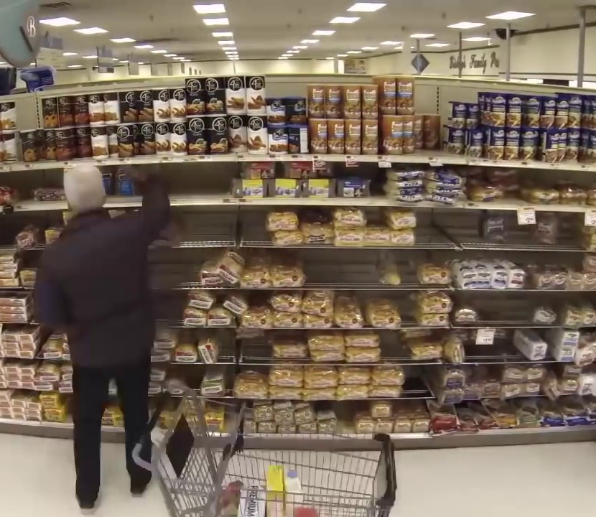
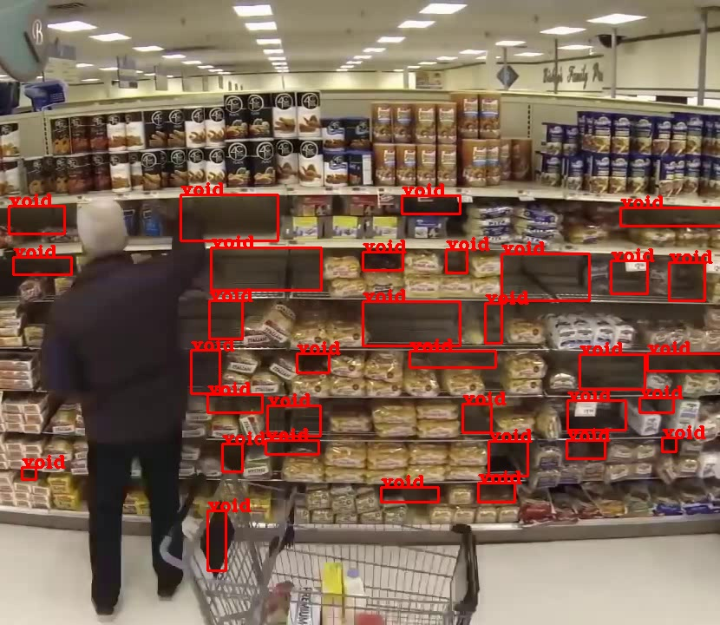
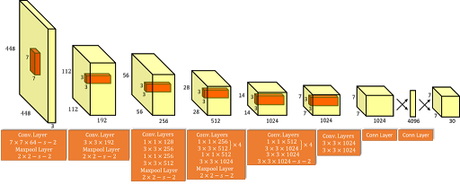
How we are solving the problem
Computer vision
Predictive Analytics
Input Frame
Fusion

Slide 3
Solution Benefits/ Advantages suitable header
Using Open CV we created a Shelf health monitoring system to keep track of each row's health in real time.

Slide 4
THANK YOU

