Slide 1
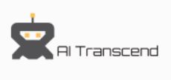
Real-Time Out of Stock Prediction in Stores and On-Shelves Inventory Tracking
The Solution objective is to minimize OOS (out of stock) at stores and improve overall customer experience and satisfaction by ensuring the products are always available on the shelves as well as in stock with the stores.
Ensuring on shelf availability using Deep Learning and Computer Vision
Solution Overview
Ensuring In Store Availability of Stock Using Predictive analytics
Ensuring proper availability of items on the shelves is very important to boost sales and customer satisfaction as well as retention.
Even though stock is available at stores but not at the shelves due to inefficient management of shelf inventories by the staff.
We Created an AI driven solution to track the shelves health and automatically notify the staff when and where to replenish stock before it get out of stock
We Trained a Deep Learning Convolution Neural Network using state-of-the-art YOLO object detection model to detect empty voids in the shelves.
It triggers a replenish request as soon as the Shelve inventory health goes below the threshold value based on the hourly selling rate of the product.
Extract transaction of last 6 months for a store and calculate hourly demand of the products available in that store.
Remove non preforming or low performing products based on analysis of hourly trend per weekday of the product.
Select top 100 best fast moving products and set the diamond line for these product watch their trend.
Calculate hourly/weekly and monthly run rate as KPI for these fast moving product.
Estimate OOS time at store and predict re-order quantity.
Train the model using linear regression and predict the hourly run rate for these diamond line products.

Slide 2
Shelf Health Tracking with Deep learning and Computer Vision
Taking live feed from a fixed point camera and running our custom trained YOLO model to identify empty voids in each row of the shelf and monitoring the shelf health in real time.
Solution Flow Chart

Slide 3
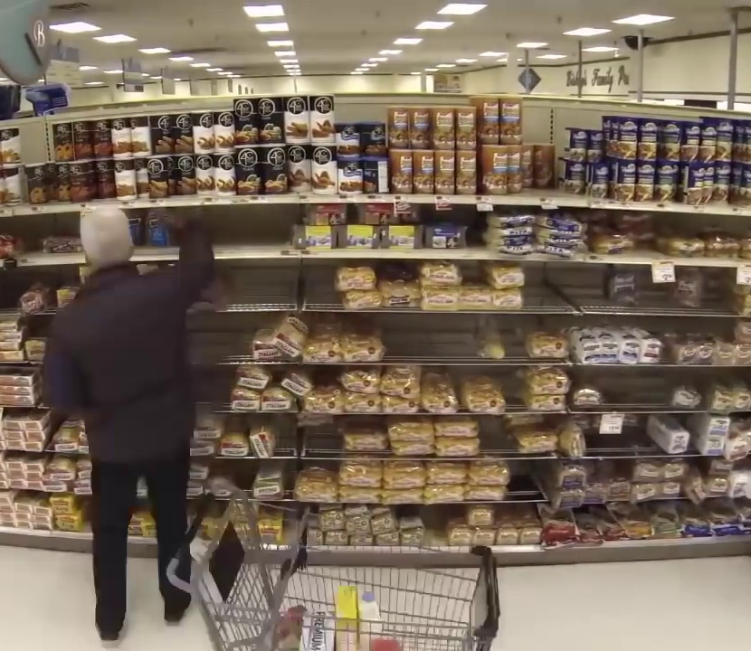
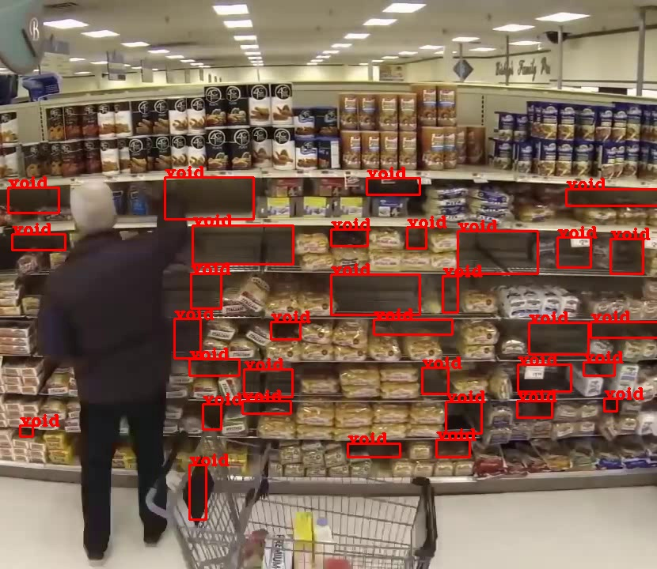
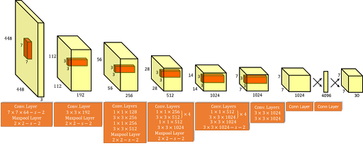
Model Training and Results
For Training YOLO object detector model , we couldn’t find much available sources for a single shelf getting empty over time.
We used a time lapse video of grocery shelf available on YouTube and extracted relevant frames to generate training data.
We labeled the data using LableImg tool and trained the YOLO layers to detect empty voids till 4000 Iterations on GPU.
If more customised and quality data is available the model could perform even better.
YOLO
Input Frame
Output Frame with Detected voids

Slide 4
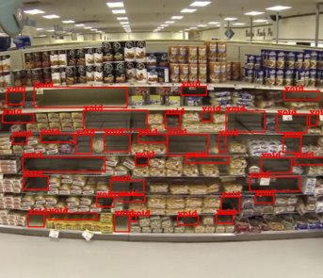
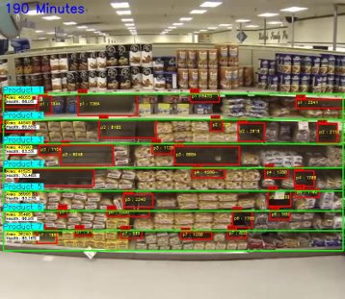
Shelf Health Monitoring Pipeline
Using Open CV we created a Shelf health monitoring system to keep track of each row's health in real time.
We estimated the area of the rows for each product and keep subtracting the empty void area to estimate the product availability and health of the row.
We continuously monitor and track the Percentage of area covered with products and display in real time and maintains a database of change in area at the backend.
As soon as the area drops below a certain estimated threshold value, It triggers a notification to the staff that a specific product is going to of Out of stock soon and replenishment of inventory is requiired.
The solution also notifies the location of shelf , row and the product information about to be Out of stock along with the estimated time of out of stock.
Computer Vision and OpenCV

Slide 5
We Couldn't get enough time to work on the Presentation further in an elaborative way. But we have made a demo video of the solution working solution.
You can find the Demo video in our submission zip file as well as hosted on Youtube . Link : https://youtu.be/rsZbaxJYumU
The demo was also run on the time-lapse video of grocery shelf found on Youtube. As soon as the inventory on shelves goes down a triggered message will appear on screen with product ID .
Also You can run the demo yourself using our source code . The instruction are given along with the Repository
THANK YOU

