Slide 1
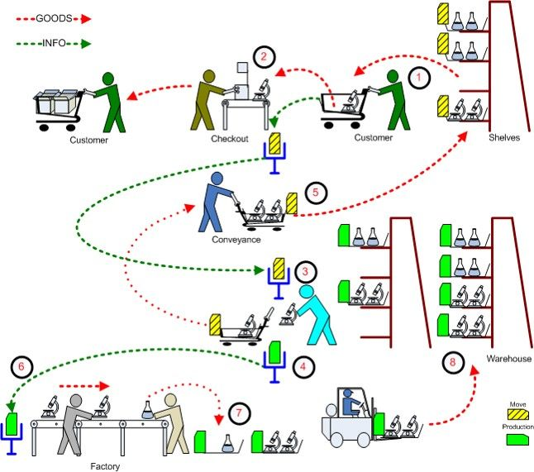
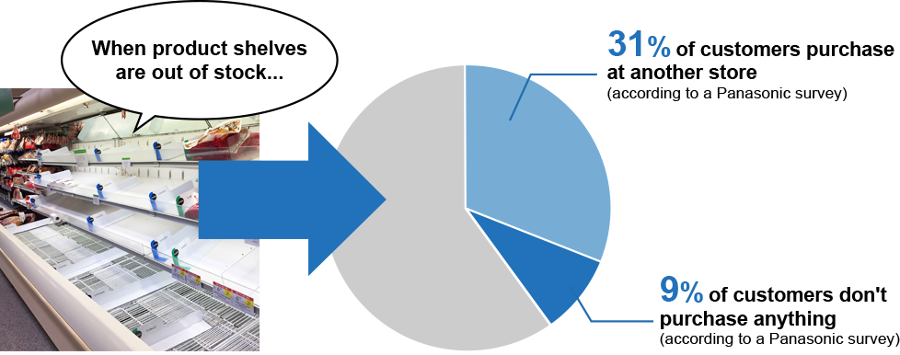
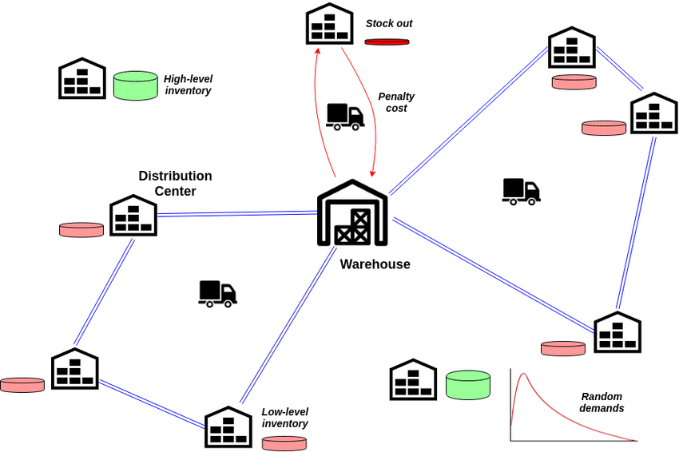
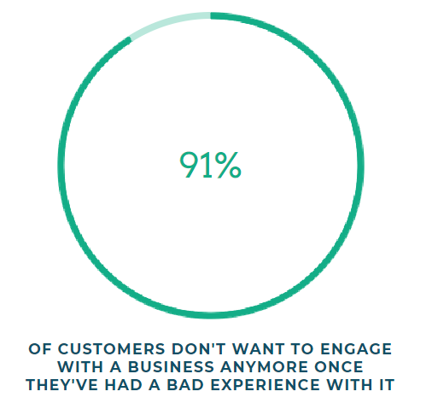
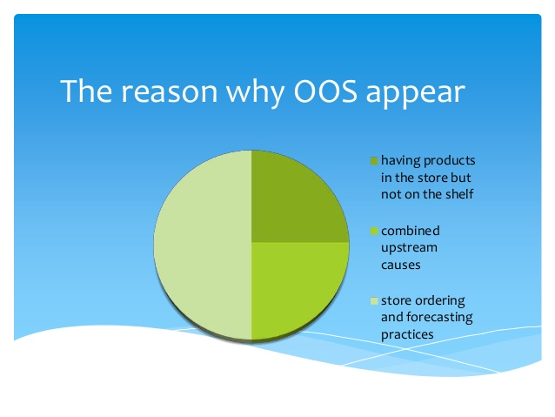

Problem Description
Defined as the unavailability of specific items or products at the point of purchase when the customer is ready to buy.
Previous studies show that the average Out of Stock rate is about 8%. That means that one out of 13 products is not purchasable in the exact moment.
There are 7 Major causes of OOS
Inaccurate data/Human error
Failure to re-order in a timely manner
Poor management of people, processes, and technology
Poor communication or relationships with your suppliers
Not enough working capital
Unexcepted surges in customer demand
Inadequate forecasting and reporting
What is OOS
Why do we solve it?
OOS has been found one of the top influencing factors regarding customer (dis)satisfaction.
three-strikes-and-you’re-out pattern.
But it is not only money that is lost due to OOS situations.
Customer loyalty towards a brand or a store can be severely damaged.
Carefully planned promotions lose impact when the product isn’t available for purchase.
Extra time and resources become necessary for additional ordering and intensified auditing.

Slide 2

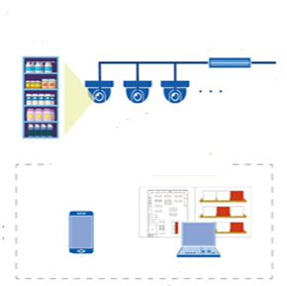


How we are solving the problem
Predictive Analytics
Computer vision
Reconciling disparities in item counts
if a specific product is selling much faster at one store than another, retailers can quickly see this trend and move stock from their warehouse or another retail location to meet that demand.
Forecasting demand more accurately
safety stock volume = (Maximum daily sales * maximum lead time in days) - (average lead time in days * average daily sales)
Managing logistical challenges
Depends on technology or handled manually
Less-than-truckload shipping offer smaller, more frequent deliveries.
Shipped to customer directly from manufacturer.
https://streetspotr.com/2017/08/14/out-of-stock/
High availability of products increases the customer satisfaction
Improves the efficiency of retail store employees and helps to boost sales
shelf
Input Frame
Monitoring cameras
Integration
Deep Learning And Computer Vision
Realtime analysis
Read video from camera
Apply Deeplearning model YOLO
Identify Void in shelf
Available product calculation based on void detected
Available product calculation based on void detected
Replenish Notification & Dashboard
Computer vision
Trigger OOS to store management
Triggered before OOS
Historical analysis
Transaction data reading
Identify fast moving objects
Calculating metrics for fast moving products
Calculate run rate matrix for 12*7(hour, day combination)
Predictive Analysis

Slide 3
Impact Analysis
Benefits
High availability of products increases the customer satisfaction
Improves the efficiency of retail store employees and helps to boost sales
With variable run rate and auto triggering the solution manages the staff members efficiently and eliminates the need to check shelves.
Prevents lost sales opportunities.
Halts customer complaints due to out-of-stock items by keeping the shelves filled.
Store always assort the products for better experience and if we capture the customer density count on the aisle and check the buy rate of the product which will help us in better product assortment in store increasing the customer experience on longer run.
If we can add a device to track the customer items at the checkout counter we can make a good real-time recommendation engine suggesting customer what items he can purchase along with the basket items.
Predictive model will help us in better stock and inventory management.

Slide 4
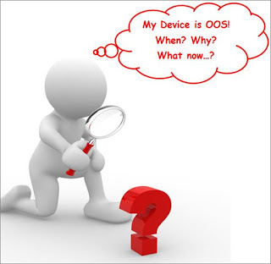
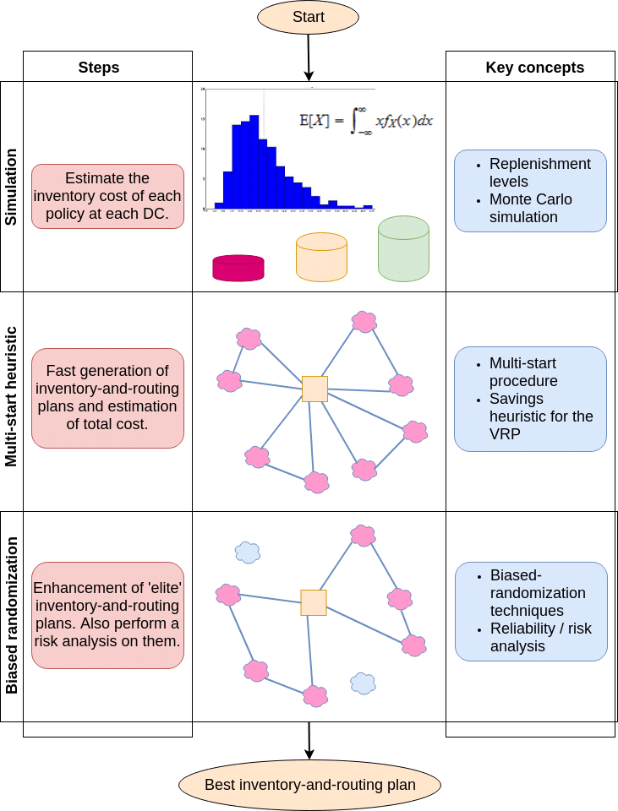

THANK YOU

