Slide 1

Note: The data and information in this document is reflective of a hypothetical situation and client. This document is to be used for KPMG Virtual Internship purposes only.
Sprocket Central Pty Ltd
Data analytics approach
Ankit Narang

Slide 2
Note: The data and information in this document is reflective of a hypothetical situation and client. This document is to be used for KPMG Virtual Internship purposes only.
Agenda
Introduction
Data Exploration
Model Development
Interpretation

Slide 3
Note: The data and information in this document is reflective of a hypothetical situation and client. This document is to be used for KPMG Virtual Internship purposes only.
Introduction
In this analysis, we have used both machine learning and visualization to find out the new customers who can be targeted basis different reasoning and findings.
We have used customer’s demographics, Addresses and transaction data is used to build a machine learning model which predicts the price of goods they might purchases and based on that we have found a list of 100 customers.
The data of new customers is visualized and explored to create a dashboard to show which region of Australia to target and other variables that can be kept in mind while targeting the right market.

Slide 4
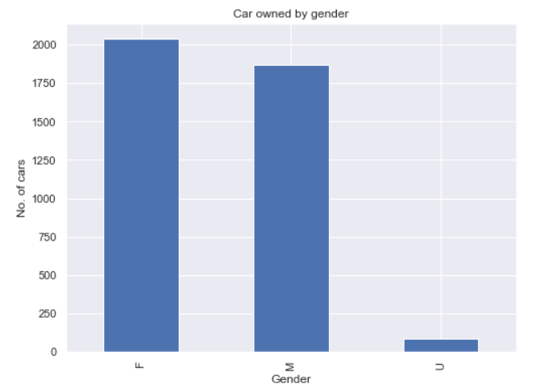
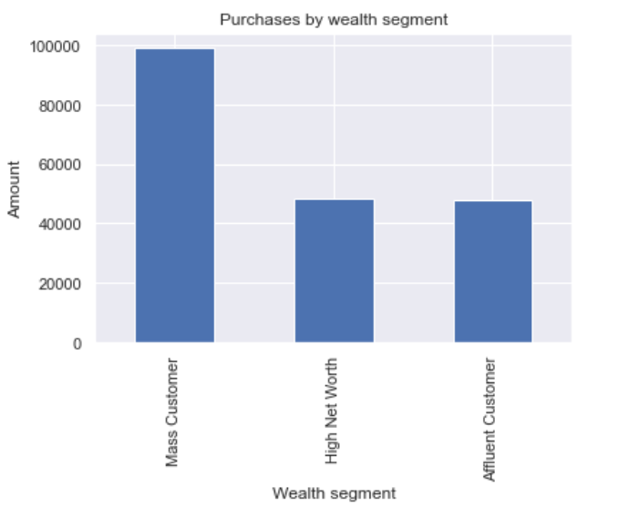
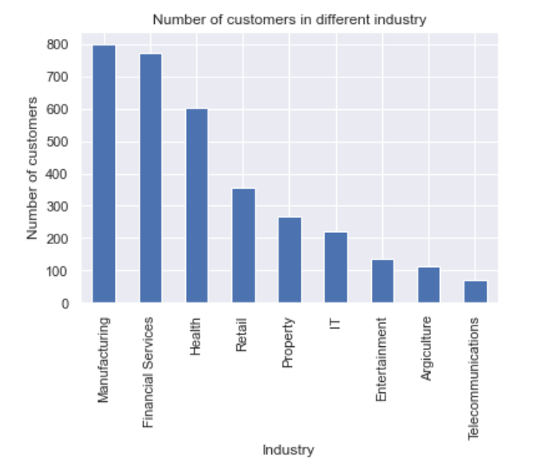
Note: The data and information in this document is reflective of a hypothetical situation and client. This document is to be used for KPMG Virtual Internship purposes only.
Data Exploration
Data Exploration has been done taking variables like Gender, wealth segment and Industry customer works in and the result are as follows.
Female customers are more valuable to the business based on the past 3 years sales data.
Mass customer should be targeted as the amount of goods they purchased is quite high.
The top 3 industries in which customers works include:
Manufacturing
Financial Services
Health

Slide 5
Note: The data and information in this document is reflective of a hypothetical situation and client. This document is to be used for KPMG Virtual Internship purposes only.
Model Development
The features/variables used to make a price prediction model are: gender,past_3_years_bike_related_purchases, job_industry_category, wealth_segment, owns_car, tenure, property_valuation, Age, online_order, product_class, list_price,and states.
We used Random Forest classifier and other algorithm as well but the best accuracy we could achieve was 72.08 % which makes complete sense for a market targeting model.
It means that out of 100 times the price that model predicts would be accurate 72 times which is a decent accuracy.
We used this model to predict the amount of purchases a new customer might make with the company and came up with the list 100 customers. Please find the csv file containing the customer details below.
Final list of customers to target.

Slide 6
Note: The data and information in this document is reflective of a hypothetical situation and client. This document is to be used for KPMG Virtual Internship purposes only.
Interpretation
Based on our analysis of the customers data, we can interpret our finding as follows:
Female customers tend to purchase more as compared to male customers.
Mass customers should be targeted as they make a big chunk of customers of the company and tend to purchase more.
The customers from New South Wales are more valuable to the company.
Among all the customers 50 % Mass customer owns a car.
As far as job industry of the new customer is concerned, the top 3 of them are as follows:
Retail
Entertainment
IT
The customers working in these industry are more valuable to our business.
Apart from the top 100 customers to be targeted predicted by the model, I also tried exploring and analysing the data of new customers using a visualization tool called Tableau and we were able to gain some important and interesting insights. The dashboard is on the next page.

Slide 7
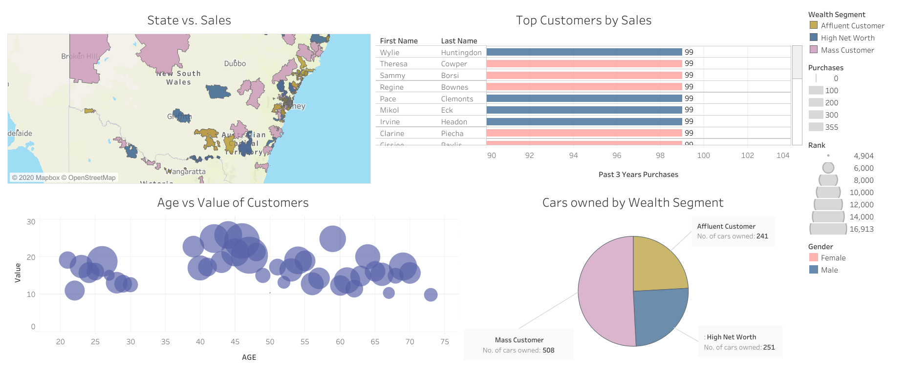
Note: The data and information in this document is reflective of a hypothetical situation and client. This document is to be used for KPMG Virtual Internship purposes only.
Interpretation
Tableau Dashboard: LINK

Slide 8
Note: The data and information in this document is reflective of a hypothetical situation and client. This document is to be used for KPMG Virtual Internship purposes only.
Appendix

Slide 9
Note: The data and information in this document is reflective of a hypothetical situation and client. This document is to be used for KPMG Virtual Internship purposes only.
Appendix
This is an optional slide where you may place any supporting items.

