Slide 1
Problem Statement:
Client runs a contact center which manages IT backend support team here in India. There are experiencing high Average Handling Time (AHT), which is a big concern. They are in need of support from analytics team in driving key decision in this regard.
Objective:
Help the client in driving low AHT across the board.
Using your data science experience please do either of the following:
Text mining on the textual feedback data.

Slide 2
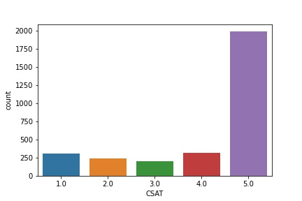
Based on the CSAT(Rating column) we found maximum customers has given 5 Rating.

Slide 3
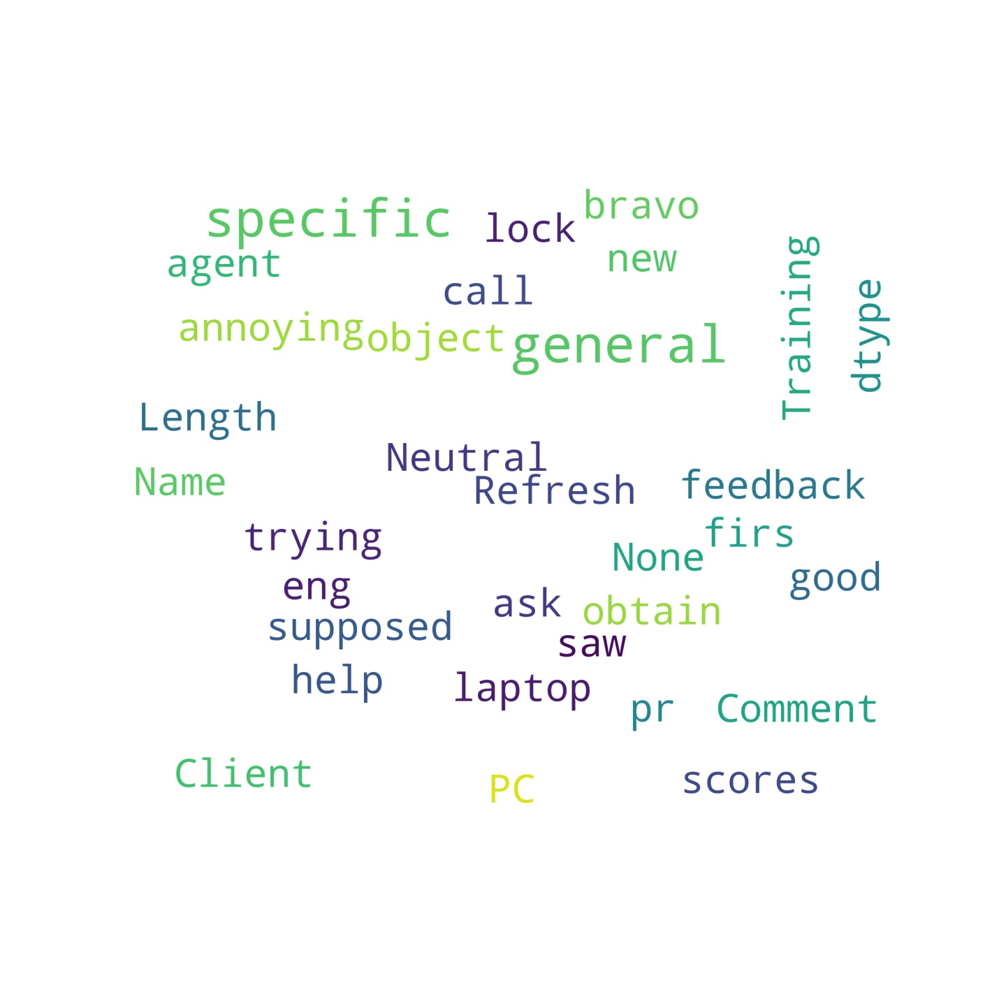
We have extracted the most common words from the General Comment column to find out which are the common words used by the maximum Customers.

Slide 4
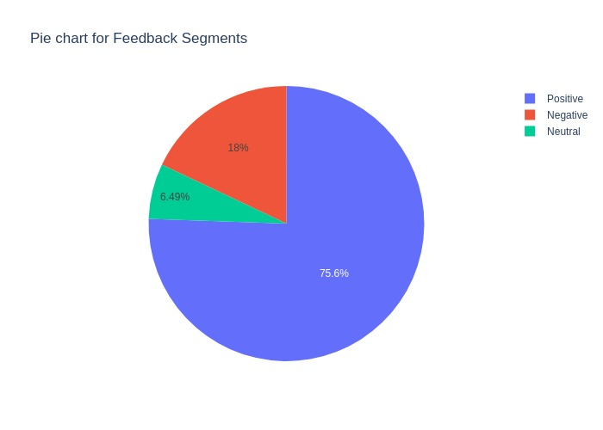
Plotting Pie Chart for Feedback Column to check the Percentage of Customers has given Positive/Negative/Neutral feedback. If CSAT Rating is > 3 we have given Positive feedback Rating=3 Neutral ,Rating<3 Negative feedback.

Slide 5
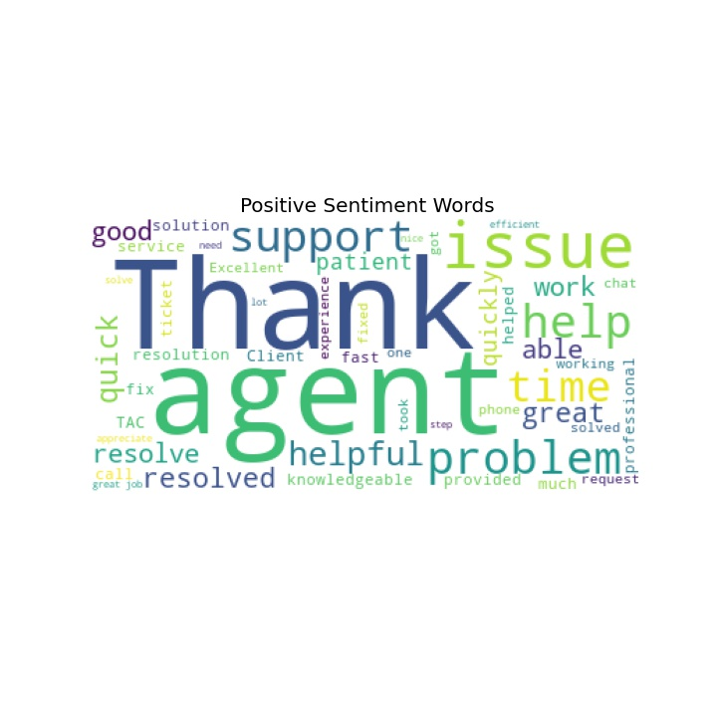
We have identified words like Thank,Great, Good,Quick etc were the most common words used in Positive Feedback.

Slide 6
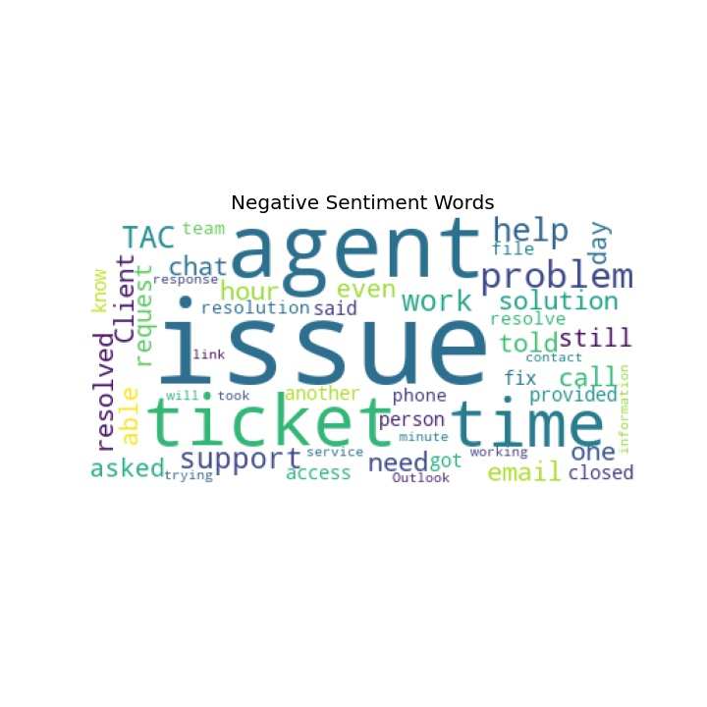
We have identified words like Issue, fix, agent, support etc were the most common words used in Negative Feedback.

Slide 7
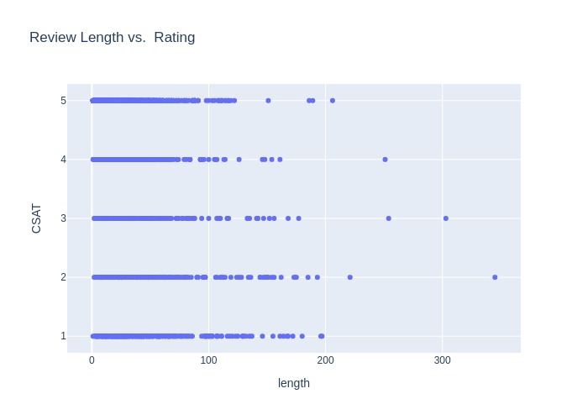
We have used Scatter Graph to check Review Length based on the Rating Column. Review Length with Rating 5 is low compare to other Rating.

Slide 8
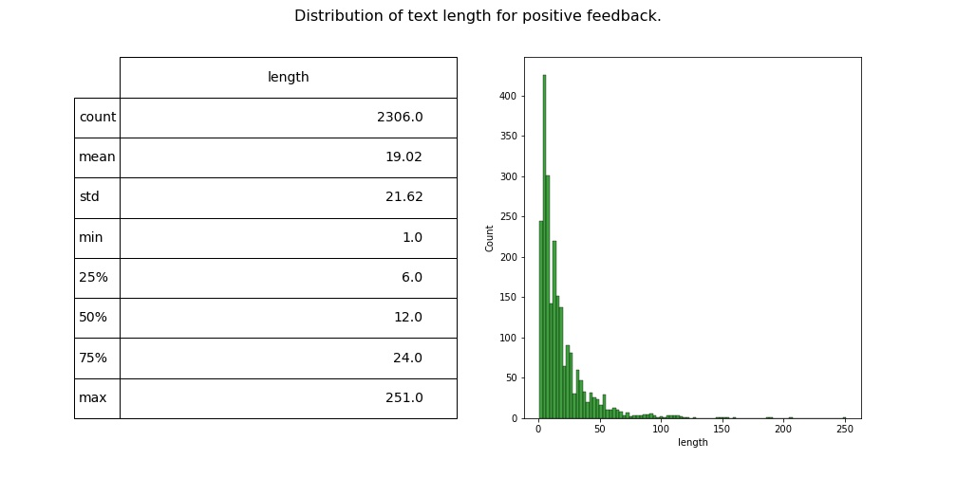
Used Distribution of Positive Comments to get the maximumn sentence length(251) and matrix of count, mean,median etc.

Slide 9
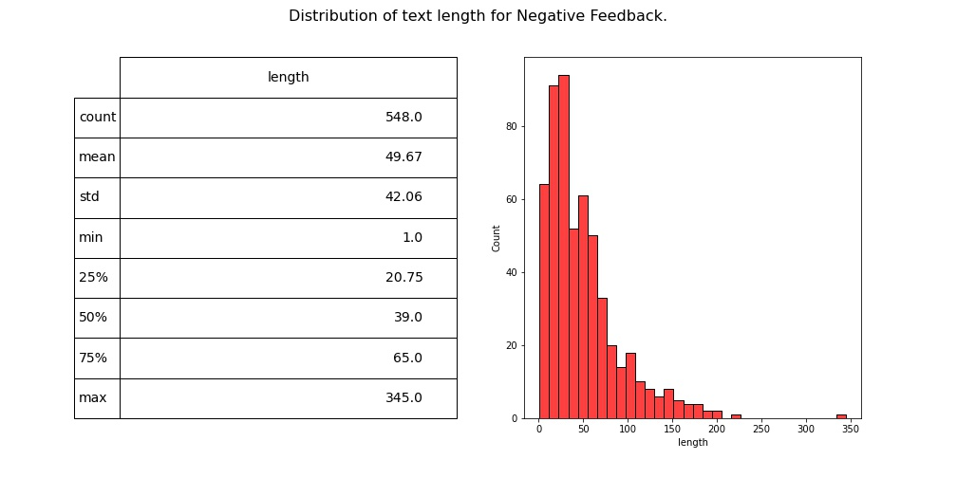
We have used Distribution of Negative Comments to get the maximumn sentence length(345) and matrix of count, mean,median etc.

Slide 10
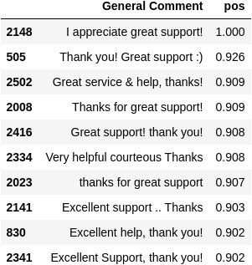
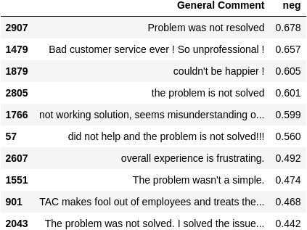
After Using Vedar Sentimental Analysis we have segregated Comments based on the Negative/Positive Scores.

Slide 11
Conclusion
We found that Tickets with Low priority has higher escalation might be agent didn’t focus on that and delayed in resolution. So, we need to improve our services to resolve tickets asap.
77% of the Customers are Very Satisfied with the Service Quality also with the Agent Skill maximum Customers are Very Satisfied.
The comments are more Positive compare to Neutral and Negative.
There are recurring words both in the Negative and Neutral comments.

