Slide 1
CLARITY IN PROPER ARTICULATION

Slide 2

ARTICULATION
Articulation refers to how clearly someone forms words. It includes the ability of a speaker to be clear and easily understood. Articulation involves using proper pronunciation and grammar and using an appropriate volume and rate of speech.
It also refer to the physical abilities necessary to form clear sounds and words, including the movements of the tongue, lips, teeth and vocal cords.
It is a crucial component of effective verbal communication, impacting the clarity and comprehensibility of spoken messages.

Slide 3
EXAMPLE
Scenario: A marketing manager presents a new advertising campaign strategy to the executive team.
Good Articulation: The marketing manager begins by clearly stating the campaign's objectives and target audience. They articulate each phase of the strategy with precision, explaining the rationale behind creative choices and anticipated outcomes. They use appropriate pauses and emphasize key metrics to demonstrate the campaign's potential impact.
Result: The executive team follows the presentation seamlessly, understanding the strategy's nuances and strategic objectives. They engage in a constructive discussion, asking pertinent questions and providing feedback based on the clear articulation of ideas. The marketing manager's articulate presentation effectively persuades the team of the campaign's feasibility and potential return on investment.

Slide 4

EXAMPLE
Scenario: A marketing manager presents a new advertising campaign strategy to the executive team.
Good Articulation: The marketing manager articulate each phase of the strategy with precision, explaining the rationale behind creative choices and anticipated outcomes. They use appropriate pauses and emphasize key metrics to demonstrate the campaign's potential impact.
Result: The executive team follows the presentation seamlessly, understanding the strategy’s importance and strategic objectives. They engage in a constructive discussion, asking pertinent questions and providing feedback based on the clear articulation of ideas..

Slide 5
IMPORTANCE OF ARTICULATION

Slide 6

Enhances Understanding
Clarity: Proper articulation ensures that your message is clear and easily understood by the audience.
For example-
Scenario: A teacher is explaining a complex scientific concept to a classroom of students.
Good Articulation: The teacher articulates each word clearly, uses appropriate pauses, and emphasizes key points.
Result: Students grasp the concept more quickly and accurately because the teacher's clear articulation helps them connect the spoken words with their meanings. This clarity enhances their understanding and retention of the information.

Slide 7

Boosts Confidence Self-Assurance
Self-Assurance: Knowing you can articulate your thoughts clearly boosts your confidence in various situations.
Public Speaking: Clear articulation reduces anxiety and improves performance in public speaking engagements.
For example-
Scenario: A student prepares for a class presentation on a challenging topic.
Good Articulation: The student practices their speech multiple times, focusing on clear pronunciation, appropriate pauses, and confident delivery.
Result: During the presentation, the student articulates their points effectively, maintaining eye contact and using expressive gestures to reinforce key ideas. Their clear and confident articulation not only ensures that the audience understands the topic but also boosts their own confidence.

Slide 8

Effective Communication
Engagement: Clear articulation keeps the audience engaged and attentive.
Impact: Well-articulated messages are more likely to be remembered and have a lasting impact.
For example-
Scenario: A team leader conducts a meeting to discuss a new project with team members.
Good Articulation: Throughout the discussion leader articulate each point clearly, using precise language and emphasizing key details. They allow for pauses to ensure clarity and give team members time to process information.
Result: Team members actively engage in the discussion, asking questions and providing valuable input. The articulate communication style of the team leader fosters a productive atmosphere where ideas are exchanged effectively

Slide 9
HOW TO IMPROVE ARTICULATION

Slide 10

Practice Pronunciation
Slow Down: Speak slowly to give yourself time to pronounce each word clearly
Tongue Twisters: Practice tongue twisters to improve your control over your speech muscles
Example-“Red lorry, yellow lorry”
The challenge lies in maintaining clarity and speed while repeating this sequence multiple times without stumbling over the similar-sounding words. It's a great exercise for improving articulation.

Slide 11
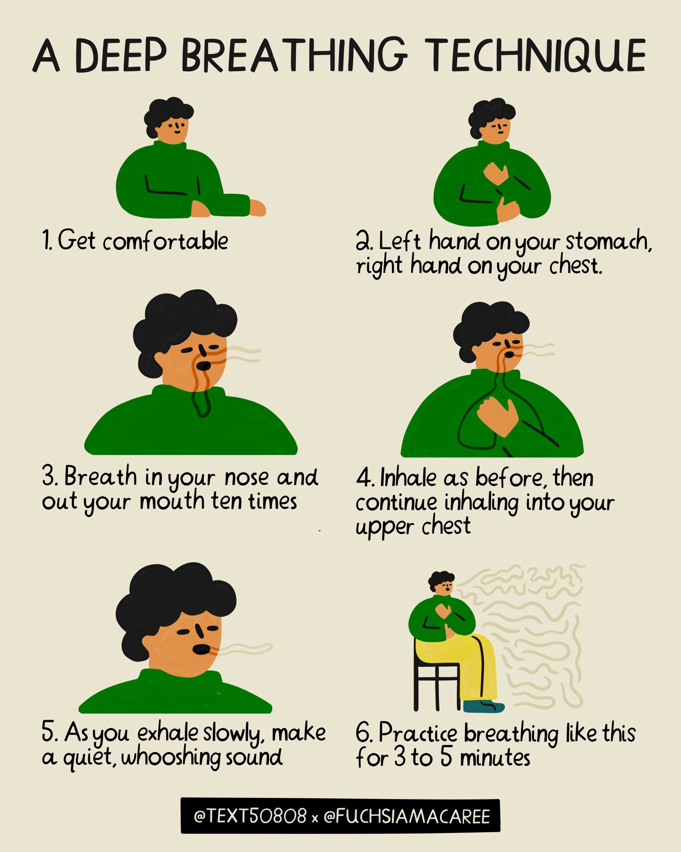
Breathing Techniques
Controlled Breathing: Practice deep breathing exercises to improve your breath control and support your voice.
Example- Take a deep breath in through your nose, hold it for a few seconds, and then release it slowly through your mouth while speaking

Slide 12
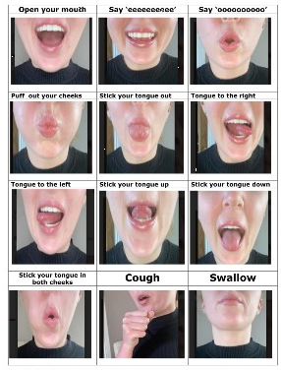
Strengthen Your Speech Muscles
Perform Chewing Exercises:
Example-Open your mouth wide as if you are yawning, then close it slowly. Repeat this motion several times.
Place the tip of your tongue against the roof of your mouth and press it upwards as hard as you can. Hold for a few seconds, then relax. Repeat several times.
It will enhance the flexibility and strength of your tongue and lips, crucial for articulation

Slide 13
THANKYOU

