Slide 1



FoodSwift
FS
Solving the Order Drop Crisis
A data-driven investigation into declining order counts and customer NPS
-12.5%
Orders/Month Drop
3.2 → 2.8 orders
-7 pts
NPS Decline
42 → 35 NPS
Goal
Restore Growth
Increase retention
Platform Context
50,000 restaurant partners • 25 cities • 2M MAU • ₹450 AOV • ~35,000 daily orders

Slide 2
Root Cause Discovery
Analyzing order data reveals a critical pattern: Restaurant cancellations spiked dramatically in March
KEY FINDING: Cancellation Rate Jumped from 7% to 33%
Restaurant-side cancellations increased by 378% from January to March, directly causing the order count decline and NPS drop.
Month | Total Orders | Successful | Cancelled | Cancel Rate
Jan 2025 | 130 | 121 | 9 | 6.9%
Feb 2025 | 125 | 114 | 11 | 8.8%
Mar 2025 | 100 | 67 | 33 | 33%
Monthly Performance Breakdown

Slide 3
Hypothesis Validation
Three hypotheses tested against order data to identify actionable root causes
H1: Inventory Management Failure (Validated)
Restaurants are unable to update menu availability in real-time, leading to orders for unavailable items.
41.5%
Item Unavailable
5 restaurants
Repeat Offenders
75%
Peak Hour Impact
Supporting Evidence
"Item Unavailable" is the #1 cancellation reason (41.5%)
Peak cancellations occur during lunch (12-1 PM) and dinner (7-9 PM) rush
Same restaurants repeatedly cancel for inventory reasons
H2: Capacity Overload During Peak Hours (Validated)
Restaurants accept more orders than they can handle, leading to cancellations due to high volume
30.2%
Volume Cancellations
41.5%
Peak Hour %
16 orders
Affected Users
Supporting Evidence
"High Order Volume" accounts for 30.2% of cancellations
Cancellations spike during 7-9 PM dinner rush (41.5%)
No order throttling mechanism exists for overwhelmed restaurants
H3: Customer Churn from Bad Experience (Partially Validated)
Users who experience cancellations are not returning, leading to declining order frequency.
42
Affected Users
8
Multi-Cancel Users
28 users
Churn Risk

Slide 4
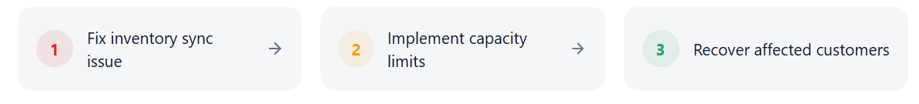
Targeted Solutions
Solution Strategy
Focus on restaurant-side improvements first, then customer recovery
Real-Time Menu Sync System
Enable restaurants to instantly update item availability with one-tap controls and smart alerts.
One-tap item availability toggle on partner app
Auto-disable items after 5 cancellations
Smart stock alerts when items run low
Batch update for busy periods
Dynamic Order Throttling
Automatically limit incoming orders when restaurants approach capacity during peak hours.
Set max orders per 15-min window
Auto-pause during overwhelm
Show 'High Demand' badge to customers
Estimated wait time display
Proactive Customer Recovery
Automatically compensate and re-engage customers who experience cancellations.
Instant apology notification with discount code
Auto-suggest similar restaurants nearby
Priority queue for re-orders
Personalized win-back campaign
Effort
Medium
Effort
Medium
Effort
Low
Impact
Medium
Timeline
4-6 weeks
Impact
Medium
Timeline
3-4 weeks
Impact
Low
Timeline
1-2 weeks
Reduce 'Item Unavailable' cancellations by 60%
Reduce 'High Volume' cancellations by 70%
Reduce 'Item Unavailable' cancellations by 60%

Slide 5
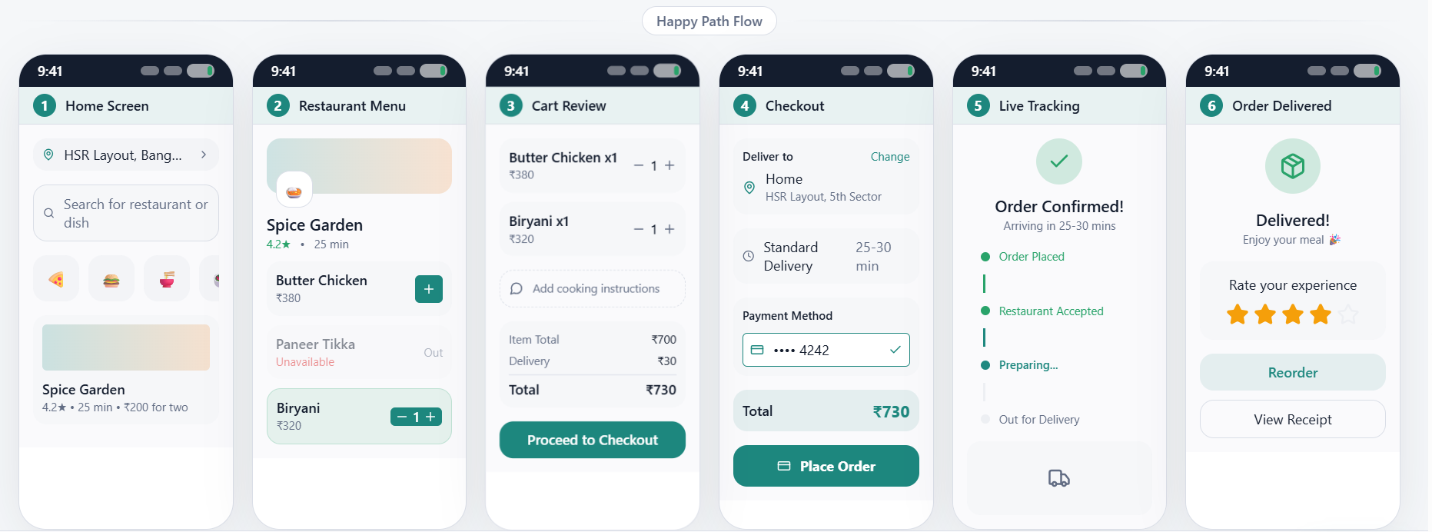
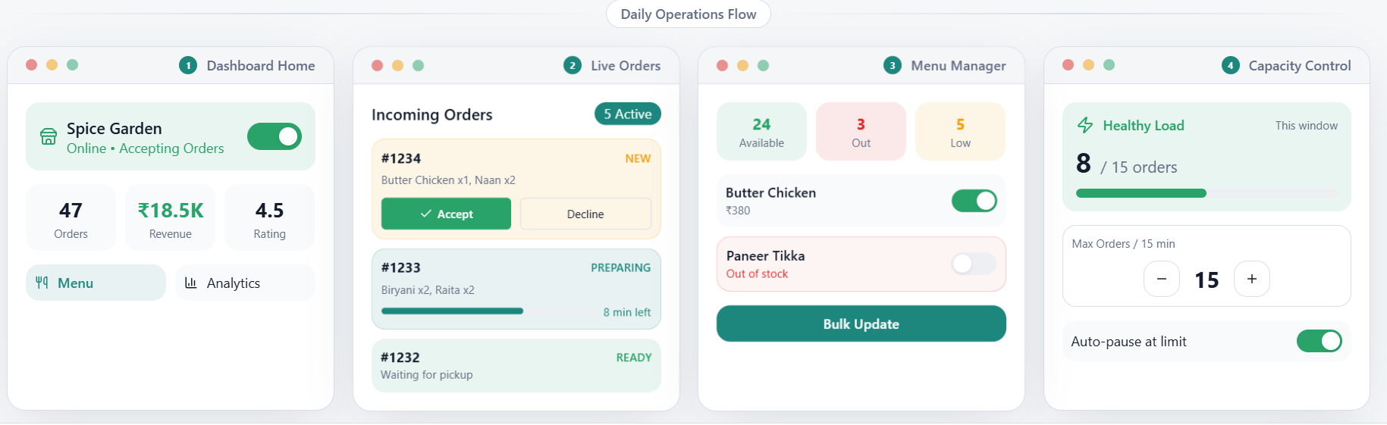
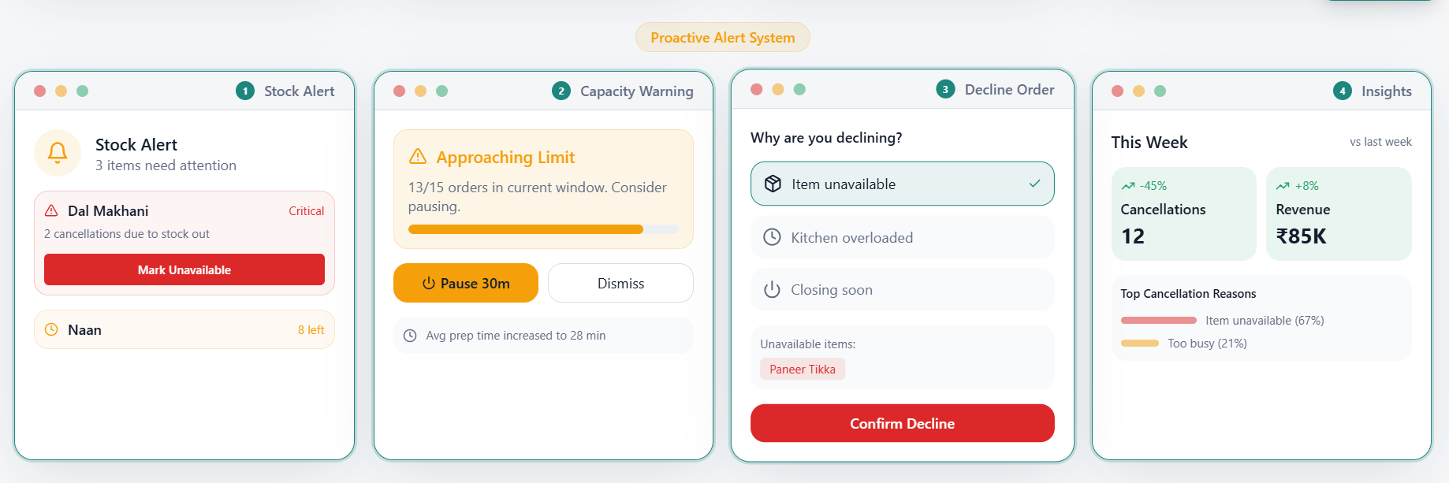
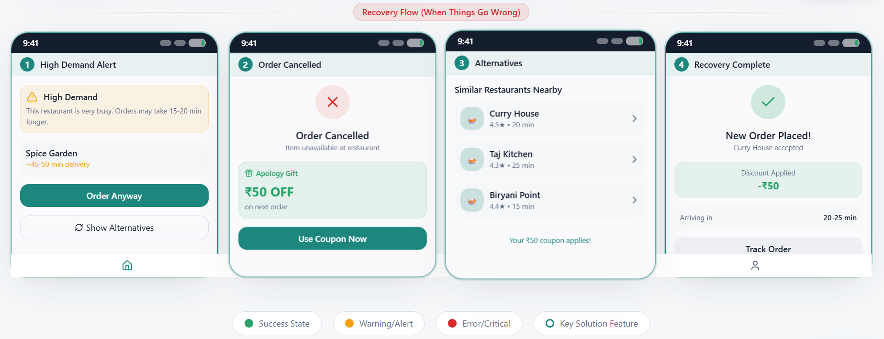
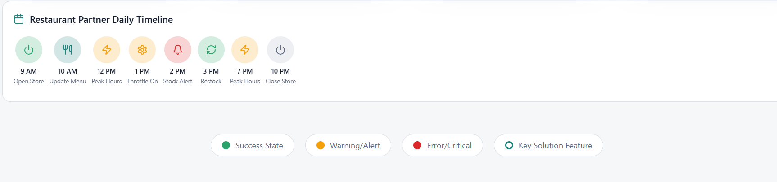
End-to-End Wireframes
Customer App - Complete User Journey
From app launch to order completion & recovery flows
Restaurant Partner App - Complete Dashboard Flow
From opening to order management, inventory control & analytics

Slide 6




Success Metrics & Risks
Defining what success looks like and how we'll manage potential downsides
Cancellation Rate
Current
33% →
Restaurant-side cancellations as % of total orders
Orders per Month
Current
2.8→
Average orders per active customer per month
Customer NPS
Current
35→
Net Promoter Score from post-order surveys
Target
<10%
Target
3.5+
Target
45+
Supporting Metrics
Guardrail Metrics
Menu Sync Rate
  % of restaurants with real-time menu updates
>95%
Target
<40 min
Limit
Order Completion Time
  Ensure throttling doesn't increase delivery time
Recovery Conversion
  % of cancelled order users who re-order within
  7 days
>40%
Target
Restaurant Churn
  Ensure new tools don't burden restaurants
<3%
Limit
Expected Outcome
By implementing these solutions over 8-10 weeks, we expect:
+25%
Orders per month
+10 pts
NPS improvement
₹2.7L
Monthly GMV recovered
70%
Reduction in cancellations

