Slide 1

People Tracking System

Slide 2

What if you were able to know who is at your door?

Slide 3
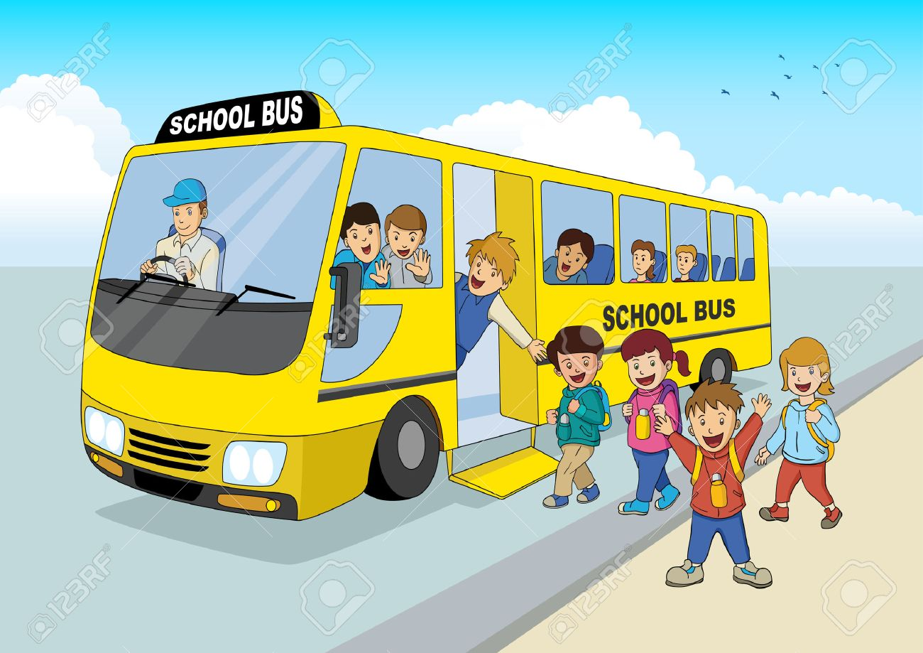
What if you could track your child?

Slide 4
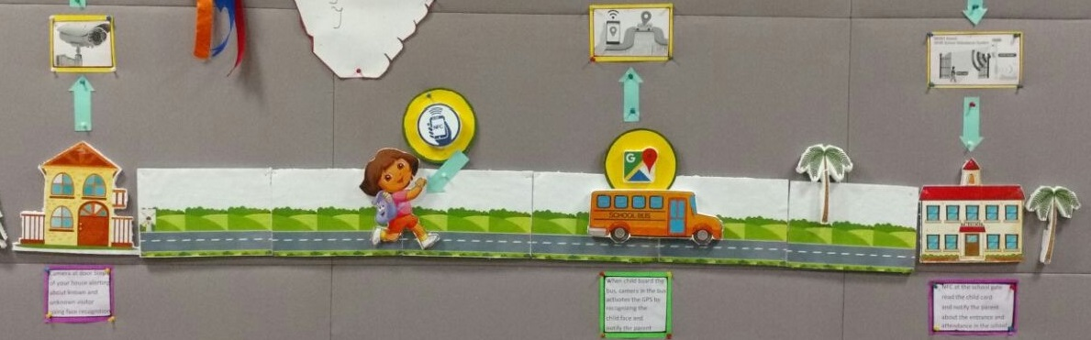
The Scenario

Slide 5

