Slide 1



Interpreting the world on a
different plane
Robert Bosch Engineering and Business Solutions
AI/ML - Car and OEM Sales Forecast for Indian Market
(Predictive Analysis)
23/04/2018

Slide 2





Overview
Car and OEM Sales Forecast for Indian Market (Predictive Analysis)
TECHNOLOGIES
Build 6 months car and OEM Sales forecast using following input data
2 years of historical car sales
Fuel Price – Petrol and Diesel
GDP
Unemployment
BOSCH OEM Car Parts
The challenge is to accurately predict future Car and OEM Sales using predictive analytics and machine learning and then to identify the optimal strategy for OEM sales forecast.
Predictive Modeling and Data Visualization used to bring
Car Sales Forecast by make, segment and Fuel
BOSCH OEM Products Forecast
Identify the optimal strategy for BOSCH OEM Sales forecast.
2
RBEI/BSX | 2018
© Robert Bosch Engineering and Business Solutions Private Limited 2016. All rights reserved, also regarding any disposal, exploitation, reproduction, editing, distribution, as well as in the event of applications for industrial property rights.

Slide 3


Project Objective
Car and OEM Sales Forecast for Indian Market (Predictive Analysis)
MACHINE LEARNING MODELS
Models that are used are as follows:
Linear Regression
Logistic Regression
Random Forest
EXPLORING AND PRE PROCESSING DATA
Our data is divided into 70:30 ratio in training and testing data
VISUALIZING DATA
For Visualizing the data we used:
Bar graph
Point Graph
Line Graph
PREDICT CAR AND OEM SALES
For Predicting car sales we used four different models.
For Predicting OEM sales we multiplied the parts manufactured for particular car with total number of sales predicted.
3
RBEI/BSB | 2018
© Robert Bosch Engineering and Business Solutions Private Limited 2016. All rights reserved, also regarding any disposal, exploitation, reproduction, editing, distribution, as well as in the event of applications for industrial property rights.

Slide 4
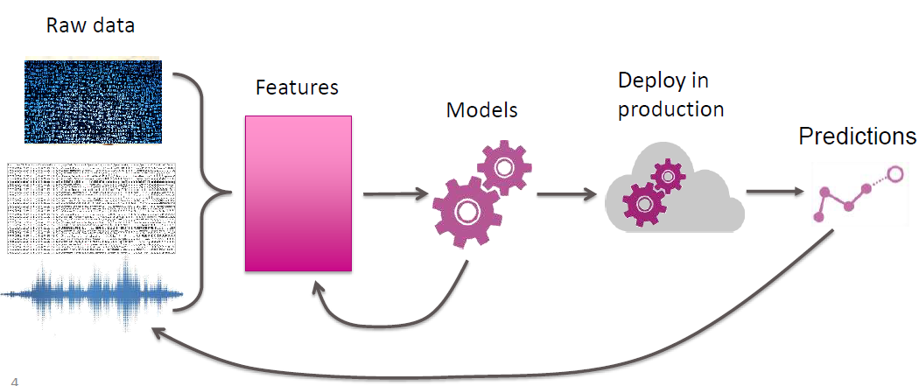
Prediction Model
Car and OEM Sales Forecast for Indian Market (Predictive Analysis)
4
RBEI/BSB | 2018
© Robert Bosch Engineering and Business Solutions Private Limited 2016. All rights reserved, also regarding any disposal, exploitation, reproduction, editing, distribution, as well as in the event of applications for industrial property rights.

Slide 5
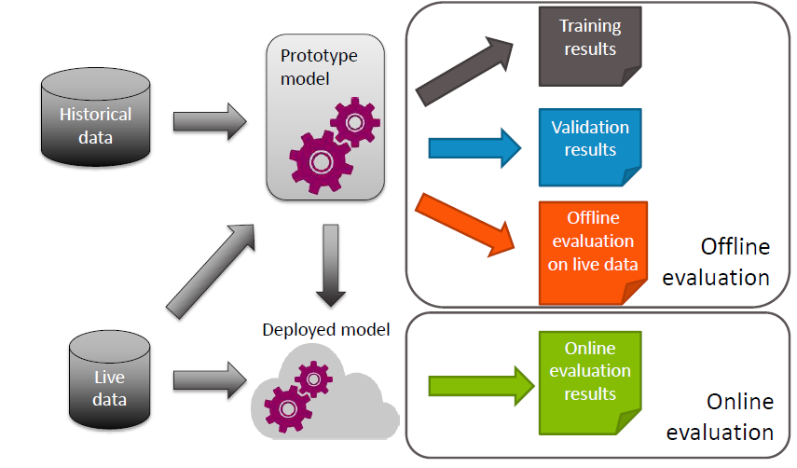
Evaluation
Car and OEM Sales Forecast for Indian Market (Predictive Analysis)
5
RBEI/BSB | 2018
© Robert Bosch Engineering and Business Solutions Private Limited 2016. All rights reserved, also regarding any disposal, exploitation, reproduction, editing, distribution, as well as in the event of applications for industrial property rights.

Slide 6
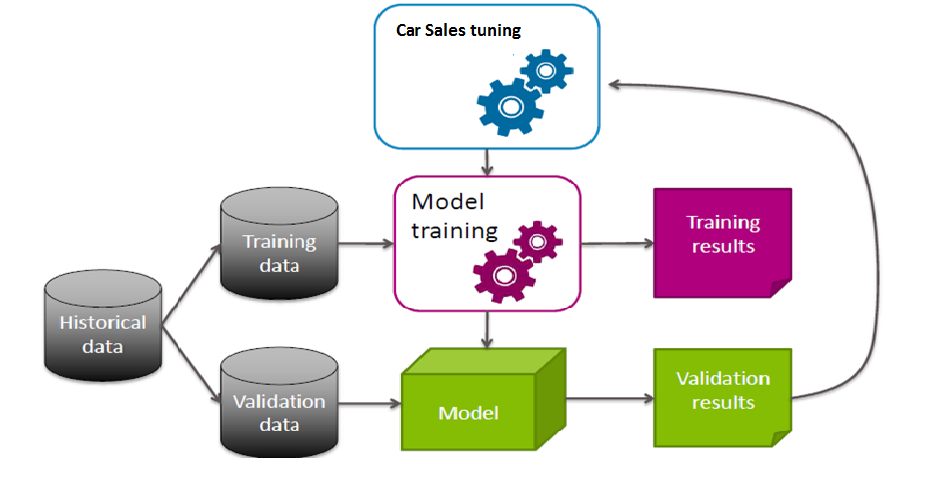
Prediction Model
Car and OEM Sales Forecast for Indian Market (Predictive Analysis)
6
RBEI/BSB | 2018
© Robert Bosch Engineering and Business Solutions Private Limited 2016. All rights reserved, also regarding any disposal, exploitation, reproduction, editing, distribution, as well as in the event of applications for industrial property rights.

Slide 7
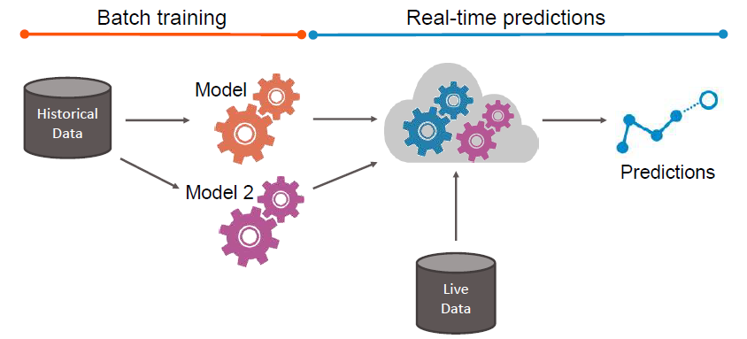
Production Data
Car and OEM Sales Forecast for Indian Market (Predictive Analysis)
7
RBEI/BSB | 2018
© Robert Bosch Engineering and Business Solutions Private Limited 2016. All rights reserved, also regarding any disposal, exploitation, reproduction, editing, distribution, as well as in the event of applications for industrial property rights.

Slide 8
(Predictive Analysis) Data Dictionary
Car and OEM Sales Forecast for Indian Market
Variable | Definition | Key (Sample)
make | Car manufacturer name.
model | Model name of the particular brand.
month_code | Code assigned to particular month.
total | Total Sale of the car for particular month.
gdp | Gross Domestic Platform of India for particular month.
unemployment | Unemployment rate of India for particular month
petrol_price | Petrol Price of India for particular month.
diesel_price | Diesel Price of India for particular month.
8
RBEI/BSB | 2018
© Robert Bosch Engineering and Business Solutions Private Limited 2016. All rights reserved, also regarding any disposal, exploitation, reproduction, editing, distribution, as well as in the event of applications for industrial property rights.

Slide 9
Data Dictionary
Car and OEM Sales Forecast for Indian Market
(Predictive Analysis)
Variable
diesel system | auxiliary system
breaking system | automotive bulbs
auto electricals | spark plugs
batteries | wiper blades
automotive belt | lightning coils
horns | charging coils
filters | ignition coils
gasoline system
9
RBEI/BSB | 2018
© Robert Bosch Engineering and Business Solutions Private Limited 2016. All rights reserved, also regarding any disposal, exploitation, reproduction, editing, distribution, as well as in the event of applications for industrial property rights.

Slide 10

Data Set Description
Car and OEM Sales Forecast for Indian Market(Predictive Analysis)
Dataset
2 Years Historic Data
Training and Test Data Set
25 Hundred Rows
8 Attributes
Deter mining the accuracy
10
RBEI/BSB | 2018
© Robert Bosch Engineering and Business Solutions Private Limited 2016. All rights reserved, also regarding any disposal, exploitation, reproduction, editing, distribution, as well as in the event of applications for industrial property rights.

Slide 11


Challenges
Car and OEM Sales Forecast for Indian Market (Predictive Analysis)
Car and OEM Sales Forecast has few challenges.
Dataset imbalance
Collecting data regarding car sales of previous two years monthly wise by considering each model of different companies.
Collection of data regarding various BOSCH OEM products of the organization used in different cars.
Mapping the OEM product sales with the prediction of car sales of a particular model.
Choosing of different algorithm for the prediction and comparing and getting best results out of all the models.
11
RBEI/BSB | 2018
© Robert Bosch Engineering and Business Solutions Private Limited 2016. All rights reserved, also regarding any disposal, exploitation, reproduction, editing, distribution, as well as in the event of applications for industrial property rights.

Slide 12
Car and OEM Sales Forecast for Indian Market (Predictive Analysis)
Predictive modelling and Algorithms
12
RBEI/BSB | 2018
© Robert Bosch Engineering and Business Solutions Private Limited 2016. All rights reserved, also regarding any disposal, exploitation, reproduction, editing, distribution, as well as in the event of applications for industrial property rights.

Slide 13
Algorithms
Car and OEM Sales Forecast for Indian Market(Predictive Analysis)
Linear Regression
Random Forest
Algorithm Used
Logistic Regression
The Following supervised learning algorithms to perform data mining and statistic analysis in order to determine Car and OEM sales.
Here data set is in the form of structure .We should use supervised learning to deal with structural data.
13
RBEI/BSB | 2018
© Robert Bosch Engineering and Business Solutions Private Limited 2016. All rights reserved, also regarding any disposal, exploitation, reproduction, editing, distribution, as well as in the event of applications for industrial property rights.

Slide 14
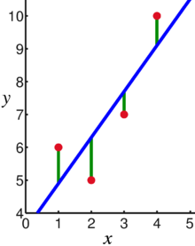
Linear Regression
Car and OEM Sales Forecast for Indian Market (Predictive Analysis)
Linear regression is a basic and commonly used type of predictive analysis.
Linear regression attempts to model the relationship between two variables by fitting a linear equation to observed data.
A linear regression line has an equation of the form
Y = a + bX, where X is the explanatory variable
and Y is the dependent variable.
The slope of the line is b, and a is the intercept (the value of y when x = 0)
14
RBEI/BSB | 2018
© Robert Bosch Engineering and Business Solutions Private Limited 2016. All rights reserved, also regarding any disposal, exploitation, reproduction, editing, distribution, as well as in the event of applications for industrial property rights.

Slide 15
Linear Regression
Car and OEM Sales Forecast for Indian Market (Predictive Analysis)
Multiple linear regression attempts to model the relationship between two or more explanatory variables and a response variable by fitting a linear equation to observed data.
The regression line can be detected using the following formula-
Min |Xi – X0i|
Every value of the independent variable x is associated with a value of the dependent variable y. The population regression line for p explanatory variables X1, X2, ... , Xn is defined to be
15
RBEI/BSB | 2018
© Robert Bosch Engineering and Business Solutions Private Limited 2016. All rights reserved, also regarding any disposal, exploitation, reproduction, editing, distribution, as well as in the event of applications for industrial property rights.

Slide 16


Error Rate For Chevrolet Cruze Linear Regression Formula for calculating Root Mean Square Error
RMSE Value
Where
predic1 is the predicted value using Linear Model
testing_data$Total is total sale of Cruze.
16
RBEI/BSB | 2018
© Robert Bosch Engineering and Business Solutions Private Limited 2016. All rights reserved, also regarding any disposal, exploitation, reproduction, editing, distribution, as well as in the event of applications for industrial property rights.

Slide 17
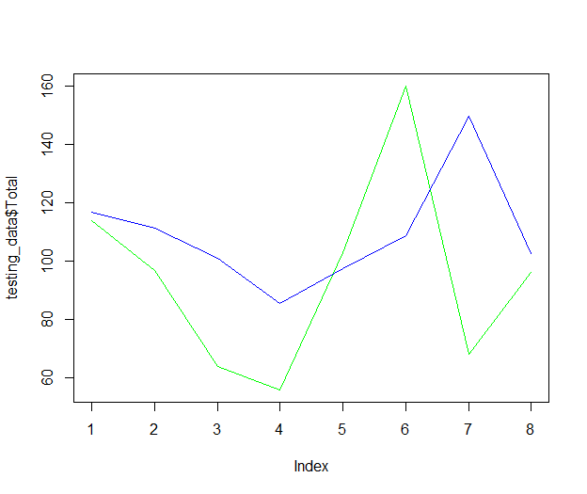
Linear Regression
Prediction Graph for Linear Regression
17
RBEI/BSB | 2018
© Robert Bosch Engineering and Business Solutions Private Limited 2016. All rights reserved, also regarding any disposal, exploitation, reproduction, editing, distribution, as well as in the event of applications for industrial property rights.

Slide 18
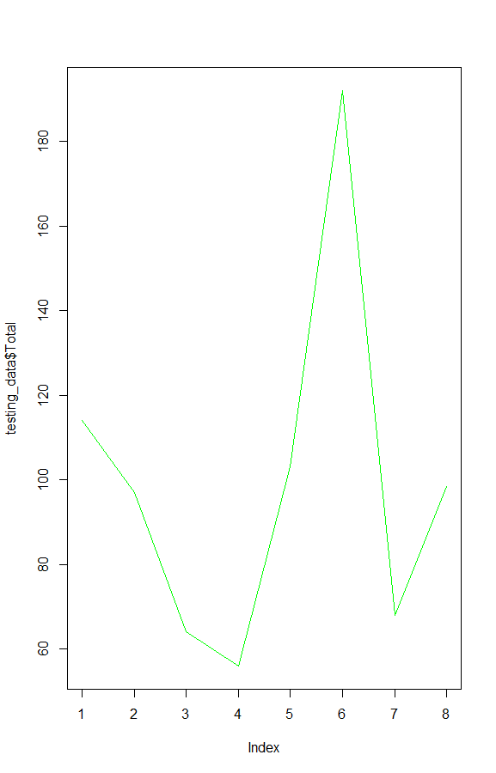
Logistic Regression
\
Car and OEM Sales Forecast for Indian Market (Predictive Analysis)
Logistic Regression is a basic and commonly used type of predictive analysis.
Logistic Regression is part of a larger class of algorithms known as Generalized Linear Model (glm).
The Fundamental Equation of generalized linear model is::
g(E(y)) = α + βx1 + γx2
Here, g() is the link function, E(y) is the expectation of target variable and α + βx1 + γx2 is the linear predictor ( α,β,γ to be predicted)
18
RBEI/BSB | 2018
© Robert Bosch Engineering and Business Solutions Private Limited 2016. All rights reserved, also regarding any disposal, exploitation, reproduction, editing, distribution, as well as in the event of applications for industrial property rights.

Slide 19

Logistic Regression
After Using Predict Functions::
19
RBEI/BSB | 2018
© Robert Bosch Engineering and Business Solutions Private Limited 2016. All rights reserved, also regarding any disposal, exploitation, reproduction, editing, distribution, as well as in the event of applications for industrial property rights.

Slide 20

Error Rate For Chevrolet Cruze
Logistic Regression
Formula for calculating Root Mean Square Error
RMSE Value
Where
predic1 is the predicted value using generalized Linear Model
testing_data$Total is total sale of Cruze.
20
RBEI/BSB | 2018
© Robert Bosch Engineering and Business Solutions Private Limited 2016. All rights reserved, also regarding any disposal, exploitation, reproduction, editing, distribution, as well as in the event of applications for industrial property rights.

Slide 21
Logistic Regression
Prediction Graph for Logistic Regression
21
RBEI/BSB | 2018
© Robert Bosch Engineering and Business Solutions Private Limited 2016. All rights reserved, also regarding any disposal, exploitation, reproduction, editing, distribution, as well as in the event of applications for industrial property rights.

Slide 22

Random Forest
Car and OEM Sales Forecast for Indian Market (Predictive Analysis)
Random forests are a way of averaging multiple deep decision trees, trained on different parts of the same training set, with the goal of overcoming over-fitting problem of individual decision tree. In other words, random forests are an ensemble learning method for classification and regression that operate by constructing a lot of decision trees at training time and outputting the class that is the mode of the classes output by individual trees.
22
RBEI/BSB | 2018
© Robert Bosch Engineering and Business Solutions Private Limited 2016. All rights reserved, also regarding any disposal, exploitation, reproduction, editing, distribution, as well as in the event of applications for industrial property rights.

Slide 23
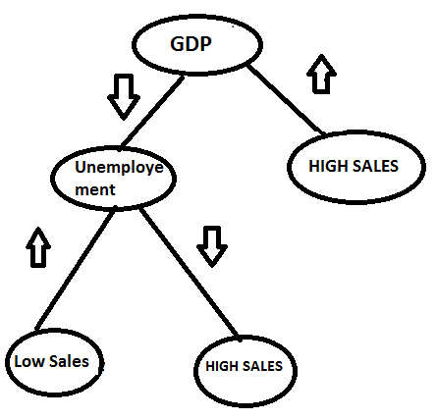
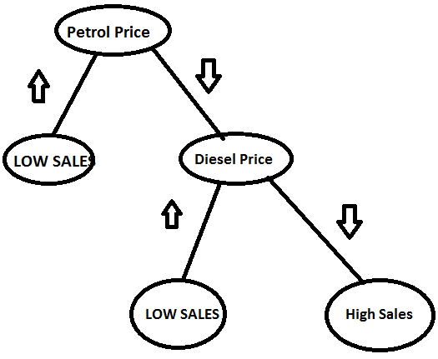
Random Forest
Car and OEM Sales Forecast for Indian Market (Predictive Analysis)
HIGH SALES
Low Sales
23
RBEI/BSB | 2018
© Robert Bosch Engineering and Business Solutions Private Limited 2016. All rights reserved, also regarding any disposal, exploitation, reproduction, editing, distribution, as well as in the event of applications for industrial property rights.

Slide 24
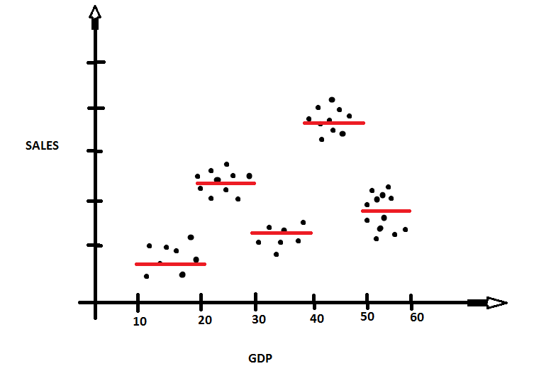
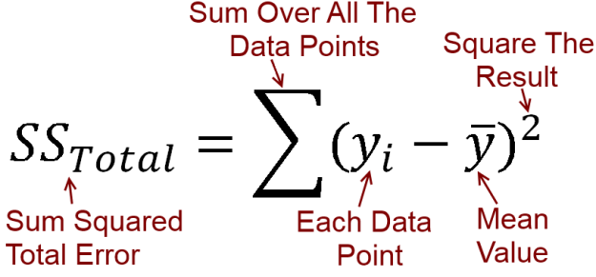
Random Forest
Car and OEM Sales Forecast for Indian Market (Predictive Analysis)
24
RBEI/BSB | 2018
© Robert Bosch Engineering and Business Solutions Private Limited 2016. All rights reserved, also regarding any disposal, exploitation, reproduction, editing, distribution, as well as in the event of applications for industrial property rights.

Slide 25

Error Rate For Chevrolet Cruze Random Forest
Formula for calculating Root Mean Square Error
RMSE Value
Where
predic1 is the predicted value using Random Forest Model
testing_data$Total is total sale of Cruze.
25
RBEI/BSB | 2018
© Robert Bosch Engineering and Business Solutions Private Limited 2016. All rights reserved, also regarding any disposal, exploitation, reproduction, editing, distribution, as well as in the event of applications for industrial property rights.

Slide 26
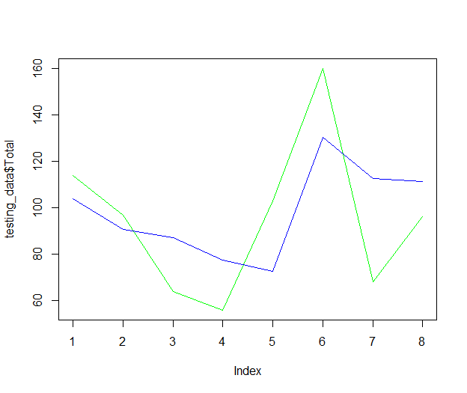
Random Forest
Prediction Graph for Cruze model:-
26
RBEI/BSB | 2018
© Robert Bosch Engineering and Business Solutions Private Limited 2016. All rights reserved, also regarding any disposal, exploitation, reproduction, editing, distribution, as well as in the event of applications for industrial property rights.

Slide 27


ML Use case - 3
Interns @BSX : 2018
Car and OEM Sales Forecast for Indian Market (Predictive Analysis)
Team
Overview
Build 6 months car and OEM Sales forecast using following input data
2 years of historical car sales
Fuel Price : Petrol and Diesel
GDP
Unemployment
Different types of Prediction Methods and Data Visualization are used to bring
Car Sales Forecast by make, segment and Fuel
BOSCH OEM Products Forecast
Mentors
Ponvannan Ponnuramu (RBEI/BSW3)
Yuvaraj Vellore Chandrasekaran (RBEI/BSW3)
Interns
Ankit Parichha
Shobhit Sinha
Gaurav Kumar
Harshit Srivastava
Technologies
R Language for Predictive Analysis
Azure SQL DB or CSV file to Store data
Azure ML Studio to host and Deploy
27
RBEI/BSX | 2018
© Robert Bosch Engineering and Business Solutions Private Limited 2016. All rights reserved, also regarding any disposal, exploitation, reproduction, editing, distribution, as well as in the event of applications for industrial property rights.

Slide 28
Picture Here
Team
Interns
Shobhit Sinha
Ankit Parichha
Gaurav Kumar
Harshit Srivastava
Mentors
Ponvannan Ponnuramu
Yuvaraj Vellore Chandrasekaran
28
RBEI/BSB | 2018
© Robert Bosch Engineering and Business Solutions Private Limited 2016. All rights reserved, also regarding any disposal, exploitation, reproduction, editing, distribution, as well as in the event of applications for industrial property rights.

Slide 29

Happy Machine Learning dANKE(THANK YOU)

