Slide 1
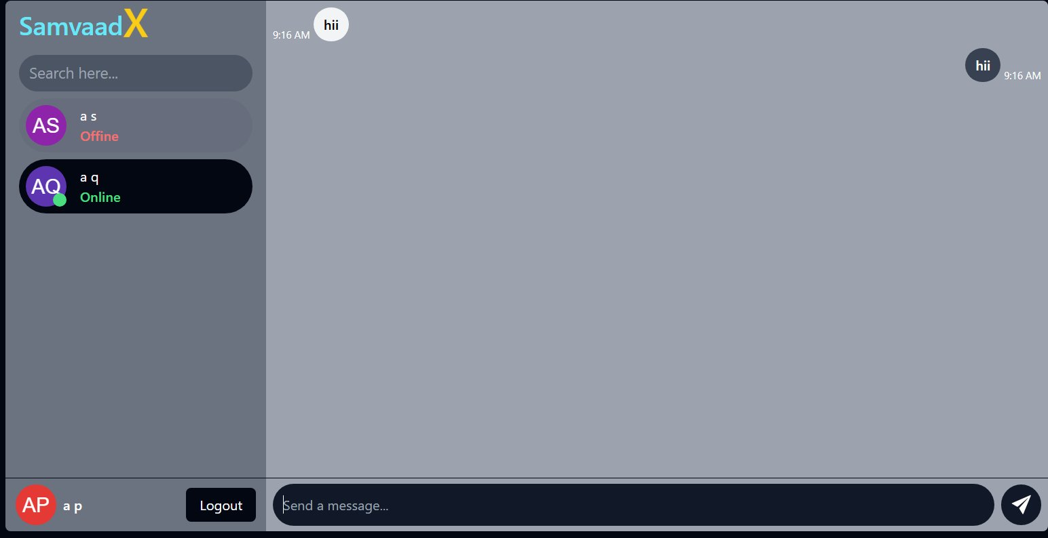
SamvaadX
Real-Time Chat Application
A full-stack MERN application with Socket.IO
for bidirectional real-time messaging
React 19
Node.js
MongoDB
Socket.IO
Redux
JWT
1 / 11

Slide 2



What is Vartalap?
Real-Time
Secure
Presence
Instant messaging powered by Socket.IO WebSocket technology — messages delivered without any page refresh.
JWT authentication with bcrypt password hashing. Protected API routes ensure only verified users get access.
Live online/offline indicators for all users. See who's available instantly as they connect or disconnect.
2 / 11

Slide 3


Technology Stack
FRONTEND
BACKEND + DATABASE
React.js 19
UI Component Library
Node.js
JS Runtime Environment
Vite
Build Tool & Dev Server
Express.js 5
REST API Framework
Tailwind CSS 3
Utility-First Styling
Socket.IO v4
WebSocket Server
Redux Toolkit
Global State Management
MongoDB
NoSQL Database
React Router v7
Client-Side Routing
Mongoose 9
ODM / Schema Layer
Socket.IO Client
Real-Time WebSocket
JWT
Auth Token Generation
Axios
HTTP API Client
bcrypt
Password Hashing
3 / 11

Slide 4

System Architecture
FRONTEND
BACKEND
DATABASE
React 19 + Vite
Node.js + Express.js
MongoDB Atlas
⇔
⇔
Redux Toolkit
REST API (/api/v1)
Mongoose ODM
Tailwind CSS
JWT Middleware
User Collection
Socket.IO Client
Socket.IO Server
Message Collection
Axios + React Router
bcrypt + CORS
Conversation Collection
External: DiceBear Avatar API
4 / 11

Slide 5
Authentication Flow
▶ User Opens App
▼
Has Account?
YES
NO
Login Page
Sign Up Page
▼
▼
Enter Email + Password
Name + Email + Password
▼
▼
Validate Credentials (DB)
Validate All Fields
▼
▼
bcrypt.compare(password)
Hash Password (bcrypt)
▼
▼
Generate JWT Token (1yr)
Generate DiceBear Avatar
▼
▼
→ Home Dashboard
Save to MongoDB
5 / 11

Slide 6
Real-Time Messaging Flow
Connect Socket.IO (userId in query)
✔ YES — Online
▼
Look up receiver's socket ID
Server maps userId → socket.id
▼
▼
io.to(socketId).emit('new-message')
Emit 'send-all-online-users' → All
▼
Message appears instantly in UI
▼
Select Contact → Fetch History
▼
✘ NO — Offline
Type & Send Message
No socket emission
▼
POST /api/v1/send-message
▼
Message persisted in MongoDB only
▼
Is Receiver Online? (Socket.IO map)
Receiver loads history on next login
6 / 11

Slide 7
Database Schema
User
Message
Conversation
Field
Type
Req.
Field
Type
Req.
Field
Type
Req.
firstName
String
✔
senderId
ObjectId → User
✔
members
[ObjectId → User]
✔
lastName
String
✔
receiverId
ObjectId → User
✔
messages
[ObjectId → Msg]
✔
email
String
✔
message
String
✔
createdAt
Date
Auto
password
String
✔ (hashed)
createdAt
Date
Auto
updatedAt
Date
Auto
profilePicture
String
✔
updatedAt
Date
Auto
7 / 11

Slide 8
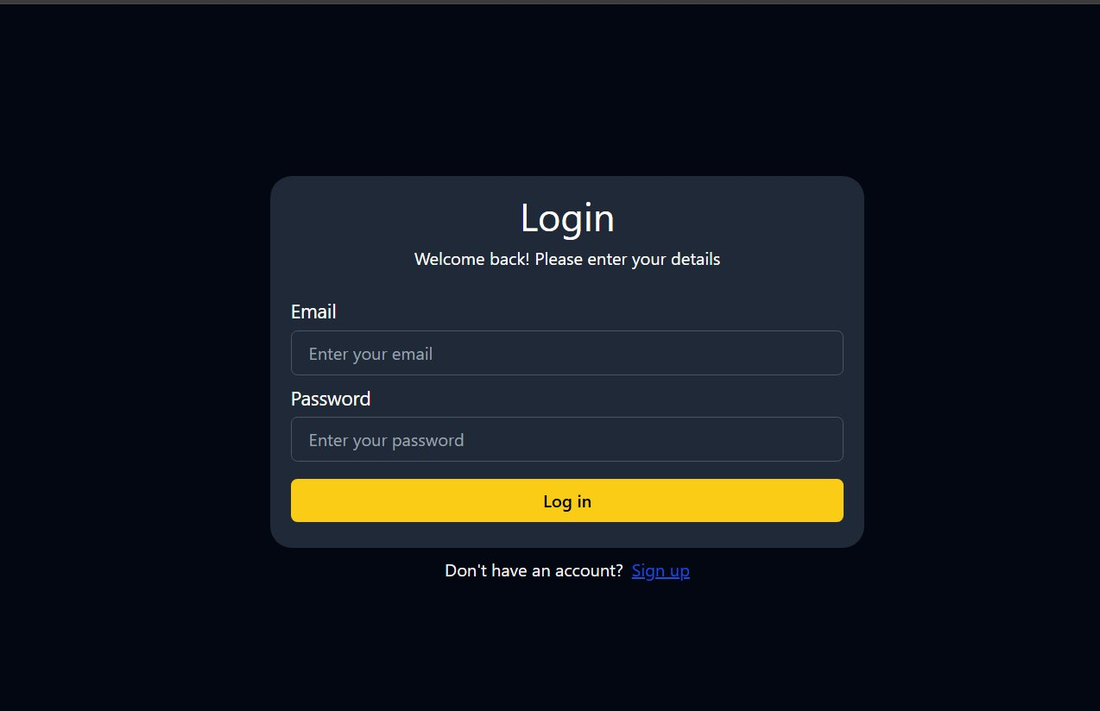


UI — Login Page
How it works
Email + Password fields
JWT issued on success
Token stored in Redux state
Protected routes enforced
"Don't have account?" link to Sign Up
8 / 11

Slide 9
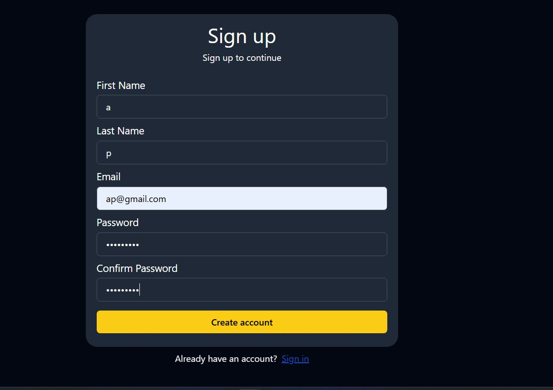


UI — Sign Up & Chat Dashboard
Sign Up — 5-field registration form
Chat Dashboard — real-time messaging + online presence
9 / 11

Slide 10


Key Features
Secure Auth
Real-Time
Presence
› bcrypt password hashing
› Socket.IO WebSockets
› Live online indicators
› JWT stateless tokens
› Instant message delivery
› Green/red status badges
› Protected API routes
› No page refresh needed
› Auto-disconnect cleanup
Data Layer
Modern UI
Future Ready
› MongoDB persistence
› React 19 SPA
› Mobile app (future)
› 3 related collections
› Redux state mgmt
› Group chat (future)
› Mongoose populate()
› Tailwind dark theme
› Media sharing (future)
10 / 11

Slide 11
Conclusion &
Future Scope
Future Scope
What was built
Group chat rooms
Full-stack MERN chat app with Socket.IO
Media & file sharing
Secure JWT auth + bcrypt hashing
Read receipts & typing
3-collection MongoDB data model
Push notifications
Live online presence for all users
End-to-end encryption
React 19 SPA with Redux state management
React Native mobile app
Thank You ✦ Questions Welcome
Message search & archive
Docker + CI/CD pipeline
11 / 11

