Slide 1
IoT Based Smart Weigh Scale and Tank Monitor *PCB DESIGNING*
Submitted to:
Prof. Mike Aleshams
Submitted by : GROUP 5
Gurvinder Singh
Ankit
krutika

Slide 2
Contents
Introduction
Working with EasyEDA
Schematic Design
PCB design
Auto Route vs Manual Route
References

Slide 3
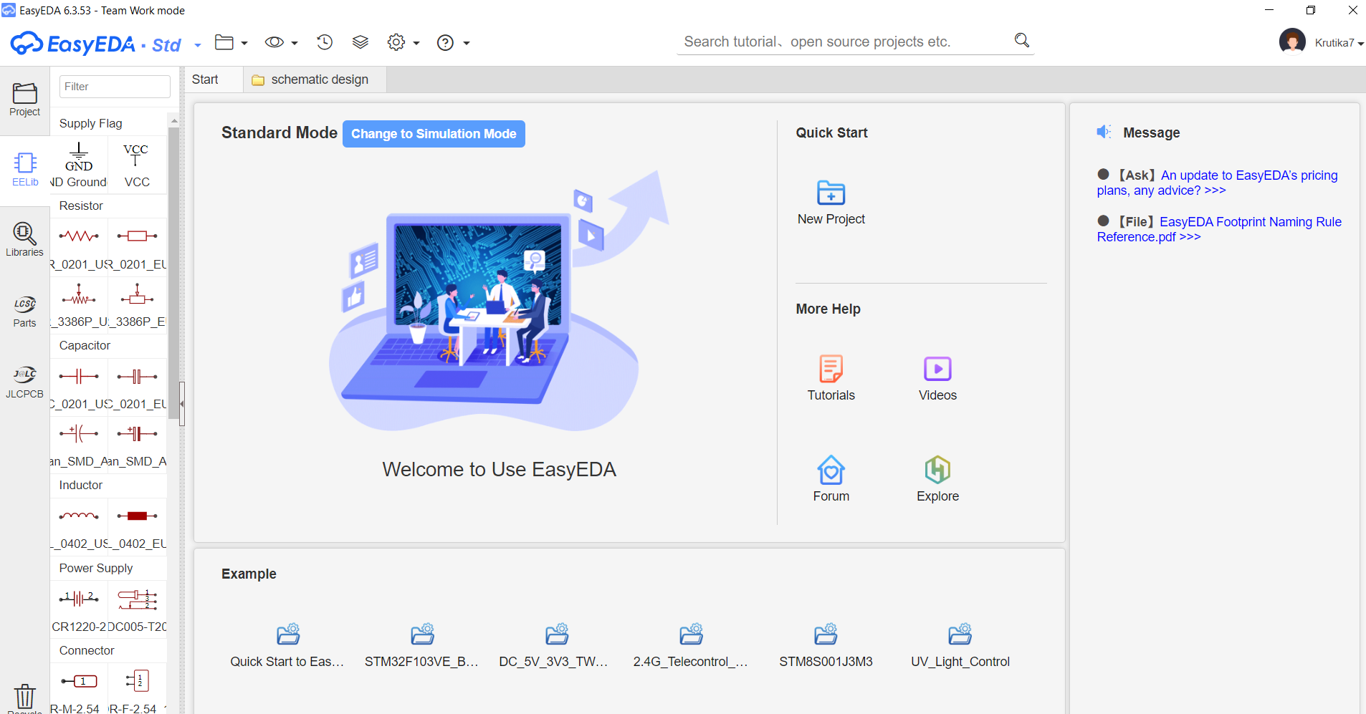
Introduction
EasyEDA is an open source web based Electronic Design Automation tool.
It has a user-friendly interface with an enormous built-in libraries.
It provides real time team cooperation and numerous open source projects.
Some of the main features are Schematic Capture, PCB layout, Library Management and Import.

Slide 4
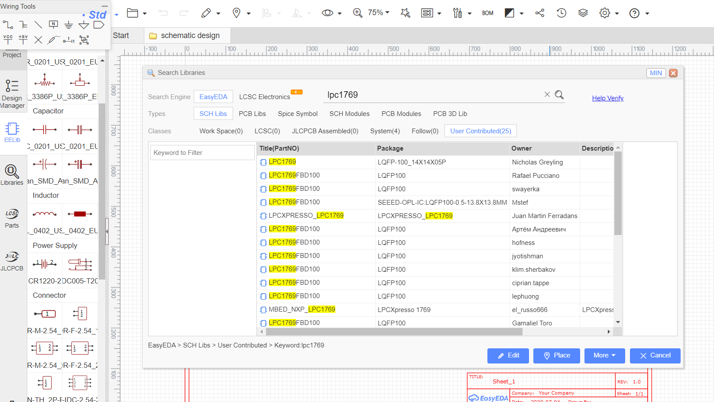
Working with EasyEDA
The User interface is simpler in comparison to other softwares.
The libraries of the tool provides 700,000+ components.
For the designing of the schematic, user has to just drag and drop the components.
Library also has User Contributed components that are modified according to user requirement.

Slide 5
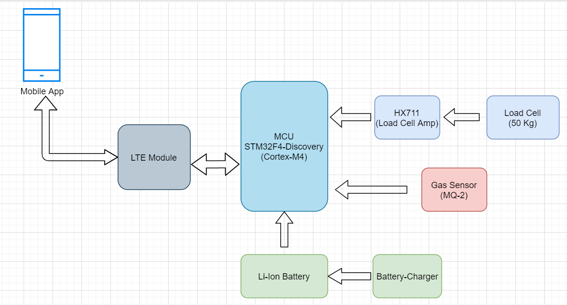
Block Diagram
The block diagram of the proposed IoT based smart weigh scale and tank monitor.

Slide 6
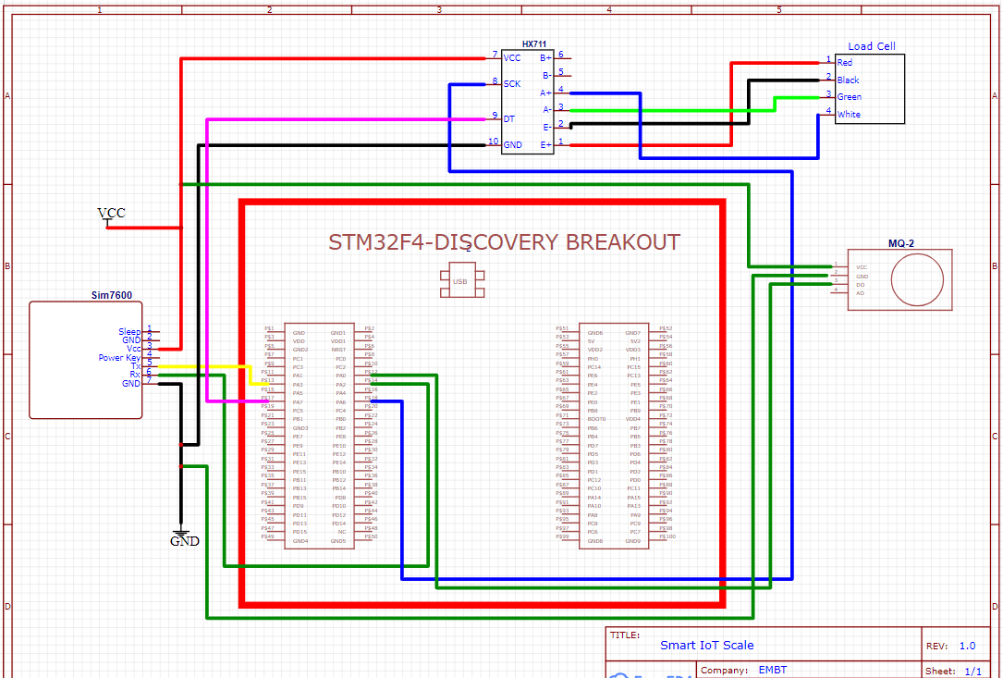
Schematic Diagram

Slide 7
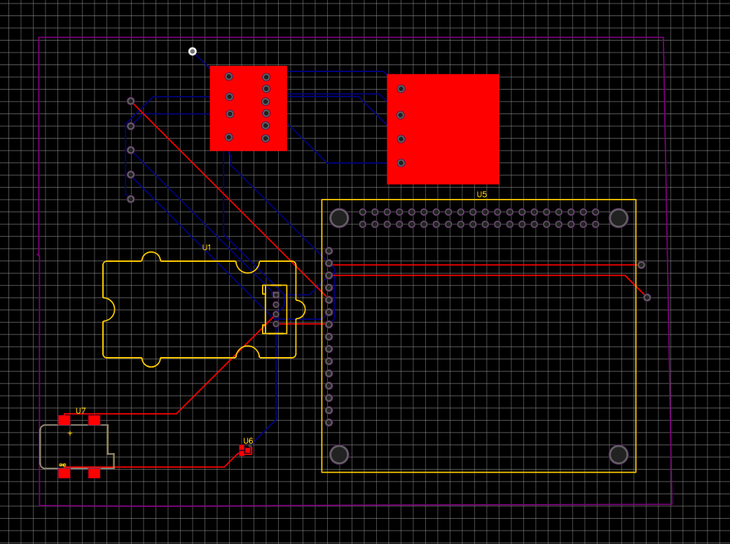
PCB design
2 Layer PCB
Auto Route Net connections
PIN connection Nodes for MQ2, HX711,SIM7600, Load Cell.
Female Power Connector.
Ground (DGND,AGND).

Slide 8
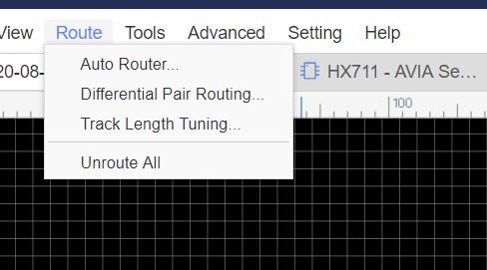
Auto Route vs Manual Route
Manual Route: -
- Connecting Nets Manually
- Must Select layers our self.
-Hard to do for complex circuits.
-More time Consuming.
Auto Route: -
-Less Time
-More professional
- Cost effective.

Slide 9
References
Introducing: EasyEDA 2 KiCad by Uri Shaked , Modified on November 15, 2019
https://medium.com/@urish/introducing-easyeda-2-kicad-37489da1dfa7
Load Cell Amplifier HX711 Breakout Hookup Guide by Sarah Al-Multaq and Alex the Giant, Modified on January 12, 2019
https://learn.sparkfun.com/tutorials/load-cell-amplifier-hx711-breakout-hookup-guide/discuss
Schematic Design Software by Gerry Chen, Modified on June 12, 2016
https://easyeda.com/GerryChen/Schematic_Design_Software-GuoGAR9rl

