Slide 1



CricketDataAnalysis
View in Power BI
Last data refresh:
4/4/2023 7:52:30 PM UTC
Downloaded at:
4/4/2023 7:54:08 PM UTC

Slide 2
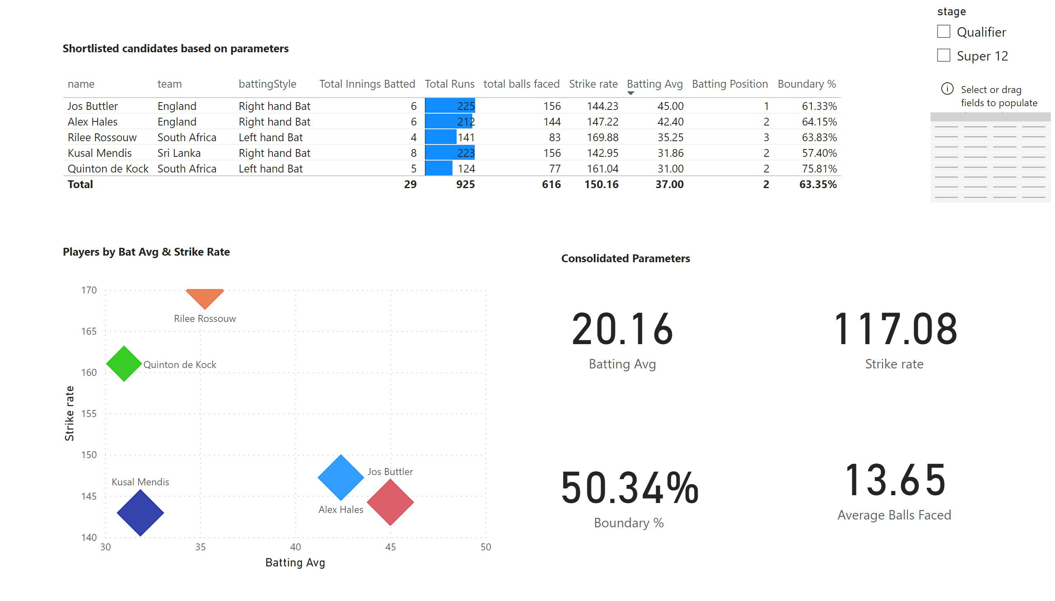
Power Hitters / Openers
Notes:
tableEx
No alt text provided
scatterChart
No alt text provided
card
No alt text provided
card
No alt text provided
slicer
No alt text provided
card
No alt text provided
textbox
No alt text provided
textbox
No alt text provided
card
No alt text provided
textbox
No alt text provided
tableEx
No alt text provided

Slide 3
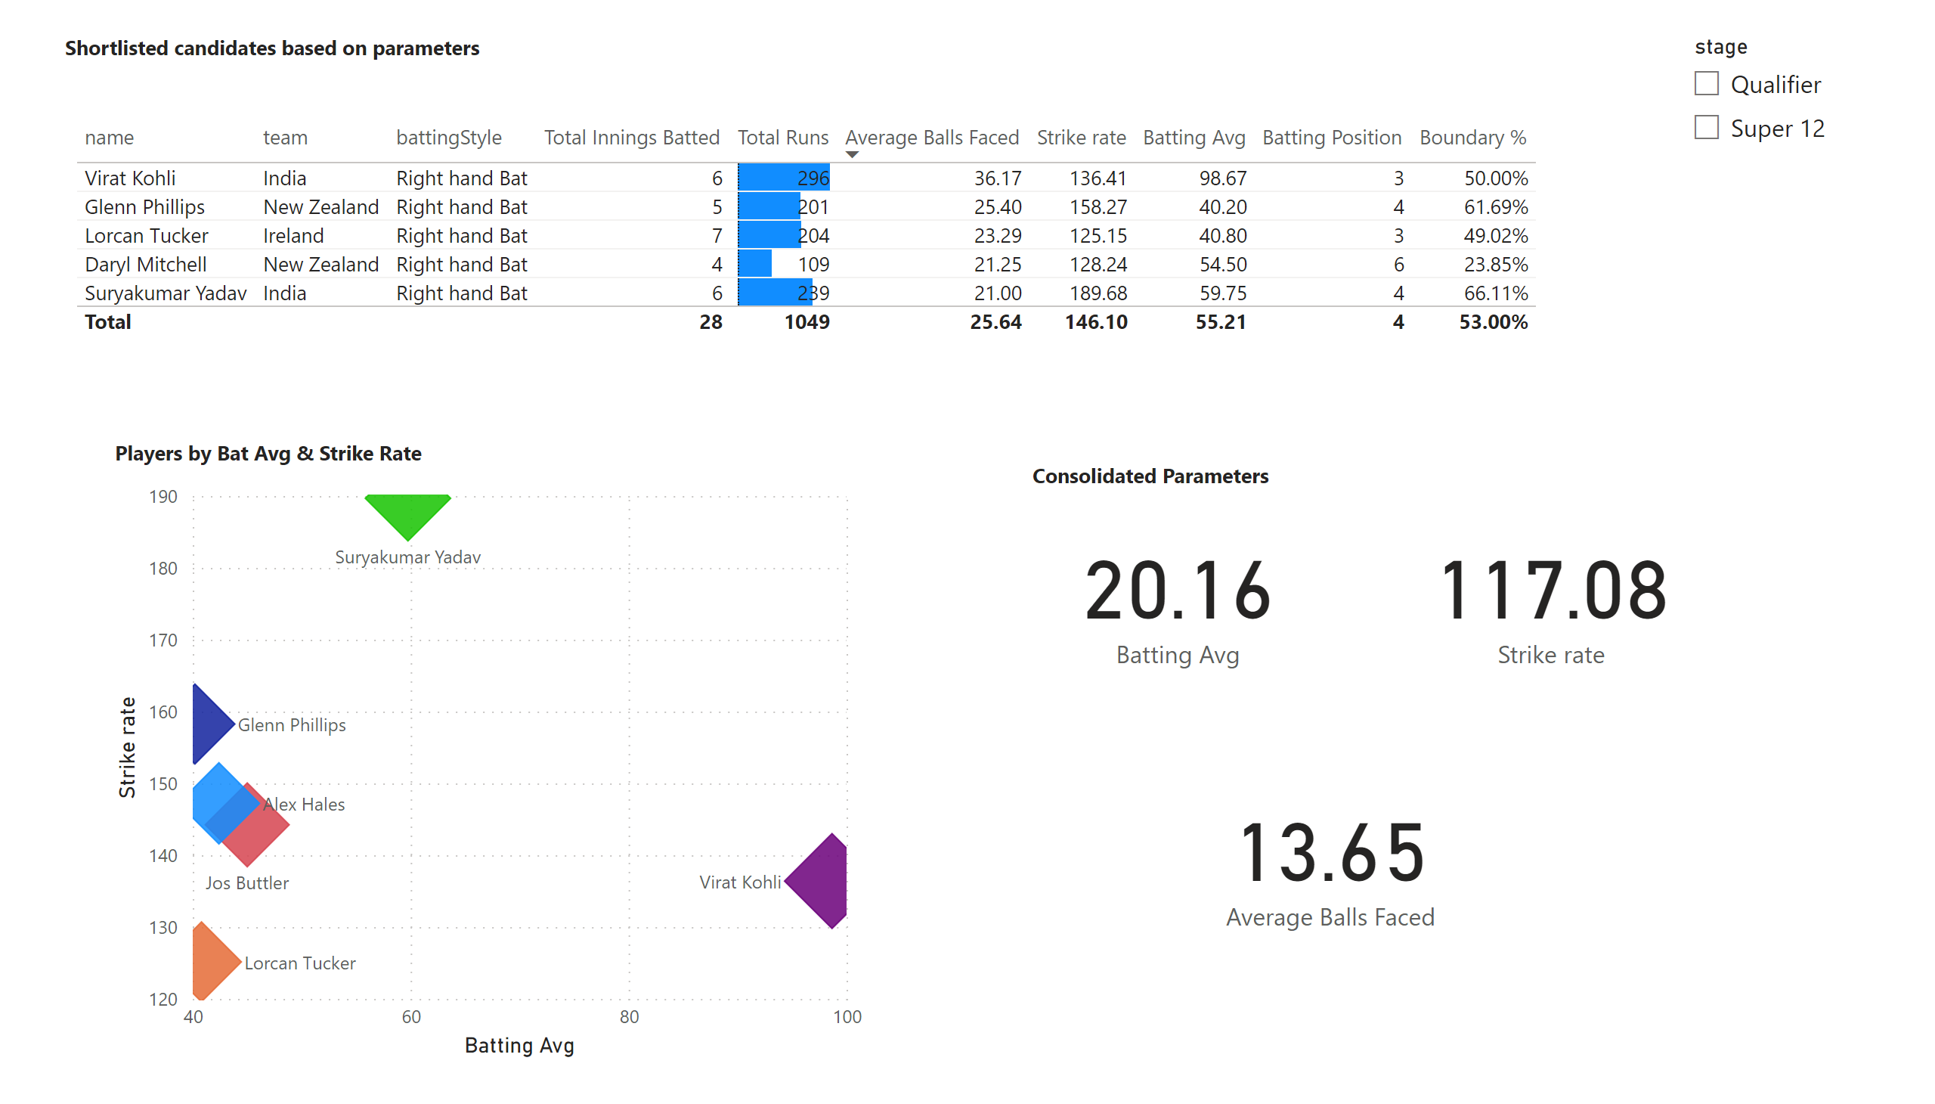
Anchors / Middle Order
Notes:
tableEx
No alt text provided
scatterChart
No alt text provided
slicer
No alt text provided
textbox
No alt text provided
textbox
No alt text provided
card
No alt text provided
card
No alt text provided
card
No alt text provided
textbox
No alt text provided

Slide 4
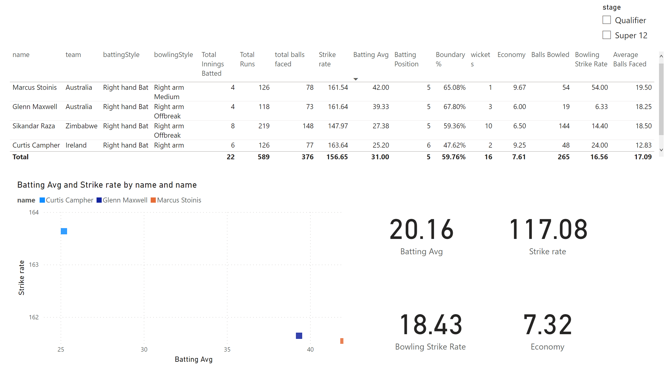
Finisher / Lower Order Anchor
Notes:
tableEx
No alt text provided
scatterChart
No alt text provided
card
No alt text provided
card
No alt text provided
slicer
No alt text provided
card
No alt text provided
card
No alt text provided

Slide 5
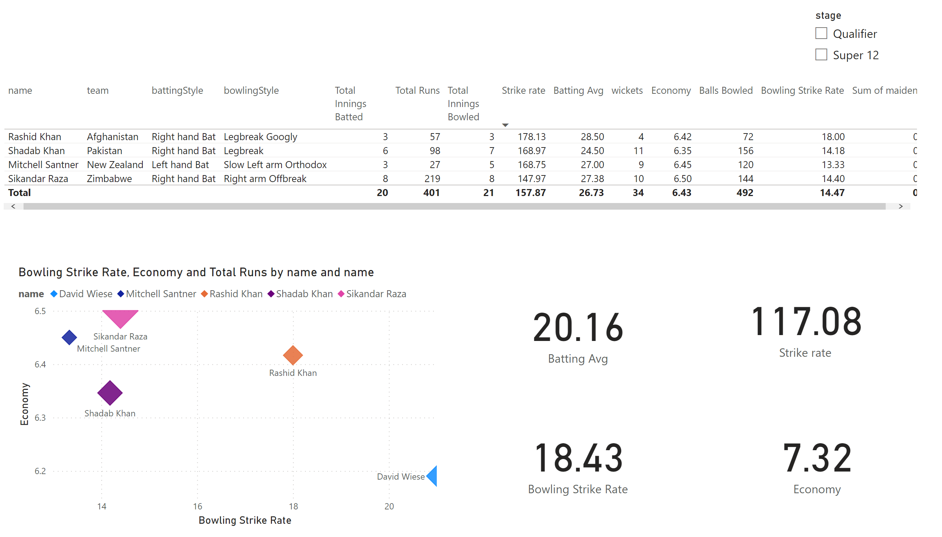
All Rounders / Lower Middle Order
Notes:
tableEx
No alt text provided
slicer
No alt text provided
scatterChart
No alt text provided
card
No alt text provided
card
No alt text provided
card
No alt text provided
card
No alt text provided

Slide 6
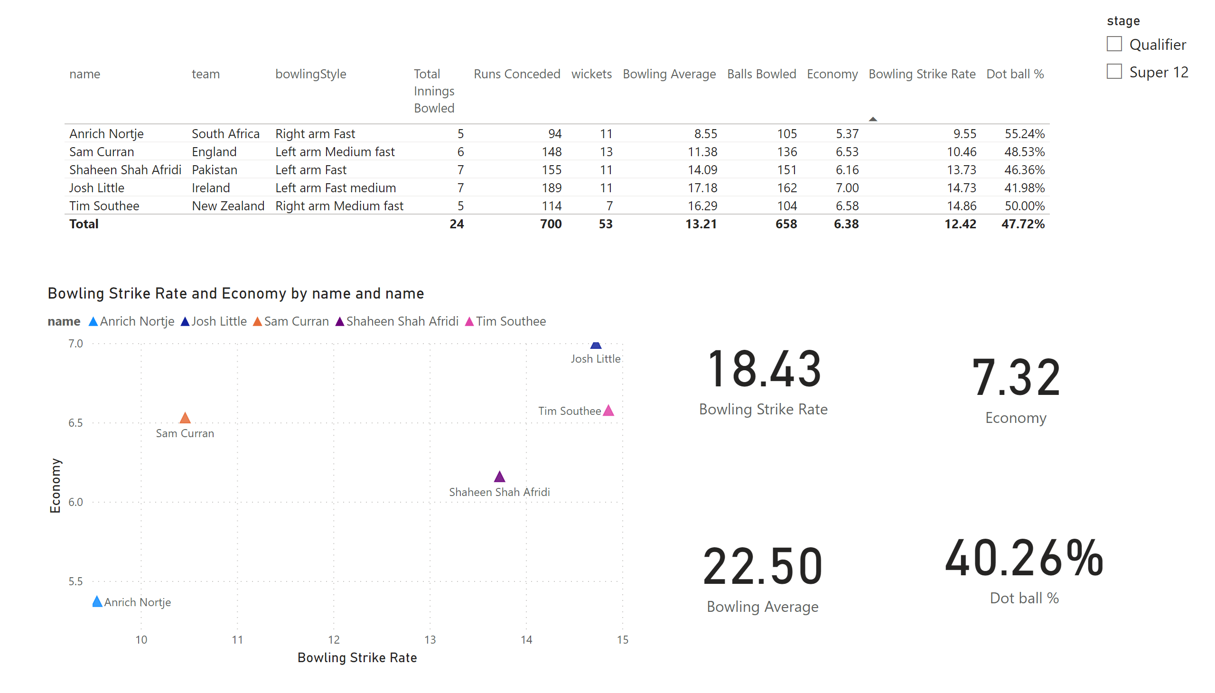
Specialist Fast Bowlers / Tail End
Notes:
tableEx
No alt text provided
scatterChart
No alt text provided
card
No alt text provided
card
No alt text provided
card
No alt text provided
card
No alt text provided
slicer
No alt text provided

Slide 7
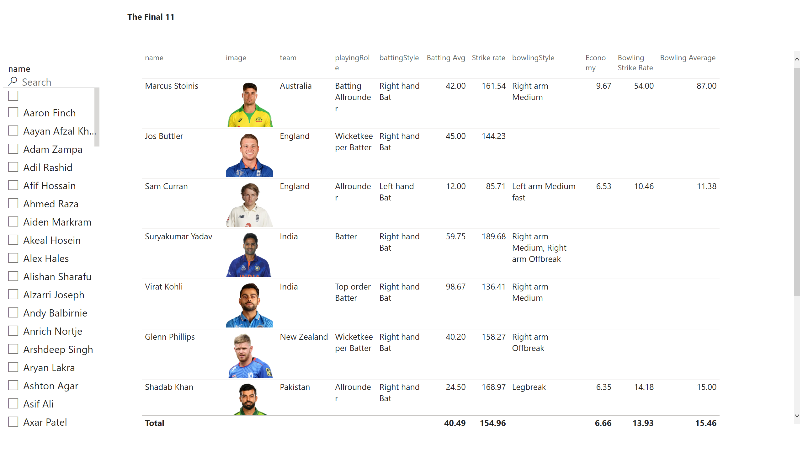
Final Team
Notes:
tableEx
No alt text provided
slicer
No alt text provided
textbox
No alt text provided

