Slide 1
Front Looking Sonar System
HEAUV Project - Real-time Visualization
Autonomous Underwater Vehicle Sensing Technology
High Endurance Autonomous Underwater Vehicle • 2026

Slide 2
Project Objective
Design a real-time sonar visualization system capable of:
Displaying targets within scanning field of view
Measuring real-time distance and angle of underwater objects
Simulating target movement with animated graphical elements
Supporting HEAUV underwater robotics project development

Slide 3
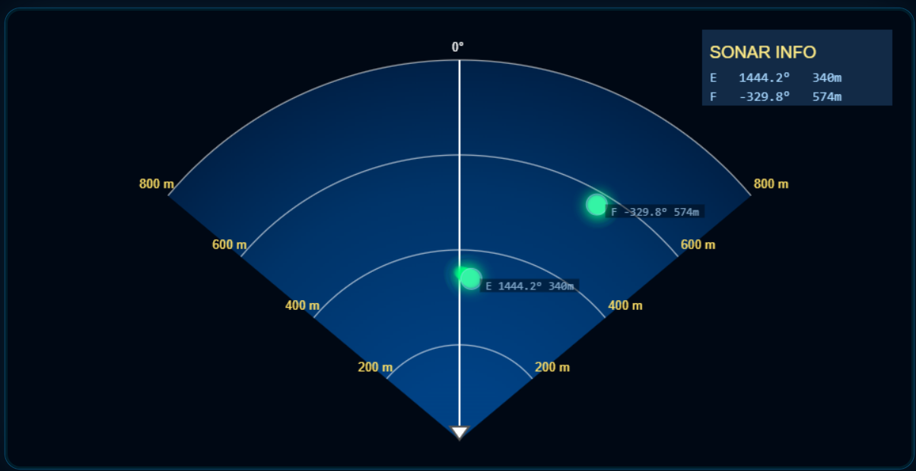

Slide 4
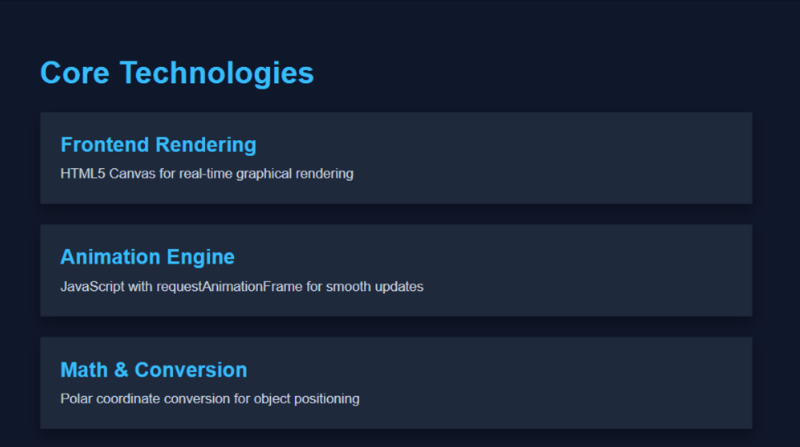

Slide 5
Mission Module Updates
Mark AOP (Area of Operation) and save mission settings
Automatic option disabling after mission save
Mission Window displays only enabled controls
Mission submenu disabled after save
Operational d status displayed on top panel

Slide 6
Mines Module Requirements
Define fixed maximum number of mines allowed 1-100
Zero mines not permitted during creation
Modify mine count without updating entire scenario (panding)

Slide 7
Search Area Module - Validation
Key Requirements:
Validate location modifications in real-time
Detect overlapping Search Area positions
Display error message for overlaps
Only non-overlapping positions allowed for updates
Prevent marker save on overlap detection

Slide 8
Search Area Module - Database Logic
Marker disappears on overlap detection
Previous valid Search Area location retained in database
Only non-overlapping positions allowed for updates
Database consistency maintained throughout validation

Slide 9
Complete System Architecture
Visualization Layer: Sonar display with real-time graphics
Mission Management: AOP marking and operational status
Minefield Control: Mine count and configuration management
Search Coordination: Validated area management and tracking

Slide 10
Sonar Technology in Underwater Navigation
This simulation supports learning, research, and development
HEAUV Project Development

