Slide 1
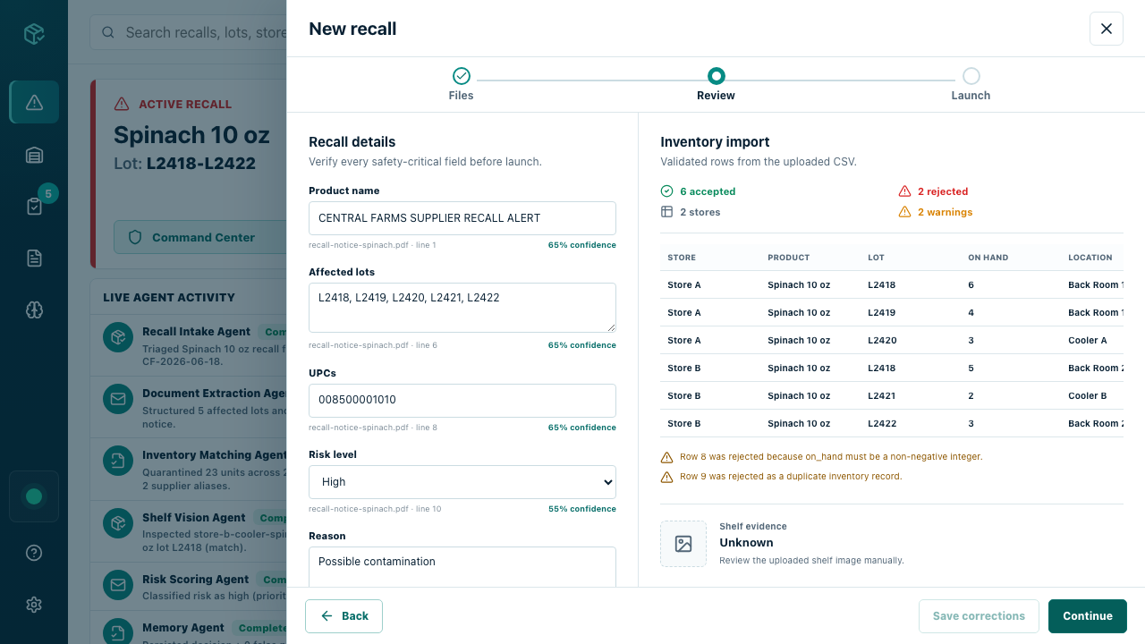
BatchHelm
A recall packet becomes a controlled response.
Real intake. Nine specialist agents. Human evidence gate.
Qwen Global AI Hackathon
Ankit Ranjan

Slide 2
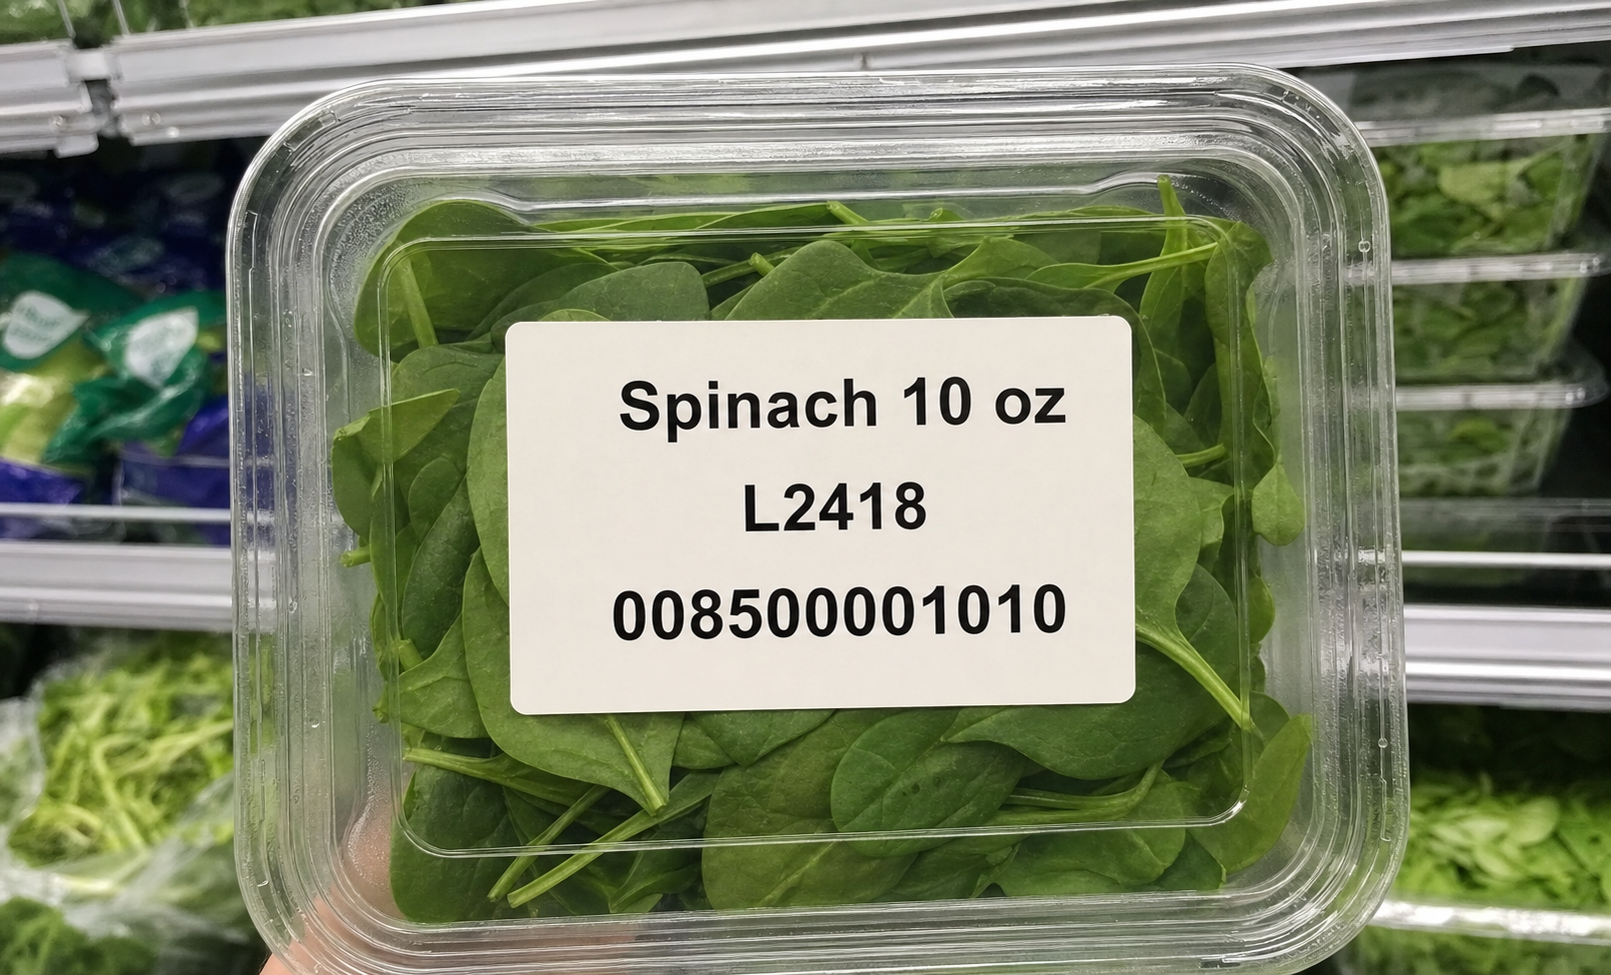
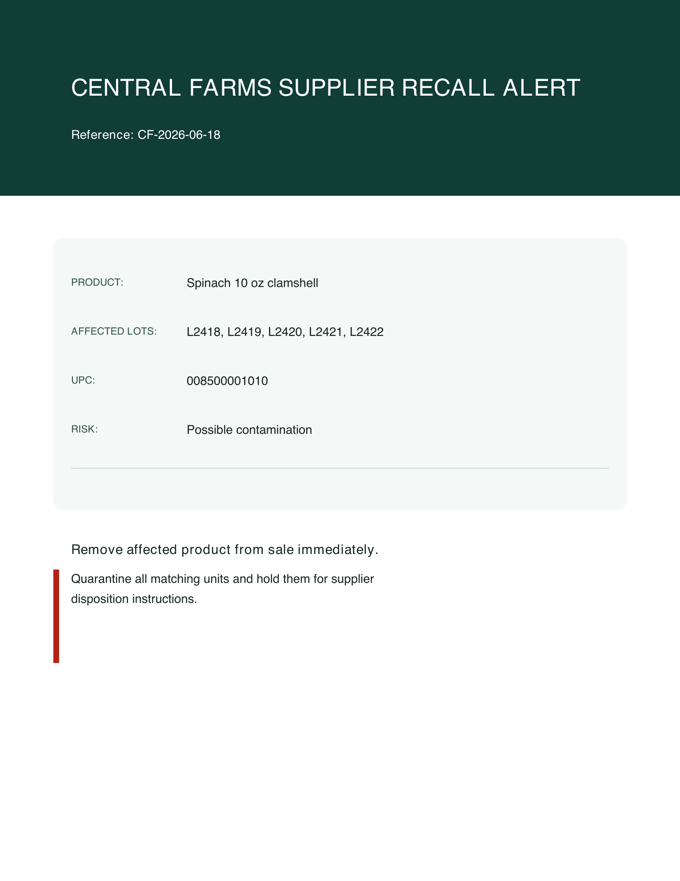
Recalls create five unanswered questions
01 What product and lots are affected?
02 Where are matching units now?
03 Who must act?
04 Who may need notification?
05 What evidence must survive?
Small operators must answer all five without enterprise recall tooling.
SYNTHETIC PACKET
The notice identifies risk.
The shelf image proves why evidence still needs interpretation.

Slide 3
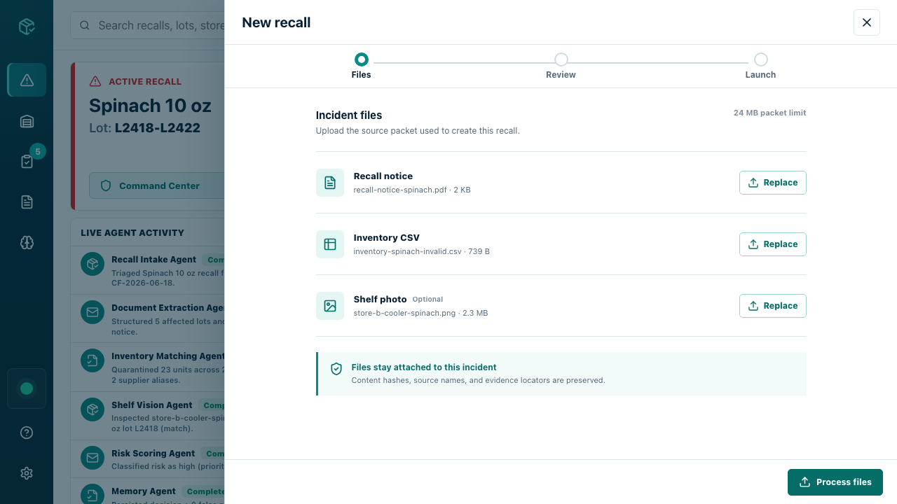
Files, Review, Launch
Ambiguous inputs become a launchable incident only after review.
6 accepted rows
2 safely rejected
23 on-hand units
2 stores
2 review warnings
01 FILES
02 REVIEW
03 LAUNCH
Field-level provenance is visible before launch
Supplier notice identifies the product and lots. Inventory rows carry accepted or rejected status. Shelf evidence remains explicitly unknown until reviewed.

Slide 4
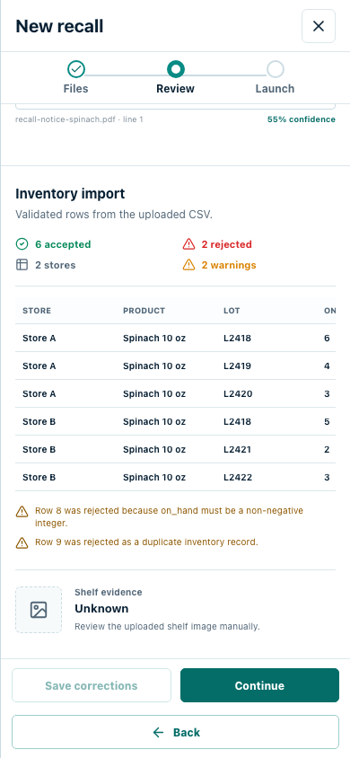
Autonomy stops at the evidence gate
The system can act quickly because uncertainty is never hidden.
VERSIONED Reviewer corrections become new evidence.
CONFLICT Stale reviewer versions cannot overwrite newer work.
IMMUTABLE Confirmation creates the incident snapshot.
BLOCKED Launch is unavailable before confirmation.
UNKNOWN Unreadable shelf evidence escalates to review.
HUMAN EVIDENCE GATE
Neutral fallback
Arbitrary images never become matches. Unknown evidence keeps provenance and requires review.
2 warnings remain visible
1 confirm to unlock launch

Slide 5
Qwen handles the uncertain work
Qwen reasons where literal rules are not enough.
EXTRACT Text and rendered-page recall evidence
SEE Shelf-image interpretation
MATCH Inventory reasoning across imperfect rows
CLASSIFY Operational risk
WRITE Customer communication
BRIEF Management decision summary
Typed control
01 Structured JSON requests
02 Pydantic validation
03 Explicit provider source
04 Bounded retries
05 Neutral or literal fallback
06 Reviewer escalation
Qwen handles uncertainty. Typed systems decide what may enter the workflow.

Slide 6
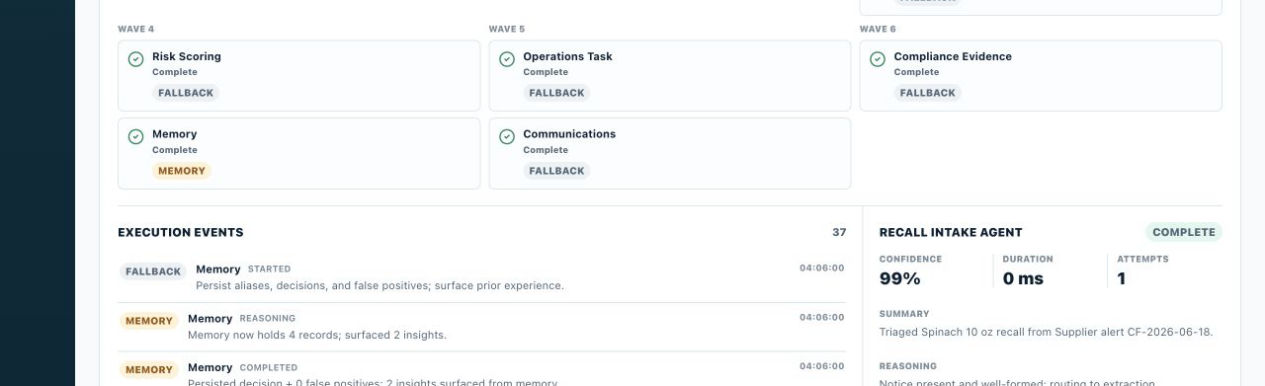
Nine specialists share one typed blackboard
The Agent Society advances in six durable waves.
9 specialist agents
6 typed waves
Independent specialists run in parallel inside a wave.
Each wave writes a checkpoint before the next one begins.
Failure skips only dependent work, preserving useful results.
W1
W2
W3
W4
W5
W6
Inventory Matching
Risk Scoring
Ops Task
Recall Intake
Document Extraction
Compliance Evidence
Shelf Vision
Memory
Comms Agent
MISSION CONTROL

Slide 7
Every event survives before it appears
PERSIST BEFORE SSE
Durability is split by responsibility, not hidden in one database box.
IDEMPOTENT Request UUIDs prevent duplicate runs.
ORDERED Events persist before SSE publishes.
REPLAYABLE Refresh resumes ordered history.
RESUMABLE Typed wave checkpoints restart safely.
RECOVERED Startup repairs non-terminal work.
Intake API
Agent Orchestrator
Ordered SSE stream
Mission Control
Intake
Lifecycle + snapshots
Artifacts
Immutable evidence
Run ledger
Events + checkpoints
Memory
Review ledger
Current SQLite lifecycle: one API replica Honest scope today; repositories preserve a clean path to distributed storage.

Slide 8
The DAG earns its complexity
1.49x faster
1095.3 ms vs 1633.9 ms
VISION FAILURE
4/9 agents still complete
Sequential baseline aborts after 3/9.
CRASH RECOVERY
3/9 agents rerun
Sequential baseline reruns 9/9.
Sequential baseline
Agent Society DAG
Parallel work improves speed without giving up useful partial results or restart efficiency.
Deterministic fallback benchmark. Both arms use the same synthetic 180 ms delay per agent to isolate orchestration strategy from provider latency.

Slide 9
One sample incident proves operational value
Synthetic demo incident
2 stores
23 affected units
6 valid inventory rows
2 safely rejected rows
5 affected lots
1 optional shelf artifact
Supplier notice
Confirmed snapshot
Durable run
37 ordered events
Evidence remains inspectable from notice to ordered event.

Slide 10
Built for the path from notice to audit
github.com/ankitranjan-dsai/batchhelm-ai
MIT license
Open the repository.
Run the synthetic recall.
Inspect every decision.
Ankit Ranjan
GREEN CI ON MAIN
✓ Backend
✓ Frontend
✓ Attribution
✓ Docker
ALIBABA CLOUD DEPLOYMENT ARCHITECTURE
Browser
Alibaba Ingress
BatchHelm UI + API
Qwen Cloud
SQLite volume
Artifact storage
Docker image · health checks · persistent volumes · one API replica

