Slide 1
Temporal Path Explorer & Visualizer COMP530 GROUP 9
Yiqing Liu / Bowen Li / Xiaohan Xu / Zixuan Tang / Wenbin Zeng / Ce Wang / Ankit Ranjan
Supervisor Dr Lutz Oettershagen

Slide 2
Introduction
Real-world systems: time is the critical factor determining how information or influence propagates.
Temporal networks: a path is only valid if its edges are traversed in a strictly increasing time order.
Existing visualization tools, designed for static networks, provide limited support for exploring how connectivity evolves over time, leading to a gap between temporal network theory and exploratory tools.

Slide 3
Project Aims
01
02
03
Implement an efficient time-reachability algorithm (One-pass Temporal Search)
Build an interactive web tool to visualize dynamic paths.
Provides a "What-if" functionality to assess the sensitivity of edges to global reachability at a specific time.

Slide 4
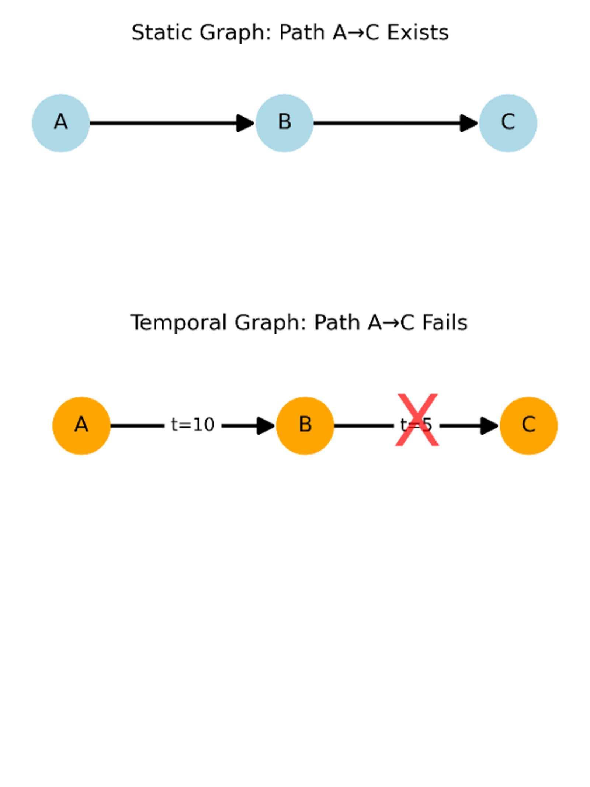
Core Concept: Temporal Path Constraint
Temporal Consistency: The path must follow a strictly ascending chronological order: t₁ < t₂ < ... < t_{n}
Earliest Arrival: The core objective of the system is to calculate the earliest time at which a node can be reached from the source, subject to temporal constraints.
Computational optimisation: Perform a One-pass scan using ordered time series (Unix timestamps).

Slide 5
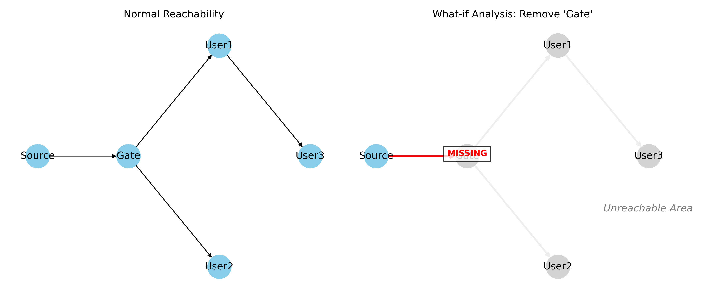
Assessing Network Robustness (What-if Analysis)
Reachability Rate: To measure the network’s dissemination effectiveness within a specific time window.
Sensitivity: Assess the contribution of this element to overall connectivity by simulating the failure of edges or nodes.
Bottleneck Identification: Identify the ‘spatio-temporal nodes’ that are most critical to maintaining temporal connectivity.

Slide 6
Temporal Graph Bottleneck & Robustness Analysis
Goal
Method
Optimization
·Identify critical edges / vertices
·Measure impact on network performance
·Remove one element at a time (what-if analysis)
·Recompute:
Reachability
Latency
·Rank by impact
·O(1) edge / vertex toggling
·Pre-sorted temporal adjacency
·Cached sensitivity computation

Slide 7
Implementation: The System
Web App
Core Features
Built with Streamlit. Users upload CSV/JSON data or load the built-in sample, then work across four tabs: Data, Explore, Analyze, Advanced.
Earliest-arrival paths highlighted on the graph; What-if removes edges/vertices and recomputes metrics; Bottleneck scan ranks critical edges and exports CSV.

Slide 8
Live Demonstration

Slide 9
Q&A

