Slide 1
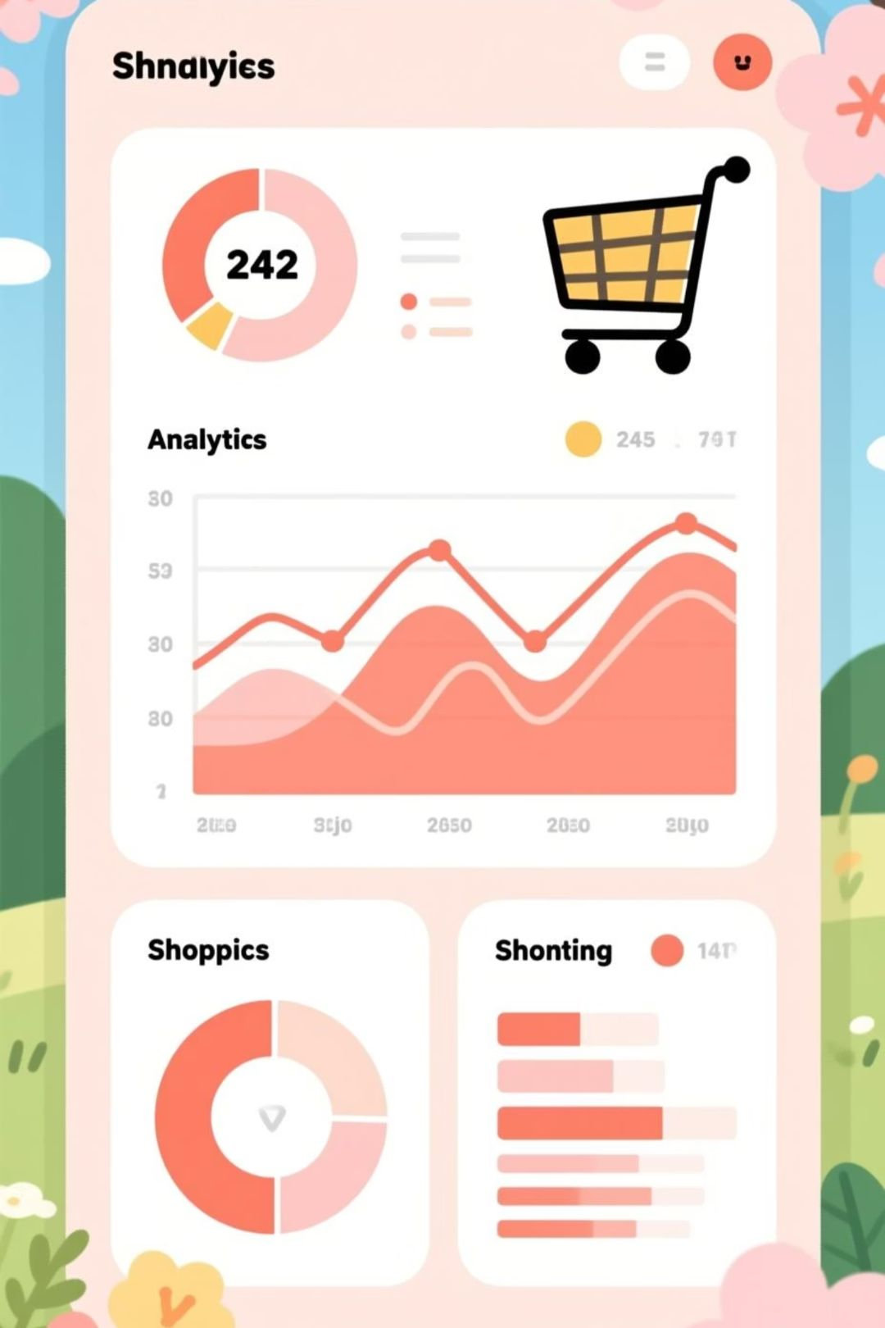
Customer Shopping Behavior Analysis
Uncovering insights from 3,900 purchases to drive strategic business decisions

Slide 2
Dataset at a Glance
3,900
18
25
50
Total Purchases
Data Points
Product Types
Locations
Transactions analyzed across all categories
Features tracked per customer
Items purchased across categories
Geographic coverage
Customer Data
Transaction Details
Age, Gender, Location
Product, Category, Amount
Subscription Status
Season, Size, Color
Purchase History
Discounts & Promos

Slide 3
Data Preparation Journey
01
02
03
Data Loading & Exploration
Missing Data Handling
Feature Engineering
Imported dataset using pandas, analyzed structure with df.info() and summary statistics
Imputed 37 missing Review Rating values using median rating per product category
Created age_group bins and purchase_frequency_days columns for deeper analysis
04
05
Data Consistency
Database Integration
Standardized columns to snake_case, removed redundant promo_code_used field
Connected to PostgreSQL and loaded cleaned data for SQL analysis

Slide 4

Revenue Insights by Gender
Male customers drive 68% of total revenue
Male shoppers generated $157,890 compared to $75,191 from female customers
Male
Female

Slide 5



Smart Spenders: Discount Users Above Average
839
$60
21.5%
High-Value Discount Users
Average Purchase
Customer Share
Customers who used discounts but spent above average purchase amount
Baseline spending threshold
Portion of total customer base
These savvy shoppers prove that discounts can drive volume without sacrificing transaction value

Slide 6
Product Performance Leaders
Top Rated Products
Discount-Dependent Items
97%
50%
Gloves
Hat
3.86 average rating
49.7%
96%
Sneakers
Sandals
49.1%
3.84 average rating
Coat
95%
48.2%
Boots
Sweater
3.82 average rating
95%
Hat
3.80 average rating

Slide 7


Shipping Preferences & Spending
Express Shipping
$60.48
Average purchase amount
Standard Shipping
$58.46
Average purchase amount
Express shipping customers spend 3.5% more per transaction, indicating higher purchase intent and urgency

Slide 8



Customer Segmentation Breakdown
New (83)
Returning (701)
Loyal (3,116)
Subscription Analysis
Repeat Buyer Insight
Subscribers: 1,053 customers averaging $59.49 spend
Of customers with 5+ purchases:
Non-subscribers: 2,847 customers averaging $59.87 spend
958 are subscribers
2,518 are non-subscribers

Slide 9
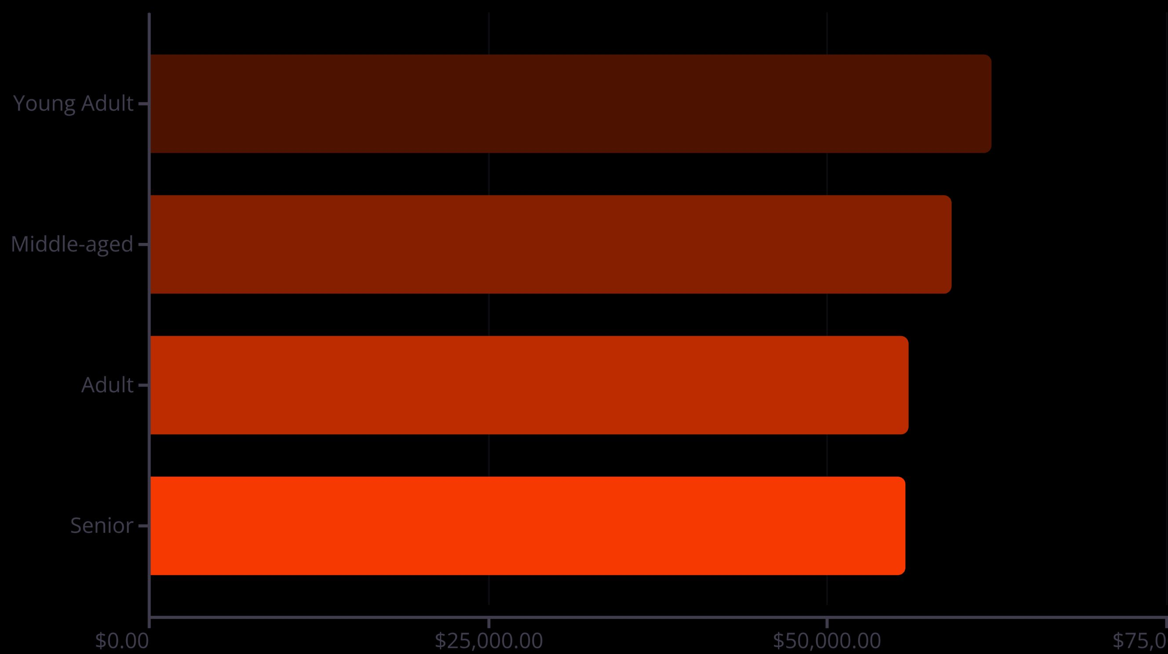
Revenue by Age Demographics
Young adults lead revenue generation, contributing $62,143 across all categories. Revenue remains relatively balanced across age groups, suggesting broad market appeal.

Slide 10
Strategic Recommendations
Boost Subscriptions
Customer Loyalty Programs
Review Discount Policy
Promote exclusive benefits to convert repeat buyers—958 loyal customers already subscribe, but 2,518 don't
Balance sales boosts with margin control—some products show 50% discount dependency
Reward repeat buyers to accelerate movement from Returning to Loyal segment
Product Positioning
Targeted Marketing
Highlight top-rated items (Gloves, Sandals, Boots) in marketing campaigns
Focus on high-revenue young adults and express-shipping users for premium offerings

