Slide 1

$10 Trillion
The $10 Trillion Problem
A deep dive into the global cost of cybercrime — and the actionable steps your business must take right now.
Cybersecurity Executive Briefing · 2024

Slide 2
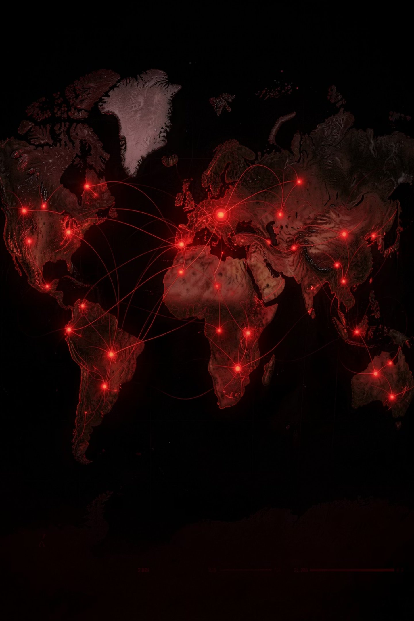
The Scale of the Problem
Cybercrime has become the world's third-largest economy — and it's accelerating.
$10T
39s
Annual Cost
Attack Frequency
Exceeds the GDP of every nation except the US and China — and projected to reach $23 trillion by 2027.
A cyberattack occurs somewhere in the world every 39 seconds, around the clock.
2,200+
Daily Attacks
More than 2,200 confirmed attacks happen globally every single day — and rising.

Slide 3
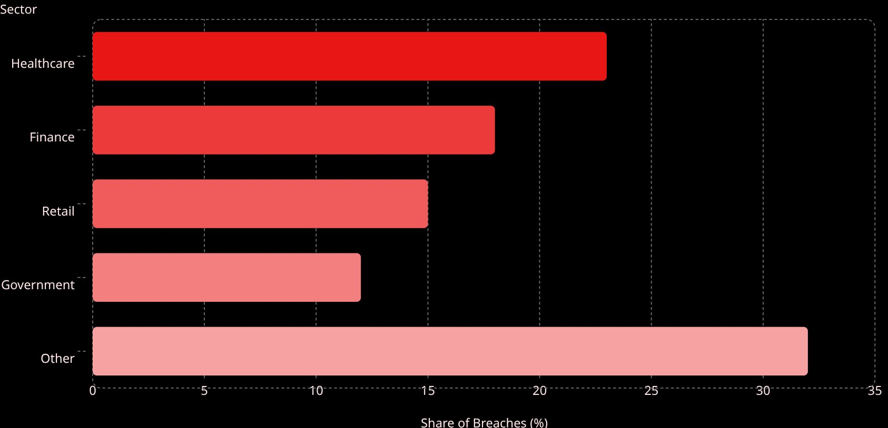

Who Gets Hit — and How
No sector is immune. Every industry faces a unique threat profile, yet the attack vectors remain strikingly consistent.
Breaches by Industry
Top Attack Vectors
23
Ransomware
Phishing
18
Encrypts critical data; demands payment for recovery.
Deceptive emails that harvest credentials and access.
15
12
Supply Chain
Insider Threats
32
Exploiting trusted third-party vendors as entry points.
Negligent or malicious employees bypassing defenses.
82% of all breaches involve human error — making people your most critical vulnerability.

Slide 4
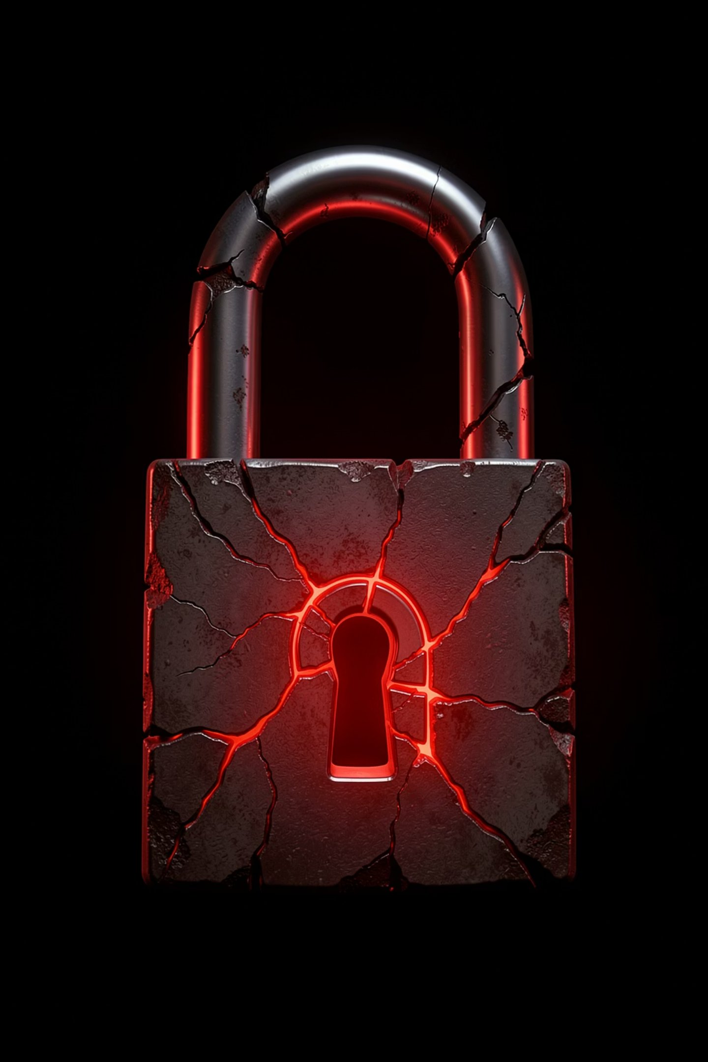

THREAT SPOTLIGHT
Ransomware: The $20 Billion Monster
Ransomware is no longer a fringe threat — it is the dominant weapon of choice for sophisticated criminal enterprises worldwide.
$20B
Total cost to businesses in 2023 alone — up 95% year-over-year.
$1.54M
Average ransom demand per incident, with payments often made under duress.
21 Days
Average operational downtime following a successful ransomware attack.
65%
Share of encrypted data ever recovered — even when the ransom is paid in full.

Slide 5


Two Cautionary Tales
Real-world breaches reveal how swiftly a single vulnerability can trigger catastrophic, enterprise-wide failure.
CASE STUDY · 2023
MGM Resorts
CASE STUDY · 2021
Colonial Pipeline
A single compromised password — no MFA — was the sole point of entry
Shut down 45% of US East Coast fuel supply within hours
$4.4M ransom paid; 17 states declared emergency status
Weeks of operational disruption and regulatory scrutiny followed
Hackers social-engineered the IT helpdesk in a single 10-minute phone call
Casino floors went dark; hotel systems failed across multiple properties
$100M+ in losses; millions of customer records exposed
Brand damage and customer trust erosion persisted long after recovery

Slide 6
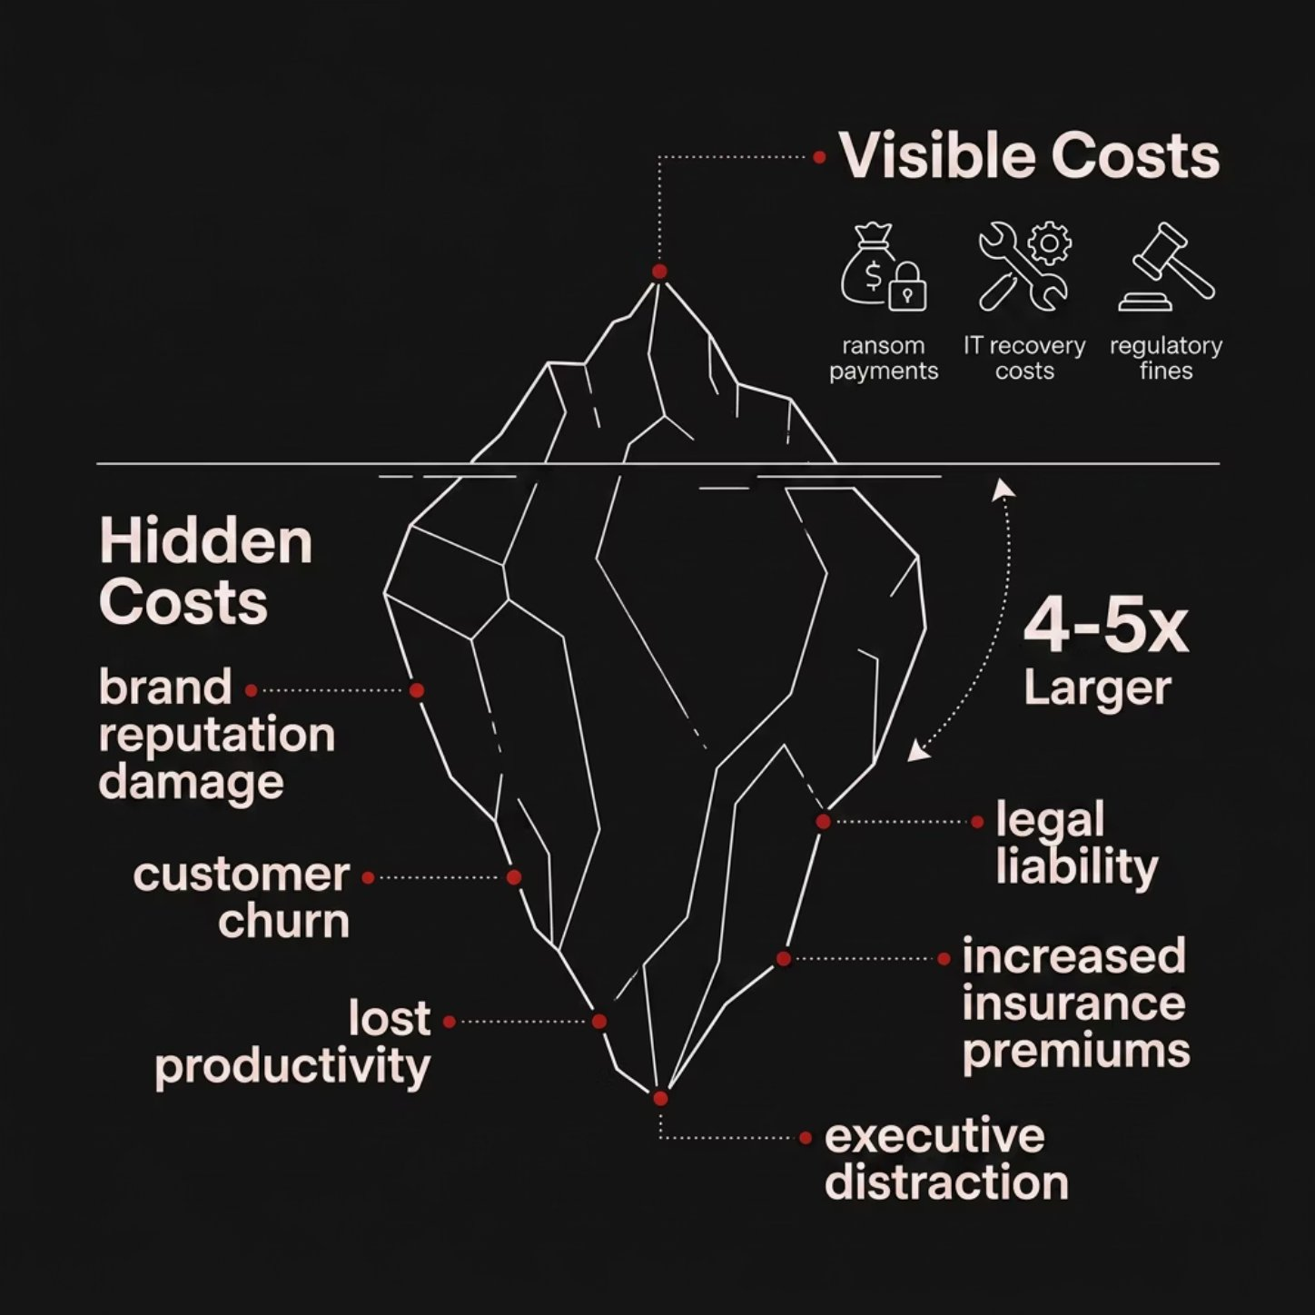

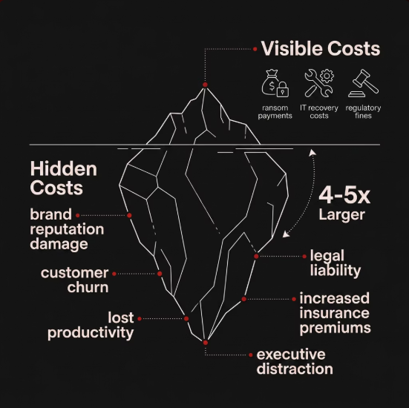

The True Cost Iceberg
What companies report as "breach costs" is rarely the full picture. The most damaging expenses lie hidden beneath the surface.
Visible Costs (Above the Surface)
Ransom payments to threat actors
Emergency IT recovery and forensics
Regulatory fines and compliance penalties
Hidden Costs (Below the Surface)
Brand reputation damage and customer churn
Lost productivity across the organization
Legal liability and litigation exposure
Surging cyber insurance premiums
Executive distraction from core business
Hidden costs are typically 4–5× greater than the visible breach expenses most organizations account for.

Slide 7
The Human & Structural Gaps
"The gaps attackers exploit every single day."
82%
3.5M
43%
Human Error
Unfilled Jobs
Target SMBs
Of all confirmed breaches trace back to negligence, mistakes, or manipulated employees.
Cybersecurity roles sitting vacant globally — a critical talent shortage with no quick fix.
Of attacks specifically target small businesses, assuming weaker defenses and faster payouts.
60%
77%
SMBs Close
No IR Plan
Of small businesses shut down permanently within 6 months of suffering a major breach.
Of organizations have no formal incident response plan in place when an attack occurs.

Slide 8
5 Actionable Steps to Protect Your Business
The most resilient organizations don't wait for a breach — they build defenses that make attacks exponentially harder and recoveries exponentially faster.
Zero Trust Architecture
Verify every user, every device, every time. No implicit trust inside or outside the perimeter.
Employee Security Training
Simulated phishing campaigns and continuous awareness programs transform your riskiest asset into your strongest defense.
Incident Response Planning
A documented IR plan reduces average breach cost by $2.66M — the highest-ROI investment in security.
Third-Party Vendor Audits
62% of breaches originate with a vendor. Rigorously audit all third-party access and supply chain integrations.
Cyber Insurance
Purpose-built coverage for ransom payments, business interruption, recovery costs, and legal liability.

Slide 9




Your 90-Day Action Plan
A clear, sequenced roadmap from vulnerability to resilience — built for execution, not just awareness.
Month 1 — Assess
Month 2 — Strengthen
Month 3 — Test & Insure
Commission a full security audit
Map and rank all critical vulnerabilities
Review and restrict all vendor access privileges
Deploy Zero Trust architecture and MFA enterprise-wide
Launch mandatory employee security training program
Formalize and distribute the incident response plan
Execute live phishing simulations across all staff
Conduct tabletop breach response exercises with leadership
Finalize and activate your cyber insurance policy
Organizations that complete all three phases reduce average breach costs by more than $2.66M and recover 40% faster than unprepared peers.

Slide 10

The Cost of Doing Nothing
"The question is no longer if your business will be targeted — it's when. Every day without action is a calculated, compounding risk."
The Hard Reality
Companies that delay cybersecurity investment spend 3× more on breach recovery than those who act proactively.
Your Next Move
Schedule your security audit this week. Identify your gaps before an attacker does. The window to act on your terms is now.
Start your security audit this week. The cost of preparation is always less than the cost of a breach.

