Slide 1
PERSONALIZED DYNAMIC DISCOUNT RECOMMENDATION
Contextual Multi-Armed Bandits with Commercial Guardrails & Financial Ledgers
Course: BCSE209L — Machine Learning | Digital Assessment 3 (DA3 Project Review)
Class: CH2026270100894 | Slot: B2 | School: CNI
Faculty: Dr. S. Sridevi, Associate Professor
Team Members: Ankit Sthitapranjya (24BAI1287) & Ananya Shandilya (24BAI1428)
Evaluation Dates: 15.10.2026 to 19.10.2026 | Marks Allocated: 10 Marks

Slide 2
RUBRIC SECTION 1
1. Project Objectives
PRIMARY OBJECTIVES (Need of the Hour Problem)
• 1. Dynamic Pricing Personalization: Personalize discounts across 5 arms ({0%, 5%, 10%, 15%, 20%}) based on 20D context.
• 2. Solve Exploration vs. Exploitation: Deploy LinUCB and Thompson Sampling to minimize cumulative regret vs. static A/B testing.
• 3. Guaranteed Safety via Guardrails: Programmatically enforce loyalty tier ceilings and unit margin floors (100% compliance).
• 4. Dual-Mode Evaluation: Benchmark Online (20,000 rounds learning) vs. Frozen (5,000 rounds operational) over 10 random seeds.
• 5. Auditable Accounting: Maintain an immutable microeconomic transaction ledger tracking profit, revenue, and discount concessions.
• 6. Frontline Explainability: Deliver an interactive, 100% offline Streamlit decision dashboard for store merchandisers.

Slide 3
RUBRIC SECTION 2
2. Literature Review
KEY FOUNDATIONAL LITERATURE
• Li et al. (WWW 2010) — LinUCB: Formulated contextual bandits with linear ridge regression and matrix concentration confidence bounds.
• Li et al. (WSDM 2011) — Replay Evaluation: Proved that rejection sampling on logged data produces an unbiased offline estimator.
• Agrawal & Goyal (ICML 2013) & Chapelle & Li (NeurIPS 2011) — Contextual Thompson Sampling: Evaluated Bayesian posterior sampling with linear payoffs.
• Lattimore & Szepesvari (Cambridge 2020) — Bandit Theory: Grounded cumulative expected regret formulations to isolate policy quality from noise.
• Hughes (1994) — RFM Framework: Customer segmentation by Recency, Frequency, and Monetary value for commercial loyalty tiers.

Slide 4
RUBRIC SECTION 3
3. Proposed Methodology: Algorithmic Architecture
LinUCB & Thompson Sampling
• LinUCB Upper Confidence Bound: p_{t,a} = x_t^T theta_a + alpha * sqrt(x_t^T A_a^-1 x_t)
• Sherman-Morrison Update: M_a <- M_a - (M_a x x^T M_a)/(1 + x^T M_a x), updating inverse directly in O(d^2) operations.
• Contextual Thompson Sampling: Samples theta_tilde_a ~ N(theta_hat_a, v^2 B_a^-1) for Bayesian exploration.
• Action Space: 5 discrete discount arms {0%, 5%, 10%, 15%, 20%}.
Safety Guardrails & Simulator
• Inviolable Guardrails: Programmatic filtering restricts action set before scoring: New (max 5%), Regular (max 15%), Loyal (max 20%).
• Unit Cost Margin Floor: DiscountedPrice >= CostPrice + MarginFloor.
• Calibrated Demand Simulator: Logistic purchase link P(Y=1|x,a) calibrated at ROC-AUC 0.6322 on historical demand tertiles.
• Omniscient Oracle: Evaluates expected profit across all 5 arms simultaneously for exact regret computation.

Slide 5
RUBRIC 2 COMPLIANCE
Hardware and Software Module Specifications
Module Name | Type & Technology | Inputs / Dependencies | Outputs & Artifacts
Hardware Platform | Multi-core x86_64 CPU, 16GB RAM, No GPU | Local PC environment | Fast CPU execution (<18s training)
Data & Simulator (`src/simulation`) | Python 3.14, NumPy, Pandas, Scikit-learn | 73,100 Kaggle rows, 8k registry | 20D context vectors, P(Purchase), Oracle
Guardrails (`src/guardrails`) | Deterministic Python filter (`rules.py`) | 20D Context, Action space | Eligible action set A_t (100% compliance)
Bandit Policies (`src/policies`) | LinUCB (Sherman-Morrison O(d^2)), Thompson | Eligible set, Context, Reward | Recommended discount, Uncertainty score
Dashboard (`app/streamlit_app.py`) | Streamlit 1.42.0, Plotly 6.0.0, 100% Offline | Pre-trained .npz models, config | Live recommendation, What-If, Audits

Slide 6
RUBRIC SECTION 4
4. Novel Aspects of the Project
Sherman-Morrison O(d^2) Updates
High-Throughput Linear Algebra
Bypasses naive O(d^3) matrix inversion by updating inverse covariance directly via rank-1 outer products, slashing latency to microseconds.
Inviolable Safety Envelope
100% Operational Compliance
Eliminates below-cost sales and loyalty breaches programmatically (0 breaches in 200k decisions), avoiding policy collapse of soft penalty terms.
Dual-Mode & Ledger Protocol
Microeconomic Auditability
Pairs theoretical regret with double-entry ledgers, revealing early exploration tax, Round 3,200 break-even, and gross revenue leadership.

Slide 7
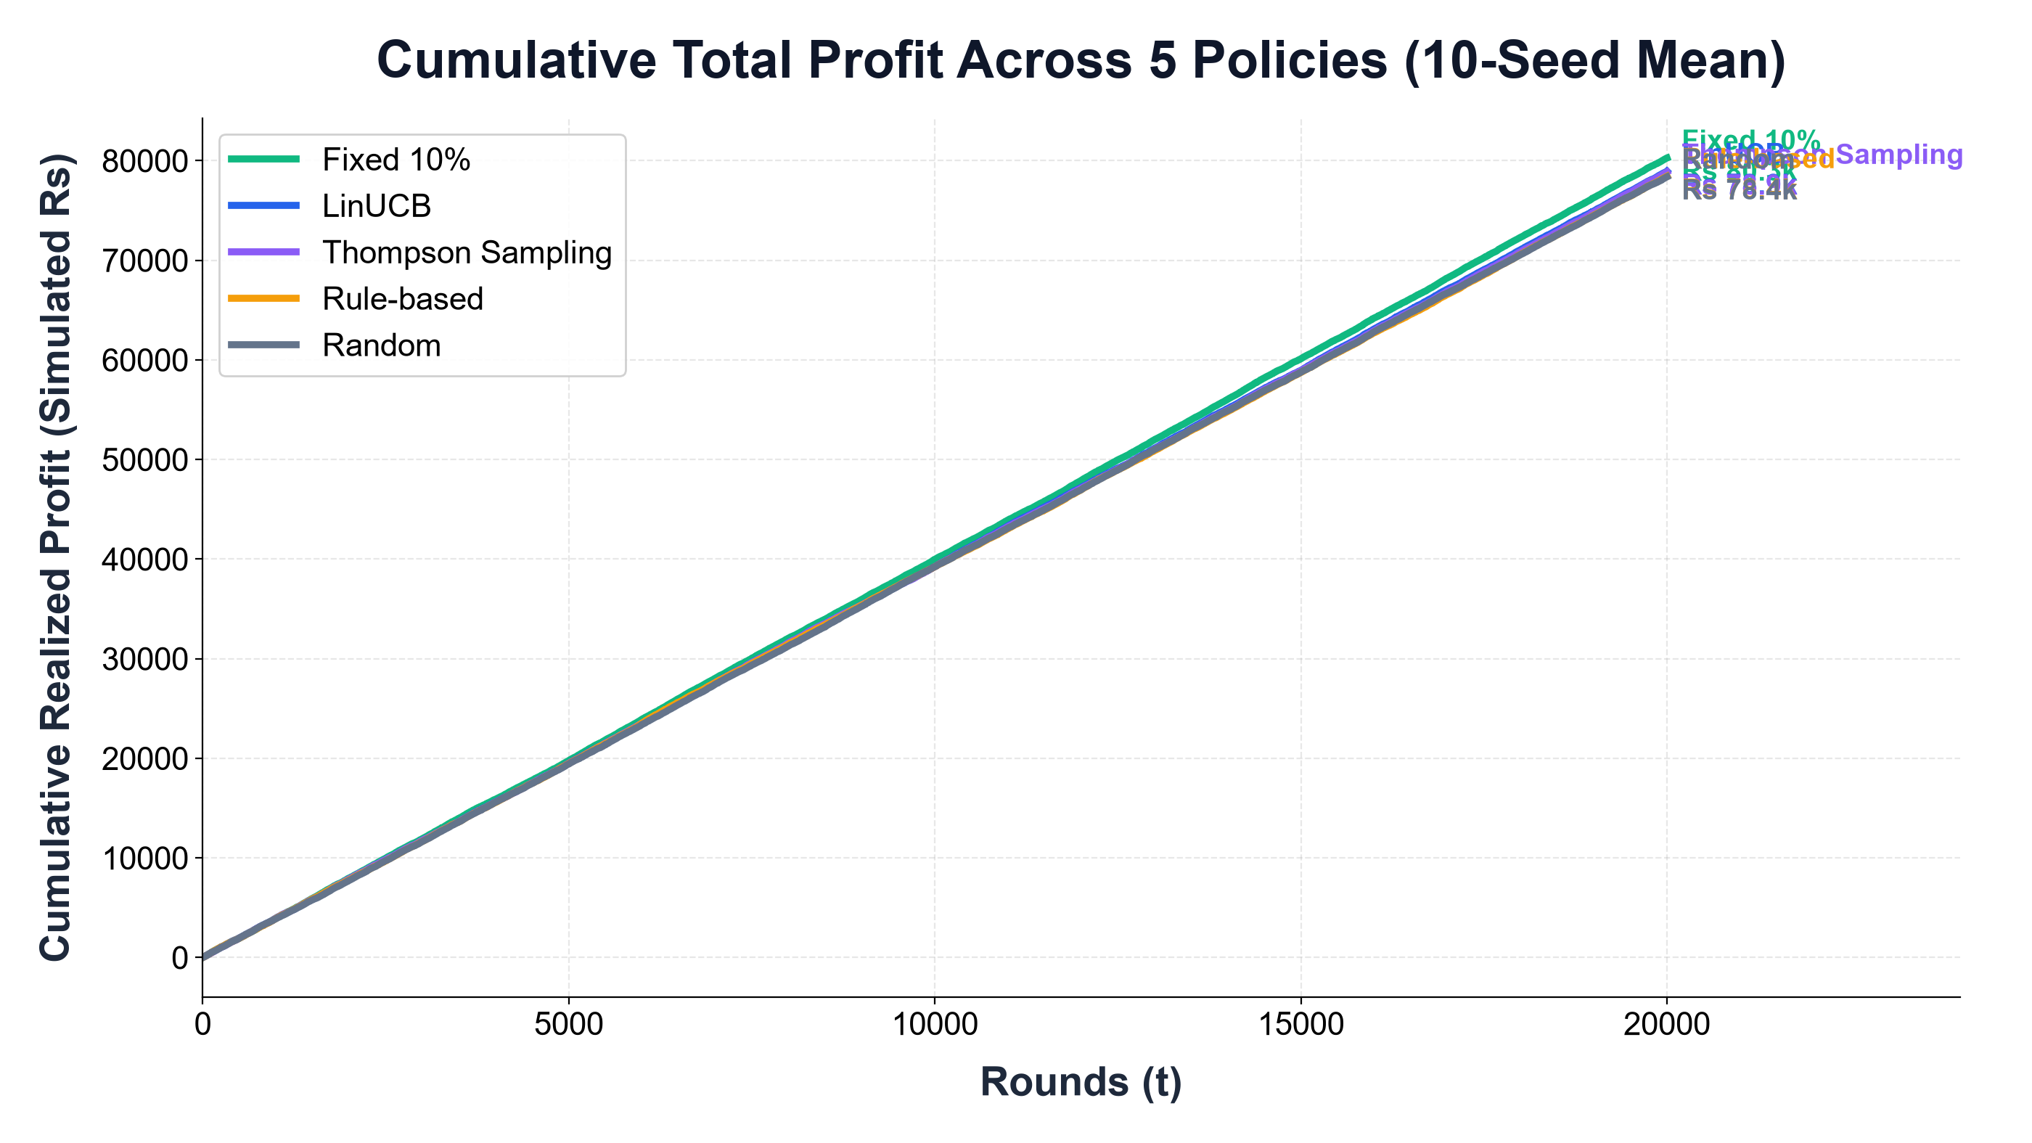
RUBRIC SECTION 5
5. Results & Discussion: Policy Benchmarks
HEADLINE FINDINGS (10 Seeds)
• Profit Winner: Fixed 10% earned Rs 80,265.41 +/- 1,788.01 (hit elasticity sweet spot).
• Revenue Winner: LinUCB captured highest gross revenue: Rs 234,276.84 +/- 4,476.98.
• Conversion Lift: LinUCB achieved 24.29% conversion vs. 23.81% for Fixed 10%.
• Lift vs. Retail Rules: LinUCB beat enterprise Rule-based by +Rs 492.50 (won in 8/10 seeds).

Slide 8
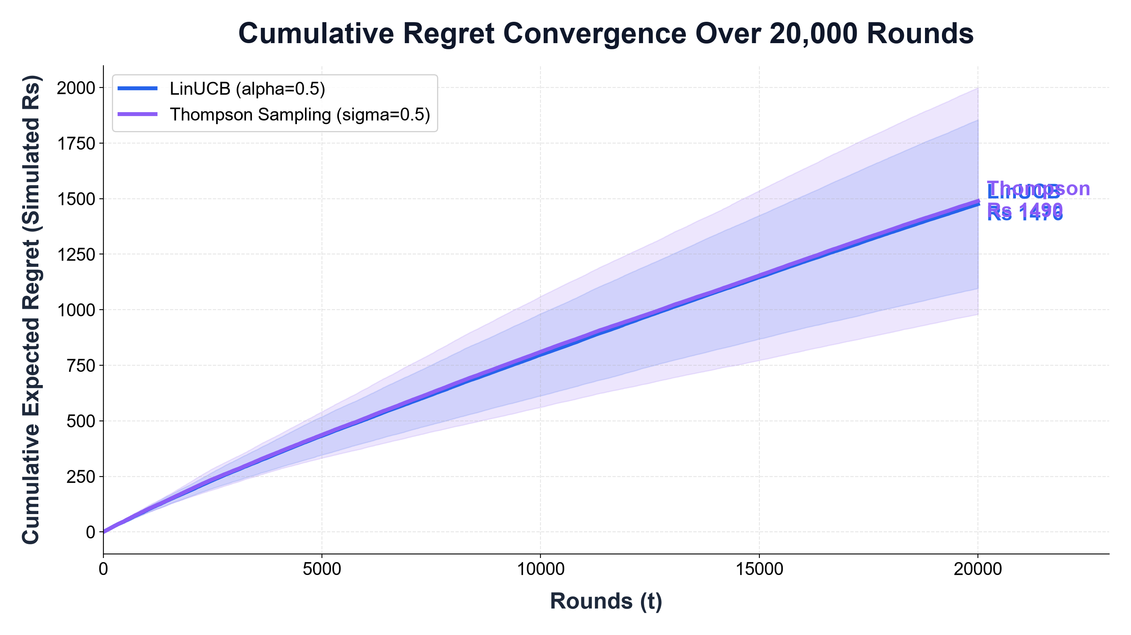
RUBRIC SECTION 5
5. Results & Discussion: Convergence & Cash Flows
REGRET & LEDGER DYNAMICS
• Sublinear Convergence: Regret drops from Rs 0.229 to Rs 0.092/round (learning flattens).
• Non-Zero Asymptote: Linear model cannot fit sigmoidal demand link across 20 dimensions.
• Break-Even Crossover: Crossed break-even vs. Rule-based at Round 3,200 on Seed 42.
• Volume-Margin Trade-Off: LinUCB conceded Rs 24.6k discounts vs. Rs 20.9k for Fixed 10%.

Slide 9
RUBRIC SECTION 6
6. Conclusion & Commercial Insights
SUMMARY OF CONTRIBUTIONS
1. ML Application: Contextual bandits successfully personalize retail discounts, driving top-line revenue to Rs 234.3k and outperforming rule-based baselines in 80% of runs.
2. The Profit Lesson: Heuristic Fixed 10% earned highest profit (Rs 80.3k) by hitting the price elasticity sweet spot without suffering steep unit margin penalties on 15-20% discounts.
3. Hard Guardrails are Mandatory: Deterministic programmatic filtering achieved 100% operational safety (0 breaches across 200k rounds) without the policy collapse of soft penalties.
4. Accounting Integrity: Double-entry financial ledgers revealed cash-flow dynamics that theoretical regret curves hide.
5. Scientific Integrity: Evaluated within our calibrated simulation environment; physical retail deployment requires global store-wide promotional spend budgets.

Slide 10
RUBRIC SECTION 7
7. References
BIBLIOGRAPHIC REFERENCES
[1] L. Li, W. Chu, J. Langford, and R. E. Schapire, 'A contextual-bandit approach to personalized news article recommendation,' in Proc. 19th Int. Conf. World Wide Web (WWW), 2010, pp. 661-670.
[2] L. Li, W. Chu, J. Langford, and X. Wang, 'Unbiased offline evaluation of contextual-bandit-based news article recommendation algorithms,' in Proc. 4th ACM WSDM, 2011, pp. 297-306.
[3] W. R. Thompson, 'On the likelihood that one unknown probability exceeds another in view of the evidence of two samples,' Biometrika, vol. 25, pp. 285-294, 1933.
[4] S. Agrawal and N. Goyal, 'Thompson Sampling for contextual bandits with linear payoffs,' in Proc. 30th ICML, 2013, pp. 127-135.
[5] O. Chapelle and L. Li, 'An empirical evaluation of Thompson Sampling,' in Adv. Neural Inf. Process. Syst. (NeurIPS 24), 2011.
[6] T. Lattimore and C. Szepesvari, Bandit Algorithms. Cambridge University Press, 2020.
[7] R. S. Sutton and A. G. Barto, Reinforcement Learning: An Introduction, 2nd ed. MIT Press, 2018.
[8] D. Zhou, L. Li, and Q. Gu, 'Neural contextual bandits with UCB-based exploration,' in Proc. 37th ICML, 2020.
[9] A. M. Hughes, Strategic Database Marketing. Probus Publishing, 1994.
[10] Kaggle Retail Store Inventory and Demand Forecasting Dataset, 2023. [Online]. Available: https://www.kaggle.com/datasets.

