Slide 1
Project of Presentation
Title: Iris Species Prediction Using Logistic Regression
Subtitle: Industrial Training Project (BCA 551)
Presented by: Ankit Saini (Enroll_No: TCA2201092), 5th Semester, Section: C
Project Guide: Mr. Ajay Rastogi
Institution: Teerthanker Mahaveer University, Moradabad
Date: September 2024

Slide 2
Project Overview
Project Title: Iris Species Prediction Using Logistic Regression
Domain: Machine Learning, Web Development
Problem Statement: Classifying iris flowers into species (Setosa, Versicolor, Virginica) based on measurements of sepal length, sepal width, petal length, and petal width.
Objective: Create a web-based system for automated species prediction.

Slide 3
Project Description
Develop a web app using Flask for iris species prediction.
Utilize logistic regression model trained on Iris dataset.
The app accepts sepal and petal measurements and returns a predicted species.

Slide 4
Scope of Work
Create a user-friendly web interface.
Integrate a pre-trained logistic regression model.
Display the result dynamically.

Slide 5
Project Modules
Web Interface: Input form for flower dimensions.
Model Integration: Logistic regression for prediction.
Result Display: Shows the predicted species on the same page.

Slide 6
Technologies Used
Front-End: HTML, CSS
Back-End: Flask (Python)
Libraries: Pandas, Scikit-learn, NumPy, Pickle
Tools: Visual Studio Code, Git, GitHub, Matplotlib

Slide 7
Accuracy & Algorithm
Model Accuracy: 90.32%
Model = LogisticRegression(max_iter=200)

Slide 8
Implementation Methodology
Flask used for the web app backend.
Logistic regression model loaded using Python's pickle module.
Model processes user inputs and returns predictions.
Error handling for smooth operation.

Slide 9
Hardware and Software Requirements
RAM: 8 GB minimum
Hard Disk: 256 GB minimum
Operating System: Windows 11
Editor: Visual Studio Code

Slide 10
Advantages
Simple and accessible iris species prediction system.
Integrates machine learning with real-time results.
Demonstrates logistic regression in practical classification problems.

Slide 11
Future Scope
Expand model for additional flower species.
Enhance user interface.
Implement advanced machine learning techniques.

Slide 12
Conclusion
Successful integration of machine learning into web applications.
Provides a simple interface for predicting iris species.

Slide 13
References
Geeks for Geeks
Kaggle
YouTube

Slide 14
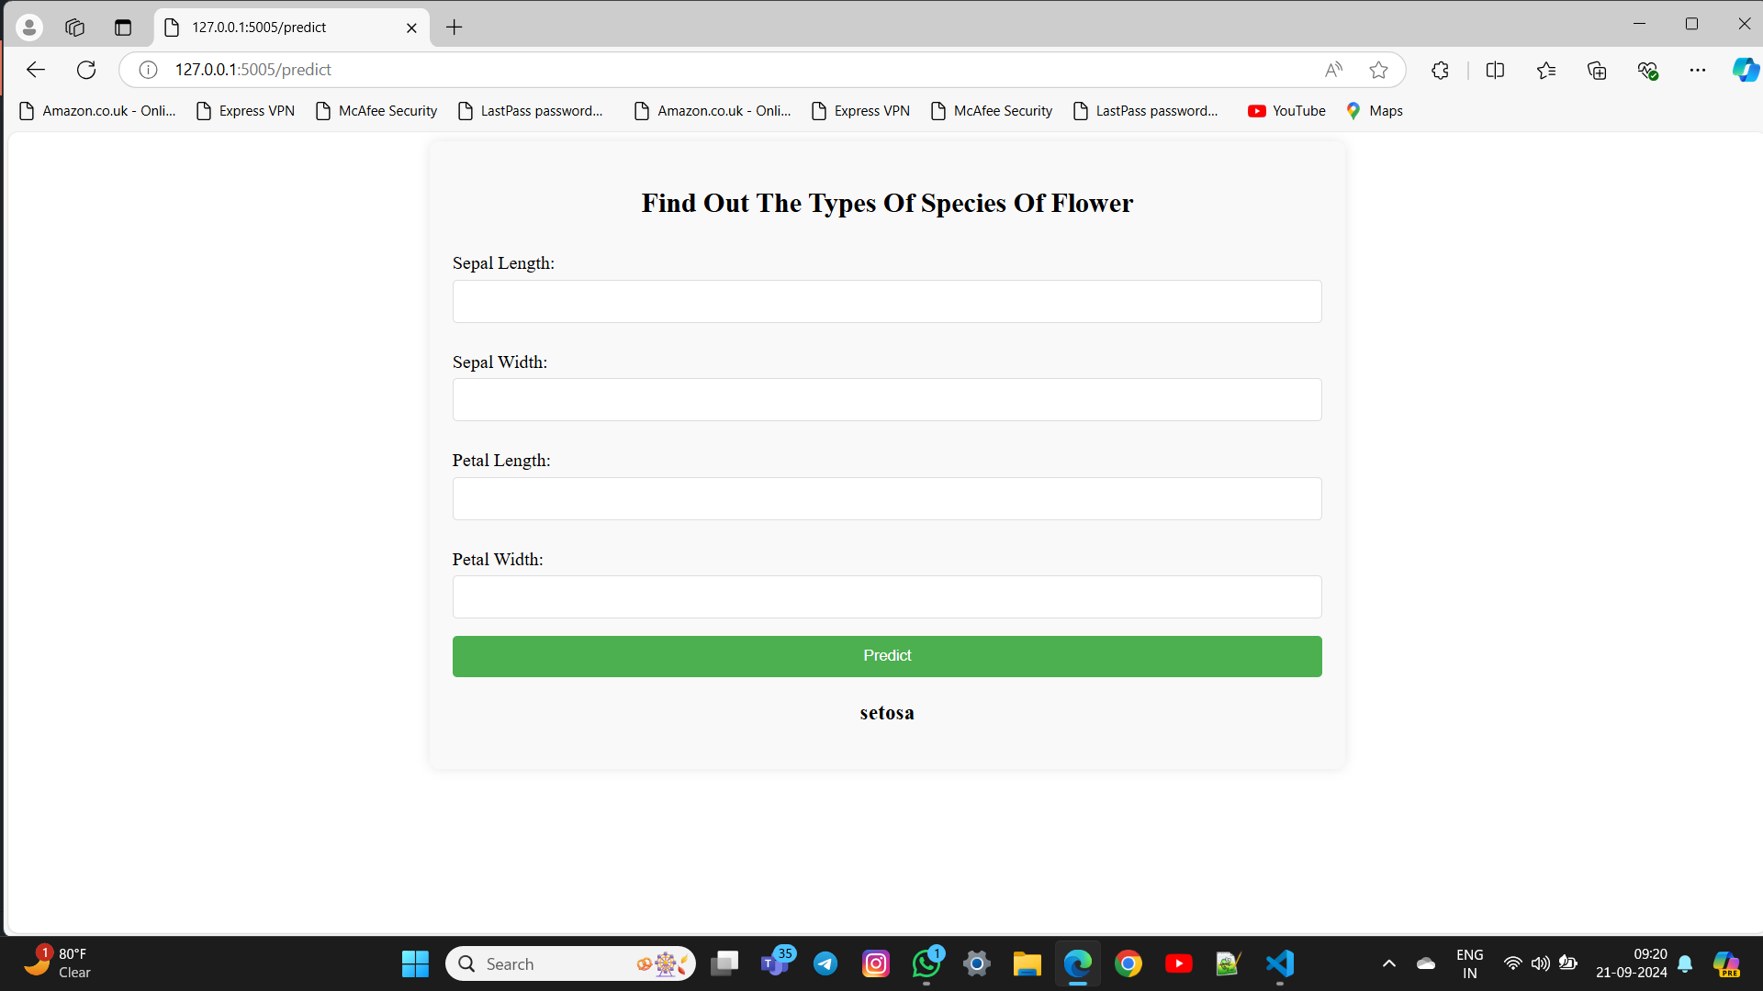
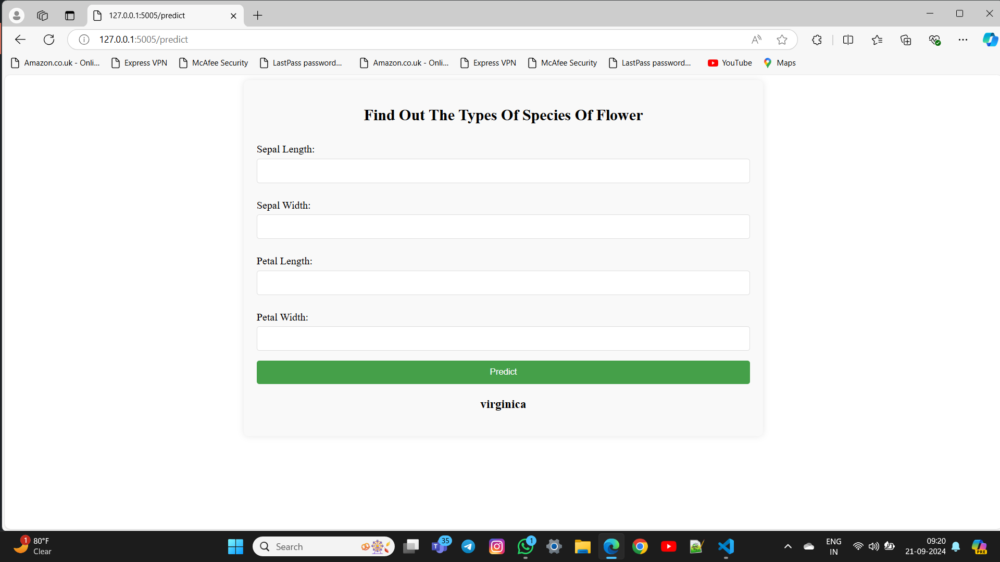

Output

Slide 15
Thank You

