Slide 1
Project of Presentation
Title: Medical Insurance Prediction Model Using Linear Regression
Subtitle: Industrial Training Project (BCA 551)
Presented by: Ankit Saini (Enrollment_No: TCA2201092), 5th Semester, Section: “C”
Project Guide: Mr. Ajay Rastogi
Institution: Teerthanker Mahaveer University, Moradabad
Date: November 2024

Slide 2
Introduction
Medical insurance cost estimation is crucial for both providers and consumers.
Objective: Predict insurance costs based on personal and medical information.

Slide 3
Dataset Overview
Source of dataset (mention if it’s public or proprietary).
Key attributes: Age, Body Mass Index(BMI), Smoking Status, Number of Children , etc.
Target variable: Insurance Cost.

Slide 4
Data Preprocessing
Handling missing values and data cleaning.
Encoding categorical variables (e.g., Gender, Smoker status).
Data normalization or scaling for numerical features.

Slide 5
Features
The project considers the following key features to estimate medical insurance costs accurately:
Age: Represents the age of the individual. Typically, older individuals may incur higher insurance costs due to increased health risks.
Gender: Captures the individual's gender as Male or Female. Gender-based risk factors may influence insurance premiums.
BMI (Body Mass Index): BMI reflects body fat and is calculated using weight and height. Higher BMI values often indicate greater health risks, impacting insurance costs.
Formula : BMI = Weight (kg) / [Height (m)]²
Children: Refers to the number of dependents or children. A higher number of dependents may increase the overall insurance premium.

Slide 6
Smoker: Specifies whether the individual is a smoker. Smoking significantly raises health risks and, consequently, insurance costs.
Region: Identifies the residential region of the individual. Different regions may have varying healthcare and insurance cost structures.
Southeast: Includes states like Florida, Georgia, Alabama.
Southwest: Includes states like Texas, Arizona, New Mexico.
Northeast: Includes states like New York, Pennsylvania, Massachusetts.
Northwest: Includes states like Washington, Oregon, Idaho.

Slide 7
Exploratory Data Analysis (EDA)
Key insights from the data:
Age vs. Insurance cost correlation.
Body Mass Index(BMI) and Smoking status impact on cost.
Visualizations: Scatter plots, bar charts, and histograms.

Slide 8
Model Selection
Algorithms tried (e.g., Linear Regression, Decision Trees, Random Forest).
Model selection based on performance and interpretability.

Slide 9
Model Training
Train-test split ratio.
Cross-validation approach (if used).
Hyper parameter tuning (Grid Search , Randomized Search).

Slide 10
Evaluation Metrics
Metrics used: MAE (Mean Absolute Error), RMSE (Root Mean Squared Error), R² score.
Evaluation results for the selected model.

Slide 11
Results and Interpretations
Best-performing model and its accuracy.
Key factors affecting insurance costs based on model output.

Slide 12
Results
Our linear regression model performed well on the test data, achieving an MAE (Mean Absolute Error) of 3,534.50, MSE (Mean Squared Error) of 25,306,900.17, and RMSE (Root Mean Squared Error) of 5,030.47. The scatter plot of the predicted versus actual values showed a strong linear relationship, indicating a good fit of the model and reasonable prediction accuracy.

Slide 13
Accuracy & Algorithm
Model Accuracy: 0.7064951721664848
Algorithm: Linear Regression
Formula: 𝑌=𝑚𝑋+𝑐
Y: Dependent variable
X: Independent variables (age, BMI, smoker status)
m: Slope y a coefficient of each independent variable
c: Y-intercept (constant term)

Slide 14
Challenges and Limitations
Challenges in data quality and availability.
Limitations like model bias, sample size, etc.

Slide 15
Future Scope
Potential model improvements.
Possible features to add (e.g., medical history, geographical data).

Slide 16
Conclusion
Summary of findings.
Relevance and potential impact of the model.

Slide 17
References
Geeks for Geeks
Kaggle
YouTube

Slide 18
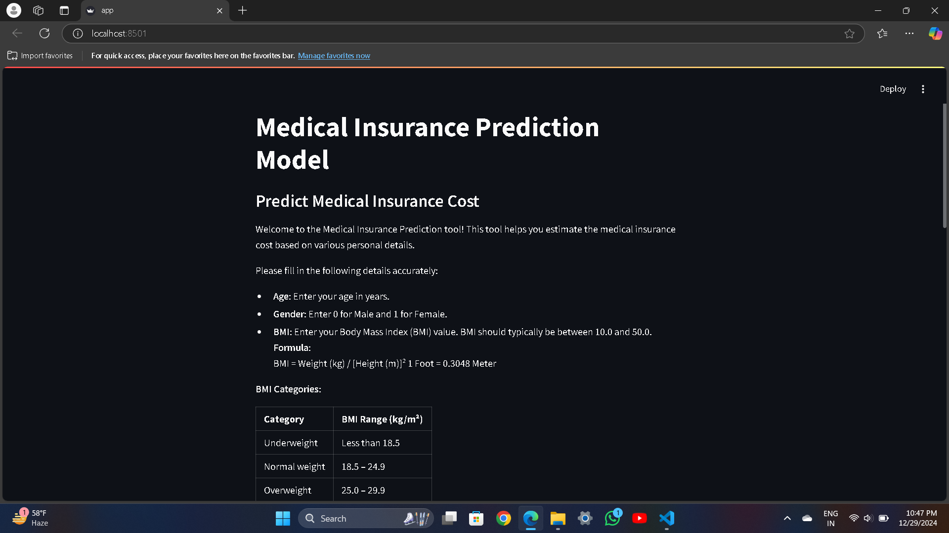

Slide 19
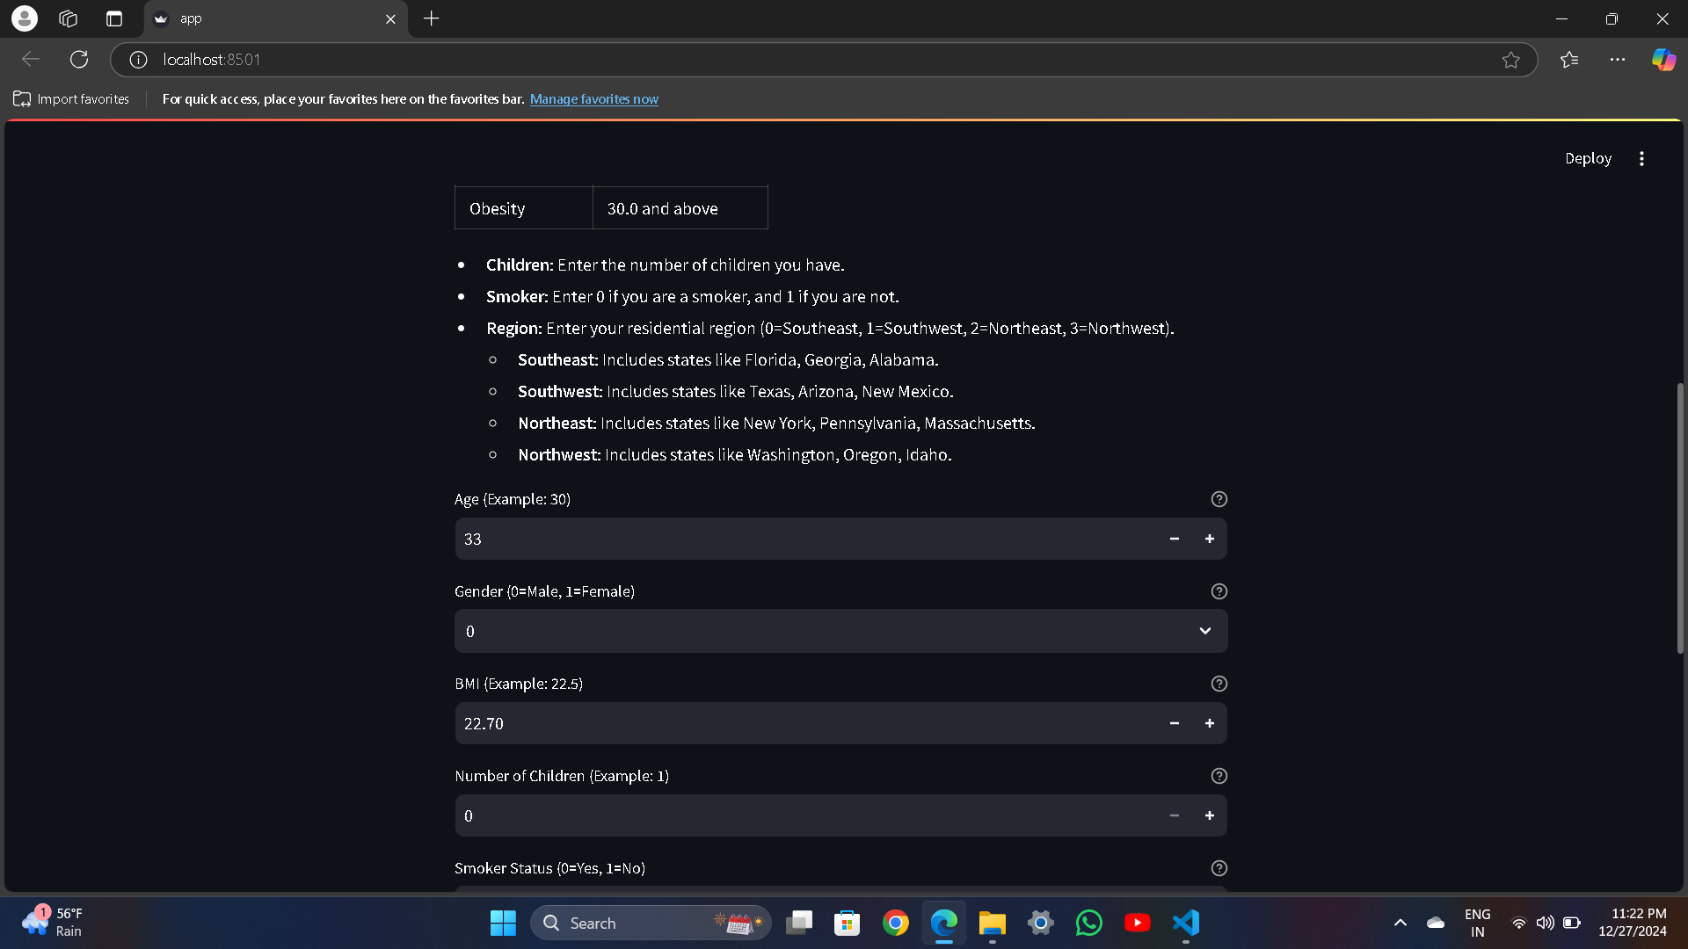

Slide 20
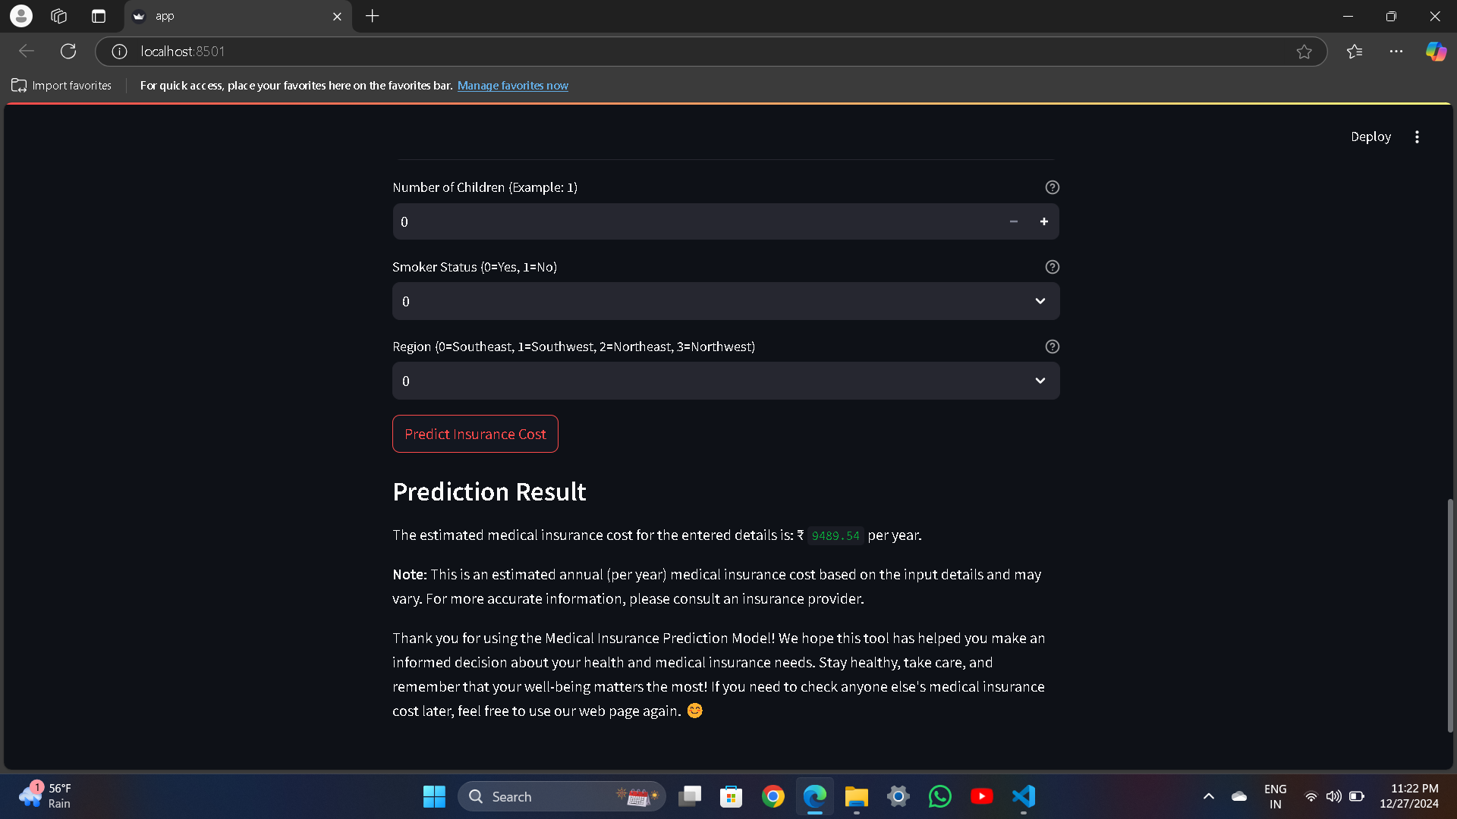

Slide 21
Thank You

