Slide 1
FREETOKEN · PROGRESS UPDATE
FreeToken: Reproduction, Experimental Analysis & Research Directions
PROJECT FOCUS
Reproducing FreeToken and investigating its behaviour across overlap, q execution, and routing locality.*
What we completed since 10 September 2026, what prefill overlap reveals, and where the bandwidth-derived q* policy diverges from measured latency.
paper reproduction → edge-device experiments → Prefill Overlap → q Policy → Routing Locality & LRU → Qwen vs GPT-OSS → proposed future investigations*
Research review · September 2026
Notes:
Frame the update around the reproduced experiment and the gap between the bandwidth-derived q* prediction and measured latency.

Slide 2

Since the last meeting, the core experiment is reproduced
1
Last meeting: 10 September 2026
2
Completed detailed reading and understanding of the FreeToken paper
3
Reproduced the key experiments
4
Implemented and experimented with FreeToken on our edge devices
Next focus: turn the reproduced measurements into decisions about overlap, routing, locality, and model-specific behavior.
Notes:
Use the four numbered rows as the progress report. The final strip transitions from reproduction to the next investigation.

Slide 3
Four follow-ups frame the next investigation
1
Prefill overlap: look for patterns beyond throughput and TTFT improvements.
2
q* policy and CPU bandwidth: measure host-bandwidth use when q* is removed or replaced by fixed execution.
3
Routing locality and LRU: compare original versus shuffled routing order to isolate temporal-locality benefit.
4
Qwen vs. GPT-OSS: investigate whether expert geometry or active-expert ratio explains measured bandwidth and execution differences, and whether the execution formula or pruning strategy should adapt.
Notes:
These four questions define the next phase: first understand overlap, then test the q* policy, isolate routing locality, and compare model behavior.

Slide 4
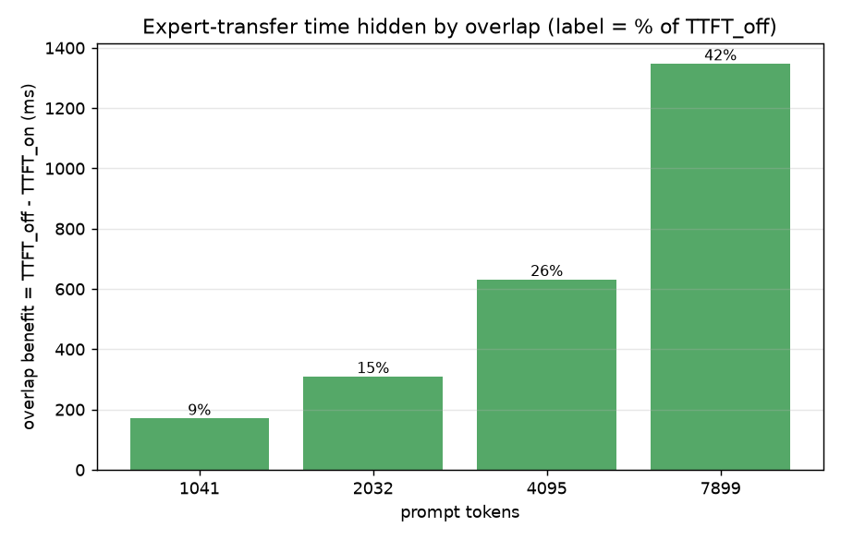
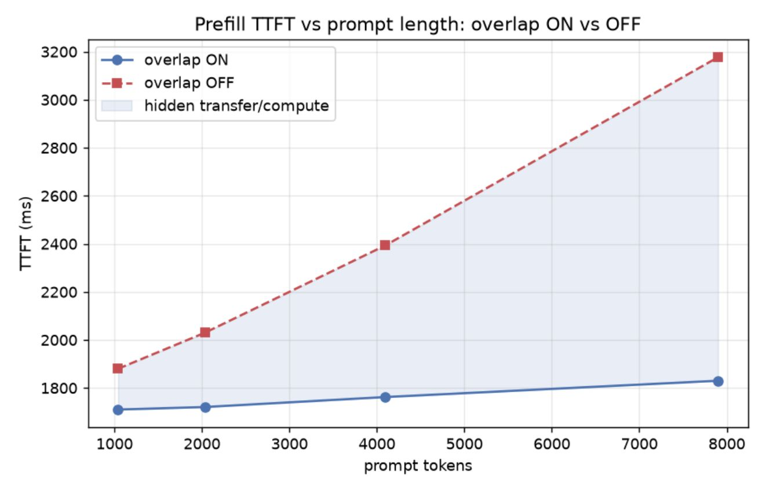
PREFILL OVERLAP · EVIDENCE 01
1. Prefill overlap keeps TTFT stable as prompts grow
Overlap ON remains comparatively stable while overlap OFF rises sharply with prompt length. The gap widens from 1,041 to 7,899 tokens.
Benefit: ≈ 9% at 1,041 tokens · ≈ 15% at 2,032 · ≈ 26% at 4,095 · ≈ 42% at 7,899
Takeaway: overlap hides an increasingly larger fraction of transfer/compute time as prompt length increases.
Notes:
Start with the shape of the curves: overlap ON stays comparatively stable as prompt length increases, while overlap OFF rises. The benefit grows from approximately 9% to 42%.

Slide 5

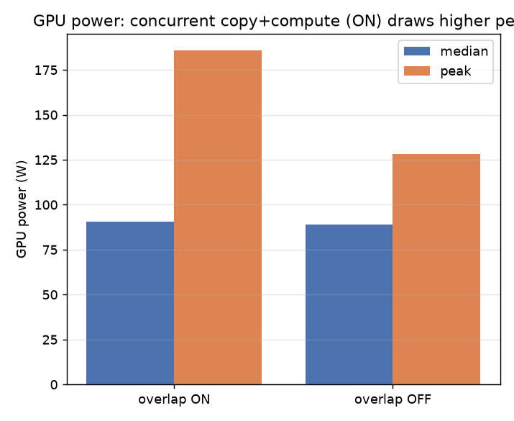
PREFILL OVERLAP · EVIDENCE 02
1. Prefill overlap hides more work, with a power trade-off
Hidden transfer/compute time grows from approximately 0.17 s at 1,041 tokens to 1.35 s at 7,899 tokens, while the corresponding benefit rises from 9% to 42%.
Hidden work grows with prompt length.
Peak GPU power: about 185 W ON versus 128 W OFF.
Key finding: concurrent copy + compute increases peak GPU power demand.
Notes:
Overlap hides more work as prompts grow, but concurrency has a cost: peak GPU power rises from about 128 W to about 185 W.

Slide 6
Q* POLICY · MODEL
2.FreeToken chooses q* by balancing two concurrent branches
For m cache-missing experts, q go to GPU and m−q execute on CPU; q* determines how many go to GPU so CPU execution and GPU transfer/execution finish at approximately the same time. Let S = expert size; BP = host-to-GPU bandwidth; BH = host-side CPU expert-processing bandwidth.
m
GPU BRANCH
CPU BRANCH
q → GPU
m−q → CPU
cache-missing experts
T_fill(q) ≈ qS / BP
T_CPU(m−q) ≈ (m−q)S / (BH−BP)
split into two concurrent branches
Concurrent execution: T = max(T_fill, T_CPU); balance T_fill = T_CPU
Derivation: qS/BP = (m−q)S/(BH−BP) → qBH = mBP → q* = m × BP/BH
Notes:
The model balances the GPU transfer branch against the CPU branch. q* determines how many cache-missing experts should go to the GPU so both branches finish at approximately the same time.

Slide 7
Q* POLICY · EXPERIMENT
2.Experiment: fixed q policies expose the CPU/GPU trade-off
Keep the model, hardware, resources, and workload fixed; change only the CPU/GPU split of cache-missing experts.
POLICY SPECTRUM
WORKLOADS
low_miss · med_miss · high_miss
q = 0
q = 25%
q = 50%, 75%
q = m
0% GPU
all CPU
fixed mixed split
100% GPU
no CPU
METRICS
more GPU
CPU traffic, CPU branch time, GPU/PCIe branch time, end-to-end latency, throughput, and branch balance.
q* · FreeToken’s bandwidth-derived adaptive decision
Notes:
Only the CPU/GPU split changes. The workload moves from low_miss to high_miss, and the measurements expose how CPU traffic, branch times, latency, throughput, and balance respond.

Slide 8
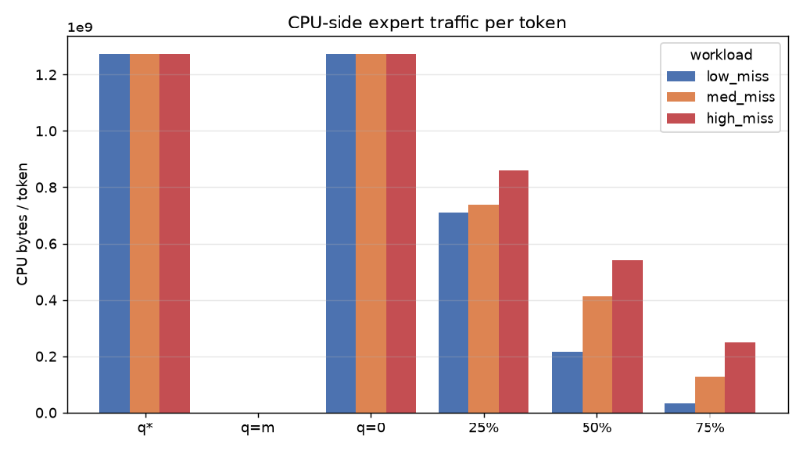
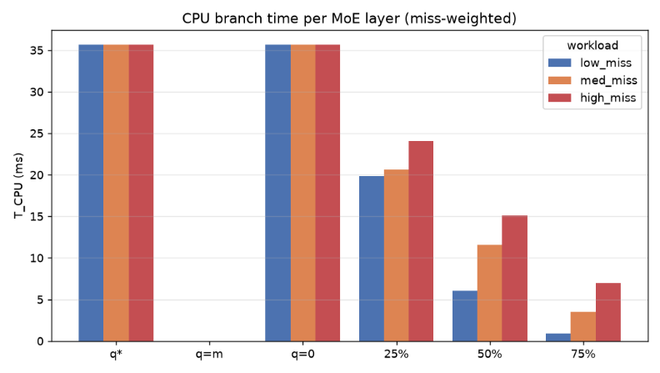
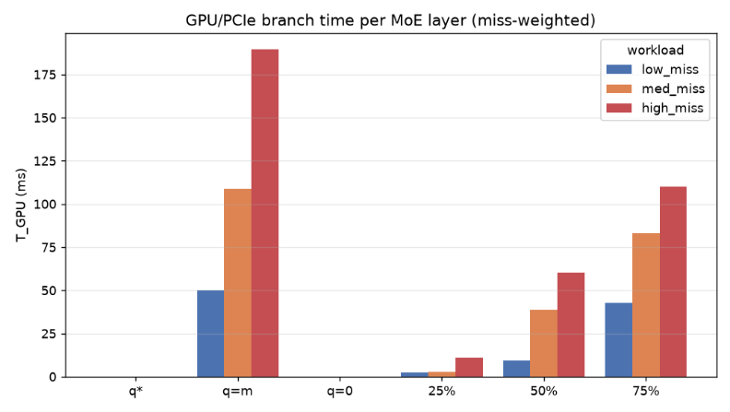
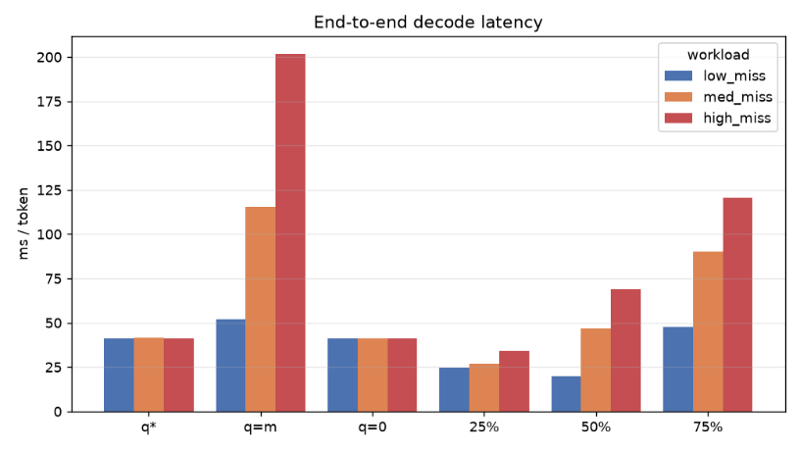
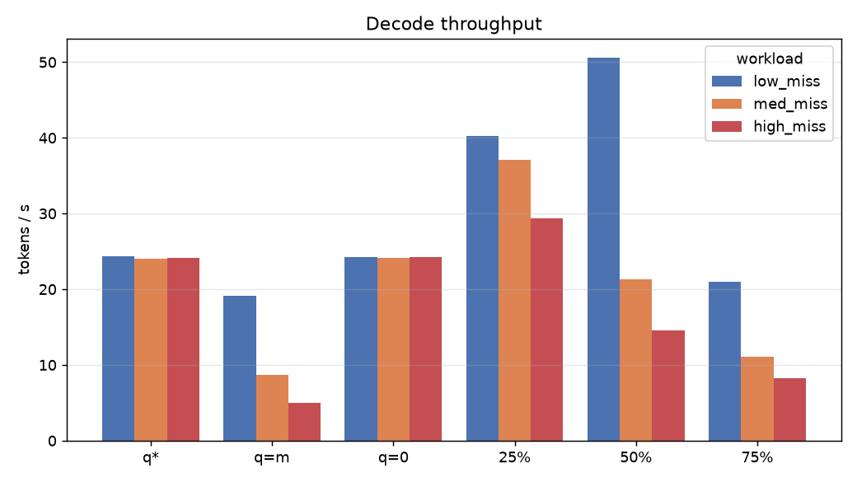
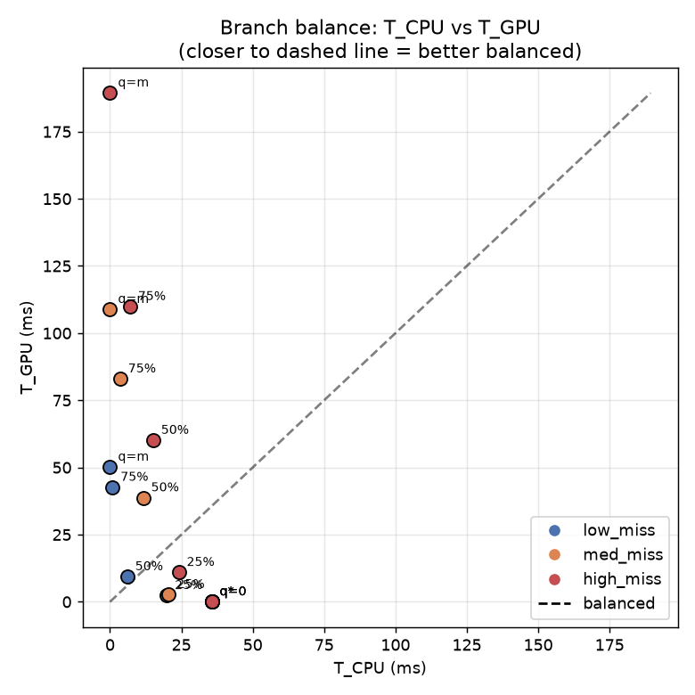
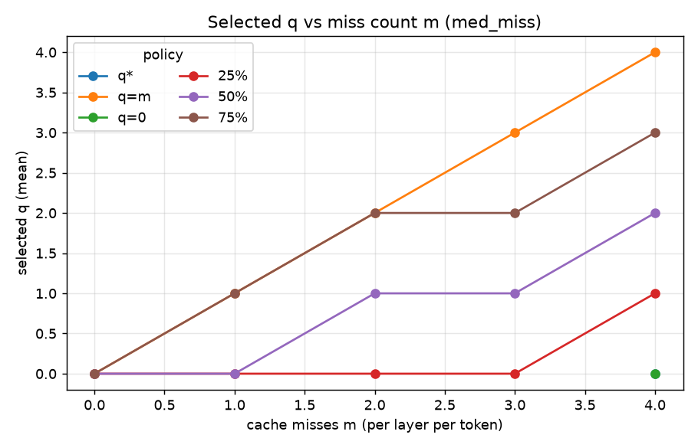
RESULTS · EVIDENCE WALL
2.What the results show: q*≈0, but q=25% wins on stability
The predicted q* and measured oracle q are approximately 0 in this configuration, so q* behaves essentially like q=0. Yet the measured end-to-end results show q=25% is substantially better across workloads.
CPU bandwidth
CPU execution
GPU execution
Decode latency
Tokens per sec
T_CPU vs T_GPU
m vs q
Measured distinction: q*=q=0 keeps CPU traffic near 1.27×10^9 bytes/token and CPU branch time near 36 ms/layer; q=25% cuts CPU branch time to roughly 20, 21, and 24 ms for low, medium, and high miss.
q=50–100% makes GPU/PCIe cost dominant, especially at high miss; q=m reaches roughly 190 ms. End-to-end latency: q=25% is about 25/27/34 ms versus about 42 ms for q*=q=0.
Research gap: for this hardware, model, and workload, the bandwidth-only q* decision does not correspond to the lowest observed latency. A richer policy may need CPU execution, PCIe transfer, GPU execution, and overlap costs.
Notes:
Close by preserving the distinction: the bandwidth model predicts q* approximately 0, but measured end-to-end latency favors q=25% across workloads. The conclusion is specific to this hardware, model, and workload; the research gap is a richer policy that includes execution, transfer, GPU, and overlap costs.

Slide 9
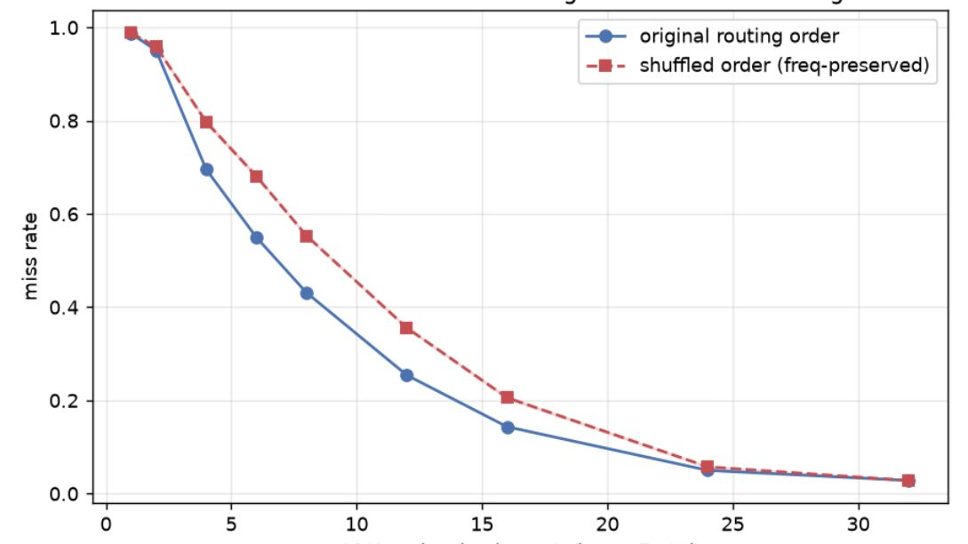
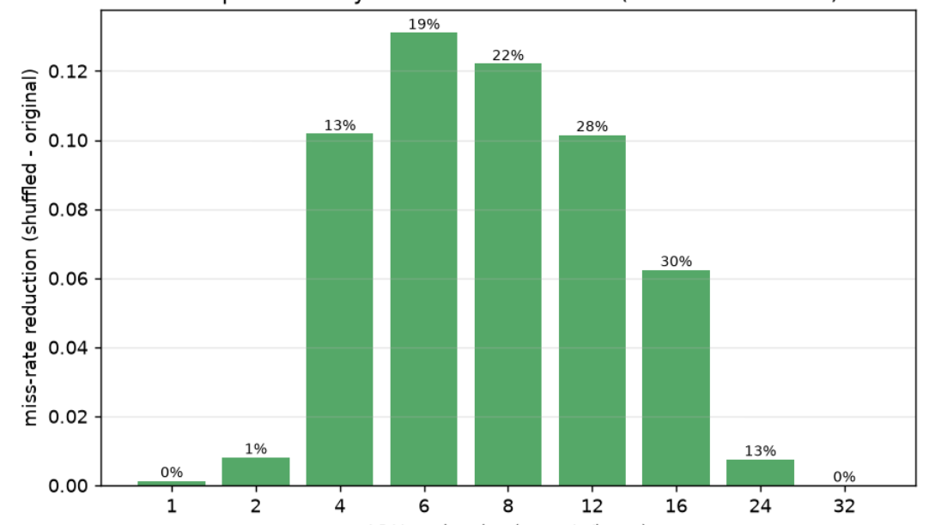
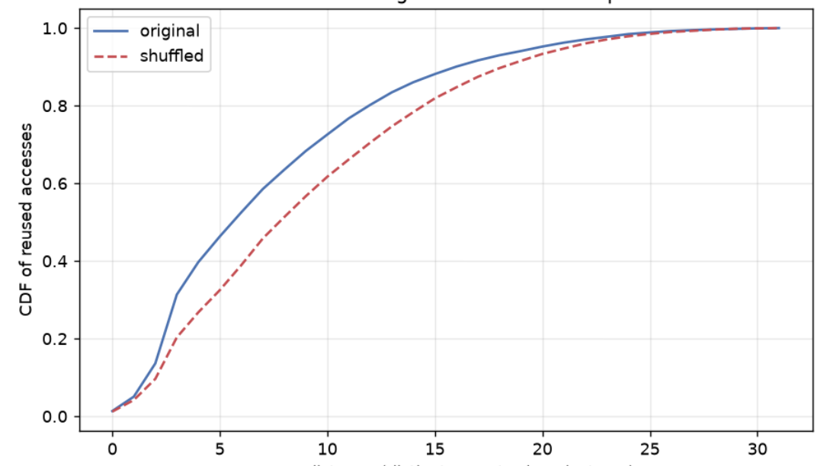
ROUTING LOCALITY · LRU CACHE BENEFIT
3.Preserving routing order improves LRU behaviour
Original order vs frequency-preserved shuffle
LRU miss rate · original routing is lower, especially at medium cache sizes
Temporal-locality benefit · about 30% around cache size 16
Reuse distance · original routing reuses experts sooner
Pattern: benefit is strongest around cache sizes 6–16 and disappears near full cache.
Notes:
Compare original routing with the frequency-preserved shuffled order. The three figures show lower miss rates, a temporal-locality benefit of about 30% around cache size 16, and earlier expert reuse under the original routing order.

Slide 10
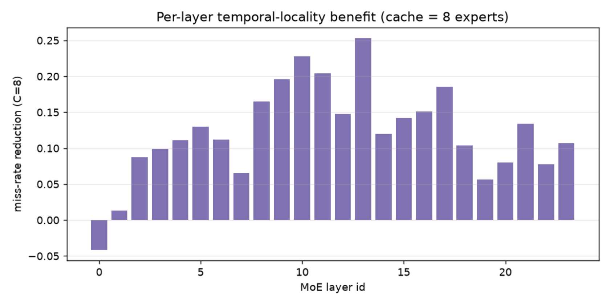
ROUTING LOCALITY · LAYER-WISE BEHAVIOUR
3.Temporal locality varies across MoE layers
Most layers show positive benefit, with some layers substantially higher.
At cache size 8: strongest layer-level benefit is around 25%.
Key takeaway: Preserving routing order improves LRU cache behaviour because experts are reused sooner; the benefit depends on cache size and MoE layer.
Notes:
The per-layer view shows that locality is not uniform across the network. Most layers benefit, but the strongest layer-level benefit at cache size 8 is around 25%.

Slide 11
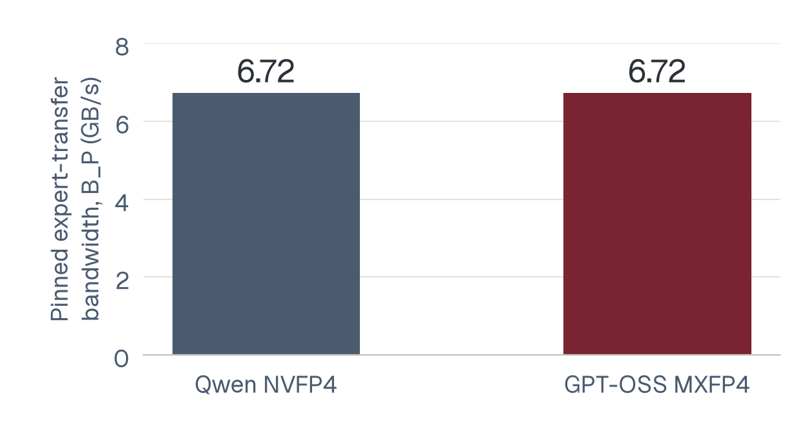
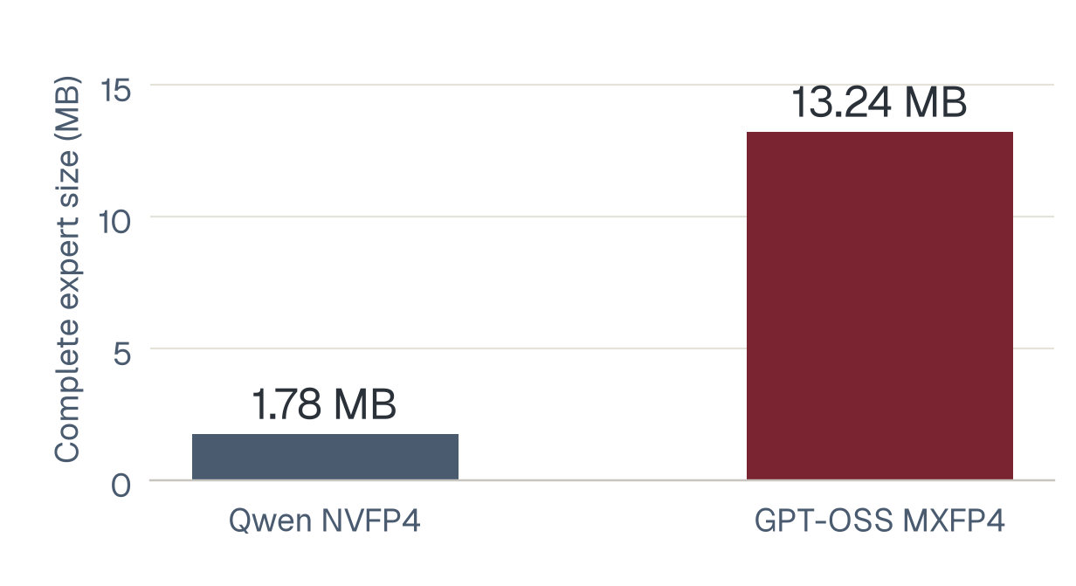
QWEN vs GPT-OSS · EXPERT GEOMETRY
4. Same link capacity, very different expert sizes
RTX 4070 (12 GB), Gen4 x4; five calibration repeats per model. Qwen: 40 layers, 256 experts/layer, top-8. GPT-OSS: 24 layers, 32 experts/layer, top-4.
Pinned expert-transfer bandwidth (B_P): 6.72 GB/s
GPT-OSS experts are about 7.45× larger
Finding: expert count alone does not explain bandwidth or memory demand.
Scope: Qwen3.6-35B-A3B NVFP4 / GPT-OSS-20B MXFP4.

Slide 12
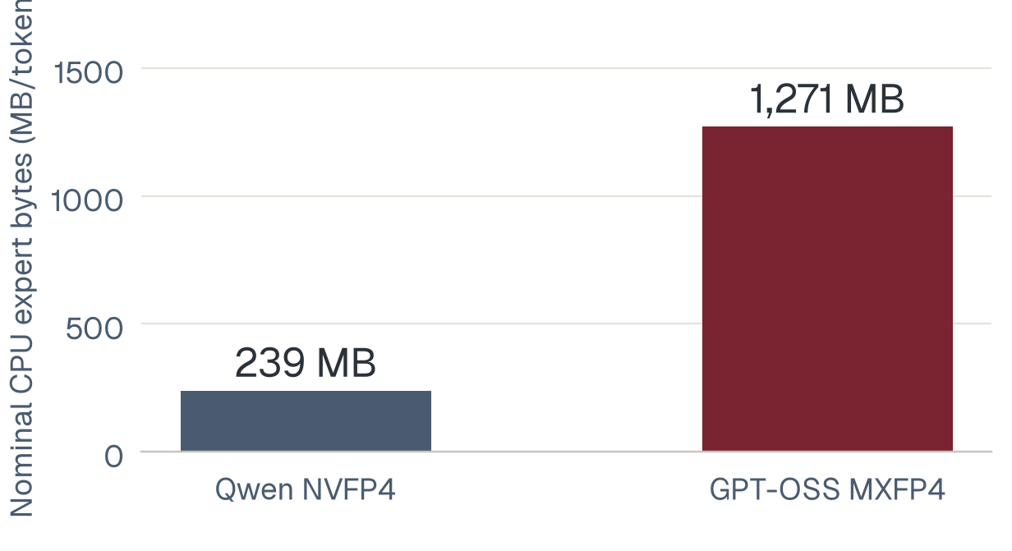
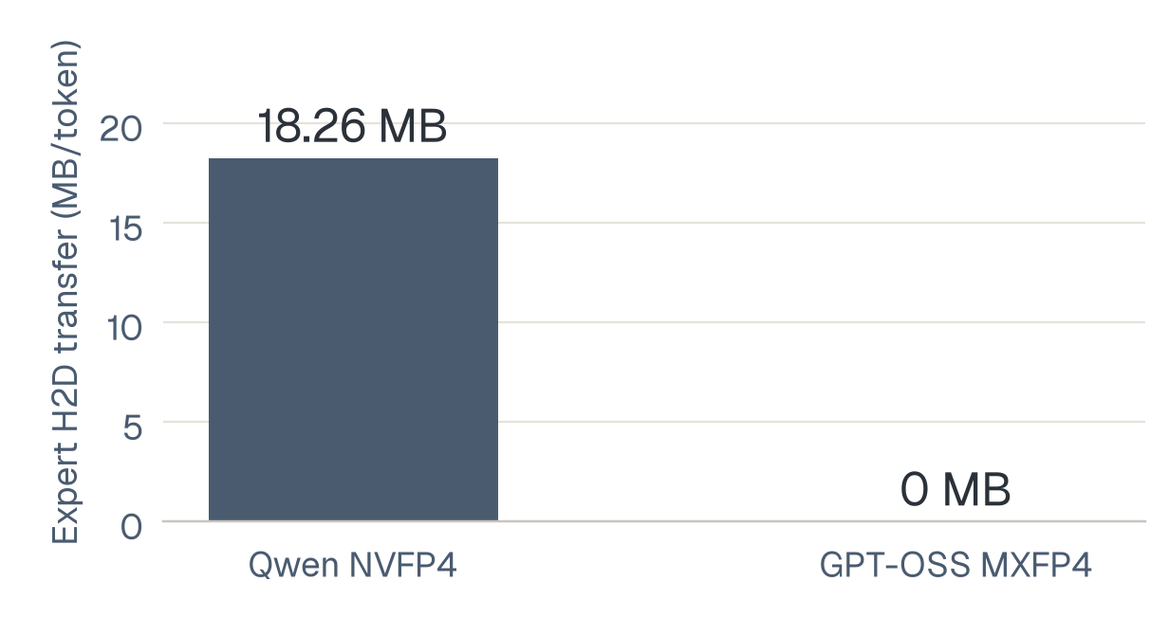
QWEN vs GPT-OSS · TRAFFIC & SPLIT VALIDATION
4. Zero GPU fills shifts expert work to the CPU
Measured 20%-cache hybrid trace: Qwen has 320 expert evaluations/token; GPT-OSS has 96. GPT-OSS chooses q=0 at four misses, so its observed expert cache stays empty.
CPU expert-byte demand: GPT-OSS is about 5.3× higher
Expert H2D: Qwen 18.26 MB/token; GPT-OSS zero
Oracle: 36 states / 8,000 trials; Qwen m=5 is state-dependent, not a blanket policy failure.
CPU bytes are logical weight accounting, not DRAM counters.

Slide 13
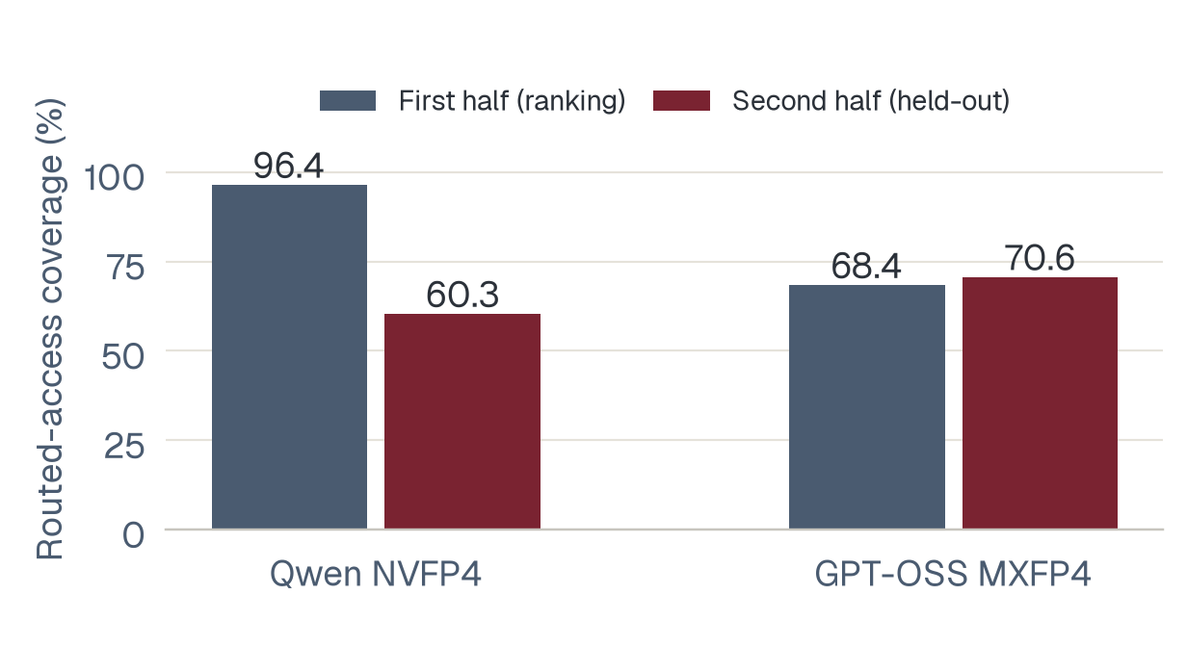
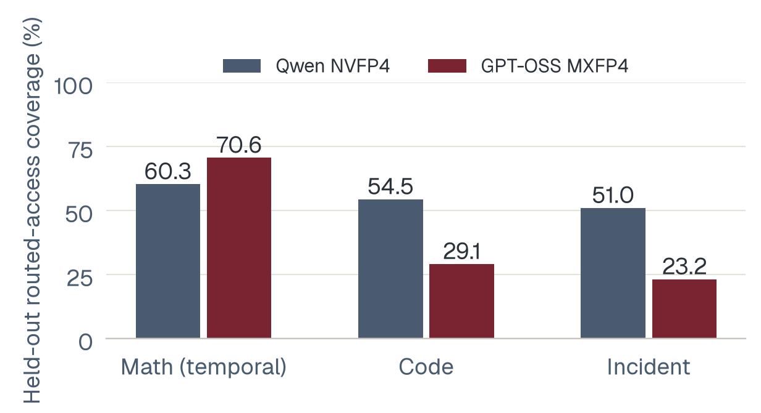
EXPERT PRUNING · HELD-OUT EVIDENCE
4. Expert popularity does not justify static pruning
Offline replay only: rank experts on math, retain the top 25%, and measure routed-access coverage. Test the later math tokens and separate code / incident requests (63 tokens each).
Temporal holdout: Qwen coverage falls 96.4% → 60.3%
Math-ranked experts generalize poorly across workloads
Conclusion: access coverage is not quality; no weights were pruned or speedup demonstrated.
Cross-workload ranking uses the full math trace; temporal ranking uses its first half.

Slide 14
FURTHER RESEARCH · FREE TOKEN
Further Research Directions for FreeToken
Four potential directions connect directly to FreeToken’s current architecture.
01
Beyond host-RAM capacity
02
Dynamic host-memory management
03
Size-aware caching and scheduling
04
Runtime-aware q selection
Notes:
These are scoped research directions and limitations, not claims of definitive novelty. Each extends a current FreeToken design choice.

Slide 15
DIRECTION 1 · MEMORY HIERARCHY
Beyond the Host-RAM Capacity Limit
Current architecture
Proposed extension
GPU VRAM → GPU Expert Cache → Host RAM → Complete Expert Pool
GPU → RAM → NVMe / Secondary Storage
Hot experts on GPU · warm experts in RAM · cold experts on NVMe
Host RAM is the source of truth when Expert Pool Size ≤ Available Host RAM.
Research question: How can expert residency be dynamically managed across GPU memory, host RAM, and NVMe when the complete expert pool cannot fit in host RAM?
The challenge is intelligent multi-tier residency based on bandwidth, latency, expert reuse, and memory capacity—not simply putting experts on SSD.
Notes:
FreeToken assumes the complete expert pool remains resident in host RAM. A tier below RAM could preserve the source-of-truth model while adding a cold tier for larger pools.

Slide 16
DIRECTION 2 · ELASTICITY
Dynamic Host-Memory Management
Today
Potential hierarchy
GPU memory is elastic: expert cache + KV cache.
NVMe → RAM cache → GPU cache
Under pressure, cold experts move to NVMe; when RAM returns, frequently used experts come back.
Host RAM’s complete expert pool is effectively resident.
Available RAM at t1 ≠ Available RAM at t2. Other applications, OS activity, containers, workloads, and runtime state can change the usable budget.
Research question: Can FreeToken dynamically manage host-memory expert residency in response to changing RAM availability and memory pressure?
Notes:
This direction extends FreeToken’s existing GPU-cache elasticity to the host-memory tier, rather than treating host RAM as an immutable pool.

Slide 17
DIRECTION 3 · BYTES, NOT COUNTS
Size-Aware Expert Caching and Scheduling
Simplified view
Heterogeneous reality
Expert 1 · Expert 2 · Expert 3
Expert A 5 MB · Expert B 5 MB
Expert C 18 MB · Expert D 18 MB
One expert = one cache unit.
Count does not equal memory or transfer work.
Byte-aware decisions: S_GPU = total bytes sent to GPU · S_CPU = total bytes executed on CPU
Allocation, eviction, admission, PCIe transfer, CPU execution, and q* scheduling may all need to account for size. Replacement could combine recency + expert size + reuse probability + transfer cost.
Research question: How should FreeToken’s expert caching and CPU/GPU scheduling change when experts have heterogeneous memory footprints?
Notes:
A 5 MB expert and an 18 MB expert should not necessarily be equivalent cache units. The right accounting unit may be bytes, transfer work, or execution cost.

Slide 18
DIRECTION 4 · POLICY ADAPTATION
Runtime-Aware q Selection
Current model
Observed scope
q* ≈ m × BP / BH
Tested: q*, 0%, 25%, 50%, 75%, 100%
m = cache-missing experts
BP = host→GPU bandwidth
BH = host-side processing bandwidth
For the tested model, hardware, and workloads, q* ≈ 0 while q=25% had lower end-to-end decode latency. Higher q increased GPU/PCIe cost, especially at high miss rates.
Future policy: q = f(BP, BH, CPU cost, GPU cost, transfer cost, overlap, resource utilization, workload)
The bandwidth-ratio model may not capture every runtime cost affecting the best CPU/GPU split. This does not make q* universally incorrect; it motivates broader signals.
Research question: Can a runtime-aware q-selection policy choose the CPU/GPU expert split more accurately than a bandwidth-only q* model?
Notes:
The result is scoped: in the tested configuration, the bandwidth-derived q* did not correspond to the lowest measured end-to-end latency. A runtime-aware policy could incorporate utilization, overlap, memory pressure, and current workload.

