Slide 1

LAST WEEK · CONTEXT 01
FreeToken reproduction and experimental context
Reproduction complete
Read the paper, reproduced the key experiments, and tested FreeToken on our edge devices.
Overlap and locality
Prefill overlap improved TTFT as prompts grew. Preserving routing order improved LRU cache behaviour.
Model geometry and retention
Qwen and GPT-OSS had different expert sizes and routing patterns. Static popularity rankings lost coverage on held-out workloads.
This week
8 October 2026: focus on choosing the CPU/GPU split using runtime state.
Notes:
This is the context from the 1 October deck. The project already reproduced the execution pipeline, studied prefill overlap, tested fixed CPU/GPU splits, and measured routing locality. Overlap benefit grew from about 9% to 42% across the tested prompt lengths. Original routing had about 30% locality benefit near cache size 16. The model comparison also showed that expert counts alone do not explain bytes or execution cost. The static-retention experiment measured routed-access coverage only, not model quality or actual pruning speedup. These observations motivate the two objectives on slide 3.
Sources: FREE_TOKEN_PROGRESS_1-10-2026 (1).pptx, slides 2, 4–5, 9–13.

Slide 2
WEEKLY OBJECTIVES · 8 OCTOBER 2026
Two objectives for this week
1
Runtime-aware q selection
Choose the CPU/GPU expert split using CPU cost, GPU cost, transfer cost, overlap, and resource utilization beyond the bandwidth-derived q* formula.
2
Adaptive reduction of m
Study selective expert pruning or retention across MoE model families and expert sizes, then use those observations to adapt q selection.
Notes:
Introduce both tasks assigned last week. Objective 1 investigates the decision for a known missing set. Objective 2 asks whether pruning or retention can change the missing set itself, across models and expert sizes. Objective 2 belongs to my team member. No new pruning result is claimed in this presentation.
Sources: User-provided weekly objectives.

Slide 3
OBJECTIVE 2 · STATIC PRUNING
Can a fixed expert set reduce missing work?
Retain the most frequently accessed 75% per layer
Fit task-specific and mixed expert rankings on calibration requests. Shared branches remain active; native top-k routing is recorded before masking.
Collect and evaluate held-out routing
90 distinct requests per checkpoint: 30 math, 30 code, 30 incident. Five grouped folds; 18 extra captures of nine requests assess repeat sensitivity.
Separate coverage from systems effects
Measure access coverage, retained routing weight, workload transfer and ranking stability. Replay cache demand with fixed and reduced cache budgets.
Scope
This stage measured routing and conditional cache replay. Task quality and serving speed were unmeasured.
Notes:
Completed static study before actual M75 autoregressive inference. Source: closeout75/report.md, protocol/protocol.json, retention75/summary.csv. 90 independent requests/model and 18 additional repeat captures/model; repeats are not independent tasks. Native routes were captured with complete checkpoints; no weights were physically removed. U/F/R are separate cache replay interventions, not the running inference study.

Slide 4
EXPERIMENT · MODEL CONFIGURATIONS
Three supported MoE configurations on one device
Checkpoint | Layers | Experts / retained | Top k | Cache slots
nvidia/Qwen3.6-35B-A3B-NVFP4 | 40 | 256 / 192 | 8 | 2048
openai/gpt-oss-20b | 24 | 32 / 24 | 4 | 154
nvidia/Gemma-4-26B-A4B-NVFP4 | 30 | 128 / 96 | 8 | 768
Retained experts are per layer. Checkpoint precision: Qwen/Gemma NVFP4; GPT-OSS MXFP4.
RTX 4070 (12 GB) + Ryzen 5 8500G
FreeToken hybrid execution; one request at a time; CUDA graphs disabled. Gemma used text-only mode, memory ratio 0.8 and a 1,280-token sequence limit.
Controls
Exact revisions and cache budgets were frozen. Kimi was excluded; shared experts were not ranked.
Notes:
Source: closeout75/checkpoint_lock.csv and qualified_resources.csv; model-specific protocol/configuration artifacts. Full checkpoint revisions: [{"model": "qwen_nvfp4", "checkpoint": "nvidia/Qwen3.6-35B-A3B-NVFP4", "revision": "1355db6a052410cfd62085d94b58866fd0f2c3c5", "layers": "40", "experts_per_layer": "256", "native_top_k": "8", "retained75_per_layer": "192", "expert_bytes": "1775616", "cache_slots": "2048", "cache_bytes": "3636461568"}, {"model": "gpt_oss_mxfp4", "checkpoint": "openai/gpt-oss-20b", "revision": "6cee5e81ee83917806bbde320786a8fb61efebee", "layers": "24", "experts_per_layer": "32", "native_top_k": "4", "retained75_per_layer": "24", "expert_bytes": "13236480", "cache_slots": "154", "cache_bytes": "2038417920"}, {"model": "gemma_nvfp4", "checkpoint": "nvidia/Gemma-4-26B-A4B-NVFP4", "revision": "a19cfe00be84568a6867111c9a68c9c44fdcffe6", "layers": "30", "experts_per_layer": "128", "native_top_k": "8", "retained75_per_layer": "96", "expert_bytes": "3353856", "cache_slots": "768", "cache_bytes": "2575761408"}]. Qwen/GPT primary v5; Qwen repeat allocator v6 separately qualified. Gemma cache 768, prefill 1024, max sequence 1280, memory ratio .8. Same physical hardware does not make model hidden states or quantization layouts identical.

Slide 5
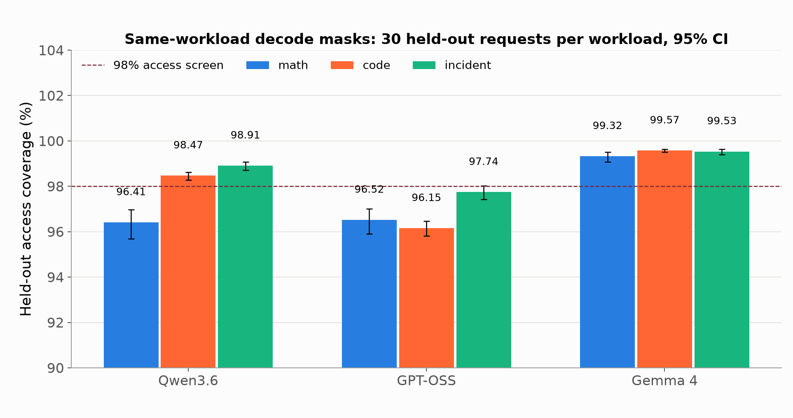
STATIC PRUNING · HELD-OUT COVERAGE
Task-specific masks preserve most decode accesses
Reading
Gemma reaches 99.32-99.57% coverage. Access coverage alone does not establish answer quality.
Notes:
Source: closeout75/primary_summary.csv. Same-workload decode-derived top-75% masks, five grouped folds; held-out request macro coverage, 30 requests/workload/model. Error bars are 95% request bootstrap intervals conditional on fitted masks (10,000 resamples), not between-fold intervals. The 98% line is an access screening threshold; passing it does not satisfy all activation gates. Y-axis starts at 90% to show differences. All source cells saved in chart_source_rows.json.

Slide 6
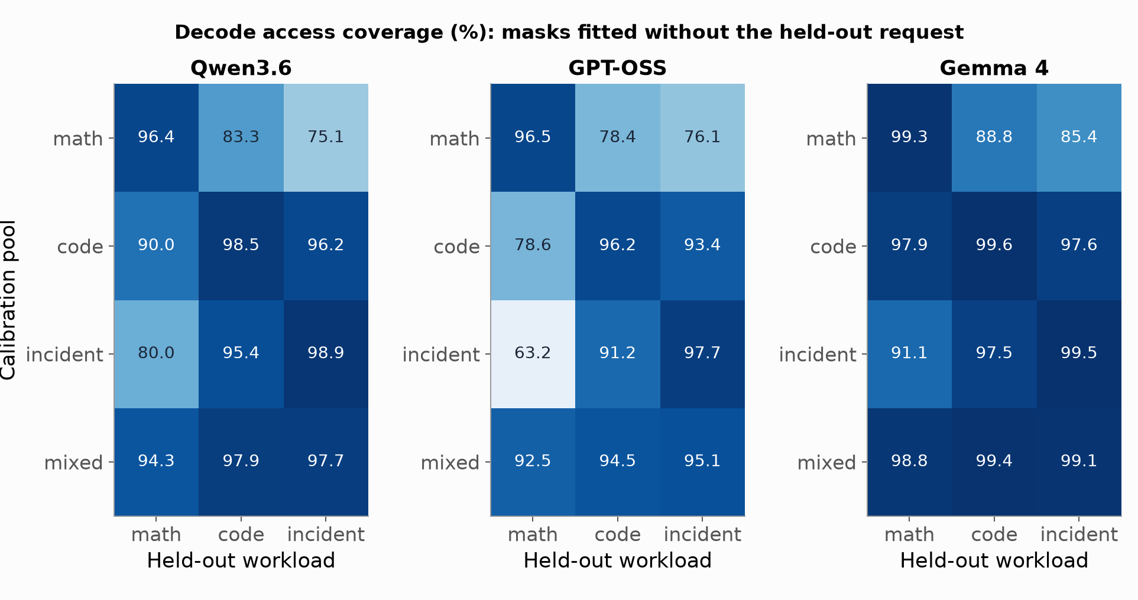
STATIC PRUNING · WORKLOAD TRANSFER
A task-specific mask can lose coverage on another task
Transfer
GPT-OSS incident mask: 97.7% on incident, 63.2% on math. Mixed rankings trade specialisation for coverage.
Notes:
Sources: retention75/summary.csv and additional/gemma_v1/retention75/summary.csv. Each heatmap cell is held-out macro decode access coverage (%), 30 requests. Rows identify the mask calibration pool; columns identify held-out evaluation workload. Masks fitted without the held-out grouped fold. No causal cross-architecture comparison: tokenizations and generated routes differ. Blue color scale is fixed at 60-100% across panels. Exact cells in chart_source_rows.json.

Slide 7
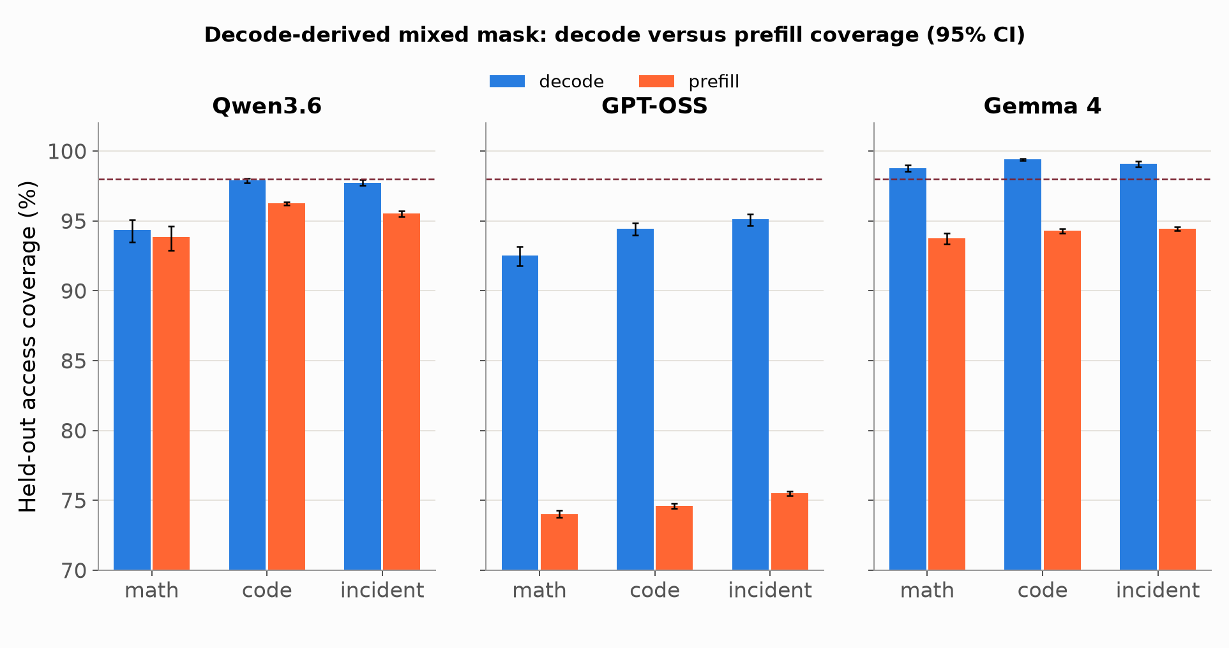
STATIC PRUNING · PREFILL TRANSFER
Decode rankings transfer poorly to prefill
Phase shift
GPT-OSS mixed mask retains about 74-76% of prefill accesses versus 93-95% of decode accesses.
Notes:
Sources: retention75/summary.csv and additional/gemma_v1/retention75/summary.csv. Every mask is decode-derived and calibrated on the mixed pool. Held-out prefill and decode evaluated separately on 30 requests/workload. Error bars are request bootstrap 95% intervals conditional on fitted masks. The 98% screen is dashed; y-axis starts at 70%. Phase values are paired observations, not independent task samples. Exact source cells in chart_source_rows.json.

Slide 8
STATIC PRUNING · RANKING STABILITY
Stable rankings can still omit important routes
Model | Retained-set Jaccard | Random reference | Excess overlap
Qwen3.6 | 0.891 | 0.600 | 0.291
GPT-OSS | 0.943 | 0.601 | 0.342
Gemma 4 | 0.937 | 0.601 | 0.336
Mean per-layer Jaccard across disjoint calibration halves; mixed decode mask, 75% retained.
All three clear the 0.10 excess-overlap screen
Retained sets overlap more than random 75% masks. The layer/subset comparisons are dependent; high overlap does not guarantee coverage across tasks or phases.
Sensitivity
18 additional captures per checkpoint assess repeat sensitivity; they do not add independent tasks.
Notes:
Sources: retention75/stability.csv; additional/gemma_v1/retention75/stability.csv; closeout75/masking_decisions.json; repeatability75 completion records. Rows restricted to kind=disjoint_halves, phase=decode, pool=mixed. Means over dependent comparisons: Qwen 2000, GPT-OSS 1200, Gemma 1500. Random reference is empirical random_reference, not assumed exactly 0.6. Excess equals the averaged observed-minus-reference Jaccard. Do not assign these comparisons independent confidence intervals.

Slide 9
STATIC PRUNING · NATIVE CACHE REPLAY
Rerouting gives little benefit at the fixed cache budget
Model / workload | Fixed-cache reduction | 75%-cache reduction | Scope
Qwen / math | 2.24% | -4.73% | 3 requests
Qwen / code | 0.96% | -4.30% | 3 requests
Qwen / incident | 0.87% | -5.05% | 3 requests
GPT-OSS / each task | 0.00% | 0.00% | 3 requests/task
Gemma / all tasks | 0.46% | -9.51% | 9 requests
Relative reduction in missing experts/event under cold calibrated-hybrid R replay. Negative = more misses.
Replay scope
R reroutes at recorded original hidden states. These are demand estimates; latency was not measured.
Notes:
Sources: replay75/summary.csv (Qwen/GPT R, mixed, cold, calibrated_hybrid); additional/gemma_rerouting_v2/native_controls75/R75_summary.csv (Gemma nine-request aggregate). Baseline is original fixed cache in both budget columns. Reduced slots: Qwen 1536 vs 2048, GPT-OSS 116 vs 154, Gemma 576 vs 768. U replays original routes; F deletes excluded original accesses and lowers active k; R recomputes native masked top-k on unchanged recorded hidden states and preserves native k. This table uses R only. GPT hybrid remains at m=4 with q=0; unconditional-fill diagnostics differ and are not interchangeable. Gemma's repaired router includes native projection, learned expert scaling and original dtypes; 100% eligibility weights reproduce exactly, all 12 native cold cache controls matched. Gemma hybrid fractions reused Qwen NVFP4 calibration, so no Gemma-specific optimal split is established. Cold and post-prefill coincide for Gemma because observed initial cache is empty. Gemma fixed delta m=-0.0138562 with paired 95% CI [-0.0201311,-0.0072763]. Nine requests/model are descriptive conditional replay evidence, not a broad serving benchmark.

Slide 10
STATIC PRUNING · DECISION AND NEXT STEP
No checkpoint passed every static activation check
Coverage and stability answer different questions
Require access-CI lower bound >= 98%, retained-weight-CI lower bound >= 99%, and protection for weak requests, layers and 64-token windows. Ranking stability passed.
The systems screen also failed
Native R replay needed at least 5% fixed-cache miss reduction in every workload. Qwen reached 0.87-2.24%; GPT-OSS 0%; repaired Gemma averaged 0.46%.
Next: actual inference with 25% of experts excluded
A separate autoregressive 75%-retention study is evaluating task quality and serving performance despite the failed static screens. The 60% and 50% ablations follow later.
Conclusion
Static routing evidence did not qualify deployment. The current inference study has its own evaluation.
Notes:
Sources: closeout75/masking_decisions.json, closeout75/report.md, additional/gemma_rerouting_v2/report.md, docs/MoEPruningActualInferencePlan.md. Original static gates also require request p5>=.95, every workload/layer mean>=.95, every complete rolling64 window>=.90, disjoint mean excess Jaccard>=.10, and paired delta CI upper<0 with >=5% reduction in every workload. All three were skipped_by_gate in the original closeout; Gemma native R was unavailable then and subsequently repaired without changing the frozen original report. Gemma aggregate .46% is not a per-workload estimate. Current M75 exploratory inference is separately authorised; no current results are included on these slides. Physical checkpoint compaction and measured memory savings are not claimed. 60/50 retention is deferred until current 75% work is finished.

Slide 11
Notes:
Reserved for the current actual 75%-retention inference study once its report and serving measurements are final. Intentionally empty.

Slide 12
Notes:
Reserved for the current actual 75%-retention inference study once its report and serving measurements are final. Intentionally empty.

Slide 13
OBJECTIVE 1 · MOTIVATION
A broader policy for choosing q
q = f(m, B_P, B_H, CPU cost, GPU cost, transfer cost,
overlap, utilization, workload, reuse, cache state)
1. Runtime-aware learned policies
Use runtime context to predict the cost of each valid q. We experimented with statistical ML, neural networks, and contextual bandits.
2. Reuse-Aware analytic policy
Estimate the immediate cost of fetching and the future CPU work saved while the expert remains in cache.
Main question
Which signals improve the actual decision, and how simple can the policy be?
Notes:
The expanded function is a research question rather than a claim that every signal must remain in the final policy. We explored a data-driven approach and an analytic approach. Statistical ML included linear regression, ridge, a tree and gradient boosting. The neural model was a GELU MLP. The RL-style experiments were contextual bandits, not a full long-horizon deep-RL controller. The feature study then helped identify the missing mechanism: a fetch changes future cache hits.
Sources: README.md, introduction; FreeToken_q_selection_report.pdf, sections 3, 6 and 7.

Slide 14
RUNTIME-AWARE POLICY · FORMULATION
Predict cost for context x and candidate q
(x, q) → L(x, q)
q* = argmin L(x, q) for q ∈ {0, …, m}
x is the information available before the action
Current routing and cache state, plus timing and utilization observations already available from earlier calls.
89 candidate runtime features
63 retained = 89 − 6 constants − 20 near-duplicates
q is an action input, separate from the runtime context.
Notes:
Read the top equation as: for the same observed context x, what cost does the model predict if we choose q? The selected q is the legal candidate with the smallest predicted cost. On this slide, the star denotes the learned minimum-cost decision. L is predicted execution cost, distinct from the regression training loss. The reported screening removed six constant signals and twenty near-duplicates with absolute Spearman correlation above 0.98. The constants included calibrated bandwidths, top_k, expert size, CPU thread count and routed-unique count. They remain physically meaningful but cannot explain variation on this single setup. Future observations are never included in x.
Sources: PROGRESS.md, steps 3–4; FreeToken_q_selection_report.pdf, sections 4.1–4.3 and 7.

Slide 15
RUNTIME FEATURES · 1 OF 2
Features describing current execution cost
Family (candidate / kept) | Example signals | Question the family answers
Base (3 / 1) | m, calibrated B_P and B_H | How much missing work must be split?
Routing (6 / 2) | Layer, decode position, hits, miss ratio | Where are we, and what does routing request?
CPU (4 / 3) | CPU time/expert, prior task time, recent B_H | How expensive is host expert execution?
GPU (2 / 2) | Prior and smoothed GEMM time | How busy or costly is GPU computation?
Transfer (5 / 2) | PCIe time/expert, prior q and bytes | How expensive is moving experts to GPU?
Overlap (6 / 5) | Prior branch times, imbalance, exposed wait | Which branch determines visible latency?
Timing rule
Current-call CPU, GPU and PCIe outcomes become inputs only for later decisions.
Notes:
These are candidate families, so some example signals are removed during screening. Base ultimately retains m because the calibrated bandwidths are constant. Routing describes which layer and decode position we are in and how many requests hit. CPU, GPU and transfer measurements use previous observations and exponential moving averages, or EWMAs. An EWMA weights recent timings more heavily. The GPU timer covers GEMM for both cache hits and fetched experts. Overlap asks whether a cost is actually on the critical path. The retained counts here sum to 15.
Sources: FreeToken_q_selection_report.pdf, section 4.1, Table 5 and section 3.2.

Slide 16
RUNTIME FEATURES · 2 OF 2
Features describing cache value and runtime state
Family (candidate / kept) | Example signals | Question the family answers
Cache (11 / 10) | Free slots, LRU age, occupancy, churn | How long can a fetched expert stay useful?
Reuse (10 / 10) | Recent frequency, recency, routing entropy | How likely is this expert to be requested again?
Utilization (4 / 4) | Host CPU, GPU utilization, load average | Is other activity competing for resources?
Memory (3 / 2) | Free GPU memory, available host memory | Does the memory budget constrain execution?
History (35 / 22) | Rolling means over 1, 4, 8, 16, 32 visits | Do recent trends improve cost estimates?
These families retain 48 signals. Together with the previous slide: 63.
Unavailable
Direct PCIe utilization, memory-bandwidth counters and CPU queue depth were unavailable.
Notes:
Cache and reuse describe different mechanisms. Reuse asks whether a future request is likely. Cache state asks whether the fetched weight survives until that request. Churn records insertions and evictions over a recent window. LRU victim age is elapsed tokens since the potential victim’s last use, not its actual insertion-to-eviction lifetime. It will serve as a heuristic for the current cache lifetime scale. History includes rolling means of m, hits, q, layer wall time, CPU time, GPU time and PCIe time. Memory includes decode position as a proxy because direct KV-cache occupancy was not exposed. Unavailable counters were documented, not silently assumed.
Sources: FreeToken_q_selection_report.pdf, section 4, Tables 5–6.

Slide 17
EXPERIMENT · DATA COLLECTION
Record the context, action and measured outcome
Before the decision
Routing and cache lookup identify m. The hook records x, then the policy selects q ∈ {0, …, m}.
After execution
CPU and GPU branches run concurrently. CPU timers and CUDA events record layer, CPU, PCIe and GEMM costs.
Collection round | Episodes | Decision rows
Exploration: random q and exploratory base policies | 48 | 292,608
Round 2: rule and Ridge with ε-exploration | 18 | 109,728
Total logged | 66 | 402,336
Training data
Fit cost models only on the 310,896 rows with randomized actions.
Notes:
The study hooks into ensure_experts_hybrid once per MoE layer per token. It reuses existing decode hooks, native CPU timers and CUDA events. Exploration includes uniform random legal q, epsilon exploration around base policies, m-threshold policies and fixed splits. Fixed rows are useful for evaluation but not fitted as counterfactual cost-training rows: q in a fixed episode is confounded with that episode’s entire future. The second-round count is 402,336 minus 292,608. Data use three cache regimes. Each episode resets the cache, runs a 128-token warmup and then 128 measured tokens. Main evaluations discard three server burn-in episodes and rotate policy order. All policies use the same eager-mode hook.
Sources: PROGRESS.md, steps 3 and 8; FreeToken_q_selection_report.pdf, sections 3.2–3.4 and 4.3.

Slide 18
EXPERIMENT · LABELS AND SPLITS
The cost target must include later cache effects
y = current layer time + time on its next H visits
H = 0 measures the immediate decision
A fetch is expensive now. On this host, the measured single-step optimum is q = 0 for every m = 1, …, 4.
H ∈ {1, 4, 8, 16, 32} can capture future effects
Later cache hits can repay an earlier transfer. Future observations form offline labels only.
Held-out evaluation
Use episode splits with held-out exploration policies, plus warmup-train / measured-test time splits. Labels stay inside each phase.
Selection test
Run the resulting policy through full decode. Low offline error alone is insufficient.
Notes:
A label sums the current layer time and that same layer’s next H visits. Since there is one layer visit per token in this setting, H is expressed in tokens. Labels never cross the warmup/measurement boundary. Short horizons initially tended to recover q=0; longer horizons began to value fetching. Avoid claiming a universal threshold: final retraining produced a strong Ridge H=8 policy. The target estimates taking this action now and then following the logging policy. It is not the exact total cost of deploying the new policy throughout decode. Offline hold-outs assess prediction, while full-server experiments assess actual policy quality.
Sources: FreeToken_q_selection_report.pdf, sections 4.3, 5.4 and 7; PROGRESS.md, steps 5 and 8.

Slide 19
LEARNED POLICIES · TRAINING
Linear, Ridge and ANN cost models
Action-aware inputs: φ(x,q) = [x, q, q², q/m, q × x]
Model | How training fits the cost | Evaluated configuration
Linear | Least squares: minimize squared prediction error | 63 context features, H = 16
Ridge | Same linear design + L2 weight penalty | 63 context features, H = 8
ANN | Backpropagation fits a nonlinear cost function | 2 × 64 hidden units, GELU, H = 16
Training sequence
Fit the exploration round, collect another exploratory round under the rule and Ridge, then retrain and evaluate the resulting policies.
Why q × x?
Interactions let the relative cost of q change with the observed runtime context.
Notes:
For linear regression L = w^T phi + b. Ridge minimizes sum_i (y_i − L_i)^2 + lambda times the squared norm of w. The penalty reduces sensitivity to unstable or correlated features. q² captures curvature over actions; q/m expresses a fraction for positive m; q×x permits context-dependent action preferences. If m=0, q=0 is the only legal action. The MLP predicts one scalar cost, using two 64-unit hidden layers with GELU activations. The supplied documents do not specify optimizer details or a full hyperparameter recipe, so no learning rate, batch size or epoch count is claimed. A regression tree and gradient-boosted trees were also evaluated.
Sources: FreeToken_q_selection_report.pdf, section 7, Table 13; PROGRESS.md, steps 5 and 8.

Slide 20
LEARNED POLICIES · INFERENCE
How the trained model selects q at runtime
1. Read one context x
Routing and the current cache give m. Reuse the same pre-action context for every candidate.
2. Score every legal action
Evaluate L(x,0), L(x,1), …, L(x,m). At top_k = 4, there are at most five candidates.
3. Execute the minimum-cost action
Choose q* = argmin L(x,q). Fetch q experts and execute m − q on the CPU.
Example
When m = 3, score q = 0, 1, 2, 3. If q = 1 has the lowest predicted cost, fetch one.
Notes:
The model predicts a cost surface, not a fixed q class. Keep x identical while changing candidate q, including its interaction features. Ignore invalid q greater than m by never scoring them. The example illustrates the decision procedure only and does not invent model scores. At runtime the supervised model’s weights are fixed. It does not know the current decision’s realized timing until after execution. The policy changes the fetch count for the engine’s missing experts; this study does not claim to optimize arbitrary subsets of expert identities. Linear and Ridge scoring cost about 11.3 microseconds per decision, and the 2×64 MLP about 42.7 microseconds.
Sources: FreeToken_q_selection_report.pdf, sections 3.2 and 7; section 10.4, Table 24.

Slide 21
LEARNED POLICIES · ONLINE EXPLORATION
Contextual bandits and measured policy quality
RL-style experiments: LinUCB and Thompson sampling learn online from observed cost.
Policy | Cost feedback | Speedup vs q*
Ridge / Linear | Offline fitted cost models | 1.45× / 1.34×
LinUCB / Thompson sampling | 16-token delayed cost | 1.35× / 1.29×
Myopic LinUCB | Immediate layer cost | 0.94×
ANN-GELU / GBM | Offline fitted cost models | 0.94× / 0.81×
Observation
Good cost prediction did not guarantee good decisions or low runtime overhead.
Notes:
The bandits are the reinforcement-learning-style component of this study. LinUCB explores using uncertainty, and Thompson sampling samples from its parameter uncertainty. They learn from scratch within each episode. With delayed feedback, the update happens only after 16 layer visits when cost is observed. There is no future leakage into the current decision. Immediate-feedback LinUCB learns q=0, recovering the short-term optimum while adding overhead. Delayed LinUCB learns a useful fetch policy. The MLP predicts accurately but also chooses essentially zero fetches. GBM makes some useful fetch decisions but costs about 1,200 microseconds per decision, comparable with or exceeding layer execution. These are geometric-mean speedups across the three main regimes, with all methods evaluated in the same eager harness. Bandit adaptation to changing conditions was not tested.
Sources: FreeToken_q_selection_report.pdf, sections 7–8, Table 14 and section 10.4.

Slide 22
FEATURE EVIDENCE · MOTIVATION FOR REUSE-AWARE
Cache residency provided the decisive signal
Cumulative Ridge feature set | Speedup vs q* | Interpretation
Base + routing + CPU | 0.96× | Current host cost alone was insufficient
Through overlap | 1.22× | Visible branch cost added useful context
+ Cache / + Reuse | 1.41× / 1.45× | Cache state produced the largest jump
+ Utilization / + Memory / + History | 1.39× / 1.09× / 0.93× | Additional signals weakened decisions
The missing quantity
A fetched expert helps only if it is reused before eviction. Residency limits how much future CPU work the fetch can save.
Next step
Model that future value directly with an analytic Reuse-Aware rule.
Notes:
These are cumulative, separately retrained Ridge policies from the ablation sessions. They should not be mixed with the main-matrix result for the full Ridge policy: session-sensitive runtime features caused different behaviour. The strongest step in this chain was adding cache state. More detailed cache ablations identified eviction pressure and LRU age as useful, beyond occupancy and hit rate. Detailed frequency offered much less benefit than residency. Prediction error could decline as decision quality worsened. This evidence motivates comparing the marginal current fetch cost with expected useful future reuses. It is empirical evidence on the measured configuration, not a universal proof of feature importance.
Sources: FreeToken_q_selection_report.pdf, section 9.1, Table 16 and section 9.3; CONCLUSION_AND_EXPLANATION.md, sections 3 and 5.

Slide 23
REUSE-AWARE · DERIVATION 1 OF 4
Fetching is a cost now with a possible payoff later
If we execute a missing expert on the CPU
We pay CPU cost now. Its weights remain outside the GPU cache, so another request may require CPU execution again.
If we fetch the expert to the GPU
We pay PCIe transfer now. Future requests can hit the cache until the expert is evicted.
Fetch when expected future savings cover
the extra visible cost paid now.
What changes?
The decision affects both the current layer latency and the future cache state.
Notes:
Consider one missing expert E. CPU execution avoids a transfer but does not insert E into GPU cache. Fetching costs more at this instant yet creates possible future hits. On this host one measured transfer is about 1.99 ms and one CPU expert evaluation about 0.43 ms. Their ratio is roughly 4.6, but a fetch does not necessarily add that entire cost to wall time because the two branches overlap. The right comparison is therefore incremental exposed cost versus expected future benefit. A cache hit is approximated as one avoided CPU-expert unit. This is a simplified value model: GPU execution, future overlap and the opportunity cost of evicting another useful expert are not modeled exactly.
Sources: CONCLUSION_AND_EXPLANATION.md, sections 1–2; FreeToken_q_selection_report.pdf, sections 5–6.

Slide 24
REUSE-AWARE · DERIVATION 2 OF 4
Immediate cost comes from the slower branch
Normalize one CPU expert evaluation to 1 unit.
ρ = B_P / B_H ≈ 0.188 PCIe fetch cost ≈ 1/ρ = 5.32 units
C(m,j) = max(j/ρ, m − j)
j experts fetched: PCIe branch = j/ρ, CPU branch = m − j.
Δ(m,j) = C(m,j+1) − C(m,j)
Example: m = 4
C(4,0) = 4 and C(4,1) = 5.32. First fetch adds only 1.32 units.
Notes:
j is the number of experts tentatively accepted for fetching in this one layer call. It starts at zero, and becomes final q when the loop stops. The normalized model approximates CPU per-expert work as 1 and PCIe per-expert work as 1/rho. Since the branches overlap, latency is their maximum rather than their sum. The cost of accepting one more fetch is the difference between two branch maxima. At m=4, moving from zero to one fetch raises modeled latency from 4 to 5.32, an extra 1.32 units. The calibrated ratio yields 5.32, while direct timing gives around 4.6–4.7; these are related approximations, not numerically identical measurements. This simplified Reuse-Aware model also does not explicitly reproduce the original B_H−B_P shared-host-bandwidth term.
Sources: FreeToken_q_selection_report.pdf, section 6.1 and Table 12; source presentation, slide 6, for the original bandwidth model.

Slide 25
REUSE-AWARE · DERIVATION 3 OF 4
Future benefit depends on reuse and residency
R = p × T_res
Expected future CPU-expert work saved ≈ reuse probability per token × resident tokens.
Quantity | Simple estimate | Intuition
p | top_k / E = 4 / 32 = 0.125 | An expert is requested on 12.5% of tokens
T_res with a free slot | T_free = 32 tokens | A fixed assumed residency horizon
T_res when cache is full | Age of the LRU victim | A proxy for the current cache lifetime scale
Example
Free slot: R = 0.125 × 32 = 4. Full cache with age 8: R = 1.
Notes:
R estimates how many future CPU evaluations the fetch can avoid before eviction. Under a stationary per-token request probability p and an approximate residency horizon T_res, expected reuses are p times T_res. The uniform prior p=top_k/E is the simple derivation. Main runs used smoothed recent per-expert frequency; the uniform-prior variant achieved almost the same speedup, 1.51× rather than 1.52×. LRU victim age means time since its last use. A young oldest entry suggests strong turnover, whereas an old victim suggests a longer inactivity tolerance. It is a heuristic proxy, not an exact measurement or guarantee of future lifetime. T_free=32 is an assumed parameter and was not thoroughly swept. Reuses may refresh an entry, and routing may be nonstationary, so p times T_res remains an approximation.
Sources: FreeToken_q_selection_report.pdf, sections 6.1 and 8, Table 14; CONCLUSION_AND_EXPLANATION.md, limitations.

Slide 26
REUSE-AWARE · DERIVATION 4 OF 4
The final rule compares benefit with marginal cost
Fetch the next expert while R ≥ κ Δ(m,j), κ = 1
p T_res ≥ max((j+1)/ρ, m−j−1) − max(j/ρ, m−j)
Start j = 0. Accept one more while the condition holds. Stop on failure and set q = j.
m = 4, free space: R = 4 | Marginal cost Δ | Decision
First fetch: C(4,1) − C(4,0) | 5.32 − 4 = 1.32 | 4 ≥ 1.32: accept
Second fetch: C(4,2) − C(4,1) | 10.64 − 5.32 = 5.32 | 4 < 5.32: stop, q = 1
With m = 1, the first fetch costs 4.32 units, so R = 4 gives q = 0.
Full-cache thresholds
First fetch needs LRU age ≈ 11, 19, 27, 35 tokens for m = 4, 3, 2, 1.
Notes:
The condition compares quantities in the same CPU-expert units. Kappa=1 is the direct benefit-versus-cost comparison. At m=4 with the uniform prior and a free slot, expected benefit is four units. The first fetch adds 1.32 units and is accepted. The second adds 5.32 units and is rejected, leaving q=1. At m=1, little current CPU work overlaps the transfer, so the first marginal cost is 5.32−1=4.32, exceeding R. For a full cache, solve T_res ≥ Delta/p and round up: around 11,19,27,35 tokens. Candidate-specific frequency or victim state may change along the loop in a richer implementation. If R=0, the rule accepts only nonpositive marginal immediate cost. On this host that gives q=0. This recovers the local-balancing principle without claiming an exact algebraic identity to every original q* implementation.
Sources: FreeToken_q_selection_report.pdf, section 6, Table 12; README.md, The rule.

Slide 27
OBJECTIVE 1 · RESULTS AND SCOPE
Reuse-Aware improved sustained decode on this setup
Policy | Low miss | Medium miss | High miss | Geo. speedup
FreeToken q* | 65.0 | 66.0 | 65.0 | 1.00×
Ridge | 33.4 | 46.7 | 58.2 | 1.45×
Reuse-Aware | 31.6 | 45.0 | 55.9 | 1.52×
Best fixed split per regime | 34.9 (50%) | 45.8 (25%) | 54.4 (25%) | —
Latency: ms/token in eager mode. Three repeats per policy and cache regime.
Small decision cost: about 0.9 μs
Uniform reuse prior: 1.51×. The main rule uses recent expert frequency and reaches 1.52×.
Validation scope
gpt-oss-20b, RTX 4070 + Ryzen 5 8500G. Device-side and cross-model tests remain open.
Notes:
The main comparison is gpt-oss-20b MXFP4, RTX 4070 12 GB on PCIe gen4 x4, Ryzen 5 8500G, hybrid batch-one greedy eager decode. Each expert is about 13.2 MB, and top_k=4 of 32. Reuse-Aware achieved 1.52× geometric-mean speedup against q*, with 0.9 microseconds decision overhead. The uniform-prior version is nearly identical at 1.51×. At high miss, the best fixed 25% policy was slightly faster than Reuse-Aware, so do not claim a win over every fixed policy in every regime. The high-miss interval is wide, and its paired comparison has p≈0.08. The rule itself has not been implemented in CUDA-graph/device-side execution. Tests on another model, expert size or bandwidth ratio remain necessary. Objective 2 remains my team member’s work.
Sources: FreeToken_q_selection_report.pdf, sections 8, 10.4 and 13; CONCLUSION_AND_EXPLANATION.md, sections 1 and 6.

Slide 28
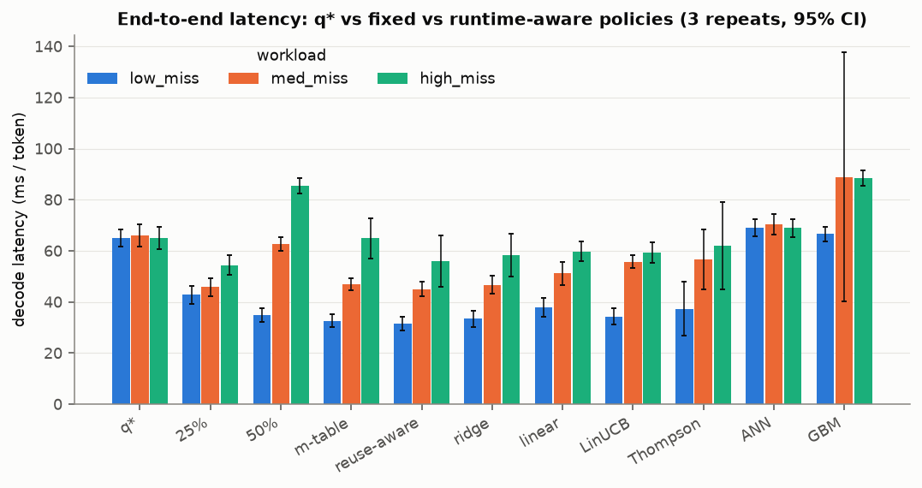
OBJECTIVE 1 · END-TO-END LATENCY
Most runtime-aware policies beat q*; ANN and GBM did not
Reading
Reuse-Aware is lowest at low and medium miss; fixed 25% edges it at high miss. GBM's interval is wide.
Notes:
Decode latency in ms/token for every evaluated policy across the three cache regimes, three repeats with 95% confidence intervals. q* sits at about 65 ms/token in all regimes. Reuse-Aware is the lowest bar at low miss (31.6) and medium miss (45.0); at high miss the fixed 25% split (54.4) is slightly ahead of Reuse-Aware (55.9), consistent with the results table. Ridge, m-table, linear, LinUCB and Thompson all improve on q*, while the ANN stays near q* and GBM is slower at medium and high miss, with a very wide medium-miss interval.

Slide 29
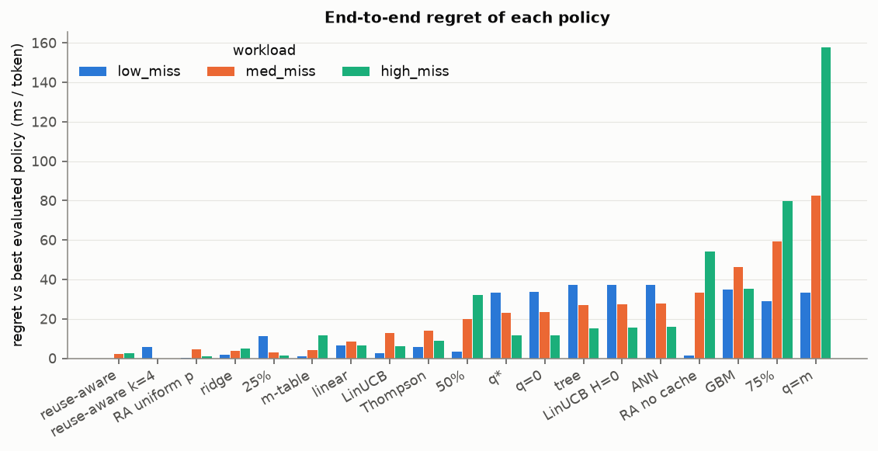
OBJECTIVE 1 · REGRET
Reuse-Aware variants stay closest to the best policy
Regret
Gap to the best policy in each regime. Without the cache term, high-miss regret rises to ~54 ms.
Notes:
Regret is each policy's latency minus the best evaluated policy in that regime, so zero means it was the best. The Reuse-Aware rule and its variants (k=4, uniform reuse prior) have the smallest regret overall, followed by Ridge, the 25% split and m-table. The Reuse-Aware variant without cache state ('RA no cache') is fine at low miss but has about 33 and 54 ms/token regret at medium and high miss, which supports the claim that cache residency is the decisive signal. Fetching everything (q=m) is worst, reaching about 158 ms/token regret at high miss.

Slide 30
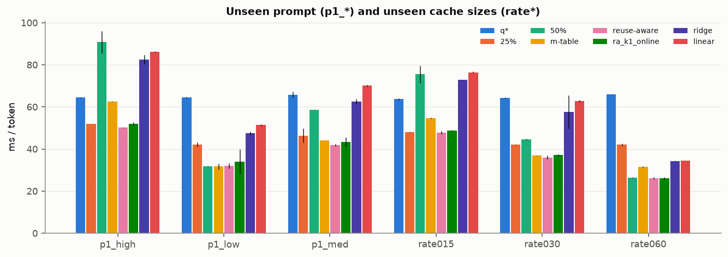
OBJECTIVE 1 · GENERALISATION
Reuse-Aware generalised; Ridge and Linear did not
Held out
On p1_high and rate015, Ridge and Linear were slower than q*; Reuse-Aware stayed at or near the best.
Notes:
Evaluation on an unseen prompt (p1_low, p1_med, p1_high) and on unseen cache sizes (rate015, rate030, rate060). Reuse-Aware and its online k=1 variant are at or near the fastest policy in all six settings. The learned Ridge and Linear models degrade: on p1_high and rate015 they are slower than the q* baseline. Fixed splits are inconsistent: 50% is best on p1_low and rate060 but worst on p1_high and rate015.

