Slide 1

LAST WEEK · CONTEXT 01
Where the project stood on 8 October
Runtime-aware q on one host
Reuse-Aware gave a 1.52× geometric-mean decode speedup over q* for GPT-OSS-20B on the RTX 4070. The learned Ridge and Linear cost models did not generalise.
Static 75% expert retention
Task-specific masks kept most decode accesses, but no checkpoint passed every activation check, and rerouting cut misses by at most 2.24%.
Two open questions
Does the q rule hold on other GPUs and models? Can we lower m, the number of routed experts missing from the GPU cache, without losing quality?
This week
15 October 2026: plan the cross-architecture study and run the m-reduction study.
Notes:
• Recap of the 8 October deck in one slide; no new numbers here.
• Reuse-Aware: analytic rule that fetches a missing expert when its expected future reuse beats the marginal transfer cost; 1.52× was GPT-OSS only, one host, eager decode.
• Learned cost models (Ridge, Linear) degraded on unseen prompts and cache sizes, which is why we keep the analytic rule.
• Static pruning: coverage looked good per task, but no checkpoint passed all activation gates; fixed-cache rerouting gave Qwen 0.87-2.24%, GPT-OSS 0%, Gemma 0.46% fewer misses.
• The two open questions map directly onto this week's two directions.
Sources: 8 October deck slides 3-10 and 27-30

Slide 2
WEEKLY OBJECTIVES · 15 OCTOBER 2026
Two directions for this week
1
Runtime-aware q across architectures
Collect the same decision episodes on more GPUs and MoE models, so the q rule is fitted and tested across hardware rather than on one host.
2
Family-adaptive reduction of m
Test cache admission, replacement, per-layer allocation, routing, and 75% pruning or merging on GPT-OSS, Qwen and Gemma, then confirm survivors live.
Today
Direction 1 is a plan. Direction 2 has qualified baselines, offline results and live runs in progress.
Notes:
• Direction 1 = how many misses to fetch (q) on different hardware; Direction 2 = how to have fewer misses (m) in the first place.
• q decides how existing misses are served (PCIe fetch vs CPU execution); m is the number of misses.
• Direction 1 slides explain the planned cross-architecture experiment (plan document pages 3-4); nothing is collected yet on other GPUs.
• Direction 2 slides first summarise every planned experiment (P1-P9), then show the results that are ready.
Sources: exp_plan.pdf pages 3-4; docs/PLAN.md

Slide 3
DIRECTION 1 · GPU ARCHITECTURES
Target GPUs differ in PCIe speed and VRAM
GPU | Architecture | VRAM | Host link (nominal) | Status
RTX 4070 | Ada Lovelace | 12 GB | PCIe 4.0; measured x4 (B_P = 6.7 GB/s) | Reference: data exists
RTX 4090 | Ada Lovelace | 24 GB | PCIe 4.0 x16 | Planned
RTX 5090 | Blackwell | 32 GB | PCIe 5.0 x16 | Planned
RTX 3090, L40S, A100, H100 | As available | - | - | Added when access exists
Nominal link speeds are vendor specifications; the actual link, B_P and B_H are measured on each host at Stage 0.
These GPUs differ in exactly what the rule depends on
A faster PCIe link raises B_P and so rho; more VRAM holds a larger expert cache. CPU model, cores and memory are recorded; the same GPU with a different CPU is a separate cell.
Key ratio
rho = B_P / B_H: PCIe expert-fetch bandwidth relative to host CPU expert bandwidth.
Notes:
• Only the RTX 4070 has data today; every other row is planned.
• Our host link is PCIe 4.0 but negotiated at x4, so measured B_P is 6.7 GB/s, far below a desktop x16 slot.
• The q rule depends on rho = B_P/B_H; a 4090 or 5090 at x16 changes rho a lot, which is the point of testing them.
• More VRAM means a larger expert cache, so fewer misses and a different reuse horizon.
• B_P and B_H are always measured on the machine, never taken from vendor numbers.
• Same GPU with a different CPU counts as a different cell because B_H changes.
Sources: exp_plan.pdf page 3, Table 4

Slide 4
DIRECTION 1 · MOE MODELS
Three models span 4× in top_k/E and 7× in expert size
Profile | Checkpoint (pinned revision) | Layers | Experts | top_k | top_k/E | Expert format
gpt_oss_mxfp4 | openai/gpt-oss-20b | 24 | 32 | 4 | 0.125 | MXFP4, 13.2 MB/expert
qwen_nvfp4 | nvidia/Qwen3.6-35B-A3B-NVFP4 | 40 | 256 | 8 | 0.031 | NVFP4, 1.8 MB/expert
gemma_nvfp4 | nvidia/Gemma-4-26B-A4B-NVFP4 | 30 | 128 | 8 | 0.063 | NVFP4, 3.4 MB/expert
Pins in configs/pruning/models.json. Layers are MoE layers; experts are per layer.
Why these three
top_k/E sets how often an expert is reused; expert size sets the price of one fetch. Both change which misses are worth fetching.
Fitting
Cross-cell models use dimensionless inputs: rho, top_k/E, residency in tokens and miss ratio.
Notes:
• Same three checkpoints as the m-reduction study, so both directions share models.
• top_k/E is the fraction of experts used per token: GPT-OSS 4 of 32 (12.5%), Qwen 8 of 256 (3.1%), Gemma 8 of 128 (6.3%).
• Expert size: GPT-OSS 13.2 MB, Qwen 1.8 MB, a 7× spread; one GPT-OSS fetch costs much more PCIe time.
• Gemma's 3.4 MB comes from the m-reduction plan's recorded geometry; the experiment plan table leaves it blank.
• Prefer dimensionless features so a rule fitted on one cell can be tested on another.
Sources: exp_plan.pdf page 3, Table 5; docs/PLAN.md section 2.2 (Gemma expert bytes)

Slide 5
DIRECTION 1 · CELL MATRIX
Each GPU and model pair is a separate cell
GPU | gpt-oss-20b | Qwen3.6-35B-A3B | Gemma-4-26B-A4B
RTX 4070 | Done (reference) | Planned, if host RAM holds the expert bank | Planned
RTX 4090 | Planned | Planned | Planned
RTX 5090 | Planned | Planned | Planned
Others | Planned | Planned | Planned
A cell is attempted only after it passes Stage 0 qualification.
Cache sizes are set relative to each model
Three rates of the layer × expert pool give low, medium and high miss pressure. Each is at least the engine minimum (2 × experts per layer with prefill overlap) and fits the GPU's VRAM.
Recorded
The chosen cache rates go into each cell's plan file, so every cell can be rebuilt.
Notes:
• 12 cells in total; only GPT-OSS on the RTX 4070 is done (last week's runtime-q study).
• Qwen on the 4070 depends on host RAM holding the pinned expert bank (about 21 GB server RSS on our 30 GB host).
• Cache size is not a fixed slot count across models: three fractions of each model's own pool, giving low/medium/high miss pressure.
• Floor: two full layers of experts for prefill overlap; ceiling: what fits in that GPU's VRAM.
• Stage 0 failure (kernels, VRAM, RAM, loader) is recorded as a failed cell, not silently skipped.
Sources: exp_plan.pdf page 3, Table 6 and cache-size paragraph

Slide 6
DIRECTION 1 · PROTOCOL 1 OF 2
Stage 0 qualifies every machine first
Install and check the host
Clone the repository, run setup and doctor before and after building the pinned FreeToken runtime, and download each pinned checkpoint.
Measure the machine
Run the bandwidth calibration to measure B_P and B_H for each expert format, then the unpruned baseline for each model with three repeats.
Reproduce the reference
Run the runtime-q pilot plan and confirm the hook reproduces the engine's q*: identical decisions and matching throughput.
Failed cell
Missing kernels, too little VRAM or host RAM, or loader errors: kept with logs, not collected.
Notes:
• Commands: scripts/setup.sh --analysis-only, scripts/doctor.sh (before runtime), scripts/setup.sh (builds pinned runtime), doctor --require-runtime, then source scripts/env.sh under bash.
• doctor writes machine_before_runtime.json and machine_after_runtime.json, the hardware record for the cell.
• Calibration measures B_P (PCIe) and B_H (host CPU) per expert format on that machine.
• Baseline: scripts/baseline.sh --profile gpt_oss_mxfp4 --model $MODEL --gpu 0 --repeats 3.
• The pilot check proves the hook does not change the engine: same q* decisions and the same throughput.
• The repository (ankitsblade/FreeToken-Reproduce) packages all of this so collection is identical on every machine.
Sources: exp_plan.pdf pages 3-4, Stage 0; section 7 opening

Slide 7
DIRECTION 1 · PROTOCOL 2 OF 2
Collect, transfer, then analyse within and across cells
Stage 1 · episode collection
Four plans per model: collect, round 2, main and generalisation. Each run saves run.json, environment.json, logs, episodes and decisions; reruns skip finished episodes.
Stage 2 · transfer
Results stay out of Git. Each machine archives and verifies its run directories; the analysis machine imports them into a fresh study root. Raw runs are never edited.
Stage 3 · analysis
Per cell: policy comparison with paired 95% intervals, the wall(m, q) cost table, reuse analysis and ablations. Across cells: leave-one-architecture-out and leave-one-model-out.
Cross-cell fit
Compare the rule's predicted fetch cost with each GPU's measured cost table.
Notes:
• Stage 1 command: bash scripts/run.sh runtime_q run --plan configs/runtime_q/<plan>.json --model $MODEL --gpu 0, for collect, round2, main and generalization plans.
• Each invocation writes results/runs/runtime_q/UTC_UUID/ with run.json (command, times, status) and environment.json (CPU, RAM, GPU, driver, packages, Git state, engine hashes).
• Interrupted runs resume because the driver skips episodes already present.
• Stage 2: archive, verify, transfer to the shared store, import into a fresh study root; nothing edited after collection.
• Stage 3 per cell repeats last week's single-machine tables; across cells, pool decisions with machine/model IDs and hold out one architecture or one model at a time.
• Key test: does the rule's predicted fetch cost match each GPU's measured wall(m, q) table?
Sources: exp_plan.pdf page 4, Stages 1-3

Slide 8
DIRECTION 1 · CONTROLS
Controls that keep cells comparable
Control | Rule
Held constant | Batch 1, greedy, 128 measured tokens, one warmup, eager decode, naive KV cache, same protocol and policies
Prompts | Frozen token-ID prompts: the GPT-OSS chat template embeds the local date, which changes prompt and routing
One GPU job at a time | Concurrent servers corrupt timings; no heavy CPU work, such as checkpoint-scale tensor jobs, beside a GPU run
Burn-in and order | Three discarded burn-in episodes per server; policy order rotated across repeats
Memory | Runs execute in a scope without swap; RAM or swap pressure rejects the whole paired unit
Separate arms | A change of quantization, cache size, driver, runtime source or execution mode is a new arm, not a repeat
Correctness | Output hashes per episode; divergent text is documented, since CPU and GPU kernels are not bit-identical
Measurement hygiene carried over from the single-machine study.
Origin
The date, memory and CPU/GPU rounding rules each come from a failure seen in our own runs.
Notes:
• These rules make cells comparable; they do not make the machines identical.
• Date in template: GPT-OSS renders today's date into the prompt, so re-rendering on another day changes tokens and routing; we send frozen token IDs instead.
• One GPU job at a time: concurrent servers or heavy CPU work distort timing; we also had an out-of-memory incident from a CPU job beside a GPU run.
• Memory: runs execute inside a no-swap scope; swap or memory pressure rejects the whole paired unit, which is then repeated.
• Any change of quantization, cache size, driver or runtime is a new arm, never pooled with old repeats.
• CPU and GPU expert kernels are not bit-identical, so output divergence between policies is recorded rather than hidden.
Sources: exp_plan.pdf page 4, Table 7

Slide 9
DIRECTION 2 · MOTIVATION
Lower the number of experts that miss the cache
What m measures
For each decode token and MoE layer, m counts routed experts not resident in the GPU expert cache. Each miss is fetched over PCIe (q of them) or run on the CPU (m − q).
Why reduce it
The q rule only decides how misses are served. Fewer misses means less PCIe and CPU work per token on the same hardware and cache bytes.
Five levers
Admission (which misses to fetch), replacement (what to evict), allocation (slots per layer), routing (prefer resident experts), and removing or merging 25% of experts.
Boundary
Lower m alone is not fewer transfers, lower latency or kept quality; each is measured.
Notes:
• m is counted before admission: unique routed experts for that token and layer minus those already in the GPU cache.
• q is the number of those misses fetched over PCIe; the other m − q run on the CPU.
• Direction 1 optimises q for a given m; Direction 2 tries to make m smaller.
• Levers 1-3 (admission, replacement, allocation) never change model outputs, so they only need m and latency evidence.
• Levers 4-5 (routing, pruning/merging) change which experts compute, so they also need quality evidence.
• m × expert bytes is missing demand, not measured PCIe traffic.
Sources: docs/PLAN.md sections 1 and 4.1

Slide 10
DIRECTION 2 · SETUP
Three models at a fixed 20% expert cache
Model | Layers × experts | top-k | Cache slots C | C / pool | Expert size | Sequence cap
Qwen3.6-35B-A3B NVFP4 | 40 × 256 | 8 | 2,048 | 20.0% | 1.8 MB | 2,048
GPT-OSS-20B MXFP4 | 24 × 32 | 4 | 154 | 20.1% | 13.2 MB | 2,048
Gemma-4-26B-A4B NVFP4 | 30 × 128 | 8 | 768 | 20.0% | 3.4 MB | 1,280
Capacity sensitivity uses 10% and 40% of the pool offline; equal-budget comparisons keep C and cache bytes fixed.
RTX 4070 (12 GB, PCIe Gen4 x4) + Ryzen 5 8500G, 30 GB RAM
FreeToken hybrid, batch 1, greedy, eager decode, five CPU expert workers. Every run is in a no-swap scope with host-memory, swap and pressure gates.
Rule
Every experiment runs on all three models; a blocked cell is recorded and repaired.
Notes:
• All values from the recorded model geometry; C is about 20% of each model's layer × expert pool.
• GPT-OSS has only 154 slots (about 6.4 per layer) for 32 experts per layer, so its cache is tight.
• Qwen holds 2,048 small experts, Gemma 768.
• Gemma's sequence cap is 1,280 tokens because of memory; prompts are capped at 1,024 and generation at 256 for all.
• Resource gates: at least 4 GiB free RAM, at most 128 MiB swap during inference, at most 1% memory pressure; a failed gate rejects and repeats the whole batch.
• All three models are mandatory for every experiment.
Sources: docs/PLAN.md sections 1.1, 2.2 and 2.3; offline_stage1 */p3/summary.json geometry

Slide 11
DIRECTION 2 · DATASETS
Four datasets, each with one job
Dataset | Content | Role
D0 routing corpus | 90 requests per model: 30 math, 30 code, 30 incident; 5 grouped folds; 9 repeat IDs | Fit and select every policy; replay; the 9-request live timing cohort
D1 synthetic quality | 300 tasks (10 families × 10 variants per domain) and 100 sequences | Task-score and KL regression screen
D2 AIME 2025-I | 15 problems, one greedy sample each, 512-token input budget | Independent math confirmation (W1-style)
D3 SWE-bench Verified | 5 psf/requests issues, 3 scripted OpenCode turns each | Agentic confirmation (W2-style); harness not pinned yet
D1-D3 never choose a candidate; they confirm or reject a frozen one.
Nested selection
Parameters are chosen on the inner folds of the 72 training requests and reported on the 18 untouched outer requests of each fold.
Statistics
10,000-resample paired bootstrap over requests; each workload weighs one third.
Notes:
• D0 is the original routing corpus from the static pruning study, rendered to frozen token IDs per model.
• Five grouped outer folds: each holds out 18 requests (6 per domain); inside each, four inner folds pick parameters.
• Nine repeat IDs (3 per domain) form the live timing cohort, five paired repetitions each.
• D1 is a known regression screen (we have seen its earlier outcomes), so it is not fresh confirmation.
• D2: opencompass/AIME2025 at a pinned revision; all 15 problems fit the input budget for all three models.
• D3 needs a pinned OpenCode + SWE-bench harness, still open; it may not fit Gemma's 1,280-token cap.
• Small D2/D3 samples are directional only, never pooled into D0.
Sources: docs/PLAN.md sections 3.1-3.5 and 4.3

Slide 12
DIRECTION 2 · EXPERIMENTS 1 OF 2
P1-P5: baseline, traces and exact cache policies
Exp. | Question | Arms | Outputs
P1 | Does q* fill, and what baseline is valid? | Native q with and without a one-expert floor; Reuse-Aware; prefill-informed cache seeding | Unchanged
P2 | Does replay reproduce live serving? | Full router logits, cache events, teacher forcing, zero-change controls | Unchanged
P3 | Why do experts miss? | Miss classes; fully admitting LRU vs Belady MIN; deletion estimates | Diagnosis
P4 | Which misses should be fetched? | Paper, overlap (native), fixed 25%, Reuse-Aware with uniform or frequency prior | Unchanged
P5 | How many cache slots per layer? | Global LRU vs uniform vs utility per-layer quotas at equal total bytes | Unchanged
Exact components: outputs must stay token-identical; m and latency decide adoption.
Baseline
overlap_floor1, the native q with a one-expert fetch floor, is the reference arm throughout.
Notes:
• P1: the paper says at least one fill per miss event; the shipped code can round q to zero. floor1 adds the one-expert floor; seeding warms the cache from prompt routes.
• P2: we need exact replay so offline results transfer to live serving; teacher forcing lets us measure quality on fixed token histories.
• P3 classifies each actual miss: first touch, admission-sensitive, capacity-like, replacement-sensitive; MIN is the optimal-eviction bound.
• P4 compares q rules: paper fraction, the measured-overlap fraction (native), fixed 25%, and Reuse-Aware with a uniform or recent-frequency reuse prior.
• P5 fixes slots per layer instead of one global LRU, at the same total bytes; utility quotas come from training-request miss curves.
Sources: docs/PLAN.md sections 5-8

Slide 13
DIRECTION 2 · EXPERIMENTS 2 OF 2
P6-P9: routing, pruning, composition, replacement
Exp. | Question | Arms | Outputs
P6 | Can routing prefer cached experts? | A: cache-prior bonus, λ 0.1-0.4; B: low-score swap, alpha 0.1 or 0.3; C: A then B | Changed
P7 | Does removing or merging 25% help? | Arm 1: miss-targeted decode exclusion; arm 2: cluster merge + router alias; R75, F75, random | Changed
P8 | Do routing and q gains compound? | 2 × 2: native or P6 routing × native or Reuse-Aware q; interaction term I_m | Depends
P9 | Does protection against thrashing help? | Segmented LRU with 25% or 50% protected; pinning 10% or 25% of slots | Unchanged
Output-changing components (P6, P7) need the quality gate before any timing result counts.
Controls
Every changed-routing arm has a zero-change control that must reproduce native routes exactly.
Notes:
• P6: bias routing toward experts already in cache; the top-J original experts are protected (J=1 GPT-OSS, J=2 Qwen/Gemma); gate weights stay from the original logits.
• P7 retains 75% of experts per layer (remove 64/8/32 for Qwen/GPT-OSS/Gemma). Arm 1 masks the experts with most misses and least saliency at decode only; arm 2 merges similar experts and aliases router IDs.
• R75 = keep the 75% most frequent; F75 = delete the dropped accesses (diagnostic only); 200 random masks as a sensitivity band.
• P8 asks whether routing and q improvements add up; it needs a qualified P6 finalist.
• P9 protects re-used experts from eviction (segmented LRU) or pins thrashing experts.
Sources: docs/PLAN.md sections 9-10

Slide 14
DIRECTION 2 · STAGES AND GATES
Each stage passes a gate before the next
Stage 0 · qualify (P1, P2)
Fresh baseline captures; observation must not change outputs; replay must match live event by event; teacher forcing must reproduce baseline logits.
Stage 1 · offline screens (P3-P9)
Replay all 90 requests per model at three cache sizes and select parameters on inner folds. G1 sets priority but never skips a model.
Stage 2 · live and quality
Fresh-server timing on 9 requests × 5 paired repeats; teacher-forced KL; D1 and D2 task quality; merged-weight execution for P7 arm 2.
G2 adoption
Exact: ≥5% m cut, same outputs, time ≤1.02×. Output-changing: ≥10% m, KL ≤0.02, top-1 ≥98%.
Notes:
• G0 (Stage 0): kernels and resources qualified on all three models; observation off/on gives identical output; replay matches live exactly.
• G1 (after P3) only reorders work: e.g. many replacement misses would prioritise P9; all experiments still run on all models.
• G2 exact components: at least 5% mean-m reduction with a positive lower 95% bound (or 10% on P95), no output change, timing ratio upper bound ≤ 1.02.
• G2 output-changing: at least 10% mean-m reduction plus quality: KL upper bound ≤ 0.02 nats/token per workload, top-1 agreement lower bound ≥ 98%, D1 task loss ≤ 2 points, Qwen/Gemma perplexity ≤ +2%.
• Also: positive reduction in at least 4 of 5 folds and no confidently negative domain.
Sources: docs/PLAN.md sections 4, 7, 10.1 and 10.2

Slide 15
RESULTS · STAGE 0 QUALIFICATION
CPU and GPU expert paths had to agree first
Outputs diverged when q changed
Changing q moves experts between CPU and GPU. GPT-OSS pilot outputs differed in 12-13 of 15 requests; the first router-logit gap was only 0.0078.
Numerical alignment fixed it
GPT-OSS: FP64 split-K accumulation with matched BF16 boundaries. Qwen and Gemma: an NVFP4 precision path. Every pilot arm then matched token for token.
Collection and P2 qualified
90 primary and 18 repeat captures per model. Teacher forcing reproduced all 270 histories exactly; the zero-change control gave KL = 0.
Cost
The aligned CPU path is slower (GPT-OSS concurrent CPU 34.9 → 4.3 GB/s); it is the new baseline.
Notes:
• This was the first blocker: the plan requires identical outputs across exact arms, and they were not.
• Cause: CPU and GPU expert kernels round differently; a 0.0078 router-logit difference at decode flipped a later token (first difference at token 47 on math_000).
• GPT-OSS fix (dot64): FP64 accumulation of split-K partial sums, same activation evaluation order, BF16 rounding at the same boundaries on both paths.
• Qwen/Gemma fix: NVFP4 precision path with FP64 accumulation and matched BF16 boundaries; disabling activation quantization alone was not enough.
• After the fix, all pilot arms matched; 270 primary captures (90 per model) plus 54 repeat captures were accepted.
• Slower CPU path is charged honestly: fresh calibration, not the faster arm's numbers.
• Host memory was the other recurring blocker (Qwen needs about 21 GB); retries and pausing background processes were logged.
Sources: docs/EXPERIMENT_LOG.md, 13-14 October entries; docs/PLAN.md section 5.1

Slide 16
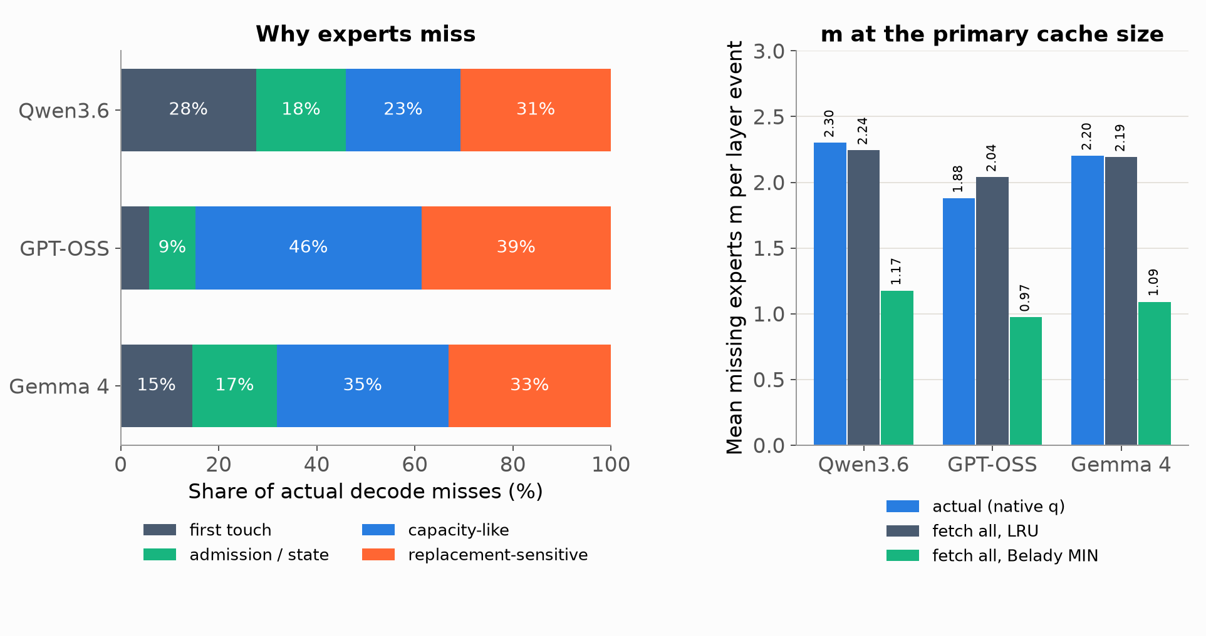
RESULTS · P3 MISS DIAGNOSIS
Capacity and replacement cause most misses
Reading
Decode starts with an empty cache, so first touches are 6-28% of misses.
Notes:
• Qwen3.6: m 2.30; first touch 27.7%, admission 18.3%, capacity-like 23.4%, replacement-sensitive 30.7%; fetch-all LRU 2.24, MIN 1.17.
• GPT-OSS: m 1.88; first touch 5.8%, admission 9.5%, capacity-like 46.0%, replacement-sensitive 38.7%; fetch-all LRU 2.04, MIN 0.97.
• Gemma 4: m 2.20; first touch 14.6%, admission 17.3%, capacity-like 35.0%, replacement-sensitive 33.2%; fetch-all LRU 2.19, MIN 1.09.
• Classes are assigned in order: first touch; admission-sensitive if fetch-all LRU would hit; capacity-like if both LRU and MIN miss; replacement-sensitive if only LRU misses.
• MIN (Belady) is an offline optimum with future knowledge: a bound, not an achievable policy at fixed q.
• All 270 captures enter decode with zero cached experts (prefill uses separate staging), so cold and native starts are identical.
• G1 outcome on all three: run P4/P5 first; P9 and P6 not prioritised (thrash concentration about 19%, below the 50% trigger); P7 not deprioritised.
Sources: offline_stage1 */p3/summary.json, cell primary/native

Slide 17
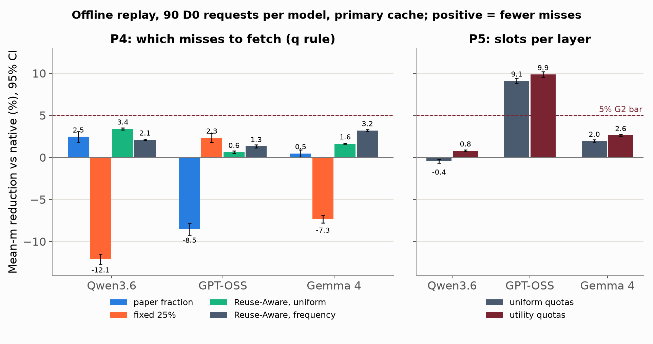
RESULTS · P4/P5 EXACT CACHE POLICIES
Exact cache policies give modest, model-specific gains
Reading
Only GPT-OSS quotas clear 5% offline; no q rule beats native by more than 3.4%.
Notes:
• Bars are mean-m reduction against the native overlap_floor1 arm; error bars are paired request-bootstrap 95% CIs.
• P4 inner-fold selection: GPT-OSS fixed 25% (5/5 folds), Gemma Reuse-Aware frequency, Qwen Reuse-Aware uniform (5/5).
• Qwen: fixed 25% is worse (-12.1%); Reuse-Aware uniform 3.4% fewer misses.
• P5 GPT-OSS: uniform quotas 9.1%, utility 9.9%; the only material offline gain. Qwen quotas do not help.
• None of these change outputs, so the live latency gate decides adoption; m alone is not latency.
• Live fidelity for all these arms on GPT-OSS is done (identical outputs); timing repetitions are running.
Sources: offline_stage1 */p4/summary.json (primary/native); offline_stage1 */p5/summary.json (vs_global_seeded_mean_m)

Slide 18
RESULTS · P6 RESIDENT-BIASED ROUTING
Routing toward cached experts drifts too far
Model | Setting | m reduction | Mass kept, mean | Mass kept, 5th pct | Eligible
Qwen3.6 | B swap, alpha 0.1 | 20.7% | 96.1% | 84.2% | No
Qwen3.6 | A bonus, λ 0.1 | 57.6% | 86.9% | 65.4% | No
GPT-OSS | B swap, alpha 0.1 | 13.2% | 96.4% | 80.4% | No
GPT-OSS | A bonus, λ 0.1 | 31.0% | 91.0% | 73.8% | No
Gemma 4 | B swap, alpha 0.1 | 16.0% | 97.4% | 89.8% | No
Gemma 4 | A bonus, λ 0.1 | 42.0% | 92.7% | 78.9% | No
Fixed-logit screen, all 90 requests. Eligible needs ≥98% mean and ≥95% 5th-percentile original probability mass.
Verdict
No setting is eligible on any model, so P6 has no finalist and P8 cannot be formed.
Notes:
• Mass kept = share of the original router probability on the experts actually used; it measures how far routing moved.
• B with alpha 0.1 is the gentlest swap and still loses 2.5-4% of mass on average and 10-20% on the worst requests.
• A λ 0.1 (cache bonus) cuts m by 31-58% but keeps only 87-93% of mass: it effectively routes to whatever is cached.
• All 11 nonzero settings (A, B, C) fail on all three models; zero-change controls reproduced native routes exactly.
• Consequence: no P6 teacher forcing, and P8's 2 × 2 interaction is recorded as missing rather than replaced.
Sources: offline_stage1 */p6/summary.json, cells.native.settings

Slide 19
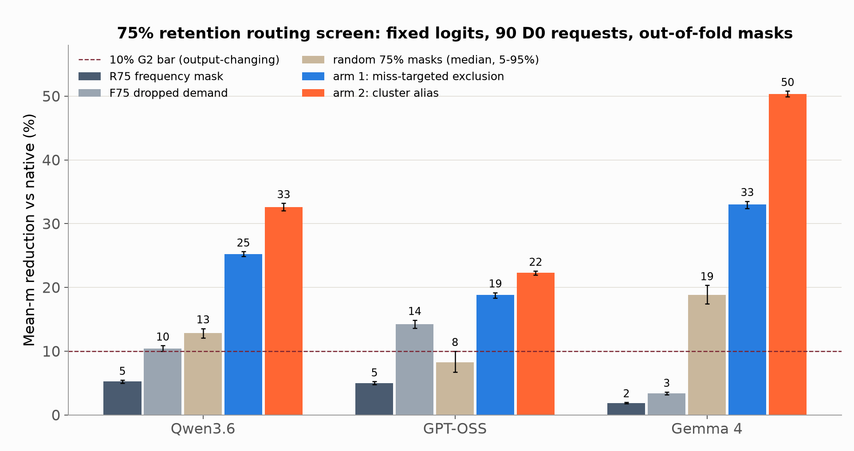
RESULTS · P7 ROUTING SCREEN
Targeted 75% arms cut m far more than frequency
Caveat
Fixed-logit routing screen; quality and merged weights are measured in Stage 2.
Notes:
• Each request is evaluated with masks fitted without it (out-of-fold); the identity alias reproduces native exactly.
• R75 (keep the 75% most used) barely helps: about 2-5% fewer misses, consistent with last week's static result.
• Arm 1 removes experts with many misses and low saliency (gate weight × output norm); arm 2 clusters experts and aliases router IDs to one physical expert.
• Arm 1: Qwen 25.2%, GPT-OSS 18.8%, Gemma 33.0%.
• Arm 2: Qwen 32.6%, GPT-OSS 22.3%, Gemma 50.3%.
• These change routing, so they must also pass the KL/top-1/task gates; the screen holds upstream hidden states fixed and is not a quality measure.
• F75 just deletes dropped accesses; it is a diagnostic, not a real model.
Sources: offline_stage1 */p7/summary.json

Slide 20
RESULTS · P7 FIRST QUALITY CHECK
Arm 1 lowers m but changes outputs too much
Metric | Gate | GPT-OSS arm 1 (smoke)
Teacher-forced m reduction | ≥10% | 18.5% (first history)
Mean KL(baseline || arm 1), nats/token | ≤0.02 (upper 95% bound) | 0.37
Top-1 agreement with baseline | ≥98% (lower 95% bound) | 74%
D1 sequence KL, nats/token | ≤0.02 (upper 95% bound) | 0.57 and 0.97
Development smoke runs: two D0 histories and two D1 sequences; not accepted evidence.
Far outside the quality gate on GPT-OSS
Masking 8 of 32 experts per layer at decode changes about one next-token choice in four. Qwen and Gemma, and merged arm 2, are still to be measured.
Status
Full 90-history teacher forcing, D1 and D2 are queued for all three models.
Notes:
• Teacher forcing: feed the baseline's own token history, let the candidate compute its own hidden states, and compare full-vocabulary next-token distributions.
• Gate is 0.02 nats/token; the smoke shows about 20× that. Top-1 agreement 74% vs a 98% gate.
• The m reduction transfers from the offline screen (18.8% offline vs 18.5% teacher forced on the first history).
• These are smoke runs on two histories, not the accepted 90-history batch; treat as an early signal.
• GPT-OSS has only 32 experts per layer, so 25% removal is coarse; Qwen (256) and Gemma (128) may behave differently; no result yet.
• Arm 2 needs merged and requantized weights; the merge code reproduces the original weights exactly in identity mode (requantization check passed).
Sources: docs/EXPERIMENT_LOG.md, Stage 2 entry (development checks)

Slide 21
RESULTS · P9 AND P1 SEEDING
Replacement and seeding help only in a few cells
Arm (mean-m reduction) | Qwen3.6 | GPT-OSS | Gemma 4
SLRU, 25% protected | 1.0% | 3.4% | 1.1%
SLRU, 50% protected | 2.2% | 5.1% | 3.0%
Pin 10% of slots | 0.7% | -0.1% | -0.4%
Pin 25% of slots | 0.3% | -1.7% | -2.9%
Prefill seeding, all tokens | 6.8% | 0.8% | 4.2%
Prefill seeding, tokens 0-63 | 22.3% | 2.9% | 14.3%
Seed copies per request | 3.6 GB | 2.0 GB | 2.6 GB
Offline replay. P9 against LRU; seeding against the empty native decode start. Positive = fewer misses.
Verdict
GPT-OSS SLRU 50% awaits timing; Qwen seeding needs a timed live arm.
Notes:
• P9 segmented LRU: new experts enter probation; a second hit promotes them to a protected segment that is evicted last.
• GPT-OSS SLRU 50% gives 5.1%: passes the m criteria, so its G2 decision is defer_timing (needs the live ≤1.02× timing bound).
• Pinning hurts or does nothing; Qwen and Gemma SLRU stay below 5%.
• P1 seeding: fill the empty decode cache with the most-routed experts from the prompt; whole-prompt and last-64-token seeds coincide because D0 prompts are short.
• Seeding mainly removes early misses (Qwen −22% in the first 64 tokens), but costs real copies (2-3.6 GB per request) and TTFT, which offline replay does not charge.
• Only Qwen reaches the 5% offline bar for seeding, so only Qwen gets a timed live seeding arm.
Sources: offline_stage1 */p9/summary.json; stage2_live_20261015T042628Z/p1_seed/*/summary.json

Slide 22
RESULTS · LIVE CONFIRMATION
Live kernels reproduce the simulator exactly
Arm | Mechanism | Outputs identical | Event mismatches
overlap_floor1 | Native q fraction (baseline) | 9/9 | 0
paper_floor1 | Paper q fraction | 9/9 | 0
fixed25_floor1 | Fixed 25% fetch | 9/9 | 0
reuse_uniform_floor1 | Reuse-Aware, uniform prior | 9/9 | 0
reuse_freq_floor1 | Reuse-Aware, frequency prior | 9/9 | 0
quota_uniform | Uniform per-layer quotas | 9/9 | 0
quota_utility | Utility per-layer quotas | 9/9 | 0
slru_0.5 | Segmented LRU, 50% protected | 9/9 | 0
GPT-OSS fidelity runs: 9 cohort requests × 256 tokens per arm, against native captures and the offline simulator.
Running
Five paired fresh-server timing repetitions per arm; Gemma and Qwen follow.
Notes:
• New live runtime: the GPU admission kernel gained per-layer quota and segmented-LRU modes, plus a decode-only P7 mask hook.
• Fidelity run = observed live serving; every decode event (m, q, admitted IDs, victims) is compared with the offline simulator: zero mismatches on all 8 arms.
• Outputs identical to the native capture for every request, so these arms really are exact (no output change).
• Rejected attempts (host swap gate), repeated in a fresh directory: reuse_uniform_floor1 x1; rejected batches are kept, never used.
• Timing: 5 repetitions, fresh server per arm, arm order shuffled per repetition, geometric latency ratios with request-cluster bootstrap.
• So the offline m results on the previous slides carry over to live serving for these arms; what remains is whether fewer misses turns into lower latency.
Sources: stage2_live_20261015T042628Z/runs_live/gpt_oss_mxfp4/fidelity/*/completion.json; stage2_live_20261015T042628Z/queue.log

Slide 23
SUMMARY · STATUS AND NEXT STEPS
What we know and what runs next
Established
Qualified baselines on three models, exact replay and teacher forcing, offline P3-P9 screens, and live kernels that match the simulator event for event.
Most promising
GPT-OSS per-layer quotas (−9.9% m) and SLRU (−5.1%); Qwen prefill seeding (−6.8%). P7 arms cut m by 19-50% offline but must pass quality.
Next
Live timing for every arm, P7 teacher forcing, D1 and D2 quality, merged-weight arm 2, then P8 closeout. Direction 1 starts as new GPUs become available.
Bottom line
Exact cache policies give modest gains; the large m cuts so far change model outputs.
Notes:
• Direction 2 has passed all of Stage 0 and Stage 1 for all three models; Stage 2 is running unattended in a serial GPU queue.
• Exact wins are small and model-specific; no exact component is adopted until the live timing bound passes.
• Output-changing arms give big m cuts offline, but the first GPT-OSS quality check is far outside the gate.
• Arm 2 merging runs after the main queue on its own runtime copy; its requantization path reproduces the original weights exactly.
• Open items: D3 SWE-bench harness pinning; live Qwen seeding arm; P8 records a missing interaction because P6 has no finalist.
• Direction 1 needs access to a 4090/5090 or other GPUs; the repository already packages Stage 0-3.
Sources: docs/PLAN.md status; docs/EXPERIMENT_LOG.md

