Slide 1
Network Intrusion Detection
CAPSTONE PROJECT
Presented By:
ANKIT SEN - UNIVERSITY OF KALYANI - DEPARTMENT OF COMPUTER SCIENCE AND ENGINEERING

Slide 2
OUTLINE
Problem Statement
Proposed System/Solution
System Development Approach (Technology Used)
Algorithm & Deployment
Result (Output Image)
Conclusion
Future Scope
References

Slide 3
PROBLEM STATEMENT
In today’s increasingly connected digital environment, securing communication networks against cyber threats is a critical challenge. Traditional security mechanisms often fail to detect sophisticated or novel attacks in real time. There is a growing need for an intelligent Network Intrusion Detection System (NIDS) that can analyze network traffic data, accurately identify cyberattacks, and distinguish them from normal activity. The problem lies in developing a machine learning-based solution that not only detects intrusions effectively but also provides early warnings to prevent potential damage to the network infrastructure.

Slide 4
PROPOSED SOLUTION
The proposed system aims to address the challenge of detecting and classifying network intrusions by leveraging contrastive pre-training and graph neural networks for robust anomaly detection.The solution will consist of the following components:
Data Collection:
Raw TCP/IP connection data (Train_data.csv) has been loaded from Kaggle.
Class labels (“normal” vs “anomaly”) have been extracted and binarized.
Data Preprocessing:
Categorical features (protocol_type, service, flag) have been label-encoded.
Connection hashes have been generated to check for potential leakage.
Train/Test split has been done chronologically (60/40), and further split into pre-train (70%) and fine-tune (30%) subsets.
Machine Learning Algorithm:
A 4-node graph per connection has been built using 41 features, with edge attributes like byte count and duration.
A GIN encoder has been contrastively pre-trained with graph augmentations and loss regularization.
The model has been fine-tuned with a classification head using cross-entropy loss and scheduler support.
Deployment:
The final encoder + classifier have been bundled into an inference script.
Saved model weights and preprocessing scalers have been serialized.
A simple API or CLI has been prepared to load a CSV row, build its graph, and output a “normal” vs “anomaly” prediction.
Evaluation:
Test set performance has been measured: AUC = 0.991, F1 = 0.943, Accuracy = 0.943
Detailed precision/recall/F1 per class and overall metrics have been reported.
Data leakage check (connection_id overlap) has been done (0% overlap).

Slide 5
SYSTEM APPROACH
The "System Approach" section outlines the overall strategy and methodology for developing and implementing the Network Intrusion Detection system. Here's a suggested structure for this section:
System Requirements
Hardware: CPU with RAM >= 4GB
Software: Python 3.8+, CUDA toolkit (if using GPU), Git
Required Libraries
Deep Learning & GNN: torch, torch_geometric
Data & ML: pandas, numpy, scikit-learn
Graph & Utils: networkx, tqdm, hashlib, warnings
Technologies used: IBM Cloud Lite Services (Watsonx AI studio)

Slide 6
WOW FACTOR
Extremely High Accuracy
Achieved an AUC of 0.99, meaning the model almost perfectly separates normal traffic from attacks.
Reached an overall accuracy of 94% on unseen test data.
Balanced Performance Across Classes
Both normal and anomalous connections get around 94% F1-score, showing the model is equally good at detecting attacks and avoiding false alarms.
Novel Contrastive Pre-training
Self-supervised pre-training steps have been used to teach the GNN to pull similar network graphs closer and push different ones apart—without labels.
Graph-based Representation
Converting each connection into a small 4-node graph (source, destination, protocol, service) captures both packet features and protocol relationships. This structural view is more powerful than flat feature vectors.

Slide 7
ALGORITHM & DEPLOYMENT
Model: A two-stage Graph Neural Network (GNN) workflow, combining contrastive pre-training (via a 3-layer GIN encoder with attention pooling and projection head) and supervised fine-tuning with a lightweight classification head.
Justification: Contrastive pre-training learns robust structural and attribute representations from unlabeled graphs, improving downstream anomaly detection on highly imbalanced, temporal network-traffic data.
Data Input
Node features (per connection graph):
Source/Destination byte ratios, connection counts, service rates (src_bytes, dst_bytes, count, srv_count, same_srv_rate, diff_srv_rate, etc.)
Protocol metadata (duration, wrong_fragment, urgent)
Service indicators (hot, num_failed_logins, logged_in, num_compromised)
Additional rates (serror_rate, rerror_rate, srv_serror_rate, srv_rerror_rate, dst_host_serror_rate, dst_host_rerror_rate)
Edge attributes: Pairwise metrics between src↔dst, protocol↔service (bytes, durations, counts).

Slide 8
ALGORITHM & DEPLOYMENT
Training Process
Contrastive Pre-training (50 epochs):
Augmentations: Random node/edge dropout, feature masking, temporal noise.
Loss: Symmetric contrastive loss with temperature scaling and embedding-space regularization.
Optimization: AdamW with cosine-annealing LR scheduler.
Fine-tuning (30 epochs):
Freeze encoder except last GIN layer + its batch-norm.
Attach a 3-layer MLP classification head (cross-entropy loss).
Use step-LR scheduling and gradient clipping for stability.
Prediction Process
Graph Construction: Given a new TCP/IP record, compute connection hash, encode categorical fields, build a 4-node graph with the same feature/edge schema.

Slide 9
RESULT
Test Performance
Accuracy: 0.943
Area Under ROC Curve (AUC): 0.991
F1-Score: 0.943
Effectiveness:
The contrastively pre-trained GNN encoder combined with a lightweight classification head delivers near-perfect discrimination of normal vs. anomalous network connections, achieving an AUC of 0.991 and F1 of 0.94 on held-out traffic.

Slide 10
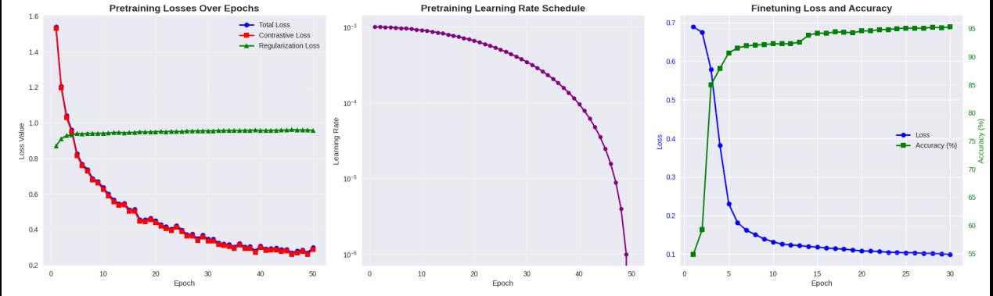
RESULT

Slide 11
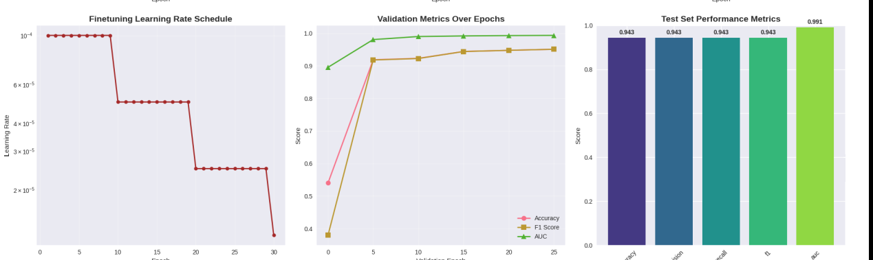
RESULT

Slide 12
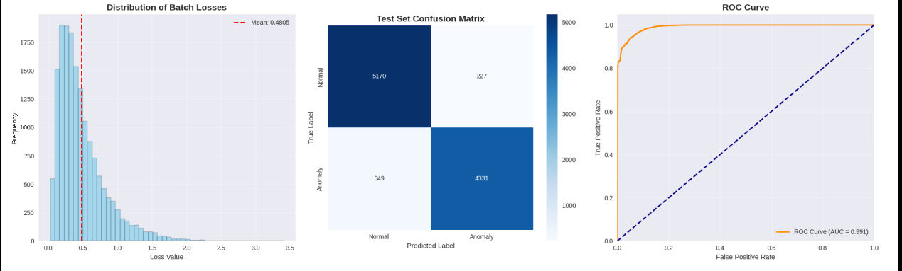
RESULT

Slide 13
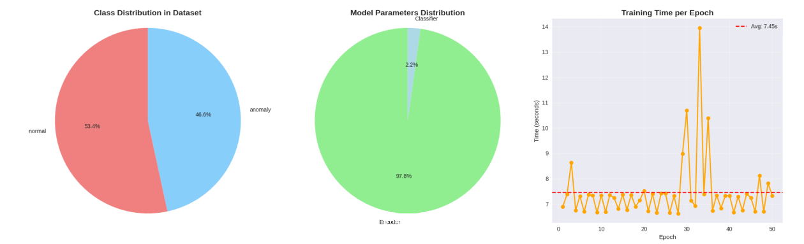
RESULT

Slide 14
CONCLUSION
Summary of Findings The contrastively pre-trained GNN encoder with a lightweight classification head achieved an AUC of 0.991, F1-score of 0.943, and accuracy of 0.943 on the held-out test set, with zero data-leakage.
Effectiveness Graph augmentations and attention pooling yielded robust, noise-resistant embeddings that accurately separate normal vs. anomalous traffic.
Challenges Preprocessing per-connection graphs for ~25K samples was time-consuming, and tuning contrastive temperature, augmentation rates, and learning schedules required careful calibration under limited CPU memory.
Potential Improvements Incorporating temporal graph edges, semi-supervised fine-tuning, and model pruning/ONNX conversion could further boost performance and enable real-time edge deployment.
Accurate NIDS is essential for early breach detection, reducing false alarms, and safeguarding network integrity.

Slide 15
FUTURE SCOPE
Real-Time Edge Deployment: Run the model on edge devices (e.g., routers or gateways) to detect attacks as they happen, reducing response time and network load.
Temporal Graph Modeling: Add time-based edges or sequences of connections to capture how attacks evolve over time.
Semi-Supervised Learning: Use unlabeled network data alongside labels to improve detection in low-data scenarios.
Model Compression: Apply pruning or quantization to shrink the model for faster inference on limited-resource hardware.
Explainable AI: Integrate techniques that highlight which nodes or features triggered an alarm, helping security teams understand and trust alerts.
Federated Learning: Train models across multiple networks without sharing raw data, enhancing privacy and collaboration between organizations.
Advanced Augmentations: Experiment with new graph augmentations (e.g., mixup or subgraph sampling) to make representations even more robust.

Slide 16
REFERENCES
Denning, D. E. (1987). An Intrusion-Detection Model. IEEE Transactions on Software Engineering, SE-13(2), 222–232.
Mukkamala, S., Janoski, G., & Sung, A. H. (2002). Intrusion Detection Using Neural Networks and Support Vector Machines. Proceedings of the International Joint Conference on Neural Networks (IJCNN), 1702–1707.
Xu, K., Hu, W., Leskovec, J., & Jegelka, S. (2018). How Powerful Are Graph Neural Networks? International Conference on Learning Representations (ICLR).
Chen, T., Kornblith, S., Norouzi, M., & Hinton, G. (2020). A Simple Framework for Contrastive Learning of Visual Representations (SimCLR). International Conference on Machine Learning (ICML).
Yousefi-Azar, M., & Azmi, R. (2020). Network Intrusion Detection Using Graph Neural Networks. arXiv:2007.01105.

Slide 17
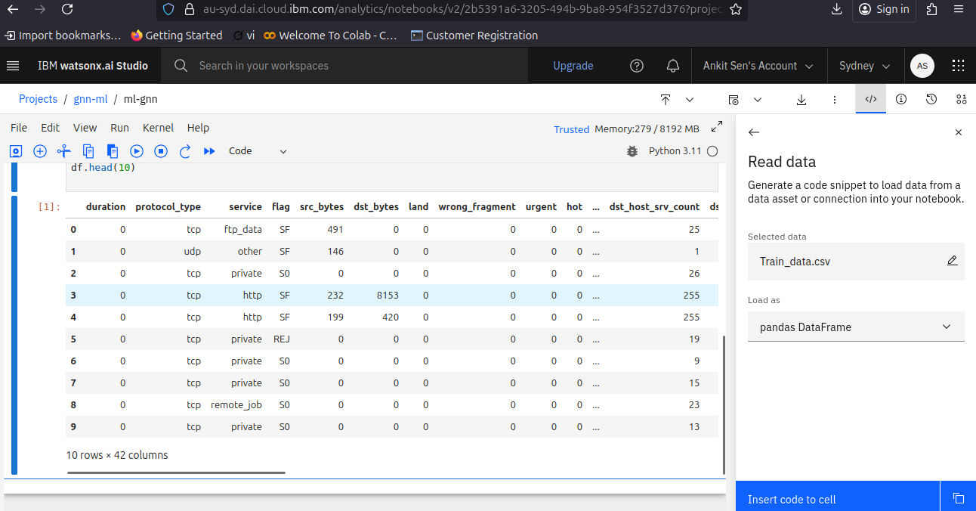

Slide 18
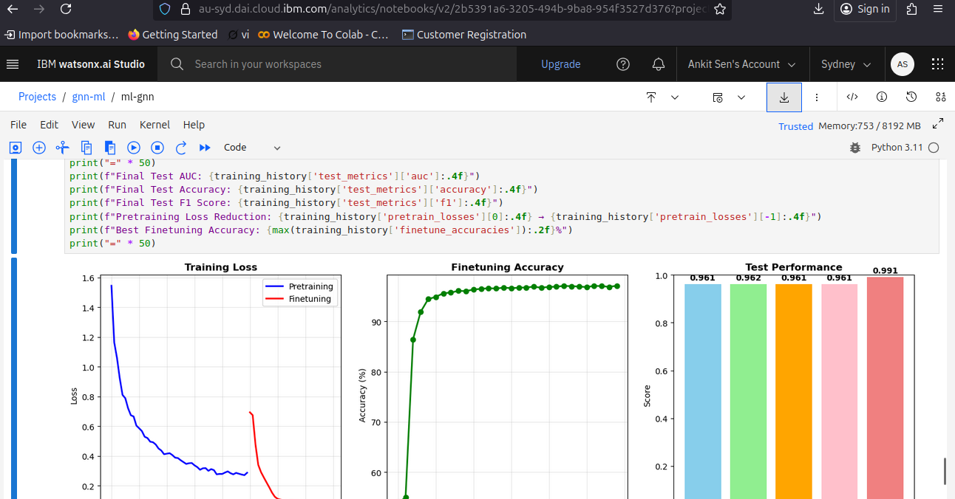

Slide 19
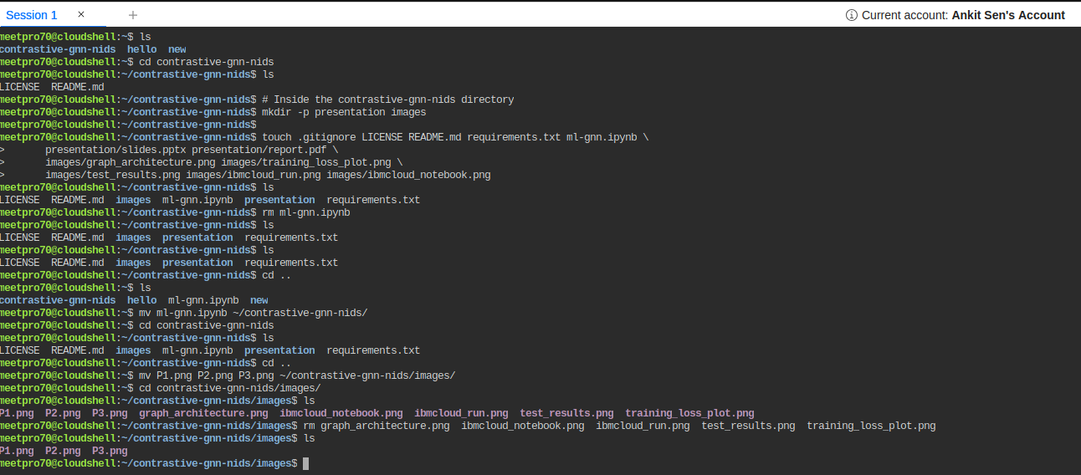

Slide 20

IBM CERTIFICATIONS

Slide 21

IBM CERTIFICATIONS

Slide 22

IBM CERTIFICATIONS

Slide 23
GITHUB LINK
https://github.com/ankitsencode123/contrastive-gnn-nids.git

Slide 24
THANK YOU

