Slide 1
Customer Modelling & Retention
Cohorts · Category Affinity · Retention · MoEngage activation
DailyObjects · DMR 2020–Jul 2026 · 1.38M customers · 2.86M orders

Slide 2
How we built it
Methodology
• Identity resolution — linked 1.38M unique customers across email + phone + account-UUID (fixes 2024 email masking; hub-suppressed to avoid over-merging).
• Enriched discounts — the DMR only stores final price, hiding price-led event drops (HPS, Diwali). We detect these from weekly ASP dips — discount penetration rises 21% → 49% of orders.
• Lifecycle slabs — every customer labelled by lifetime order count: O1 (new) · O2 · 3+ (mature).
• Behavioural cohorts — the 203K mature (3+) customers segmented via K-Means into Power Users, Deal Seekers, Light Users — on frequency, value & enriched discount reliance.
• Affinity layer — Tech vs Designer/Bags score + primary/secondary sub-category per customer.
• Leakage-safe validation — cohorts assigned at a past cut-off (31 Jul 2025) and validated on the NEXT 12 months of purchasing.
• Repository — 1.38M-row master table with cohort, tiers, affinity & contact keys — ready for MoEngage.

Slide 3
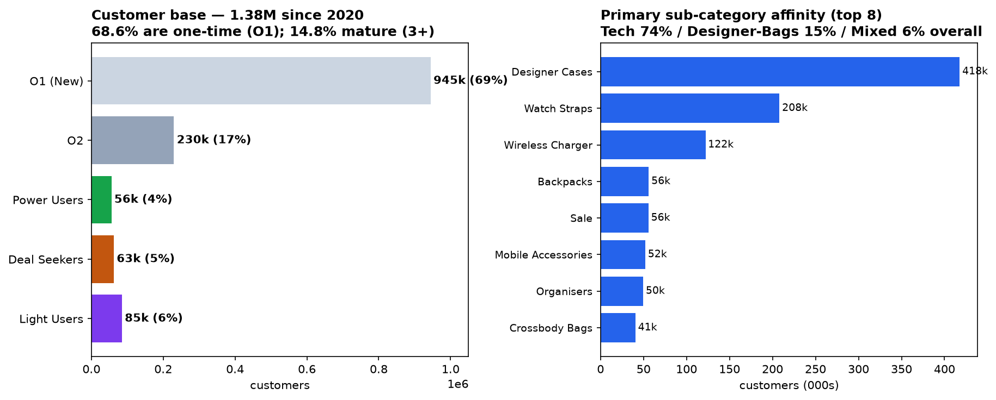
The base — a leaky bucket
68.6% buy once and rarely return
Only 8.5% of one-time buyers return within a year; value concentrates in the ~4% who become Power Users.

Slide 4
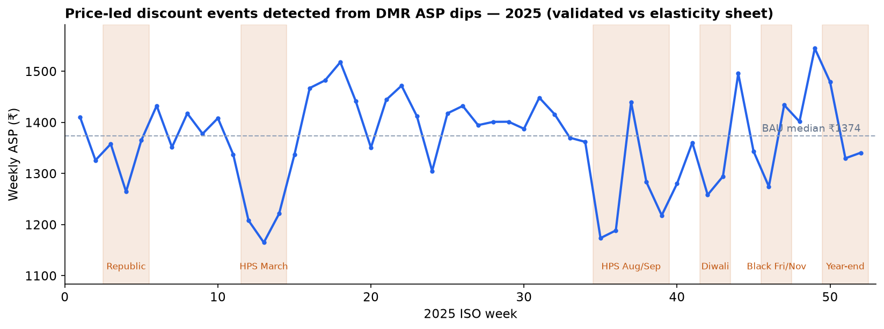
Price-led discounts, now captured
Detected from DMR weekly-ASP dips — validated vs the elasticity sheet
HPS (Mar & Aug), Diwali, Black Friday and Year-end drive 30–48% price cuts in tech. Buyers who only shop these looked ‘full-price’ before — now correctly flagged as Deal Seekers.

Slide 5
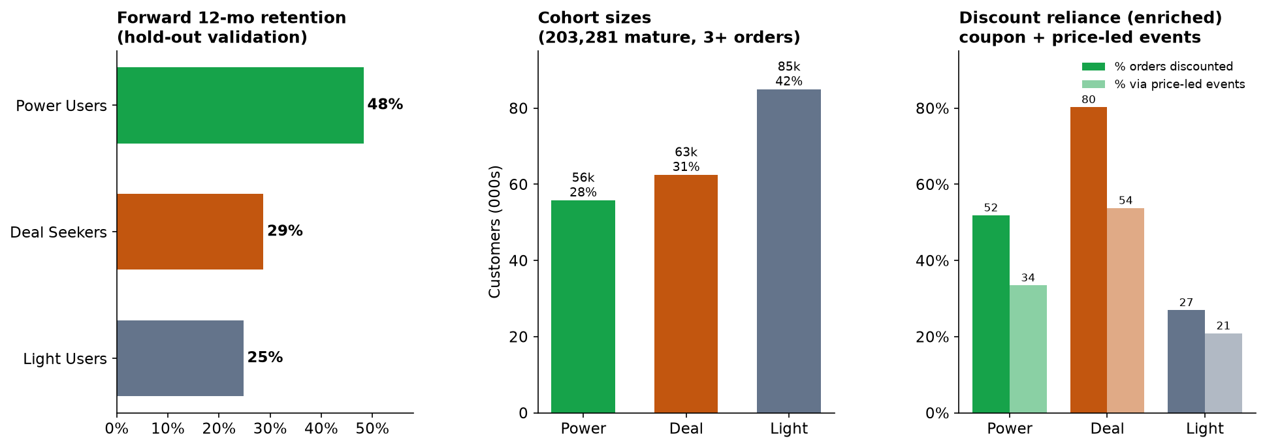
Three cohorts — validated on future retention
All 3+ order customers; behaviour (not order-count) defines the cohort
Power Users (28%) convert in BAU — 48% annual retention. Deal Seekers (31%) place 80% of orders on discount and lapse between sales. Light Users (42%) are low-value, mostly dormant.

Slide 6
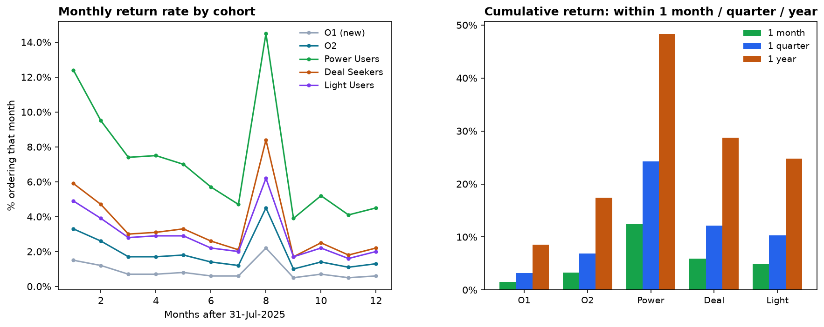
Retention by cohort — monthly / quarterly / yearly
Anchor 31 Jul 2025, next 12 months
Return spikes in ~Mar-2026 (next HPS) across all cohorts — repeat purchase is event-triggered, not habitual.

Slide 7
Return rates — the numbers
% of each cohort placing another order within…
Cohort | Share of base | 1 month | 1 quarter | 1 year
O1 — one-time (New) | 68.6% | 1.5% | 3.2% | 8.5%
O2 — two orders | 16.7% | 3.3% | 6.9% | 17.4%
Power Users | 4.1% | 12.4% | 24.3% | 48.3%
Deal Seekers | 4.5% | 5.9% | 12.1% | 28.7%
Light Users | 6.2% | 4.9% | 10.3% | 24.8%
The 1st→2nd order is the single biggest retention lever: O1 returns at 8.5% vs Power at 48%.

Slide 8
What goes to MoEngage
Warehouse computes · MoEngage activates
MoEngage attribute | Example | Refresh
lifecycle_cohort / order_cohort | O1 (New) / 3+ (Mature) | daily
behavioural_cohort | Power Users / Deal Seekers / Light Users | monthly
activity_state | Active / Lapsed / Dormant | daily
value_tier | VIP / High / Mid / Low | weekly
cat_affinity + tech_score | Tech (0.82) | weekly
primary_subcategory / secondary | Wireless Charger / Designer Cases | weekly
days_since_last · lifetime_orders · aov | 47 · 6 · ₹2,600 | daily
EVENTS: cohort_changed, became_dormant, reactivated, reorder_due | — | real-time
Keyed on email/phone. Raw ML features stay in the warehouse; MoEngage receives finished decisions only.

Slide 9
Gaps & the retention strategy
WHERE WE LOSE USERS
WHAT WE DO
• Leaky top — 68.6% one-time, 8.5% return.
• O2→O3 stall — 17% before the loyalty inflection.
• Discount addiction — 31% Deal Seekers, 80% on discount.
• Event-only repeat — little BAU habit.
• Category concentration — 74% Tech, bags under-sold.
• Dormancy — 59% of mature dormant.
• P1 Win the 2nd order — onboarding + first-repeat incentive.
• P2 Push to 3rd — cross-category + reorder timing.
• P3 Grow Power — VIP, full-price Tech→Bags cross-sell.
• P4 De-risk Deal Seekers — bundles, raise AOV, wean off discount.
• P5 Kill event-dependence — always-on replenishment journeys.
• P6 Reactivate / sunset — sized by value & affinity.

Slide 10
Operating the system
Refresh cadence
Layer | Refresh | Note
Lifecycle cohort, activity, recency | Daily | Deterministic / fast-moving
Category & sub-category affinity | Daily–Weekly | Drives creative
Value tier, discount class | Weekly | Slow ratios
Behavioural cohort (re-score) | Monthly | Hysteresis-guarded
Model + event windows (re-train) | Quarterly | Identity-changing
Analysts refresh via Claude in plain language: “Refresh the cohort model with the latest DMR, rebuild the repository, and push to MoEngage.” Claude runs the pipeline, sanity-checks cohort sizes, and syncs.

