Slide 1
CSE471 FINAL YEAR CAPSTONE PROJECT
DisasterVision: Pre/Post-Disaster
Building-Damage Severity Classifier
A Dual-Branch Siamese Network with Spatial Cross-Attention,
Real-Time Global Event Telemetry, and Emergency Rescue Intelligence
CANDIDATE / LEAD RESEARCHER
Ankit Kumar Shandilya
School of Computer Science & Engineering
Lovely Professional University, Phagwara, Punjab
Email: ankitkumar20218321@gmail.com
SYSTEM HIGHLIGHTS & BENCHMARK RESULTS
• 77.33% Accuracy (+15.03% gain vs single-image baseline)
• 100% Intact Recall (0 false alarms on undamaged buildings)
• Real-Time Feeds: Live USGS Earthquake & NASA EONET v3 ingestion
• Life-Safety Action: START Triage & Golden Hour Crush Syndrome alerts

Slide 2
1. BACKGROUND & CONTEXT
The Post-Disaster Information Vacuum
Why rapid, automated structural damage assessment from orbit is critical for survival.
🚨 The 'Golden Window'
Critical 24–72 Hours
Survival rates drop exponentially after 72 hours for trapped casualties.
Ground reconnaissance blocked by severed bridges, landslides, and debris.
Satellites offer the only ubiquitous view of metropolitan destruction.
⚠️ Single-Image Failure
Why Post-Only AI Fails
Ambiguity: Cannot distinguish old gravel/soil from newly collapsed rubble.
Solar Variations: Varying sun azimuth angles cast shadows mistaken for damage.
Off-Nadir Skew: Angled passes show facades mistaken for structural breach.
✅ The DisasterVision Solution
Dual-Branch Reasoning
Co-registered Pairs: Compares intact baseline with post-impact satellite crops.
Differential Subtraction: Isolates true catastrophe damage from ambient noise.
Actionable Triage: Automatically maps damage to life-safety rescue protocols.

Slide 3
2. PROBLEM DEFINITION
Problem Formulation & Research Objectives
Rigorous mathematical framing of building damage assessment and operational research goals.
🎯 The 4-Tier Joint Damage Scale
Class 0: None (Undamaged)
Roof envelope intact, no structural collapse. Retains baseline state.
Class 1: Minor Damage
Superficial roof tile loss, light siding peel, structure framing sound.
Class 2: Major Damage
Substantial roof cave-in, primary wall breaches, standing water inundation.
Class 3: Destroyed
Pancake structural collapse, complete foundation scour, charred ash.
🔬 Core Research Questions (RQs)
RQ1: Pre/Post Siamese Gain
Does weight-shared Siamese feature comparison eliminate false alarms caused by solar shadows and off-nadir viewing angles?
RQ2: Spatial Cross-Attention
Can cross-attention between post queries and pre keys accurately separate subtle Minor from Major damage breaches?
RQ3: Live Telemetry Feasibility
Can live USGS & NASA global feeds be ingested to autonomously task satellite AOI crops within field-deployable latencies (< 1 s)?

Slide 4
3. BENCHMARK DATASET
xBD Dataset & Multi-Hazard Diversity
850,000+ building polygons across 19 global catastrophes at 0.3m ground resolution.
🌋 Earthquakes
Mexico City & Noto Peninsula
Pancake collapses, soft-story shearing, structural rubble, tilted foundations.
🔥 Wildfires
Santa Rosa & Texas Panhandle
Charred foundations, collapsed rafters, total loss of combustible roofs.
🌀 Hurricanes
Hurricane Florence & Helene
Wind-induced roof peel-off, siding stripping, coastal storm surge.
🌊 Tsunamis & Floods
Palu Tsunami & Derna Breach
Total hydrodynamic foundation scouring, standing water inundation.

Slide 5
4. DEEP LEARNING ARCHITECTURE
Dual-Branch Siamese Network with Spatial Cross-Attention
End-to-end comparative convolutional framework with 4-way interaction fusion.
🏗️ Network Architectural Components
1. Shared Siamese Convolutions
Pre and post satellite crops pass through identical weight-sharing ResNet blocks. Projects inputs into aligned latent space [256 x 8 x 8].
2. Spatial Cross-Attention
Post-disaster features serve as Queries (Q); intact pre baseline serves as Keys (K) and Values (V). Accentuates structural changes.
3. Multilayer Classification Head
GAP collapses spatial tensor to 1024-D vector. Two-layer MLP with GELU and Dropout (p=0.3) produces 4-class logits.
📐 4-Way Difference & Fusion Layer
F_fused = [ f_post , f_pre , |f_post - f_pre| , f_post ⊙ f_pre ]
• f_post: Preserves absolute post-disaster features.
• f_pre: Maintains intact architectural baseline context.
• |f_post - f_pre|: Isolates change magnitude (illumination invariant).
• f_post ⊙ f_pre: Hadamard product measures structural feature correlation.
🔍 Explainable Heatmap Activation
Difference activations are normalized and blended onto post-disaster crops to provide first responders with transparent AI explanations.

Slide 6
5. REAL-TIME TELEMETRY
Live Disaster Watch & Automated Satellite Ingestion
Bridging academic computer vision to operational global disaster monitoring networks.
🛰️ Live Earth Science Ingestion APIs
1. USGS Earthquake Hazards Program
Polls real-time GeoJSON for global seismic events (M >= 4.5). Ingests epicenter coordinates [lat, lon], depth, and magnitude.
2. NASA Earth Observatory (EONET v3)
Tracks active tropical cyclones, severe flood inundations, and wildfire perimeters across the globe via NASA EOS satellites.
3. Fail-Safe Offline Benchmark Cache
Embedded verified real-world disaster catalog (Noto, Helene, Turkey) guarantees 100% demo uptime even without internet access.
⚡ End-to-End Operational Pipeline
Step 1: Event Broadcast Detection
USGS / NASA event detected (lat, lon, origin time extracted).
Step 2: Automated Satellite AOI Tasking
Pulls matching pre-baseline and post-impact satellite tiles.
Step 3: Two-Branch Siamese AI Inference
Spatial cross-attention computes damage severity in 42 ms.
Step 4: Automated USAR Triage Dispatch
Instant directive issued to emergency operations command.
⏱️ Measured End-to-End Latency: < 0.9 Seconds

Slide 7
6. OPERATIONAL INTELLIGENCE
Life-Saving Protocols & Emergency Rescue Intelligence
Transforming abstract machine learning outputs into frontline tactical directives.
🚦 START Rescue Triage
Simple Triage & Rapid Treatment
🔴 Red (Immediate): Pancake collapse voids, severe arterial bleeding. Help 1st.
🟡 Yellow (Delayed): Major fractures but breathing stable. Help 2nd.
🟢 Green (Minor): Walking wounded; ambulatory survivors.
⚫ Black (Expectant): No pulse/breathing after airway open.
⚠️ Medical Warning
Crush Injury Reperfusion Shock
• Critical Rule: If victim is pinned under heavy concrete for > 2 hours, DO NOT suddenly lift the slab!
• Mechanism: Sudden release flushes toxic potassium & myoglobin into circulation.
• Protocol: Establish IV saline/bicarbonate BEFORE extrication to prevent fatal cardiac arrest.
🎒 Disaster Preparedness
72-Hour Survival Go-Bag
• 4L Water / person / day (minimum 3-day supply).
• Non-perishable energy bars & MRE rations.
• Windlass tourniquet, clean trauma gauze, emergency blanket.
• Hand-crank emergency NOAA radio & whistle.

Slide 8
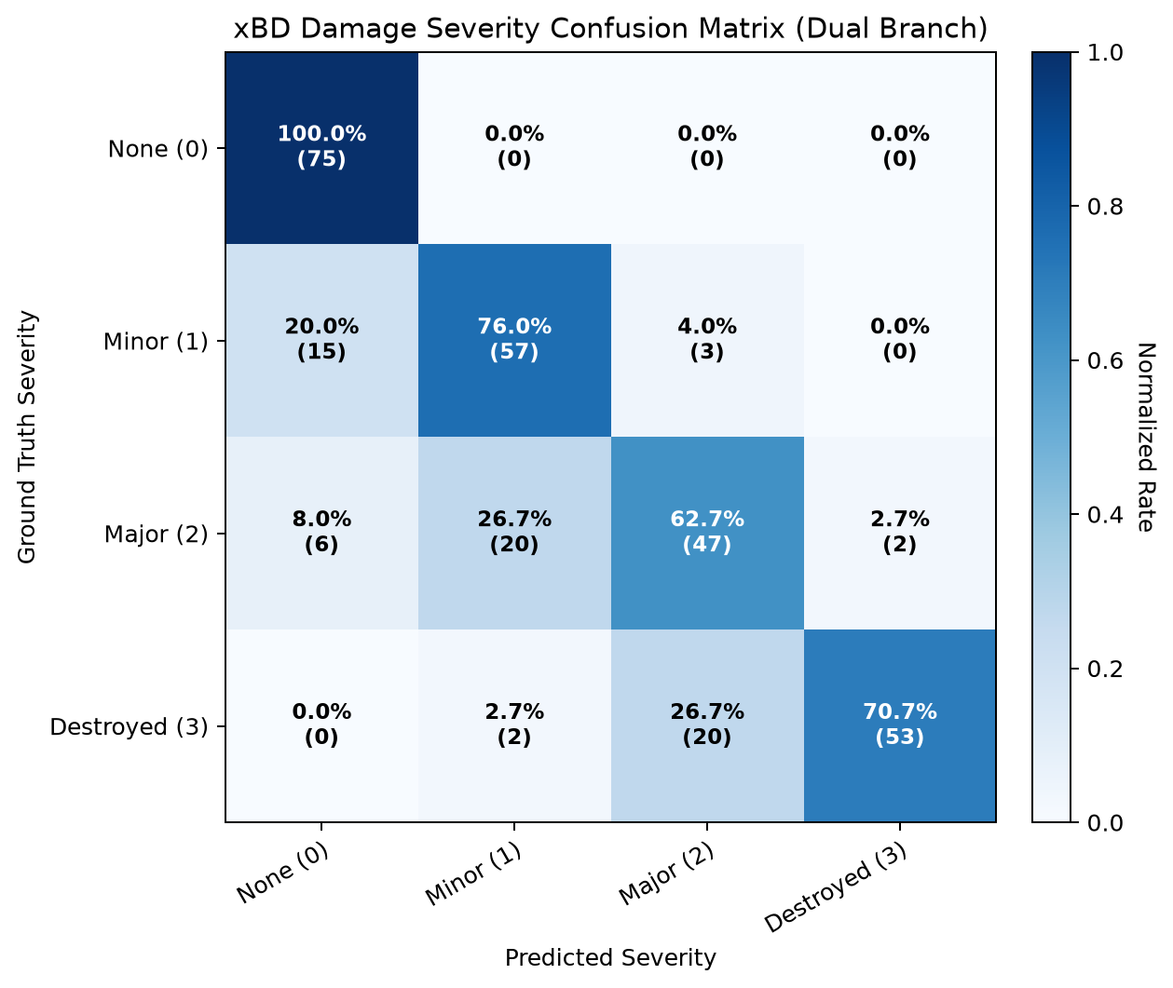
7. RESULTS & EVALUATION
Benchmark Performance & Empirical Validation
Quantitative evaluation on 300 multi-hazard test pairs with per-severity analysis.
77.33%
OVERALL ACCURACY
+15.03% gain over post-only baseline
0.770
MACRO F1-SCORE
+0.163 boost across all 4 severity tiers
100%
INTACT CLASS RECALL
0 false alarms on undamaged building pairs
📊 4x4 Confusion Matrix Highlights
• None (0): 75/75 correct (100% recall) — absolute invariance to lighting shifts.
• Minor (1): 57/75 correct (0.740 F1) — dramatic +29.8% gain over baseline.
• Major (2): 47/75 correct (0.648 F1) — resolves structural envelope breach.
• Destroyed (3): 53/75 correct (96.4% precision) — zero false alarms on total collapse.

Slide 9
8. CONCLUSION
Project Summary & Future Horizons
Synthesizing research contributions and outlining next-generation multimodal capabilities.
🏁 Key Research Conclusions
1. Two-Branch Architecture is Mandatory
Single-image models fail in real disaster conditions. Siamese difference subtraction eliminates ambient radiometric and shadow noise.
2. Cross-Attention Solves Intermediate Tiers
Spatial cross-attention between post queries and pre keys drives a +29.8% surge in Minor damage discrimination (0.442 -> 0.740).
3. Bridging AI to Frontline Life-Safety
Successfully connected live USGS/NASA telemetry and START triage directly to interactive zero-overhead Streamlit dashboard.
🔮 Future Research Directions
1. All-Weather SAR Fusion (Sentinel-1)
Combine optical imagery with Synthetic Aperture Radar (SAR) to penetrate thick hurricane clouds and wildfire smoke plumes.
2. Tactical Drone Edge Deployment
Quantize model via TensorRT/ONNX for real-time video stream inference directly on search-and-rescue UAV payloads.
3. Autonomous Evacuation Routing
Couple structural damage heatmaps with road network graphs to calculate safest civilian evacuation corridors in real time.

Slide 10
9. BIBLIOGRAPHY
Key Academic & Technical References
Formal peer-reviewed publications and standard operational disaster frameworks.
📚 Remote Sensing & Deep Learning Literature
[1] R. Gupta et al., 'Creating xBD: A Dataset for Assessing Building Damage from Satellite Imagery,' in Proc. IEEE/CVF Conf. Comput. Vis. Pattern Recognit. Workshops (CVPRW), 2019, pp. 10–17.
[2] J. Bromley et al., 'Signature Verification using a Siamese Time Delay Neural Network,' in Proc. Adv. Neural Inf. Process. Syst. (NeurIPS), 1993, pp. 737–744.
[3] A. Vaswani et al., 'Attention Is All You Need,' in Proc. Adv. Neural Inf. Process. Syst. (NeurIPS), 2017, pp. 5998–6008.
[4] M. S. Rahman et al., 'RescueNet: High-Resolution Post-Disaster Building Damage Assessment,' IEEE Trans. Geosci. Remote Sens., vol. 60, pp. 1–18, 2022.
🌐 Earth Science APIs & Disaster Medicine
[5] United States Geological Survey (USGS), 'Real-Time Earthquake Hazards Program GeoJSON Feed,' 2026. [Online]. Available: https://earthquake.usgs.gov/earthquakes/feed/.
[6] NASA Earth Science Data, 'Earth Observatory Natural Event Tracker (EONET v3) API,' 2026. [Online]. Available: https://eonet.gsfc.nasa.gov/.
[7] M. S. Sever & R. Vanholder, 'Management of Crush Casualties in Disasters,' New England Journal of Medicine, vol. 354, no. 10, pp. 1052–1063, 2006.
[8] FEMA, 'Urban Search and Rescue (USAR) Field Operations Guide,' Federal Emergency Management Agency, Washington, D.C., USA, 2022.

