Slide 1



Phool
View in Power BI
Last data refresh:
6/30/2023 11:24:21 AM UTC
Downloaded at:
7/3/2023 4:43:50 AM UTC

Slide 2
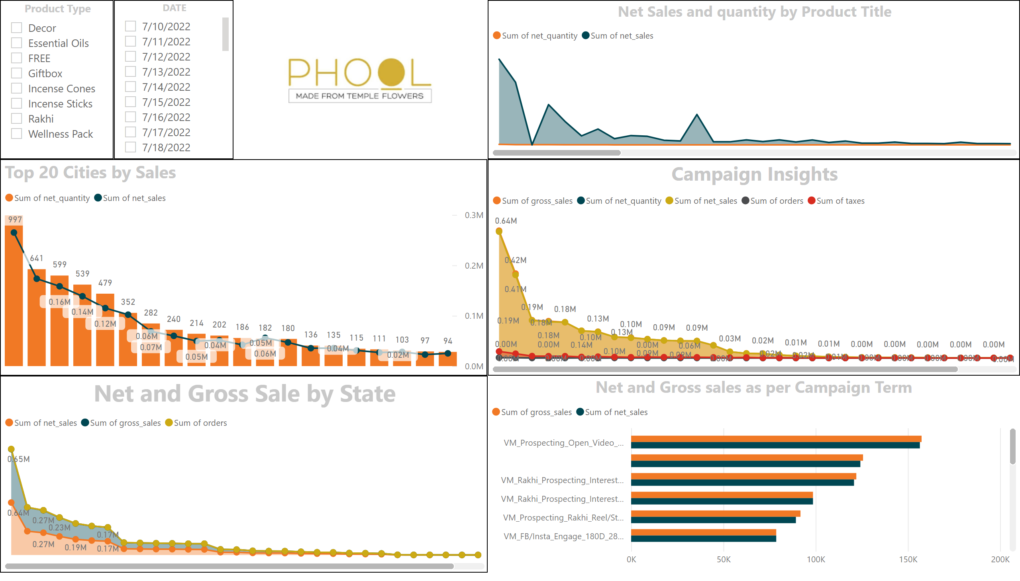
Page 1
Notes:
Net and Gross sales as per Campaign Term
No alt text provided
DATE
No alt text provided
Product Type
No alt text provided
image
No alt text provided
Net and Gross Sale by State
No alt text provided
Campaign Insights
No alt text provided
Net Sales and quantity by Product Title
No alt text provided
Top 20 Cities by Sales
No alt text provided

