Slide 1
Presentation by :
Aniruddha Shimpi &
Sahil Koley

Slide 2
Binge me

Slide 3
INTRODUCTION
BingeMe is a subscription-based streaming service that allows our members to watch TV shows and movies on an internet-connected device.
Depending on your plan, you can also download TV shows and movies to your iOS, Android, or Windows OS device and watch without an internet connection.
If you're already a member and would like to learn more about using BingeMe, visit Getting started with BingeMe

Slide 4
Abstract
Just one more episode….”
This phrase has become a conventional part of our daily lives, just like scrolling the feed on Instagram, sharing memories on Snapchat, or ordering food from Zomato.
And the full credit for it goes to “BingeMe.”
The VoD or on-demand video streaming application has taken the entertainment experience to an instance where we can’t think about a day without watching episodes of our favorite shows on BingeMe. It has brought new types of content of different genres, giving us a taste of diverse cultures, thoughts, situations, and time periods.

Slide 5
SYSTEM ANALYSIS
The existing system of BingeMe can be divided into three main components:
1.User Interface : User Interface: The user interface is the front-end system that users interact with when accessing BingeMe's content.
2.Conetnt Delivery Network (CDN) : The content delivery network is a distributed system of servers that enables BingeMe to deliver its content to users around the world.
3.Back End System : The back-end systems are the behind-the-scenes infrastructure that powers BingeMe's platform

Slide 6
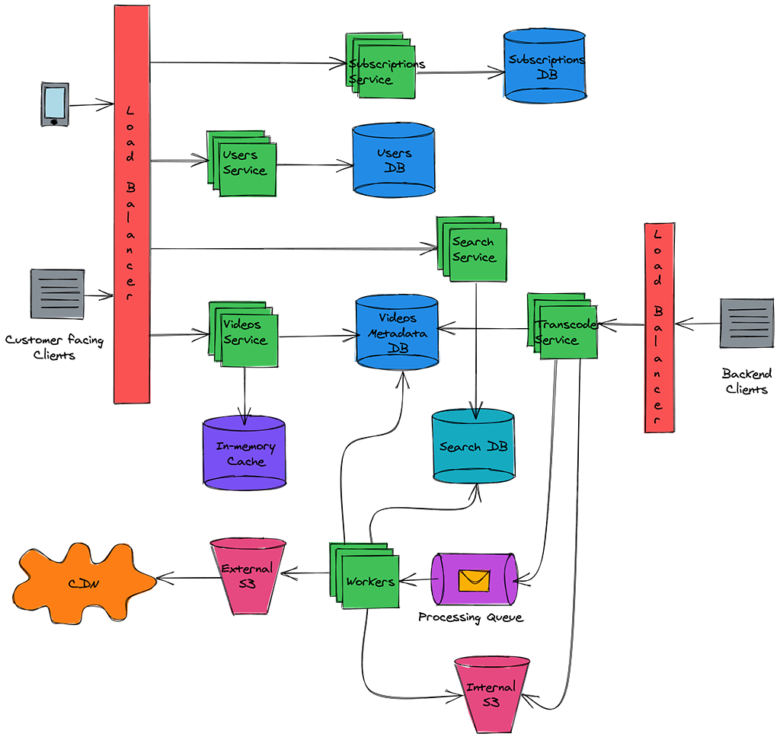
SYSTEM DESIGN

Slide 7
IMPLEMENTATION DETAILS
We implement the html & css.
We use different types html & css syntax.
We have tried to develop an OTT Platform using front end coding.
Adding new pictures and wallpapers help the users to use the website easy & simple to use.

Slide 8
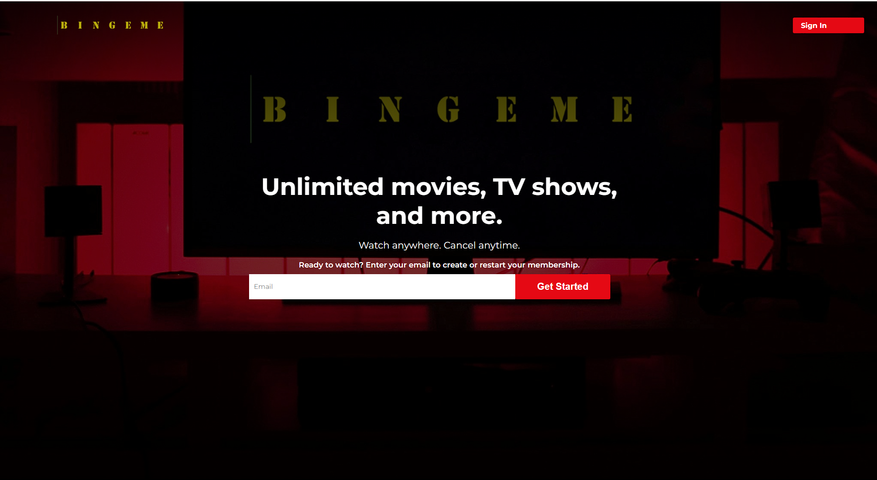
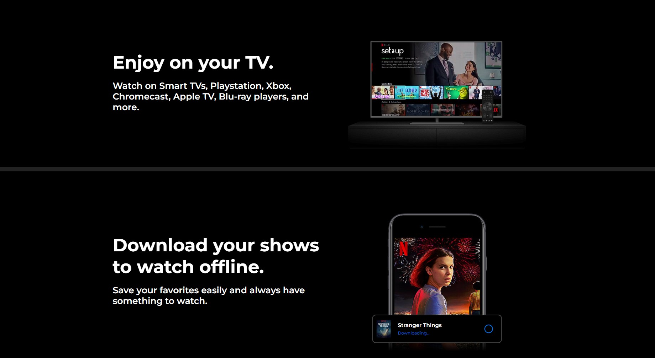
OUTPUT & REPORT TESTING

Slide 9
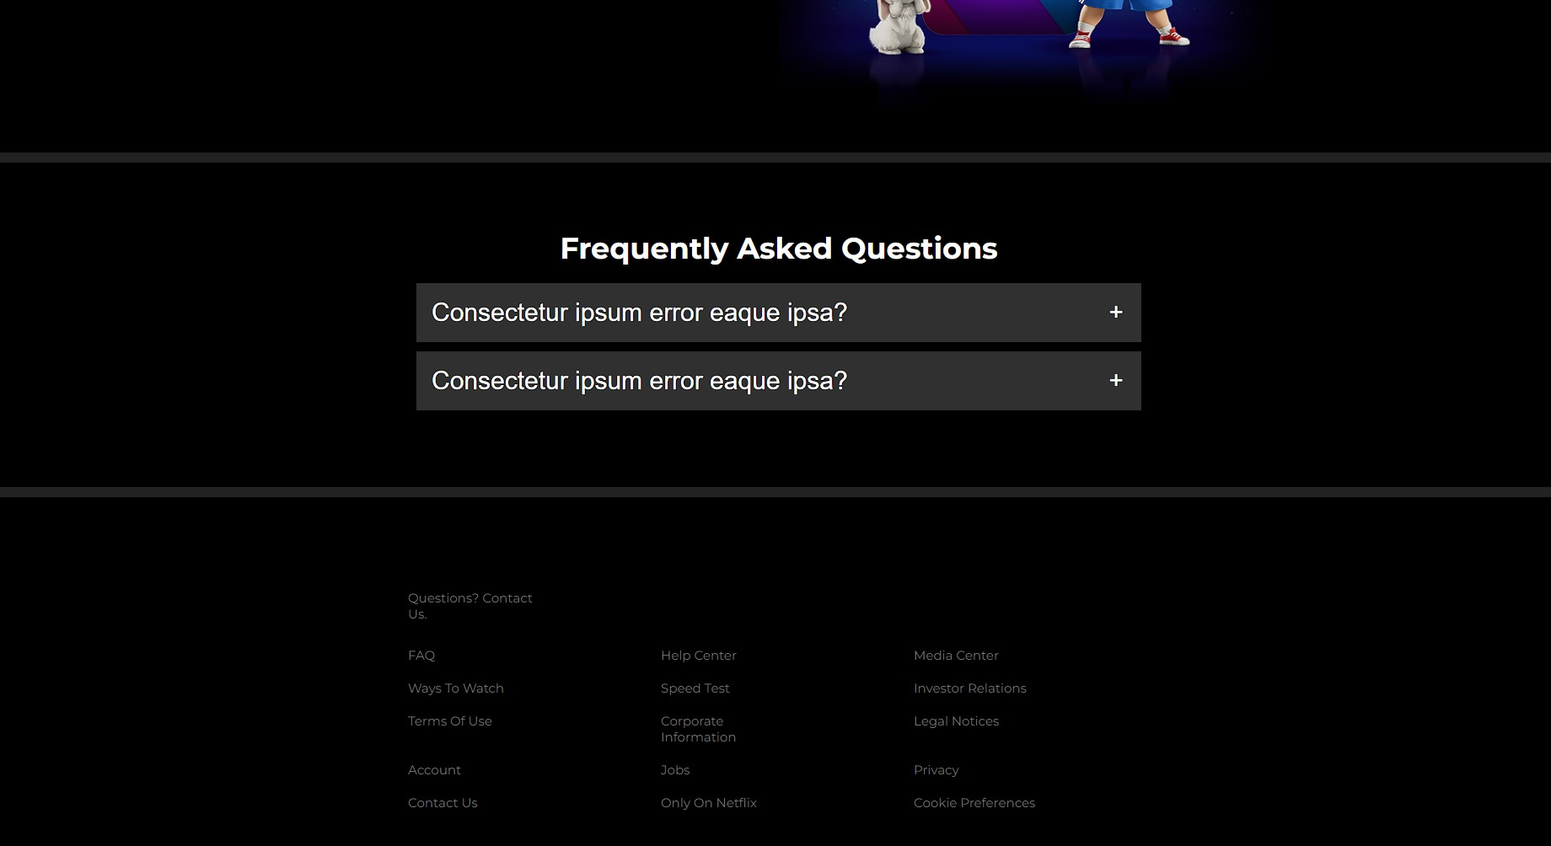

Slide 10
CONCLUSION
BingeMe is a popular streaming service that has revolutionized the way people consume video content. The company's success can be attributed to a number of factors, including its vast library of TV shows and movies, personalized recommendations engine, and ease of use across multiple devices.
BingeMe's software and hardware infrastructure is also a key part of its success, as it enables the service to deliver high-quality content to users around the world quickly and reliably. The service relies on a combination of proprietary and open source technologies, including custom-built servers, content delivery networks, and networking technologies, to manage its vast library of video content and deliver it to users with minimal buffering and loading times.

Slide 11
FUTURE SCOPE
The future scope of BingeMe looks promising, as the company continues to invest in new technologies and expand its global reach.
BingeMe has been investing heavily in producing original content, including TV shows, movies, and documentaries.
This strategy will help the company differentiate itself from its competitors and led to critical acclaim and numerous awards.

Slide 12
BIBLIOGRAPHY AND REFERENCES
Here are some references that can be used for a bibliography on programming languages
website:
[1] Anscombe, F. 1981, Computing in Statistical Sci- ence Through APL, Springer Verlag,
New York
[2] Ashworth, R. 1989, "Review of APL Programs for the Mathematical Classroom,"
Computing Reviews, November 1989, Vol. 30, No. 1, pp. 569- 570
[3] Bozman, J. 1988, "Security Firm Finds IBM Power," Computerworld, Vol. 22, No. 24.
[4] Brown, J. and Crowder, H. 1985, "Graphics Applications Using Complex Numbers in
APL2," Technical Report 03.265, IBM Santa Teresa Labo- ratory, San Jose, CA
[5] Brown, J. 1987, "Understanding the 3090 Vector Facility (From an APL2 Perspective),"

Slide 13
THANK YOU

