Slide 1
ADV EXCEL PRESENTATION
BY ANKIT SHRIWAS
DA/DS 24
AUTOMOBILE

Slide 2
introduction
Political, social, and cultural elements play in as well, with America expressing more individualism and personal liberty relative to more collectivist cultures around the world. Motor vehicles have long been ingrained into American culture. After oil and gas, cars are the United States’ biggest production export and also the top import.

Slide 3
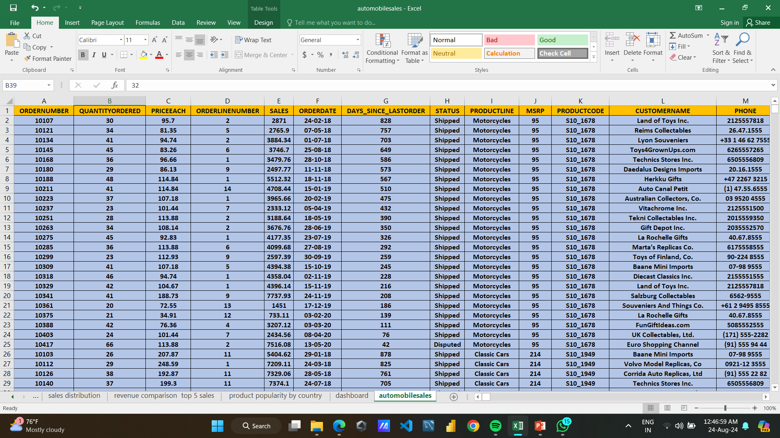

Slide 4
OVERVIEW
Sales By Quarters
Sales By Country
Sales By Year
Sales Distribution By Product Type
Revenue Comparison By Top 5 Salesperson
Product Popularity by Country

Slide 5
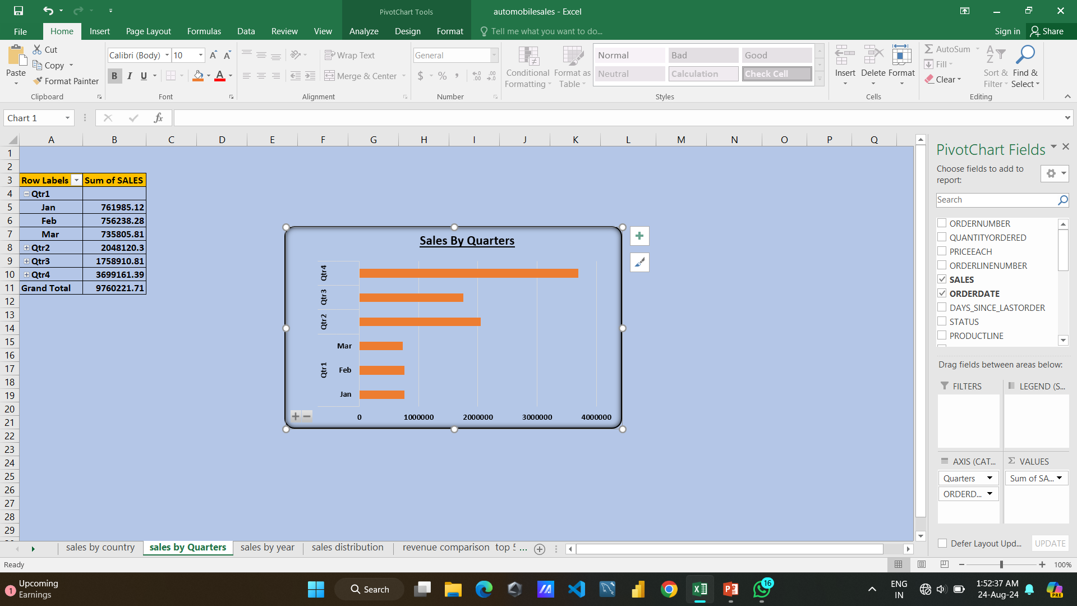

Slide 6
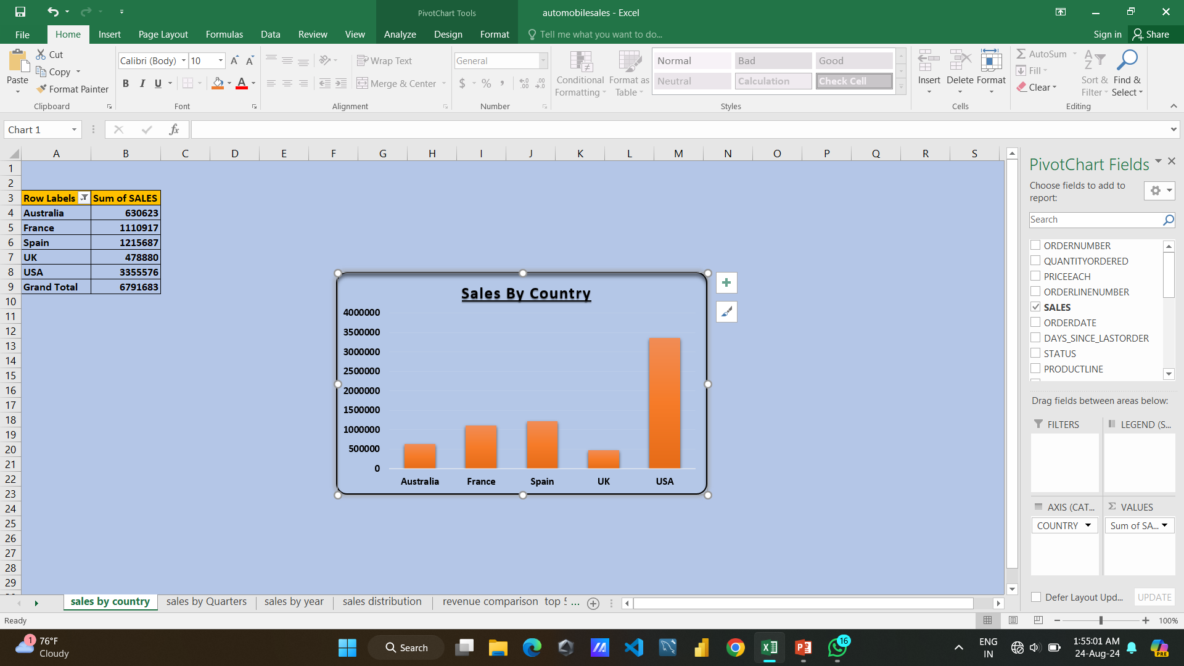

Slide 7
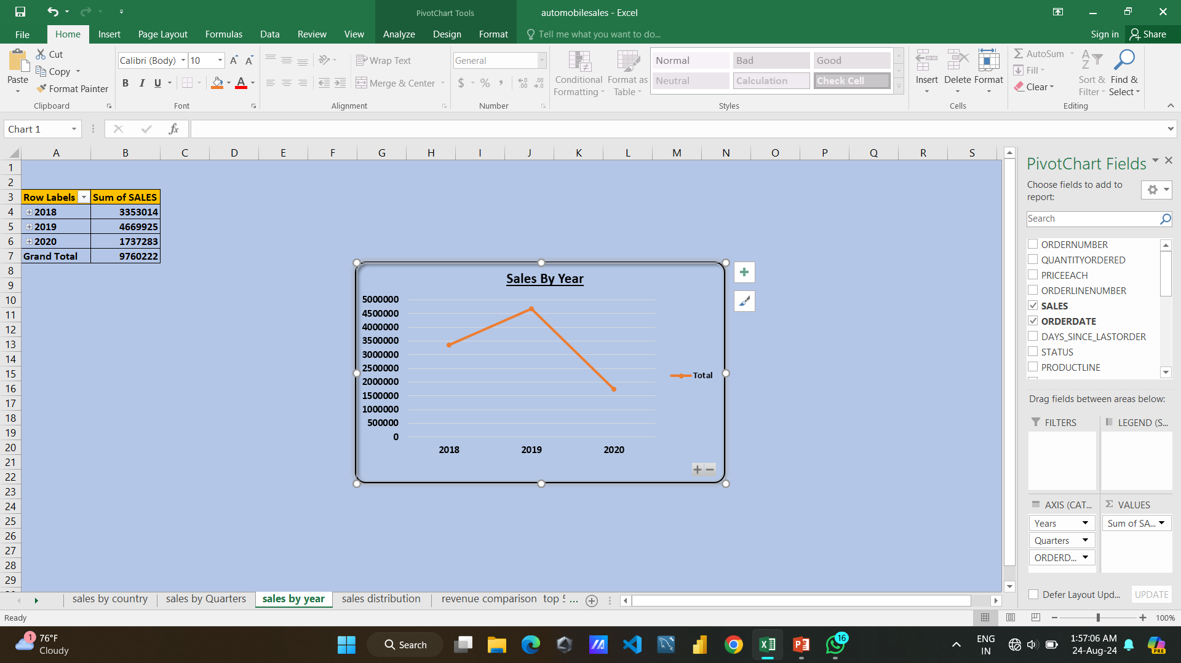

Slide 8
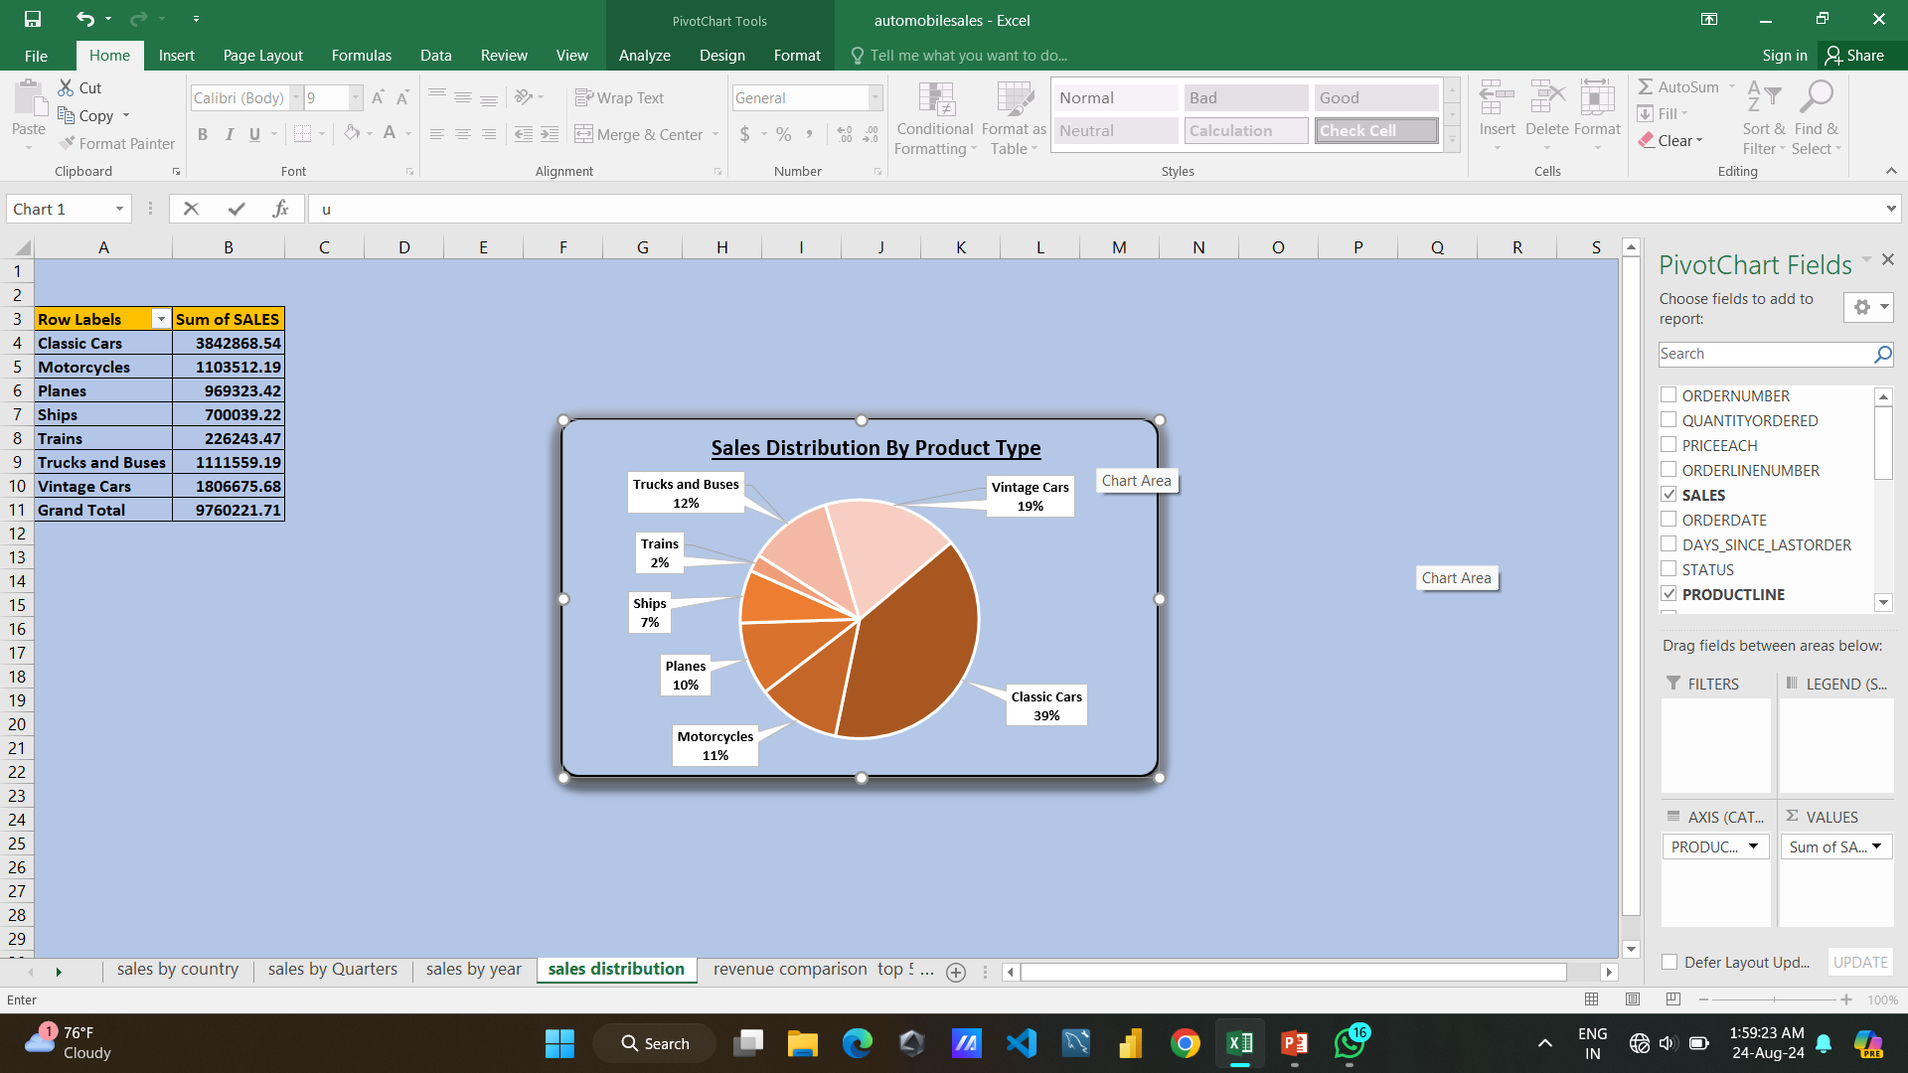

Slide 9
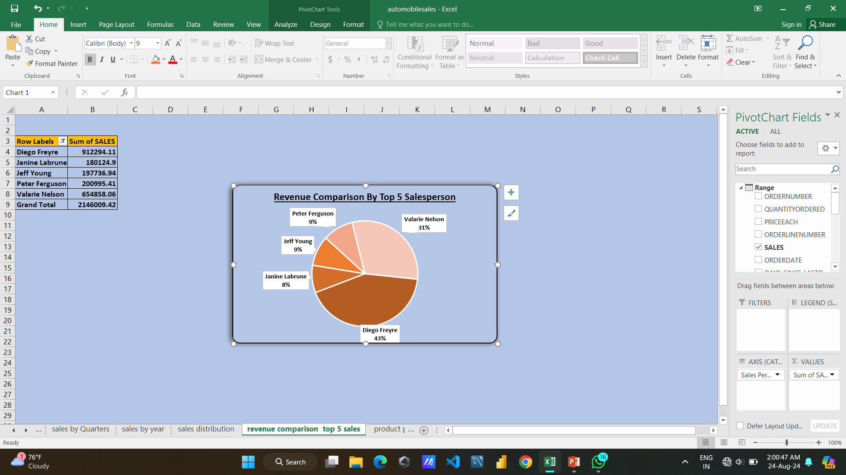

Slide 10
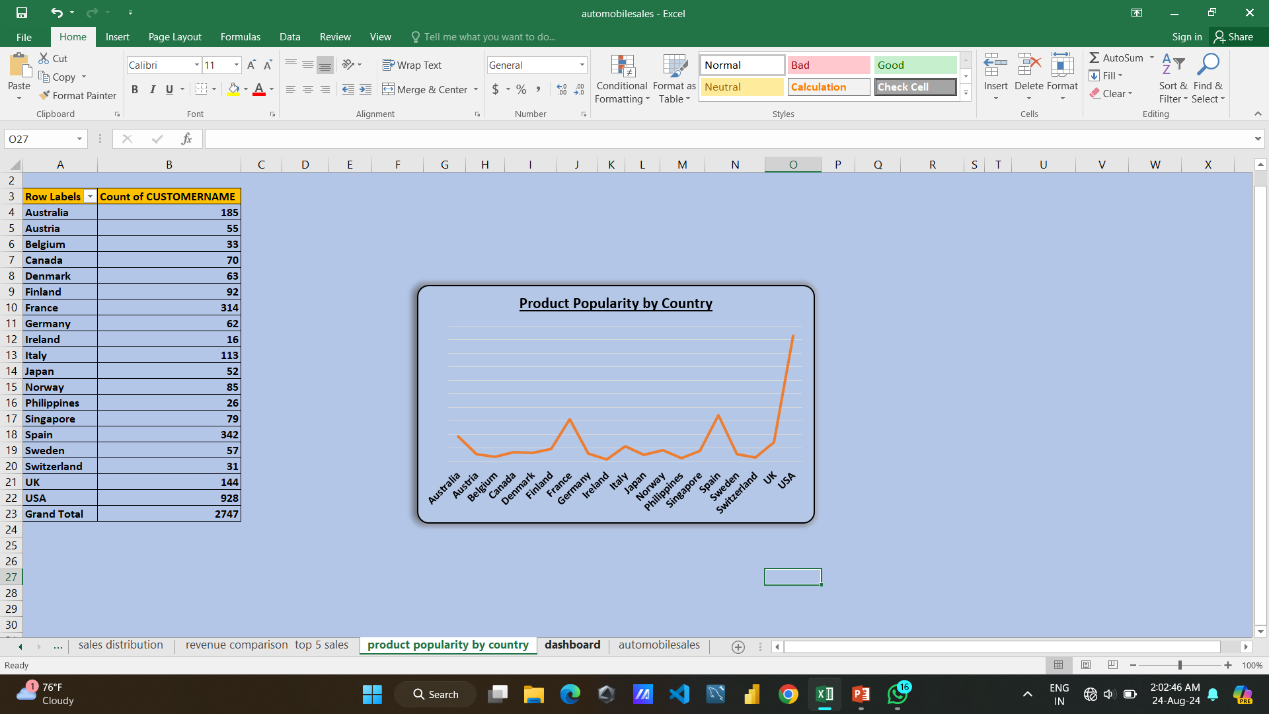

Slide 11
recommendation
# Top Performers
The USA has the highest sales, with over 3.35 million units. Focus on maintaining and growing this market through targeted marketing and sales campaigns.
# Growth Opportunities
Australia and the UK have lower sales figures. Consider exploring strategies to boost sales in these regions, such as promotions, partnerships, or tailored products.
# Regional Analysis
Perform a deeper analysis of the regions with higher sales (like the USA) to identify successful strategies that can be replicated in other regions.
# Trend Analysis
If historical data is available, examine trends over time to identify growth or decline patterns in different countries. This can help in forecasting future sales and adjusting strategies accordingly.

Slide 12
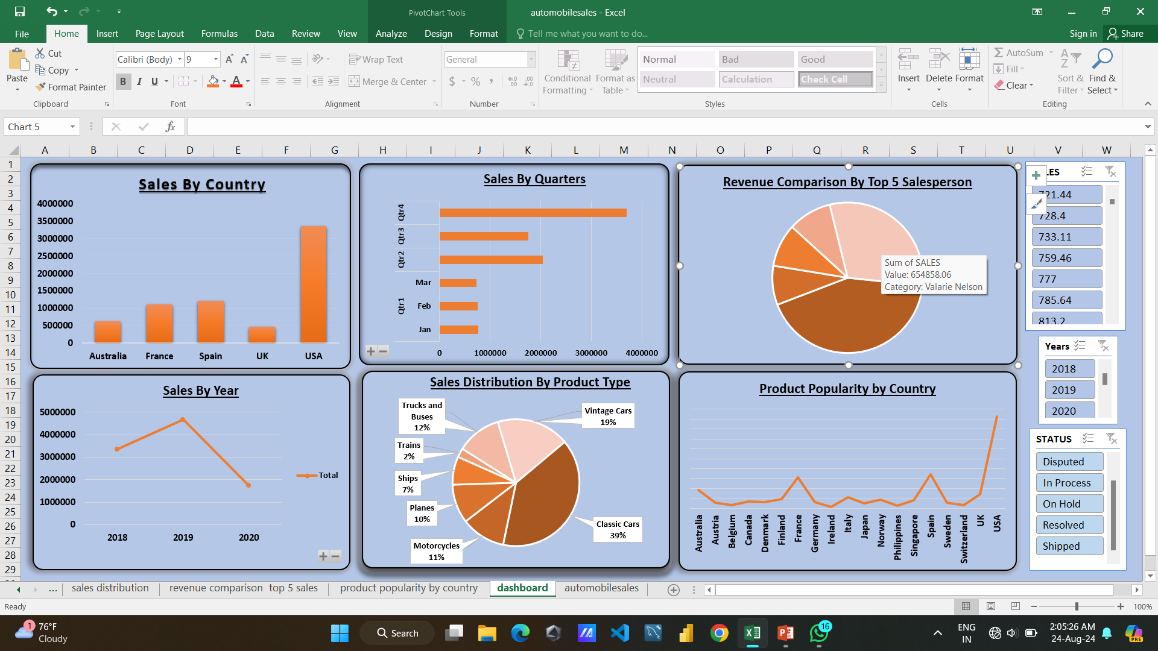

Slide 13
CONCLUSION
The dataset reveals total automobile sales of approximately 13.6 million units across multiple countries, with an average of about 2.26 million units per country. The highest sales figure appears to be a summary total rather than a specific country's data.
The data indicates the following:
Total Sales: 13583,365 units.
Average Sales per Country: 2,263,894 units.
Top Sales: The entry labeled "Grand Total" has the highest sales figure of 6,791,682 units, which likely represents the sum of all countries rather than a specific country.

Slide 14
Thank you

