Slide 1
Hyper-Personalization Using Llama 3.1 405B
AI-driven Personalized Recommendation System
Developed with Together AI & Streamlit /React UI

Slide 2
Overview
This project leverages the Llama 3.1 405B model via Together AI to generate personalized recommendations.
It analyzes customer profiles, sentiment data, and transaction history to suggest relevant products or services.

Slide 3
Technology Stack
Backend :
Python (Streamlit for UI, Pandas for data processing)
Together AI API (for AI-powered recommendations)
Frontend :
React.js (for UI integration with Streamlit)
Data Sources:
Customer Profile Data
Social Media Sentiment Analysis Data
Transaction History

Slide 4
Technical Approach
Data Upload for Model Training : User uploads an Excel file with customer details, social media sentiment, and transaction history.
Data Processing : Extracts relevant user data and prepares a structured prompt.
AI Inference : Sends prompt to Llama 3.1 405B API via Together AI.
Recommendation Generation : AI model returns personalized suggestions.
Streamlit UI : Displays results in an interactive web application(Testing model returning the recommendation).
React Frontend : Interactive React UI to display the recommendation and user detail

Slide 5
Challenges & Solutions
Large Model Access : Limited system resources, so we use Together AI's API for remote inference.
Data Formatting : Ensured structured data handling to avoid incomplete or incorrect responses.
Output Accuracy : Fine-tuned prompt engineering to generate human-readable and relevant recommendations.
Performance : Increased max tokens and adjusted temperature for better results.

Slide 6
Results & Observations
✅ The model generates highly accurate recommendations based on customer data.
✅ Supports real-time inference via Together AI API.
✅ Streamlit UI ensures ease of use and interaction.
✅ Successfully integrates structured customer data for personalization.

Slide 7
Conclusion & Future Scope
Successfully built a hyper-personalized recommendation system using Llama 3.1 405B.
Future improvements include:
Expanding data sources (e.g., real-time social media analysis).
Optimizing API calls for faster response.
Implementing multi-modal inputs (images, voice, etc.).

Slide 8
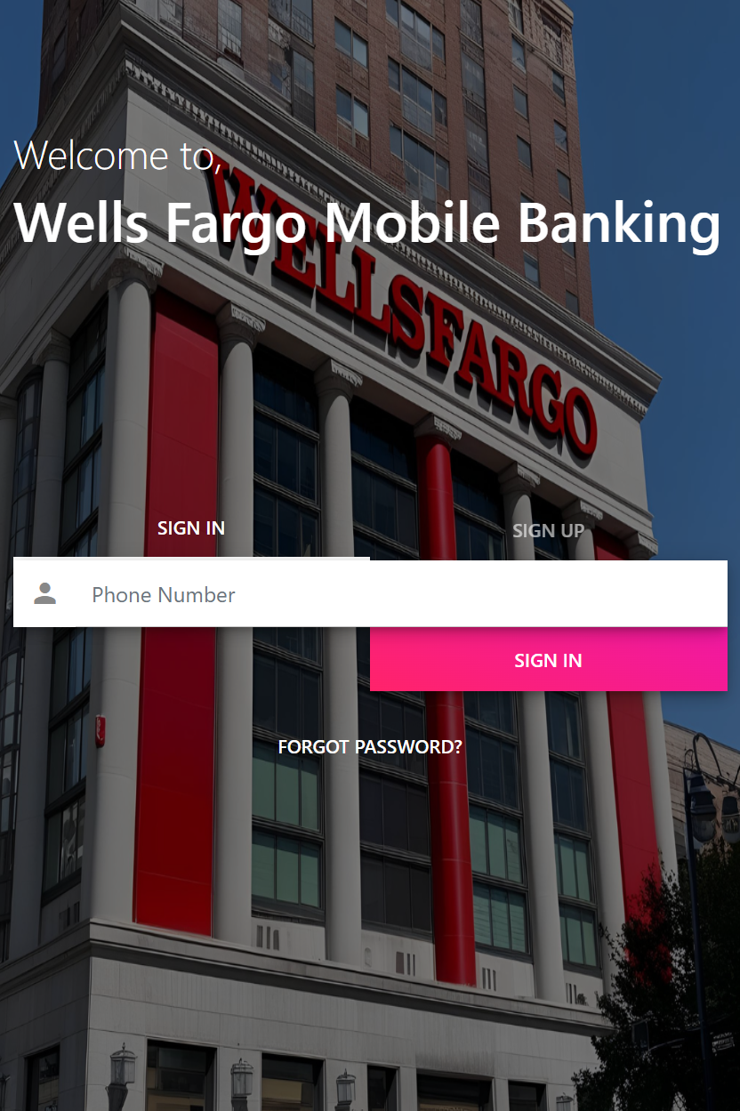
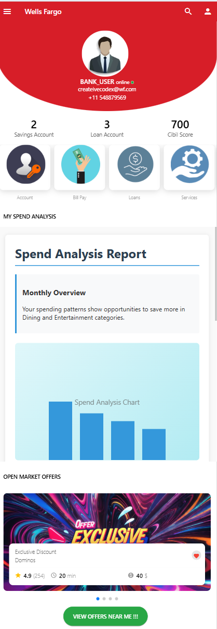
Screenshot

