Slide 1

CODECLASH 2.
East Rent
From Search to Stay — Seamless Renting.
Team Name : 404 Found
Ankit Singh Chauhan
Praveer Kumar
Ayush Gupta

Slide 2
Problem Statement
Finding and managing rental spaces remains a challenge for both landowners and renters due to the absence of a unified, digital solution.
For Landowners:
No platform to easily upload and manage room listings
Difficult to track payment history and renter details
Manual management of room status and profile info
East Rent

Slide 3
For Renters:
Lack of verified, searchable room listings
No proper way to track rental and payment history
Inability to bookmark or apply for rooms efficiently
Results:
Poor communication
Manual errors
Lack of trust and transparency
Time-consuming rental process
East Rent

Slide 4
Proposed Solution
To solve the challenges faced by both landowners and renters, we propose a centralized renters application that offers seamless interaction and management for both parties.
For Landowners:
Upload & manage room listings with details
Track and update renters’ payment history
Maintain renter records and communicate easily
Edit profile and room information anytime
East Rent

Slide 5
For Renters:
Search rooms using filters like city, price, or availability
Apply for bookings directly from the app
Save favorite listings for future reference
View and manage profile and rental/payment history
Outcome:
Efficient, transparent rental process
Reduced manual effort and errors
Better decision-making for both parties
Real-time updates and easy communication
East Rent

Slide 6
Tech Stack Used
A robust and scalable tech stack was used to ensure smooth performance, responsiveness, and security.
Frontend:
React.js – For building fast, interactive UI
Tailwind CSS – For modern, responsive styling
React Router – For navigation between pages
Axios – For API calls
East Rent

Slide 7
Backend:
Node.js – Runtime environment
Express.js – Lightweight and fast web framework
JWT (JSON Web Token) – For user authentication and authorization
Database:
MongoDB (with Mongoose) – NoSQL database for flexible schema design
MongoDB Atlas – Cloud database hosting
East Rent

Slide 8
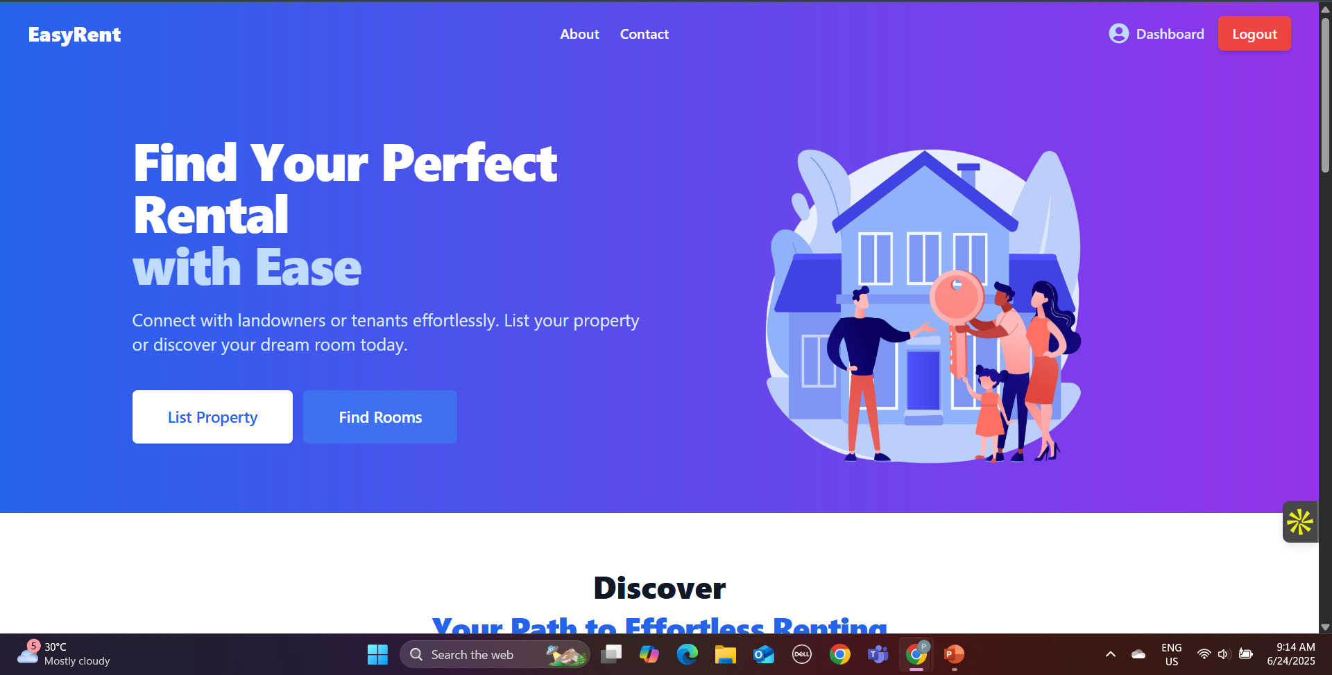
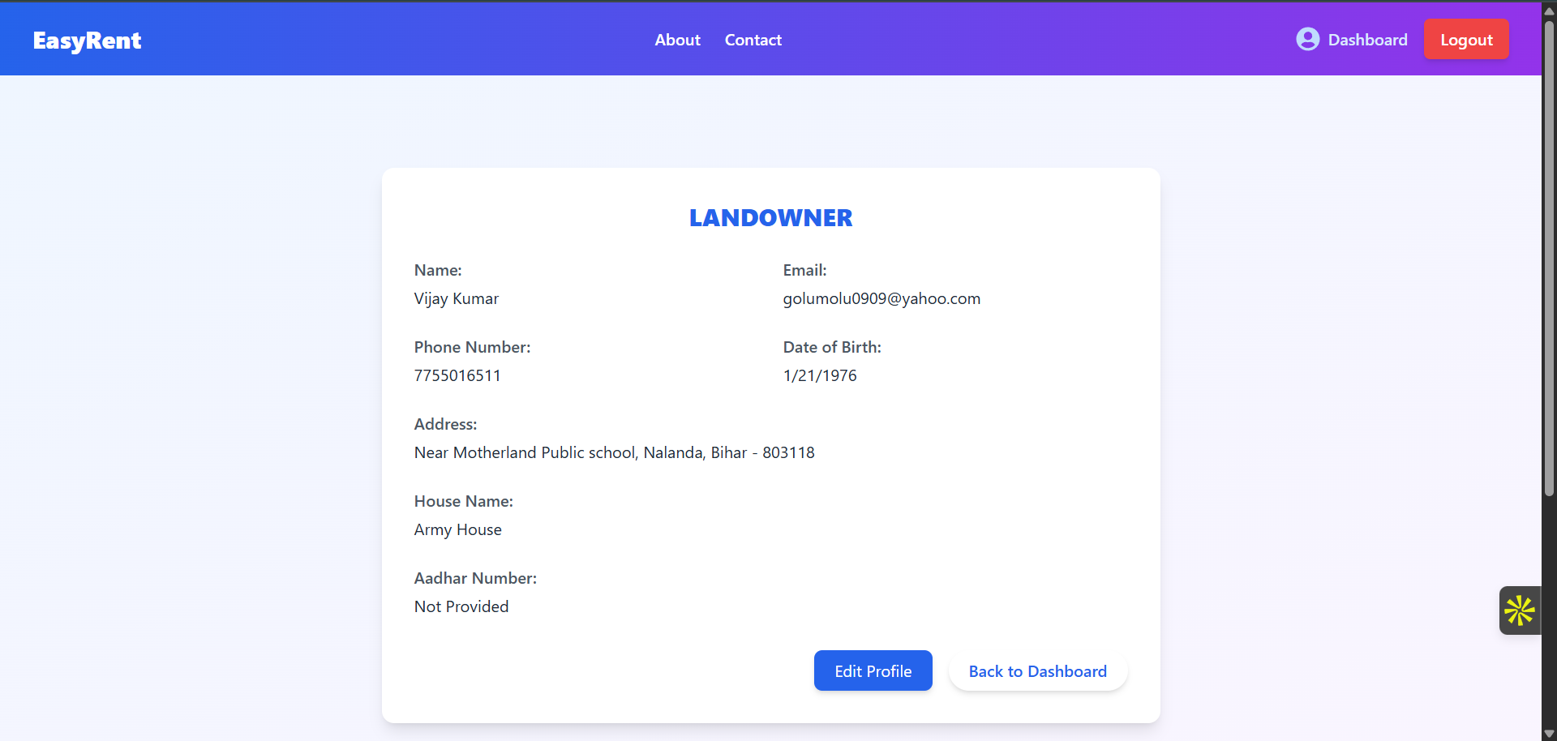
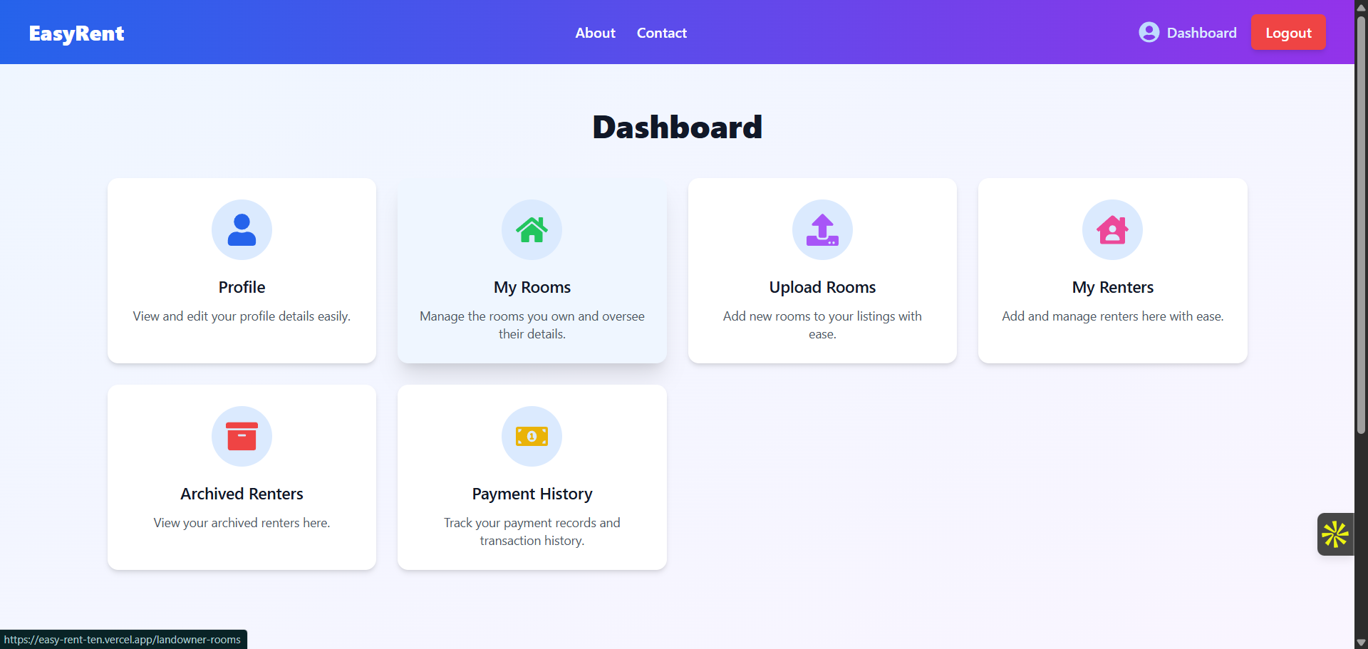
Demo/Screenshots
East Rent

Slide 9
Challenges Faced
Building a full-stack rental platform came with several real-world and technical challenges:
Request & Approval Workflow –
Designing a smooth system where renters can send requests to book rooms and landowners can accept/reject them.
Managing status updates and notifications in real-time.
Role-Based Access –
Handling different user roles (renter vs. landowner) with specific permissions.
Preventing unauthorized access to protected routes and data.
East Rent

Slide 10
Future Scope
Enhancing the platform with advanced features and scalability to meet future needs:
Mobile Application –
Develop a cross-platform mobile app using React Native or Flutter.
Improve accessibility and user engagement.
Real-Time Notifications –
Implement WebSocket or Firebase for instant booking alerts, approvals, and status updates.
East Rent

Slide 11
Smart Recommendations –
Use Machine Learning to suggest rooms based on user preferences, location, and history.
Multi-City Expansion with Geo-Search –
Add map-based room search using Google Maps API.
Expand listings to multiple cities and regions.
East Rent

Slide 12
Still Existing Problems
Despite major features being implemented, some challenges still remain:
Hybrid Payment Handling (Cash + Online) –
Difficult to track and verify cash payments.
Lack of Notification System –
No real-time updates when a request is made, accepted, or rejected.
Renters/landowners must manually check status updates.
No Mobile App –
Renters/landowners currently rely only on the web interface.
Limits accessibility for users preferring mobile access.
East Rent

Slide 13
Limited Testing with Real Users–
Yet to be tested with real landlords and tenants.
May face usability gaps or edge-case issues post-deployment.
East Rent

Slide 14
Thank You
East Rent

