Slide 1
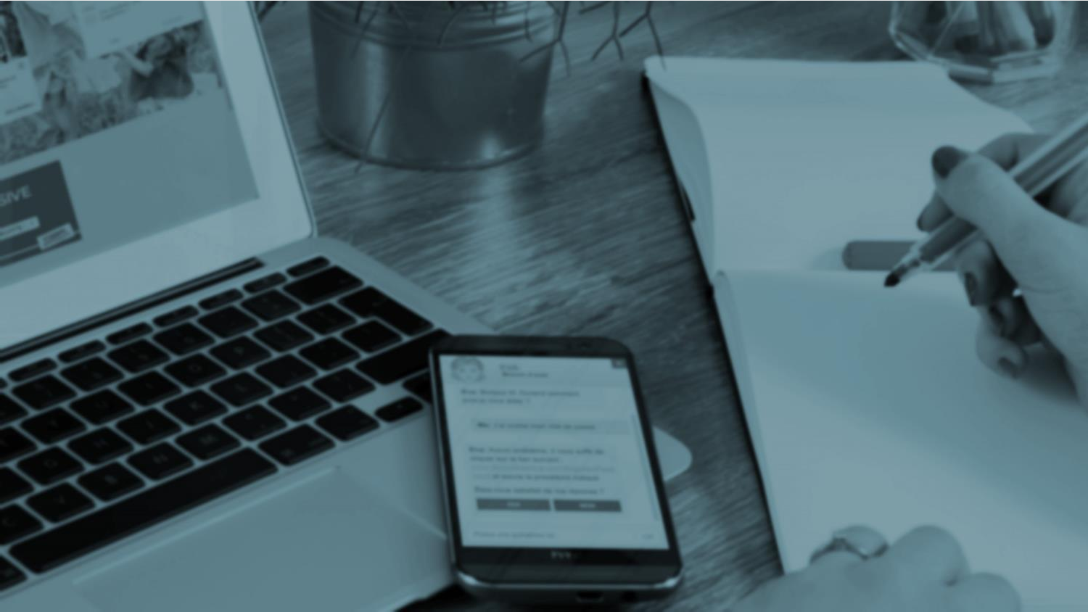
CHATBOTS
1
Created By:
Ankit Kumar
Utkarsh
Shivam Kumar
<<<
Do You Dream Up – Présentation 2015

Slide 2
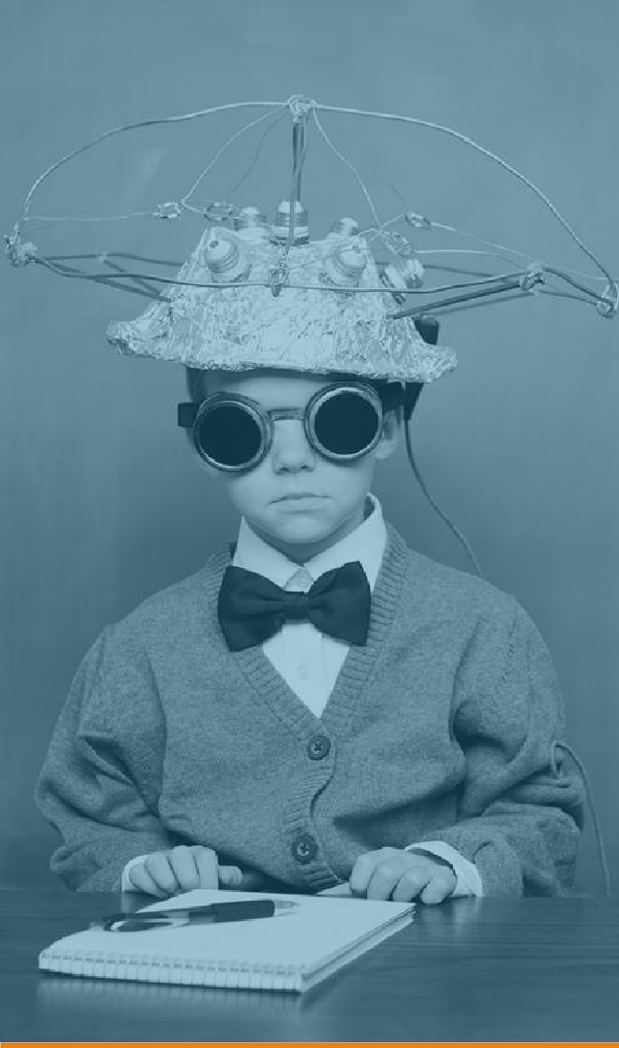
2
INDEX
Introduction to chatbot
Working
Benefits
Uses
Outcomes

Slide 3

3
3
INTRODUCTION TO CHATBOT

Slide 4
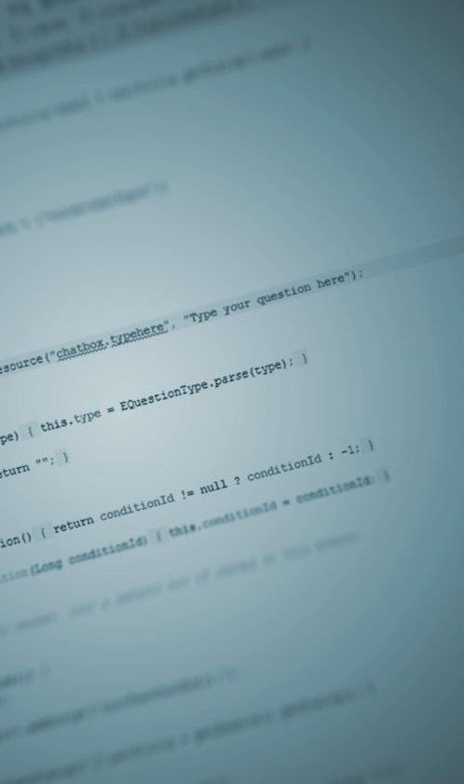
What is a chatbot?
44
4
A chatter robot (chatbot) is a type of conversational agent, a computer program designed to simulate an intelligent conversation with one or more human users in natural language via auditory or textual methods. (Wikipedia)
In short, chatbots are virtual assistant programmed to automatically answer users requests

Slide 5






How does it work?
5
User makes a request
Request analyzed by artificial intelligence
User info taken into account (history, preferences…)
Real time response Conversational strategy Interactions personalization
…

Slide 6
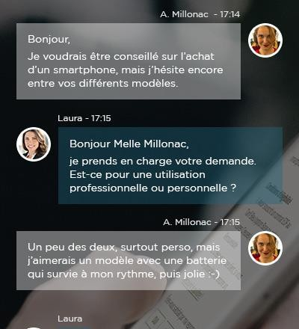
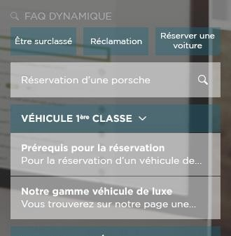
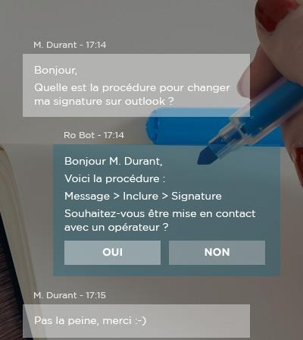
For what use?
6
Customer support
User account information Order tracking and delivery Product technical support Incident report
Sale and advice
Make an order, reservation
Internal support
Helpdesk (office applications, etc)
Ask for personalized advices
HR (leave balances, etc)
Practical services (room booking…)

Slide 7


Benefits 1/2
7
User satisfaction
Customer service enhancement
Immediate answers
Quality and detail of responses
Available 24/7
Multi-channel consistency
90% correct answers
Relieve congestion in contact centers = more free time for value added questions
Personalized answers
Valorisation of advisers
Customer autonomy
Knowledge centralization
Innovative customer service

Slide 8


Benefits 2/2
8
Simplify employees life
Enhance productivity and operational effectiveness
Staff retention
Decrease calls and e-mails to support service Resources reallocation on value added tasks

Slide 9
Outcome
9
Learned about Concept of Classes and Objects.
Learned about Concept of NLP.
Learned about Concept of Text Pre processing.
Strengthened command over Tensorflow.
Learned to train models on Cloud.
Learned the concept of RNN and LSTMs.

Slide 10
THANK YOU

