Slide 1
AI-Assisted Smart Attendance & Performance Tracker
Mini Project
Using HTML, CSS, JavaScript, Node.js MOGODB
Name:
Roll No:
Semester:

Slide 2
Problem Definition
Manual attendance is time-consuming
Human errors in calculation
No automatic performance analysis

Slide 3
Objectives
Manage student data
Calculate attendance automatically
Generate AI-based remarks

Slide 4
Technology Stack
Frontend: HTML, CSS, JavaScript
Backend: Node.js, Express
Database: In-memory JSON

Slide 5
System Architecture
User → Frontend UI
Frontend → Backend API
Backend → AI Logic → Response

Slide 6
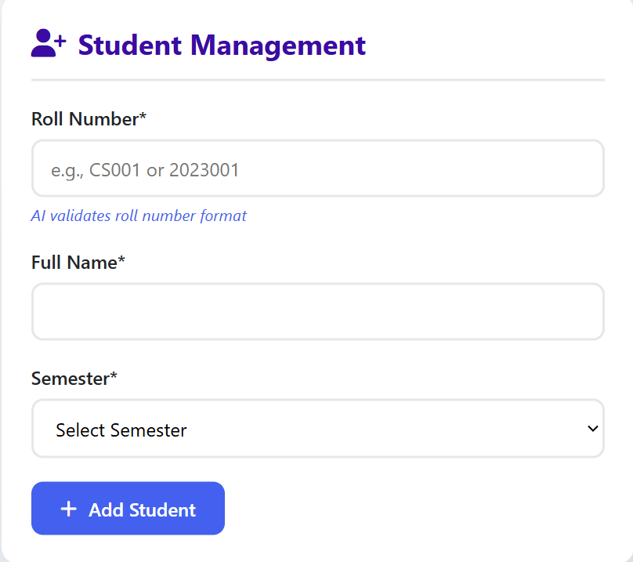
Student Management Module
Add student
Unique roll number validation
Store data in memory

Slide 7
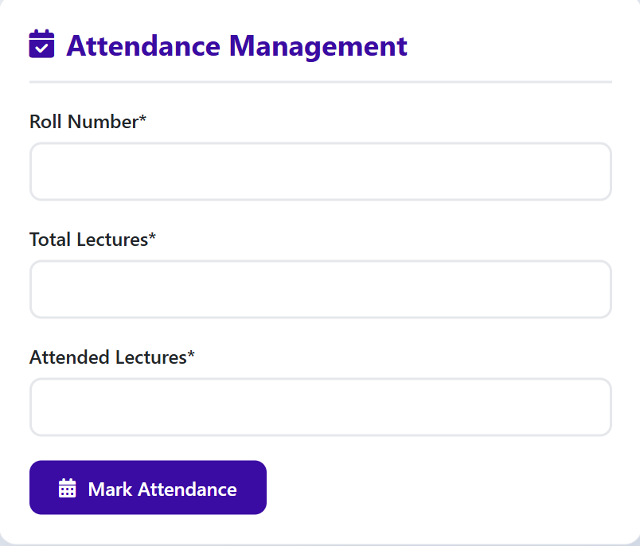
Attendance Management

Slide 8
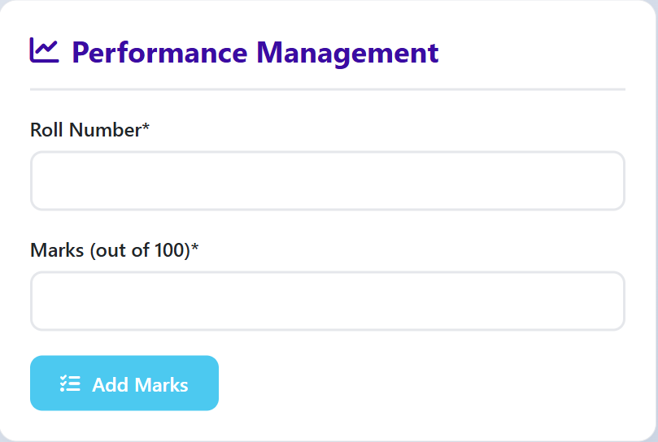
Performance Management

Slide 9
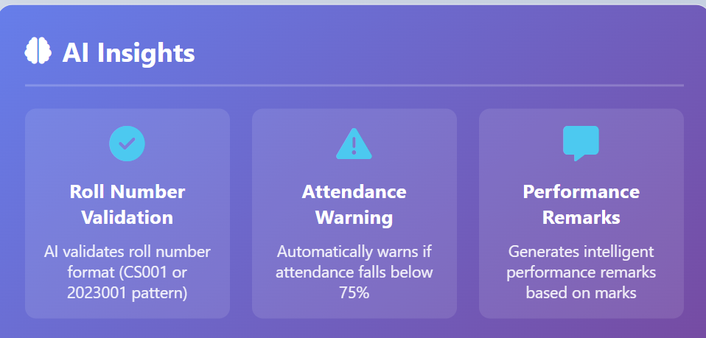
AI-Assisted Logic

Slide 10
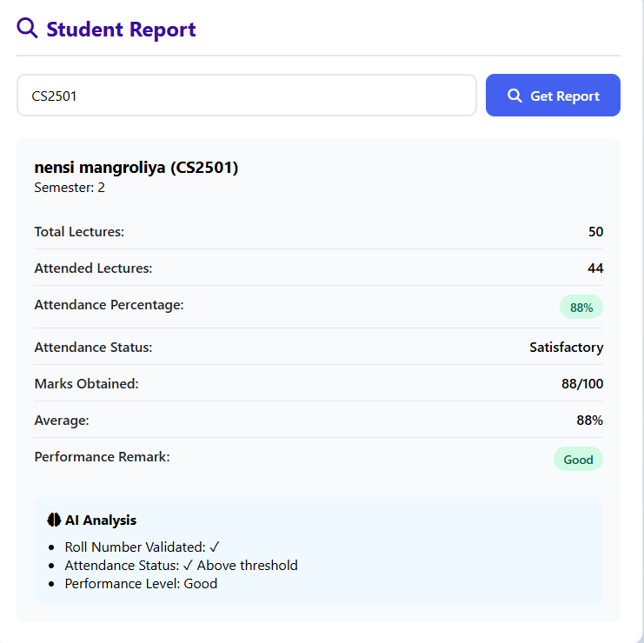
Sample Input

Slide 11
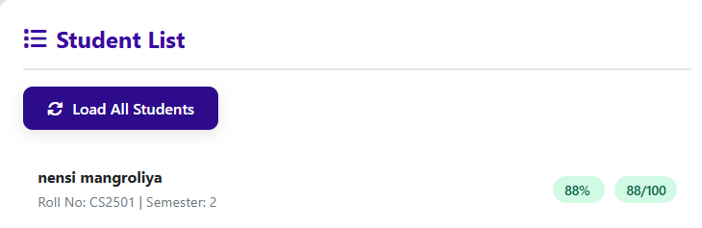
Sample Output

Slide 12
Conclusion
Smart & automated system
Reduces manual work
Exam-oriented project

