Slide 1
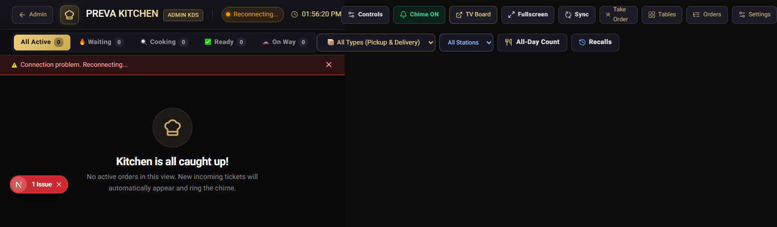
KITCHEN DISPLAY SYSTEM (KDS)
PREVA KITCHEN
How It Works
KDS LOGIN
A clear path from incoming order to kitchen handoff.
User ID
chef
Password
************
LOGIN
SECURE KITCHEN TERMINAL
Actual Preva Kitchen Live Display screenshot

Slide 2
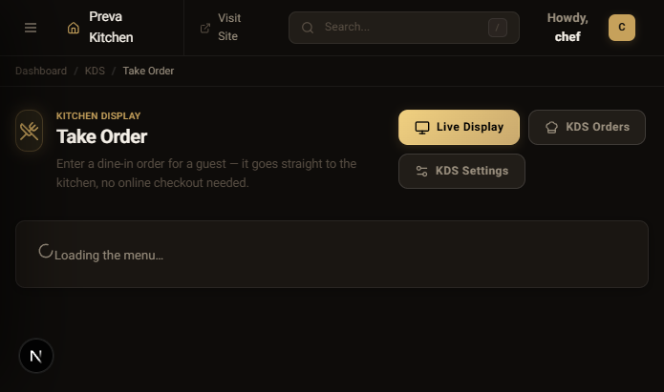
01 / OVERVIEW
PREVA KITCHEN / OPERATIONS
What is a Kitchen Display System?
KDS
INCOMING
Live kitchen visibility
A digital screen that replaces paper order tickets in a restaurant kitchen.
PREPARING
Live kitchen visibility
Orders arrive in real time, stay visible through every kitchen stage, and give the team one shared source of truth.
READY
Live kitchen visibility
Actual Preva Kitchen Take Order screen

Slide 3
02 / FLOW
PREVA KITCHEN / OPERATIONS
How It Works — Order Flow
1
2
3
4
5
Customer
Checkout
KDS
Kitchen
Complete
places order
>
validates payment
>
alerts the kitchen
>
prepares food
>
handoff confirmed
Every status change is timestamped, visible, and shared across the kitchen.

Slide 4
03 / LIVE BOARD
PREVA KITCHEN / OPERATIONS
KDS Screen — One View of Service
KDS LIVE DISPLAY
WAITING 04
READY 02
P Preva Kitchen
Live Display
Take Order
#1042
Table 4
#1043
Delivery
#1044
Pickup
Table Status
2x Wings / 1x Fries
1x Salmon / 2x Sides
3x Pasta / 1x Salad
KDS Orders
ORDER TIMER
02:14
ORDER TIMER
08:32
ORDER TIMER
14:05
KDS Settings
NEW
Station / Expo
IN PROGRESS
Station / Expo
READY
Station / Expo
Actual running Preva KDS Live Display — full captured screen from top navigation to status area.
Actual running Preva KDS Live Display — full captured screen from top navigation to status area.
Actual running Preva KDS Live Display — full captured screen from top navigation to status area.

Slide 5
04 / CONTROL
PREVA KITCHEN / OPERATIONS
Key Features
SYNC
Real-time order sync
PRIORITY
Color-coded order priority
TIMER
Order timers and SLA warnings
Built for a busy service line
Built for a busy service line
Built for a busy service line
ROUTE
Multi-station routing
LOG
Order history and audit log
Built for a busy service line
Built for a busy service line

Slide 6
05 / OUTCOME
PREVA KITCHEN / OPERATIONS
Benefits
A calmer kitchen starts with shared visibility.
01
Faster service
02
Fewer errors
Less time searching for tickets.
Clear items, options, notes, and status.
03
Paperless kitchen
04
Better coordination
One live board replaces scattered slips.
Every station sees the same truth.
FROM ORDER → TO EXPO → TO A BETTER SERVICE

