Slide 1
Continuous Testing Improvement
Roy Budhai
Sr. ST Manager, Reporting and Visualization
Oct, 2010

Slide 2
Agenda
Introduction
Software Development Learnings
Test Automation Learnings
ST Profession
Q&A
Confidential and proprietary. Copyright © 2004 Business Objects S.A. All rights reserved.

Slide 3
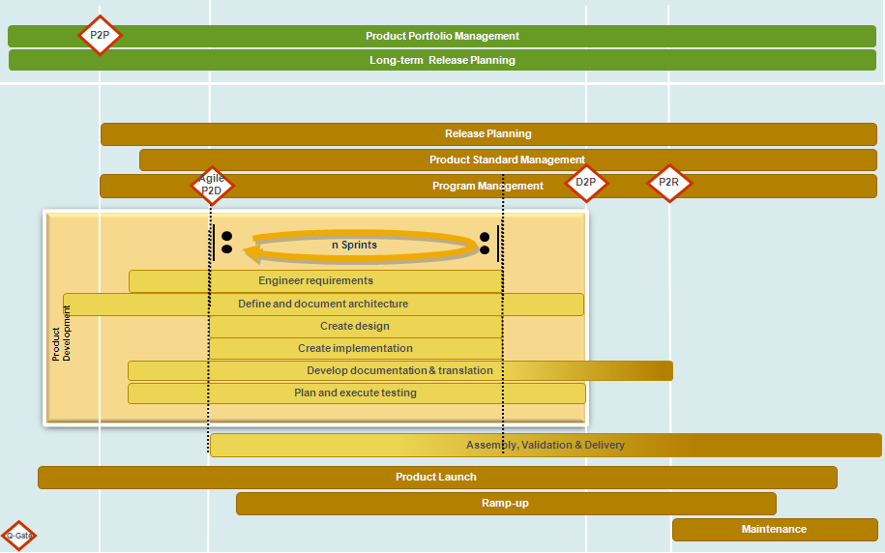
Enterprise Software Development Learnings
Defined Delivery Model incorporating SCRUM methodology
Confidential and proprietary. Copyright © 2004 Business Objects S.A. All rights reserved.

Slide 4
Enterprise Software Delivery Learnings
Compliance and Legal Requirements
ISO9001
Say what you do (document your process)
Do what you say (follow your documented process)
Prove it (provide evidence that you followed your documented process)
Testing requirement to have traceability from Requirements to Test Results
Additional Quality Metrics
Test of New Requirements, Test of Legacy Features
Feature Signoffs
Defect Tracking linked to Features
Confidential and proprietary. Copyright © 2004 Business Objects S.A. All rights reserved.
Notes:
Solution Validation
– validating the product from a customer experience perspective
- ensure the product meets legal and product standards

Slide 5
Enterprise Software Delivery Learnings
Development Organization
Enterprise SCRUM
Cross functional teams of 10
Portfolio and Release Planning
Prioritized Backlogs
Globalization of Teams
Translation Services, Tools teams, Build Acceptance, Suite Testing, Release & Delivery Ops
Focus on Innovation
“TGIF”
Tool Development
    Dedicated teams supporting tool development
    New development tooling: JLIN, Security software (AppScan, Fortify)
Confidential and proprietary. Copyright © 2004 Business Objects S.A. All rights reserved.
Notes:
Solution Validation
– validating the product from a customer experience perspective
- ensure the product meets legal and product standards

Slide 6
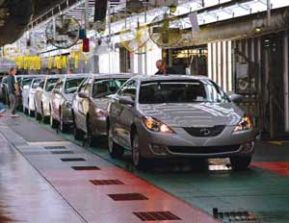
Test Automation Learnings
“Production” Test Automation
Integrated test automation into production systems
Vision: To make test automation and test execution a manufacturing process that is efficient, reliable and easy to follow.
Confidential and proprietary. Copyright © 2004 Business Objects S.A. All rights reserved.
Notes:
Solution Validation
– validating the product from a customer experience perspective
- ensure the product meets legal and product standards

Slide 7
Test Automation Learnings
Moving Up the Value Chain
Dedicated Tools Team
Focus on the test, not on Test Frameworks
UI Automation
Development buy-in
Continuous Build Quality
Full Automation
Running all test cases everyday
Reduce the time for stabilization
Reduce the time from defect injection to correction
Confidential and proprietary. Copyright © 2004 Business Objects S.A. All rights reserved.
Notes:
Solution Validation
– validating the product from a customer experience perspective
- ensure the product meets legal and product standards

Slide 8
Software Testing Profession
Focus on the ST Profession
Develop and recognize ST as a profession in comparison to Quality Management
Alignment within larger global organization
Career and Professional Development Focus
ISTQB Certification
Training
Career Definitions and Ladders for growth
Test Environment Improvements
Aligned, understandable, seamless environment for testers
Confidential and proprietary. Copyright © 2004 Business Objects S.A. All rights reserved.
Notes:
Solution Validation
– validating the product from a customer experience perspective
- ensure the product meets legal and product standards

Slide 9
Software Testing Profession
Research focused on Software Testing
Testing Methodology Investigation
All Pairs, Risk Based Testing, Test Driven Development, UI Automation
Research Projects in conjunction with Universities
Academic Research projects (Image Comparison, Distributed Test Execution, Data Mining)
Confidential and proprietary. Copyright © 2004 Business Objects S.A. All rights reserved.
Notes:
Solution Validation
– validating the product from a customer experience perspective
- ensure the product meets legal and product standards

Slide 10

Q&A
© SAP 2008 / Page <number>

