Slide 1
Shell Scripting
Let's look at a few interesting examples first.

Slide 2
Link - https://github.com/NARKOZ/hacker-scripts/blob/master/smack-my-bitch-up.sh
#!/bin/sh -e
# Exit early if no sessions with my username are found
if ! who | grep -wq $USER; then
exit
fi
# Phone numbers
MY_NUMBER='+xxx'
HER_NUMBER='+xxx'
REASONS=(
'Working hard'
'Gotta ship this feature'
'Someone fucked the system again'
)
rand=$[ $RANDOM % ${#REASONS[@]} ]
RANDOM_REASON=${REASONS[$rand]}
MESSAGE="Late at work. "$RANDOM_REASON
# Send a text message
RESPONSE=`curl -fSs -u "$TWILIO_ACCOUNT_SID:$TWILIO_AUTH_TOKEN" \
-d "From=$MY_NUMBER" -d "To=$HER_NUMBER" -d "Body=$MESSAGE" \
"https://api.twilio.com/2010-04-01/Accounts/$TWILIO_ACCOUNT_SID/Messages"`
# Log errors
if [ $? -gt 0 ]; then
echo "Failed to send SMS: $RESPONSE"
exit 1
fi

Slide 3
Link – https://github.com/NARKOZ/hacker-scripts/blob/master/kumar_asshole.rb
#!/bin/sh
#
# Requires kumar_asshole script in your bin
#
exec kumar_asshole
#!/usr/bin/env ruby
require 'dotenv'
require 'gmail'
Dotenv.load
GMAIL_USERNAME = ENV['GMAIL_USERNAME']
GMAIL_PASSWORD = ENV['GMAIL_PASSWORD']
GMAIL = Gmail.connect(GMAIL_USERNAME, GMAIL_PASSWORD)
KUMARS_EMAIL = 'kumar.a@example.com'
DB_NAME_REGEX = /\S+_staging/
KEYWORDS_REGEX = /sorry|help|wrong/i
def create_reply(subject)
GMAIL.compose do
to KUMARS_EMAIL
subject "RE: #{subject}"
body "No problem. I've fixed it. \n\n Please be careful next time."
end
end
GMAIL.inbox.find(:unread, from: KUMARS_EMAIL).each do |email|
if email.body.raw_source[KEYWORDS_REGEX] && (db_name = email.body.raw_source[DB_NAME_REGEX])
backup_file = "/home/backups/databases/#{db_name}-" + (Date.today - 1).strftime('%Y%m%d') + '.gz'
abort 'ERROR: Backup file not found' unless File.exist?(backup_file)
# Restore DB
`gunzip -c #{backup_file} | psql #{db_name}`
# Mark as read, add label and reply
email.read!
email.label('Database fixes')
reply = create_reply(email.subject)
GMAIL.deliver(reply)
end
end

Slide 4
Link - https://github.com/NARKOZ/hacker-scripts/blob/master/fucking_coffee.rb
#!/bin/sh
#
# Requires fucking_coffee script in your bin
#
exec fucking_coffee
#!/usr/bin/env ruby
# Exit early if no sessions with my username are found
exit unless `who -q`.include? ENV['USER']
require 'net/telnet'
coffee_machine_ip = '10.10.42.42'
password = '1234'
password_prompt = 'Password: '
delay_before_brew = 17
delay = 24
sleep delay_before_brew
con = Net::Telnet.new('Host' => coffee_machine_ip)
con.cmd('String' => password, 'Match' => /#{password_prompt}/)
con.cmd('sys brew')
sleep delay
con.cmd('sys pour')
con.close

Slide 5
Link - https://github.com/NARKOZ/hacker-scripts/blob/master/hangover.sh
#!/bin/sh
# Exit early if any session with my username is found
if who | grep -wq $USER; then
exit
fi
# Phone numbers
MY_NUMBER='+xxx'
NUMBER_OF_BOSS='+xxx'
EXCUSES=(
'Locked out'
'Pipes broke'
'Food poisoning'
'Not feeling well'
)
rand=$[ $RANDOM % ${#EXCUSES[@]} ]
RANDOM_EXCUSE=${EXCUSES[$rand]}
MESSAGE="Gonna work from home. "$RANDOM_EXCUSE
# Send a text message
RESPONSE=`curl -fSs -u "$TWILIO_ACCOUNT_SID:$TWILIO_AUTH_TOKEN" \
-d "From=$MY_NUMBER" -d "To=$NUMBER_OF_BOSS" -d "Body=$MESSAGE" \
"https://api.twilio.com/2010-04-01/Accounts/$TWILIO_ACCOUNT_SID/Messages"`
# Log errors
if [ $? -gt 0 ]; then
echo "Failed to send SMS: $RESPONSE"
exit 1
fi

Slide 6
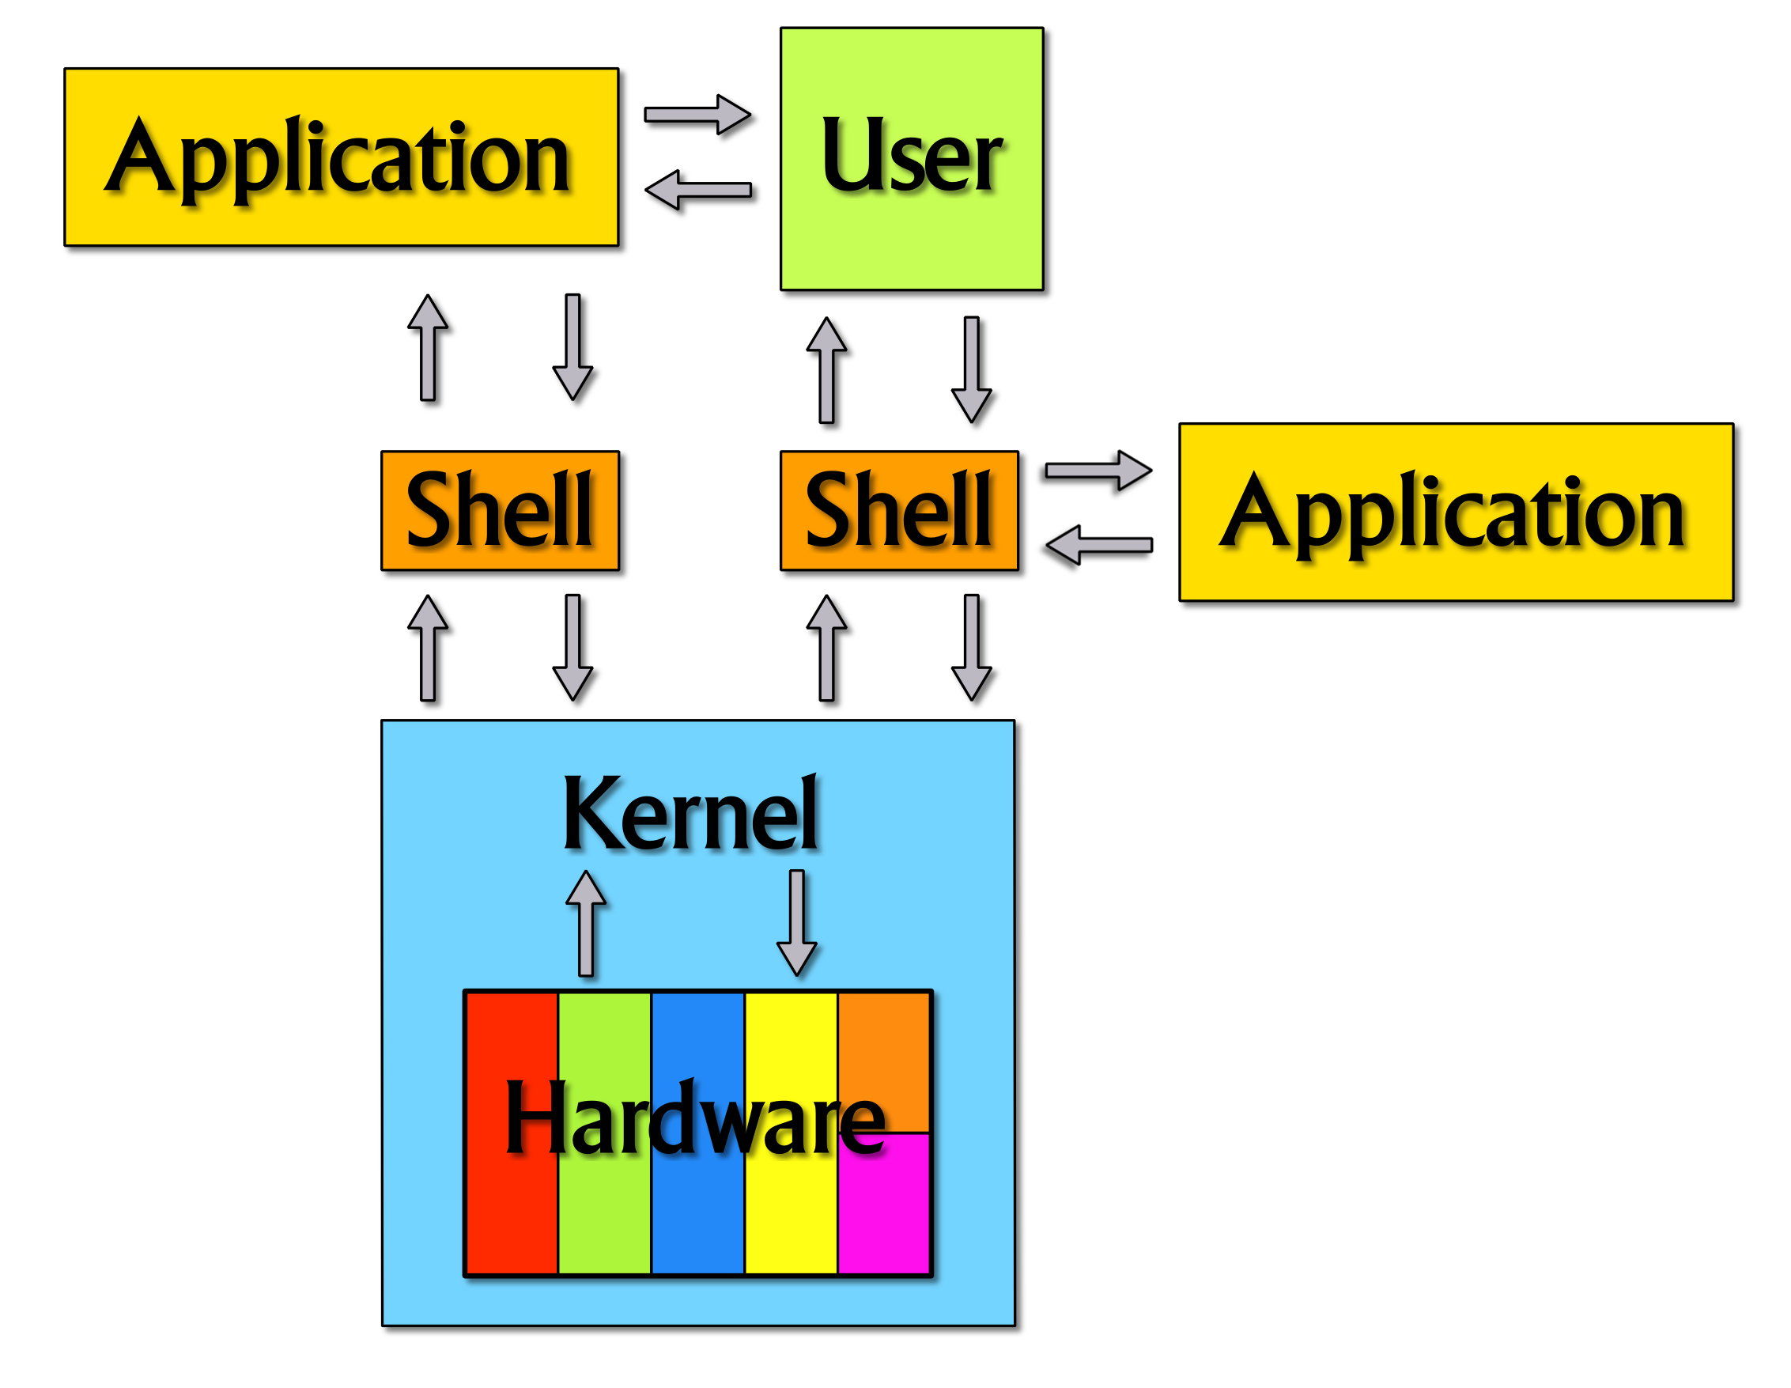
Scripting in a nut..Shell..eh, get it?

Slide 7
Kernel
Program constituting the central core
Has control over everthing occuring in the system
No direct interaction with the kernel possible

Slide 8
Shell
Interface to Kernel
Sits atop the kernel and passes messages to and from the kernel
Runs operating system commands
Traditional command line interface
Also called a command-line interpreter
Environment used for executing scripts

Slide 9
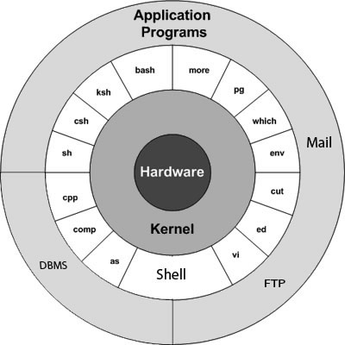

Slide 10
Availaible shells on the system
cat /etc/shells
Current shell
echo $SHELL
Default shell on linux is bash
More information on bash == man bash

Slide 11
Different types of shells
Few common shells
sh- Bourne Shell
Bash – Bourne Again Shell (incorporates useful features from csh and ksh)
csh – C Shell
Ksh – Korn Shell (compatible with sh and bash)
Zsh – a pretty damn good one
The terminal which we use while using a desktop environment is just an emulator for the shell. For eg. xterm, gnome terminal, konsole etc

Slide 12
Scripts
An executable file containing seqeuntial list of instructions along with conditional and loop constructs similar to those of higher level programming languages
Scritps are interepreted!
Could be writted in different languages
eg. bash shell scripting, python scripting, perl scripting
Scripts need not have extensions, just a convention to use .sh
Scripts i.e. commands
Shell OR Interpreter
Kernel

Slide 13
Executing a script
Before executing enable the execution flag for the script using chmod command
chmod +x test.sh
$ sh test.sh
$ test.sh
$ ./test.sh

Slide 14
General format of a script
Shebang or hash bang line, tells the OS which interepreter is to be used for the script, if executed directly
#!/bin/bash
command 1
command 2
#this is a comment
..
exit 0

Slide 15
Variables
System Variables – Created and maintained by Linux itself. This type of variables are denoted in CAPITAL LETTERS
eg. $SHELL,$PWD, $BASH, $IFS, $PATH, $HOME etc
User Defined Variables – Created and maintained by user. This type of variables denoted in lower letters
eg. choice, mult etc
Variables aren't defined with data types!
Naming conventions
  Begins with alphanumeric character or _
  Case Sensitive

Slide 16
Assigning and value to variables and reading variables
variable=value => will assign value to variable.
$variable => will print value of the variable.
While assigning the variables, do not leave spaces in between the variable name and “=” , or between the value and “=”

Slide 17
Arrays
Example = (aa 'bb cc' dd)
To access individual elements
${array_name[subscript]}
* or @ refer to array as whole
Number of elements in array :
${#array[*]}

Slide 18
Reading input and displaying output
To read input from user, read command is used
eg. read ch
To display output, echo command can be used
eg. echo $ch

Slide 19
Quotes
There are three types of quotes.
" i.e. Double Quotes
' i.e. Single quotes
` i.e. Back quote
1."Double Quotes" – globbing – allows expansion of filenames and matching characters from regular expressions and variables ($)
2. 'Single quotes' – strictly parsed as a text string
3. `Back quotes` - to execute commands
For eg.

Slide 20
Evaluating conditions
[] or test can be used
Eg while test true
    while [ true ]

Slide 21
Evaluating arithmetic expressions
a=3
b=4
C = `expr $a+$b`

Slide 22
Testing files
test -r filenm user has read permissions
-w filenm user has write permissions
-x filenm user has execute permissions
-f filenm filenm is regular file
-d filenm filenm is directory
-c filenm filenm is character special file
-b filenm filenm block special file

Slide 23
Operators
String comparison
Operators
Arithmetic : + - / * %
Relational : -lt -le -gt -ge –eq –ne
Logical : -a -o
Operators
Arithmetic : + - / * %
Relational : -lt -le -gt -ge –eq –ne
Logical : -a -o
Operators
Arithmetic : + - / * %
Relational : -lt -le -gt -ge –eq –ne
Logical : -a -o !
String Comparison True if
string1 == string2 strings are equal
string1 != string2 strings are not equal
-n string string not null
-z string string is null

Slide 24
Conditional Branching
The if-fi block
If [ condition1 ]
then
List1
elif [ condition2 ]
then
List2
else
List3
fi
The case-esac block
case word in
Pattern1)
List1
;;
Pattern2)
List2
;;
*)
List3
;; #default
esac

Slide 25
Looping Constructs
for name in {list1}
do
list2
done
while [ condition ]
do
list2
done
Until statement complements the while statement
until [ condition ]
do
list2
done

Slide 26
Functions
Use only function name (function_test ) to invoke it.
Functions can be stored in the in the .bash_profile, so that they are available in the current session
If we store the functions in a file called function_library then you must include this file in your script using dot command as follows:
$ . function_library
Parameters can be passed to the function by position. i.e. function_test arg1 arg2
function_test() {
Command1
Command2
Command3
return value
}

Slide 27
Command Line Arguements
Also known as positional parameters
$0 always holds the name of the script
$1 to $9 are available for the user
$# is the number of parameters passed to the script
$* refers to all variables, separated by first character in $IFS
$@ is similar to $*, used for working with string input

Slide 28
Debugging a script
Command set -v is used in script
Or script is invoked as sh -v
This causes shell to echo each command before it is used
Set +v can be used to turn off the debugging

Slide 29
Special Parameters
$0 – name of the shell
$$ - process ID of the current shell
$? - hold the return value of the last executed script

Slide 30
Simple Script
Create directories recursively
#!/bin/bash
for i in {1..100}
do
mkdir img$i
cd img$i
done

Slide 31
.profile – set $PATH to include the paths of custom binaries
.bash_profile – configurable for things related to bash
.bashrc – includes configurations to be set while creating an instance of bash
All stored in user's home directory
.profile and .bash_profile executed on login

