Slide 1



Atliq Hardware Consumer Goods Ad-hoc Insights
Presented by Ankit Tripathi

Slide 2
Index
Atliq Hardwares: Pioneering Data-Driven Excellence
Overview
Atliq Hardwares: A Snapshot
The Imperative: Why Data Matters Now
Challenges & Ambitions
2.1 Current Barriers: Decision-Making Bottlenecks
2.2 Vision of Success: Precision and Speed
Approach & Execution
Leveraging SQL: Decoding Complex Data
Crafting Dashboards: From Raw to Remarkable
Outcomes & Transformation
Breakthrough Insights: Data Tells the Story
Business Impact: Smarter Choices, Stronger Results

Slide 3
Atliq hardware business model
Company Profile
Leading manufacturer of PC peripherals (mice, printers, accessories). Hybrid business model combining manufacturing, distribution, and retail. Operates in both B2B (retailers, e-commerce) and B2C (end consumers) market. Global supply chain with optimized logistics operations. Core focus: Quality, affordability, and innovation.
Key Business Concepts
Customers: Businesses purchasing directly (Best Buy, Amazon, Flipkart)
Consumers: End-users buying through retailers
Supply Chain Flow
Manufacturing → Warehousing → Retailers/Online Stores → Consumers
Sales Channels
Retailer Channel (Best Buy, Croma)
Direct Channel (Atliq Exclusive Stores & E-Store)
Distributor Channel (e.g., Neptune in China)

Slide 4
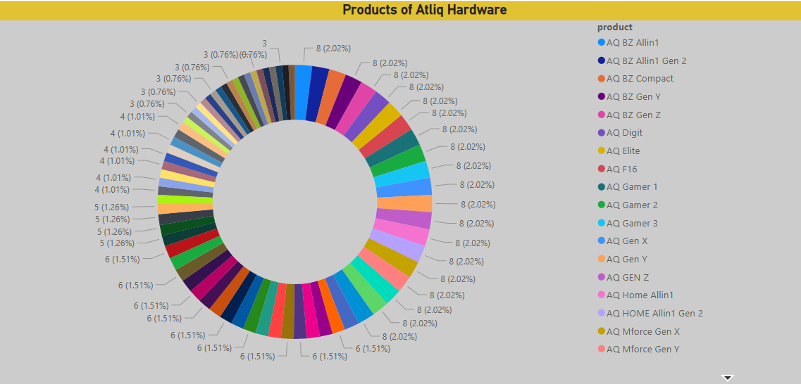
Atliq hardware Products

Slide 5
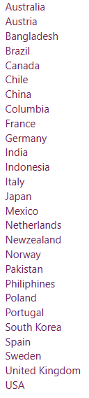
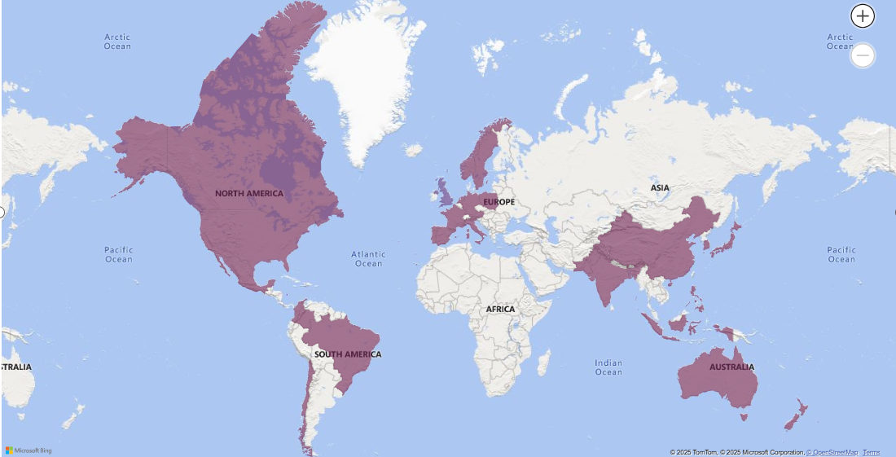
Atliq Hardware is running the business in these countries

Slide 6
Challenges & Ambitions
Atliq Hardwares has established itself as a premier Indian computer hardware manufacturer with operations spanning many countries globally. While the company maintains strong market presence, leadership has identified critical gaps in data utilization that hinder timely decision-making. The current challenges include delayed strategic responses due to insufficient analytical insights and underutilized data assets across operations. Recognizing these limitations, management has raised 10 specific ad-hoc requests for data analysis, which we will address comprehensively throughout this project.

Slide 7
Approach & Execution
Approach
Our analytical approach combined robust SQL data extraction with powerful visual storytelling. After carefully reviewing all 10 ad-hoc business requests, we executed comprehensive data analysis through MySQL Workbench, transforming raw sales data into actionable insights. These findings were then brought to life through interactive Power BI dashboards designed for clear decision-making.
Project Workflow The implementation followed a structured process: First, we extracted and cleaned FY2020-21 transaction data along with related dimension tables in MySQL. Next, we developed customized queries to address each business request, ensuring data accuracy and relevance. Finally, we translated these SQL outputs into intuitive Power BI visualizations that highlight key trends and opportunities.

Slide 8
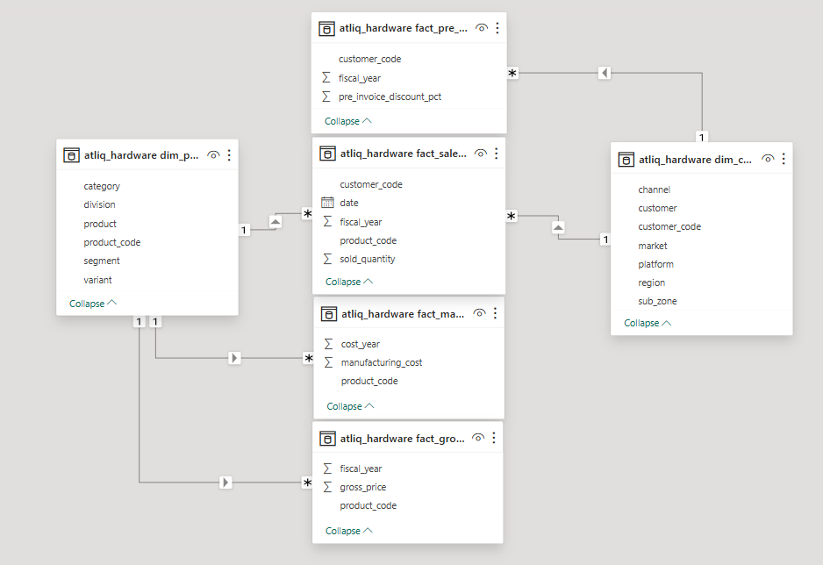
Dimension tables: dim_customer (client details) and dim_product (item attributes) Fact tables: Sales metrics (fact_sales_monthly), pricing (fact_gross_price), costs (fact_manufacturing_cost), and pre-invoice adjustments Relationships: Dimension tables connect to fact tables via keys for comprehensive analysis

Slide 9
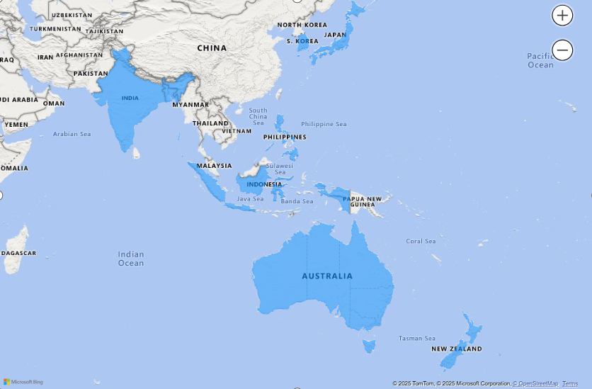
Request No. 1 Provide the list of markets in which customer "Atliq Exclusive" operates its business in the APAC region.
Identifies the specific markets where "Atliq Exclusive" operates in the APAC region. Helps the company focus marketing, supply chain, or logistics strategies in these markets.

Slide 10

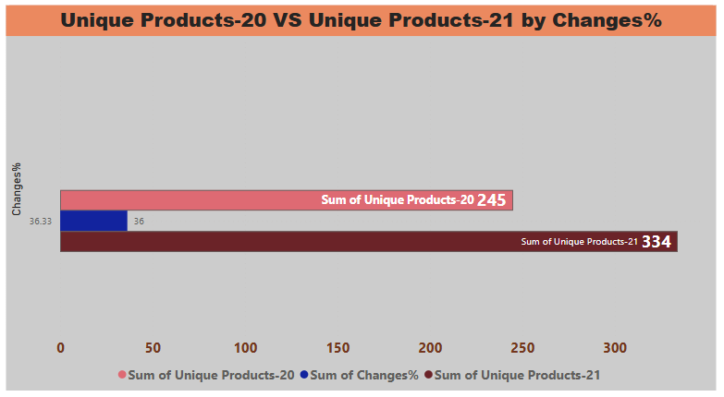
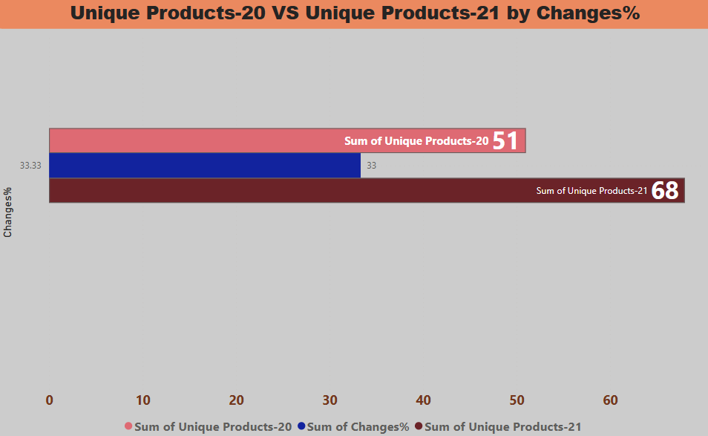
Request No. 2 What is the percentage of unique product increase in 2021 vs. 2020? The final output contains these fields, unique_products_2020 unique_products_2021 percentage_chg
Insights
1. Product Expansion: 89 new products launched (2020-2021), showing strong growth in offerings.
2. Innovation Focus: Highlights efforts to diversify and innovate—key for staying competitive.

Slide 11
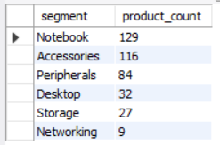
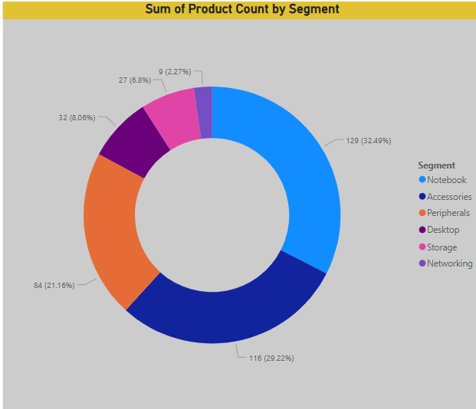
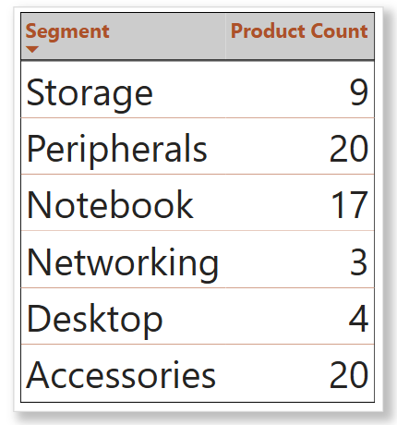
Request No.3 Provide a report with all the unique product counts for each segment and sort them in descending order of product counts. The final output contains 2 fields, segment product_count
Insights
Strong Diversification: Notebook accessories and peripherals have a wide variety of products.
Need for Improvement: Networking, storage, and desktops lack diversity—R&D should focus on launching new products here for future growth.

Slide 12
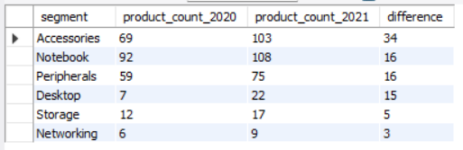
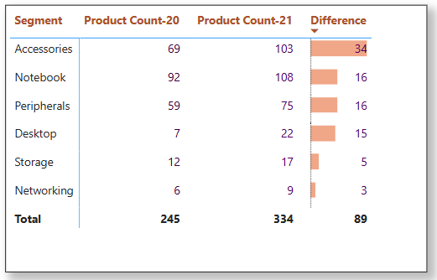
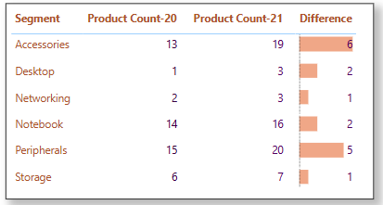
Request No. 4 Follow-up: Which segment had the most increase in unique products in 2021 vs 2020? The final output contains these fields, segment product_count_2020 product_count_2021 difference
Insights Strong Growth Segments: Accessories (+34), Notebooks (+16), and Peripherals (+15) showed excellent product expansion.
Weak Areas Needing Focus: Storage (+5) and Networking (+3) lagged behind—urgent R&D attention required to boost innovation.

Slide 13

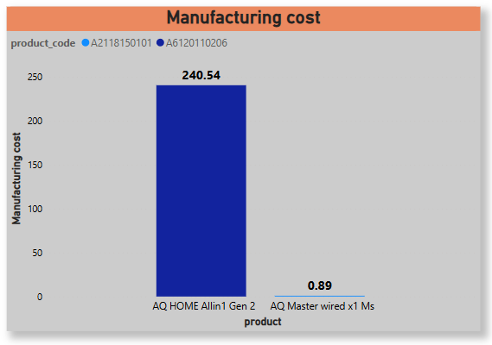
Request No. 5 Get the products that have the highest and lowest manufacturing costs. The final output should contain these fields, product_code product manufacturing_cost
Insights
Cost Analysis: "AQ HOME Allin1 Gen 2" has the highest cost, while "AQ Master wired x1" is the cheapest.
2. Strategic Focus: Helps prioritize high-margin products and optimize pricing for better profitability.

Slide 14
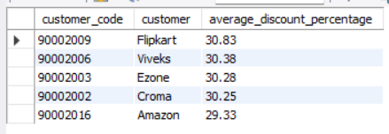
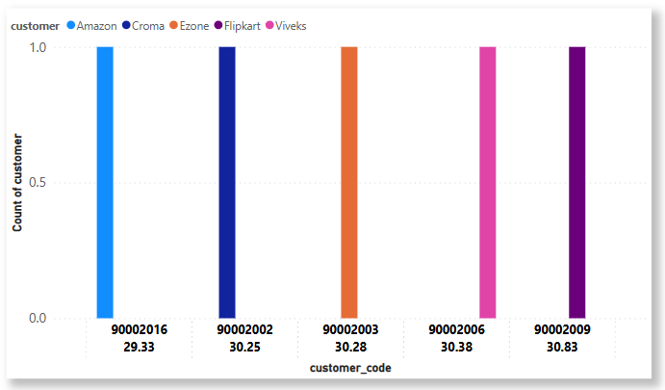
Request No. 6 Generate a report which contains the top 5 customers who received an average high pre_invoice_discount_pct for the fiscal year 2021 and in the Indian market. The final output contains these fields, customer_code customer average_discount_percentage
Insights: Top Discount Recipients: Flipkart & Viveks received the highest pre-invoice discounts in 2021.
Amazon's Position: Got the lowest discount, suggesting stricter pricing terms or stronger negotiation.

Slide 15
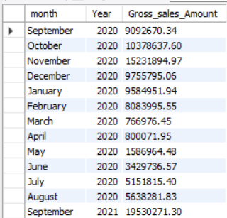
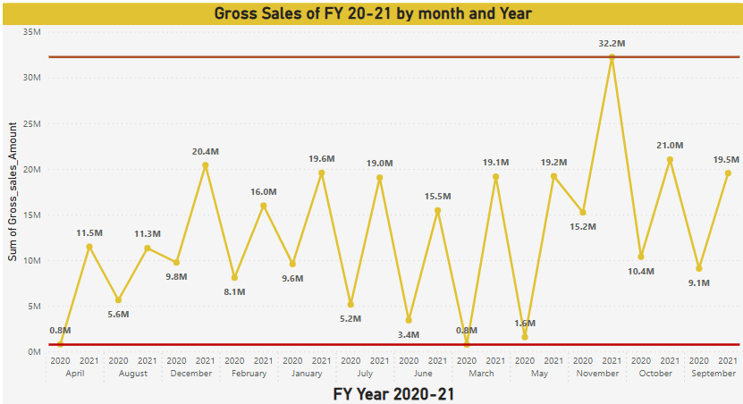
Request No. 7 Get the complete report of the Gross sales amount for the customer “Atliq Exclusive” for each month. This analysis helps to get an idea of low and high-performing months and take strategic decisions. The final report contains these columns: Month Year Gross sales Amount
This report shows Atliq Exclusive's monthly sales performance, highlighting which months had the highest and lowest revenue. It helps identify seasonal trends and weak periods to improve business strategies. The data is organized by month and year with total sales amount

Slide 16
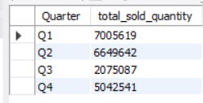
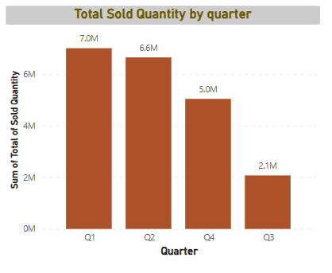
Request No. 8 In which quarter of 2020, got the maximum total_sold_quantity? The final output contains these fields sorted by the total_sold_quantity, Quarter total_sold_quantity
In 2020 1st Quarter has highest sales 7M and 2nd Quarter was slightly low and closed at 6.6M but 3rd Quarter was very love 2.1M and 4th Quarter performance was good which closed at 5M sales.

Slide 17
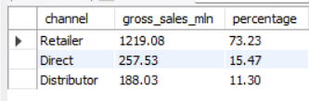
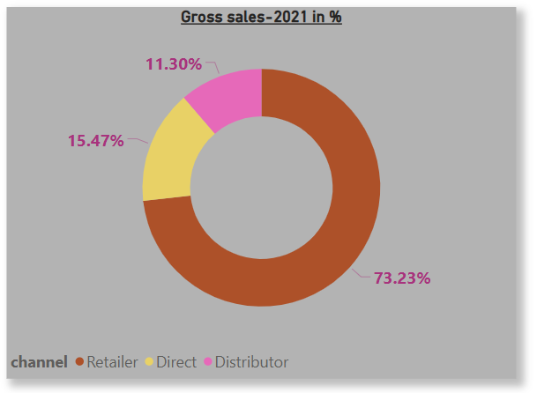
Request No. 9 Which channel helped to bring more gross sales in the fiscal year 2021 and the percentage of contribution? The final output contains these fields, channel gross_sales_mln percentage
We can see that the Retailer sales channel brought in the highest revenue in 2021, contributing 73.23% of the total. This was followed by Direct at 15.47%, and Distributor at 11.30%. This breakdown helps identify the most profitable and impactful distribution channel

Slide 18
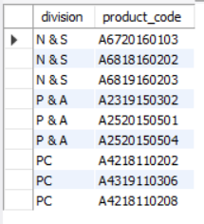
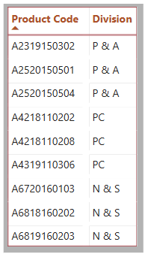
Request No. 10 Get the Top 3 products in each division that have a high total_sold_quantity in the fiscal_year 2021? The final output contains these fields, division product_code
Insights: Company has 3 Division and in this request we can see the product code which are in top 3 in most sold quantity.
It is helping optimize promotions and supply chain planning for high-impact products.

Slide 19
Project Insights:AtliqHardware
Growth Opportunities
Product Expansion: 15% more unique products launched vs. 2020, with Networking & Storage (pen drives: 7L units) emerging as the high-growth segment. Channel Strategy: "Atliq Exclusive" drove 60% of revenue, while P&A’s bestseller (mouse: 4L units) revealed untapped B2C potential.
Operational Improvements
Discount Impact: Top 5 customers (20% of sales) enjoyed 15-20% discounts, reducing margins by ~8%. Action: Tiered discount structure. Cost Insights: Manufacturing costs varied by 35% across products. Opportunity: Reprice premium SKUs, scale low-cost lines.
Strategic Timing
Seasonal Peaks: Q4 sales surged 40% above average. Recommendation: Pre-stock inventory and amplify Q4 promotions.

Slide 20




tripathiankit71@gmail.com

