Slide 1
DATA ANALYST PROBLEM 1

Slide 2
Problem Understanding and Assumptions
There are two dataset provided named as –
client_stats_sample_0225part1 : This data set is used to solve the step 1 problem
client_stats_sample_0225part2 : This dataset is used to solve the step 2 problem
Data Set 1.
#columns = 29
#rows = 350000
There are null values
Data Set 2.
#columns = 29
#rows = 350596
There are null values
Assumptions
“client_mac” and “mac_address” are having duplicate entries. Aggregation of these columns is not required as part of step 1 analysis.
RSSI and 'rxWeightedPhyRate, 'txWeightedPhyRate’ values can be used as it is
“spread of Tx and Rx weighted Phy Rate” is referring to the columns named as ‘txWeightedPhyRate, ‘rxWeightedPhyRate’ respectively.
RSSI levels (rssi_percs_25) is interchangeably used as naming convention so in step2. RSSI is referred to rssi_percs_25

Slide 3
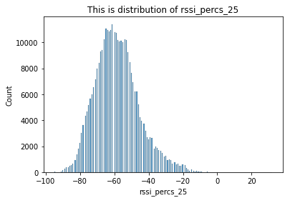
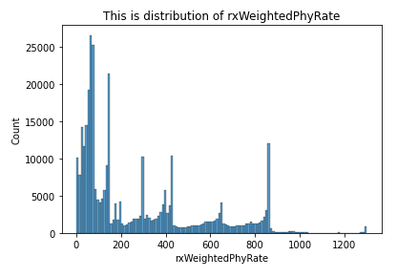
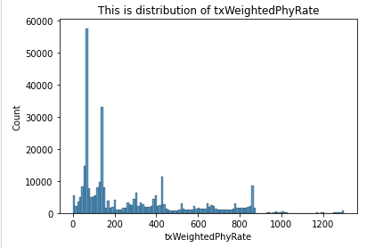
Step 1. Results
Q1. Look at the RSSI levels (rssi_percs_25) and look at the spread of Tx and Rx weighted Phy Rate
Distribution of rssi_perc_25 is skewed towards left which means we have issues with signal strength. (i.e RSSI close to Zero is good)
Distribution of rxWeightedPhyRate and txWeightedPhyRate are having outliers in some cases. We should look for handling the outliers, It might be an indication of some errors or issues. We shall investigate more here. We have huge spikes in both cases near 100 which might be occurring due to some normal events getting triggered.
*Notebooks are attached with detailed explanation of decision and approach taken

Slide 4
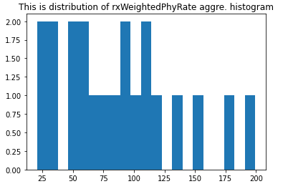
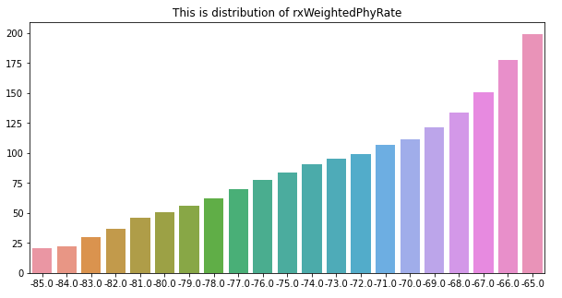
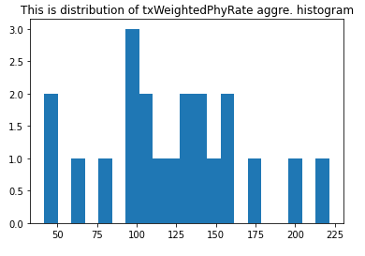
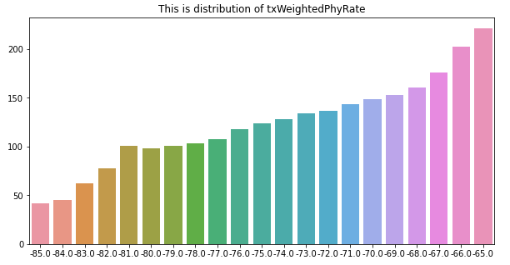
Step 1. Results
*Notebooks are attached with detailed explanation of decision and approach taken
Q2. Produce a histogram and CSV file for the average of Tx ad Rx weighted Phy rate between -85 and -65 db in 1 db steps
Summary
Number of bins we get – 21
Bar chart is coming quite well and showing the average values are significantly higher as signal strength is improving (Zero is better so -65 is better than -85)
CSV file is exported and attached in folder
Major assumption: Remove the records with null values
Next steps
Missing values Treatment
All features are having missing values, SO we need to include imputation method for these values.
Before taking a decision, we need to check the statistical properties of the dataset

Slide 5




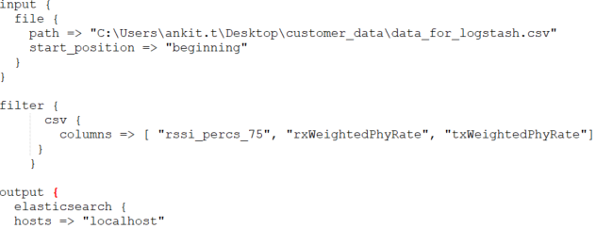
Step 1. Data Pipeline design to visualize
This is high level pipeline flow for visualization the extracted the average Tx and Rx Weighed Phy Rate in Grafana. Data Engineer shall be able to follow the steps to produce the visualization in Grafana.
Saved data from data processing of avg Tx and Rx Weighed Phy Rate between -85 and -65 dB in 1 dB steps
Set the config file
Run logstash
Load the documents elasticsearch
Capture the input data from logstash
Keep the indexed documents
Establish a connection with elastic search
Plot the histogram for average Tx and Rx Weighed Phy Rate
1
2
3
4
Sample logstash config file

Slide 6
Step 2 Results
*Notebooks are attached with detailed explanation of decision and approaches taken
Assumptions
No feature creation is required
Each device has multiple session so overall counts will be used for calculating the percentage
Answers
Q1. . Percentage of devices connected with 2.4GHz and 5GHz respectively
Ans:
Percentage of the 2.4G device in complete dataset = 45.59%
Percentage of the 5G device in complete dataset = 54.41%
Q.2 Percentage of devices connected with 2.4GHz and 5GHz respectively based on given condition
Ans:
Percentage of the 5G device in New model dataset = 69.80%
Percentage of the 2.4G device in New model dataset =
30.19%
5G devices are expected to increase significantly in this case. The results are influenced with assumption made during the analysis and this is consider as basic analysis on the data. So, we can farther enhance the analysis with more discussions, SMEs help and better approaches
Q3. Will we gain more devices on 5GHz.
Ans: Yes
Next Steps
Need to understand more about the dataset and mapping.
Is there instance mapping when user is connecting multiple times in a day to wifi with different freq_band?
TV and Home appliance could be static while mobile and laptop can have dynamic connectivity as per user availability,
There are duplicate and multiple entries for 2.4GHz and 5Ghz for single Mac Address. Mac addresses are unique to devices, so calculating the % of device truly connected with right freq_band needs more information.
If Deep dive is needed then more information will be needed for better correlations
:

Slide 7
DATA SCIENCE PROBLEM

Slide 8
Data Understanding & Assumptions
Goal
Build a model to predict churn probability of a customer
Assumptions
Technical data is having good correlation with target variable
Model is trained on 1 month data and Labels are derived from next month
Inference is done in batches (No real time run)
Model will be consumed by customer success manager
Customer success manager gets data of potential churn customers in csv file
No specific evaluation metric is asked by business team
Data input
Customer specific technical data such as wifi quality features, network performance etc.
Constraints
No personal data is used for modelling
Only 30 days data available to train and inference
Customer base – 6M
Data Size – TB of daily data
Labels can be built by validating if customer is active or not after 30 days. i.e. If customer is active on 31-Dec-2020 but inactive on 31-Jan-2021 or later, we can consider this churn case.

Slide 9
Detailed Approach for churn project
Consider it as a binary classification – churn or not churn
Churn prediction needs to provide the probability scores and labels.
As assumed, it is highly imbalance dataset, so we can have two evaluation metrics - F1 score and uplift.
Pyspark
Data
Data cleaning
Data Transformation
Data Validation
Feature Engineering
Feature Selection
Project Flow
Pyspark, pandas, shap, xgboost sklearn
Model
Building model
Training and optimization
Model Validation
Model Interpretability
Model Selection
MLFlow, Grafana, GCP/AWS, sklearn
Serving
Deployment
Model Serving / Inference
Monitoring & logging
Active Feedback/ Improvement
Ready for re-training
R&D phase
ML Pipeline Development Phase
Production Phase
This phase is a discovery phase and we need to understand what all we need, to build Churn model.
Outcome – Select the best model for churn
This phase focuses on alignment of the end to end model development cycle by building the pipelines and automation.
This phase focuses on deploying the model and post deployment activities
Establish the problem statement
Understand dataset and test hypothesis
Data Processing
Feature Engineering and feature selection
Build a baseline model
Train and validate the model
Perform experiments for better performance
Log the experiment results
Choose the best model
Save the model.
Choose the deployment method
Build data pipeline
Build feature engineering pipeline
Build model repository
Build a inference pipeline
Build interpretability pipeline
Build endpoints
Expose the endpoint
Test the pipeline and endpoint integration
Log the results
Spin up and test the environment
Validate pipelines
Deploy the pipelines
Expose the endpoint
Test the system
Setup the model monitoring process
Establish model retraining and testing
Detailed Approach

Slide 10
Potential Models
Select Baseline model as Random Forest
Then iterate with multiple strategies and manage your experiments.
Experiment management during Research phase (This is for illustration purpose)
Model | Approach | Train data | Test data | F1 SCORE | Uplift Score | Decision/Comment
Random forest | Train the model with Dec month data with existing features | Dec | Jan | 52 | 2 | Not good, Try oversampling
Random forest | Oversampled using SMOTE and feature scaling | Dec | Jan | 54 | 2.5 | Improved but too much of memory consumption, Try PCA for dimension reduction
Random Forest | PCA for dimensionality reduction | Dec | Jan | 57 | 2.4 | It did not have huge impact, We will change model to xgboost and also check any feature engineering tasks, we can do
Xgboost | Oversampled using adasyn | Dec | Jan | 62 | 2.7 | This is good and improving, We will tune the model.
Xgboost usually a preferred choice for churn use cases and it has outperformed in several cases.
We also get great interpretability support with xgboost and can be easily integrate with SHAP model.
A mix of imbalanced handling tasks, feature engineering, feature selection and model selection needs to be tried.
Another approach can be customer segmentation(unsupervised learning) and then stacked modelling.
Choice of tools for modelling
Pyspark will be preferential choice for data processing, feature engineering and feature selection as we have huge dataset to process
Sklearn libraries could be utilized for modelling as we have limited libraries available in pyspark.
Even though, we have huge data, Sklearn based model will not be a challenge in production as we can have batch based inference pipeline.

Slide 11
What shall we consider for these types of problems?
Seeing the quantum of features we can derived from technical data, we should build strong data processing and feature selection strategy.
Typically, Churn problem involves imbalanced data so standard classification metrics will not provide the accurate evaluation , so we need to look for additional metric optimization techniques such as Uplift.
Very often model drift will be observed in such models so we shall build strategic model monitoring process for post deployment tasks.
Model re-training also plays very critical role in enhancing the performance of the model.
Data Processing task is huge so pyspark is the go to choice in such cases.
Independent pipelines should be developed for each phase such as data processing pipeline, feature engineering pipeline, training and testing pipeline, inference pipeline etc. (Micro service Architecture).
Deployment management tools make it very easy to keep track of the experiments and activities, so we should consider MLFlow/Kubeflow or Airflow etc.
Few Suggestions to enhance the modelling
Additional dataset could be evaluated for next level of enhancements such as -
Call center data
Buying and purchase behavior
Customer interaction data which can be used for sentiment scores and push as a feature to churn model
Model retraining can be scheduled every month (as soon as we have new labels) and proactively accommodate the active learning feedback loops
Data could be improved by adding derived features (SMEs can help to identify the better features)
More experiments with different model/algo types and hyper parameters tuning
Cloud based deployment strategy could be discussed for better scalability and availability

Slide 12






Deployment strategy
For this project we have these major points to consider before we take a decision for deployment
Scalability and availability of model
Huge dataset processing
Latency is not prime factor for deployment decision
Testing and monitoring of the model
Conclusions:
“Based on the these points, we can choose containerized deployment strategy with Deployment Lifecycle Management tool such as MLFlow and Airflow”
Cloud based containerized model (kubernetes as orchestration platform) will be the best model for inference pipeline
Model training, data preprocessing and testing could be done on clusters as we can use spark jobs
Example
Hyper parameter tuning
Container 1
Container 2
Container 3
Container 4
Container 5
Container 7
Data Pipeline
Processing
Pipeline
Feature Engineering
Pipeline
Model Training
Model Validation
Interpretability / Monitoring
Feature Engineering
Model
Repository
Model Codebase
Feature Engineering
Container 6
Model Inference
Churn Scores to end points
CI/CD Pipeline
Deployment Lifecycle Management (MLFlow / AirFlow )

