Slide 1
FACE DETECTION AND RECOGNITION
BY
Ankit Tripathi
Roll No. 17010107
Supervised BY:
Dr. Kishorjit Nongmeikapam

Slide 2
Content
Introduction
Applications
Implementation
Face detection
Haar features
Face recognition
Opencv library
Some output results
Advantages
Disadvantages

Slide 3
Introduction
Face recognition is a technology by which our computer not only detect face but also identify that face.
Have a various use in IT industries because of contactless feature.
Can be used in any hardware having camera.

Slide 4
Applications
Biometrics: can be used in biometrics attendance systems. Can be used in adhaar.
Defence: one can hit a particular target using programmed weapons.
Payment: for verification purpose we can implement facial recognition instead for PIN.
Social media: Ex. Instagram assign username of the person in the photo.
Criminal identification: used by intelligence agencies and police.

Slide 5
Implementation
Every facial recognition system have same approach. These steps are:
Face detection
Feature extraction
Face recognition

Slide 6
Face Detection
Before identifying a face we must have to detect it first.
There are lots of algorithm to achieve our goal, ex. Viola-jones algorithm , histogram of gradient method etc.
We will use Viola-jones algorithm to detect face.

Slide 7
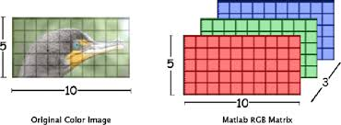
We must convert our image into grayscale as we don’t need color data for face detection.
Also color data are represented by 2D array with three channels of RGB while a grayscale image is represented by only 2D array with zero channels. So doing any operation on colored image is more complex than grayscale image.

Slide 8
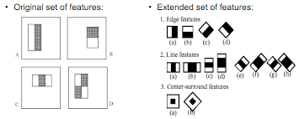
Haar features
It is a convolutional kernel used for edge detection.
It is applied all over the image to find the face.

Slide 9
We can get more than 160000 features of the face using haar features.
Most of the features founded are irrelevant.
Viola-Jones suggested to use adaboost to select only selected features . This decreases the number of features to about 6000.

Slide 10
Face recognition
Our recognition part is done by LBPH(local binary pattern histogram) algorithm to recognize the face.
In this process image from our training dataset is divided into smaller blocks and then we look over each pixels.
Now we look to each neighbour pixel. If value of neighbour pixel is greater than the inspected pixel ,then 1 is assigned to that neighbour else 0.

Slide 11
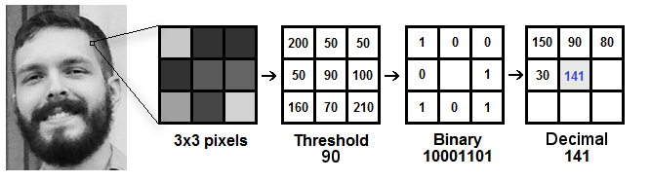
Histogram of each region is created and then finally concatenated to make a set of histograms representing the face.
This data is then trained.
Finally we do these steps and match it with our trained data for a new image.
We print the id associated with that person.

Slide 12
OpenCV library
Opencv is a widely used computer vision library.
The library has more than 2500 optimized algorithms which can do the tasks like detect and recognize faces, identify objects, track camera movements, image processing etc.
This library is used by many big companies like google, yahoo , intel as well as some startups like Applied Minds, VideoSurf.
It has c++, python , java , matlab interfaces and work on all kind of os.

Slide 13
Python is used to implement this system.
Opencv library is used for detection , training and recognizing.
Image dataset is created using phone camera.

Slide 14
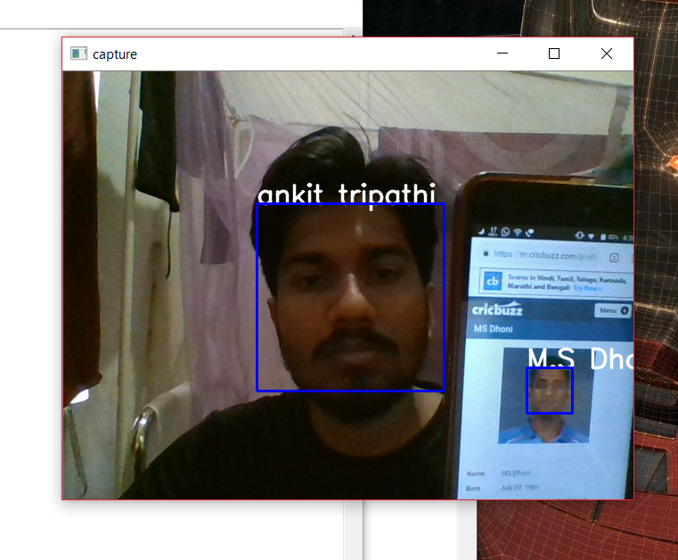
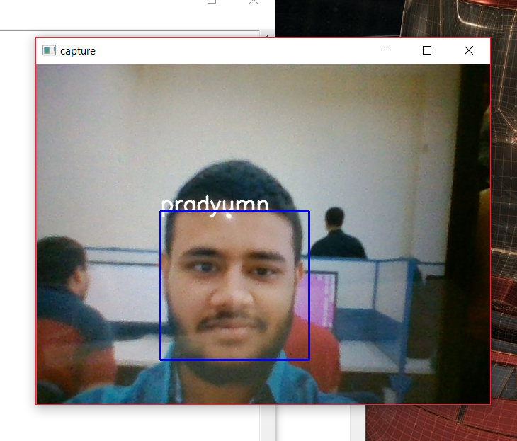
Some output results

Slide 15
Advantage of this system
It is very easy to implement.
Can work even on 5-6 image dataset but it can affect the accuracy.
Real time recognition.

Slide 16
Disadvantages
Since it is very basic system , its accuracy is not very high.
Give lots of false negative results.

