Slide 1

Flux & Redux
Reference: https://code-cartoons.com/@linclark

Slide 2

Action Creator
Think of the action creator as a telegraph operator.
You go to the action creator knowing basically what message you want to send, and then the action creator formats that in a way that the rest of the system can understand.
Charge of formating actions with type(MESSAGE_CREATE / MESSAGE_READ) and payload(has all info that require to perform the action)
Passed the created action to the dispatcher
A new developer can come on the project, open up the action creator files and see the entire API - all of the possible state changes — that system provides.

Slide 3
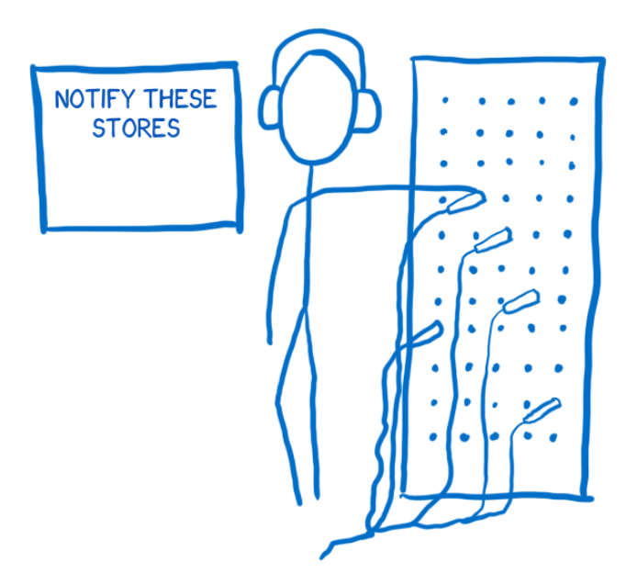
Dispatcher
Think of the dispatcher like a telephone switchboard operator at a phone switchboard. It keeps a list of all of the stores that it needs to send actions to. When an action comes in from the action creator, it will pass the action around to different stores.
A big registry of callbacks
Send action to all registered stores via callback(in sequence)

Slide 4

Store
Think of the store as an over-controlling bureaucrat. All state changes must be made by it personally. And you can’t directly request that it change the state. There are no setters on the store. To request a state change, you must follow proper procedure… you must submit an action via the action creator/dispatcher pipeline.
Image
Hold the state of the application
Also hold the all state change logic
Registered with dispatcher to accept actions
No setters, only way in is through actions
Check the action type to whether it cares about this one or not, and changes the state accordingly.
Once any change occur emits the state change event(allow the subscribe Controller views to know the state change)

Slide 5

Controller View and Views
Think of view is a presenter. It isn’t aware of anything in the application, it just knows the data that’s handed to it and how to format the data into output
Think of controller view is like a middle manager between the store and the view. The store tells it when the state has changed. It collects the new state and then passes the updated state along to all of the views under it.
Controller view take the change state from store and pass to all child views so that they can re-render itself
Views accept actions/inputs

Slide 6

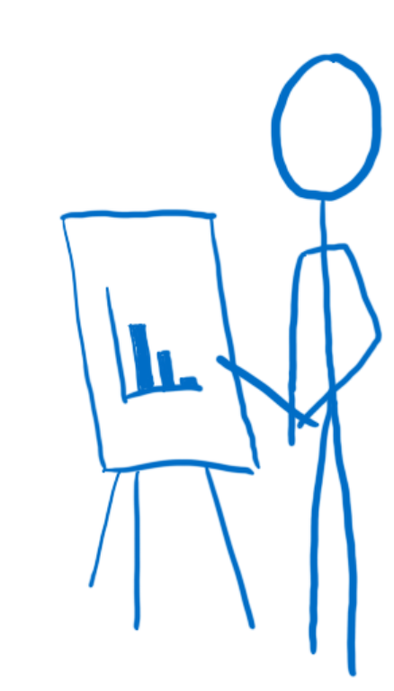
Flux
Store decide whether it cares about this action, if yes update the state
What is the Initial state?
2
Pass the updated state
Go and render this state. I will let you know when state will change
Dispatcher!! Do notify me when actions comes.
5
1
Store
Do notify me when state change
Re-render based upon the new state
4
Send action to Store in sequence
3
4
6
Change – middle no. should be 10
Controller View
1
Dispatcher
Type: UPDATE_NO
Position: Value: 10
UID:77
Sub-View
2
3
Prepare an action
Send formatted action to Dispatcher
Action Creator

Slide 7
Redux
Action Creator
Unlike Flux, action creators in Redux do not send the action to the dispatcher. Instead, they return a formatted action object only.
Store
In Flux we can have multiple store which hold state and state change logic but in Redux we have only one store which only maintain the state with no state change logic. Reducers takeall logic related tasks.
Controller View and Views
Flux have controller view and views, Redux have similar type of Smart and dumb components. Smart components are in charge of actions, they pass the actions to dumb via props.

Slide 8

Reducers
Think of reducers as as photocopy workers. They don’t want to mess anything up, so they don’t change the state that has been passed in to them. Instead, they make a copy and make all their changes on the copy.
Can have multiple reducers within root reducer.
Flux have flat store structure, instead redu have heirarchy of reducers
Reducers = State + Action = New State

Slide 9

View Layer Binding (react-redux)
Think of view layer binding as a IT department for component(view) tree. It makes sure that all of the components can connect to the store. It take care of all the technical details.
Bind the store to views
Introduce thre steps:
Provider component
Connect()
Selector

Slide 10

Root component
Think of root component as a executive. It puts all the team in place, It creates the store, telling it what reducer to use, and brings together the view layer binding and the views.
Majorly work in intilization of application

Slide 11
Redux Setup
Hire store and introduce the reducers to it
Assemble the team of reducers
1
2
Reducers
Root Component
Store
Wraps all components with provider component and connect it with Store
3
4
Create a network to update the components
Provider Component
(view-layer binder)
5
Setup action callbacks so that action will automatic dispatched once formatted
Action Creator
Smart and Dumb components

Slide 12
Replace old state with new one
Redux Data Flow
Inform about the new state
Send new state
6
Store
7
Triggers the re-render
8
Send current state and action
Provider Component
(view-layer binder)
Dispatch formatted action to store
Change – middle no. should be 10
5
4
1
Returns the formatted action
Reducers
3
Smart and Dumb components
2
Prepare a action
Action Creator

Slide 13
Thank You !
Ankit Tyagi
Email: ankit.spero@gmail.com

