Slide 1

React

Slide 2
Flux and Redux

Slide 3
MVC
Controller
Model
View
Notes:
Problem flux trying to solve

Slide 4

MVC
Controller
Server Endpoint
Service
Model
View

Slide 5
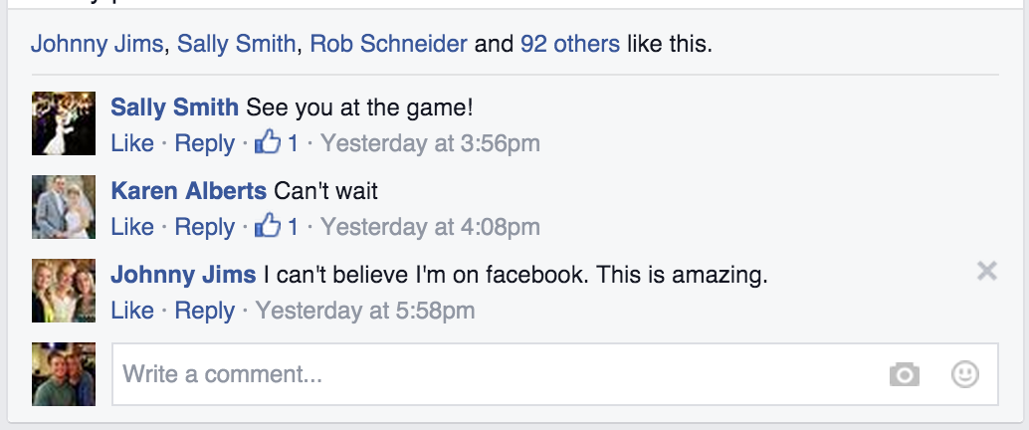
Components

Slide 6
User Model
Message Model
Thread Model
User Endpoint
User Service
Message Endpoint
Message Service
Thread Endpoint
Thread Service
Profile Card
Component
Message Item Component
Thread View Component
Notes:
View and controllers are tightly coupled as component

Slide 7
User Model
Message Model
Thread Model
Unread Message Model
User Endpoint
User Service
Message Endpoint
Message Service
Thread Endpoint
Thread Service
Profile Card
Message Item
Thread
Like Sentence
Com-
Box
Com- form
Cam-Button
Notes:
When we scales things up
FB issue

Slide 8
MVC Issues
Complexity caused by
Inter-dependencies
Cascading changes
Decentralized mutations
Difficult to reproduce bugs
Notes:
DM – we have modal and anything can change it

Slide 9
Flux
Flux is not React
Flux is a design pattern for managing state on client
Store is like modal in MVC and it holds the current state. It exposes the getters but not setters.
View - View updated whenever there is a change in store. From view action are created and dispatched to store and state are mutated.
Actions
State tree is read only, to change state component dispatch Actions – JS object represent change of data
Must have type property
Action can be user interaction or or any network request.
Notes:
React on other hand create component and keeping DOM sync with current state

Slide 10
Flux
Dispatcher
Store
Server
API
Action Creator
View
Notes:
Store hold the current state, its like M in MVC. Exposed setters.
Change store => update store

Slide 11
cb(action)
Stores
Flux
Dispatcher
cb(action)
User Store
Message Store
Thread Store
cb(action)
User Endpoint
User Service
emitChange()
dispatch(action)
Message Endpoint
Message Service
Endpoints
Services
createMessage(msg)
Thread Component
render()
Thread Endpoint
Thread Service
Message Component
Action Creators
render()
User Action Creator
Message Action Creator
Thread Action Creator
Profile Component
Notes:
No decentralized mutation and other benefits

Slide 12
Flux
Dispatcher
Stores
Endpoints
Services
Action Creators

Slide 13
One Way Data Flow
Action
Dispatcher
Store
View

Slide 14
Flux Benefits
Flux - state machine, simple and neat
Testable
Reproducing bugs
Undo functionality
Notes:
we migrate from one state to other by dispatching actions
State is what in store not what in view
React record the initial state and record all actions and state and serialize that data
And can reproduce bugs by playing all actions

Slide 15
Flux Shortcomings
Store = Data + Functions
Hot reloading wipes out data
We need separate functions
State is being written with every action
Loss of previous state
We need to make changes in a new copy of state
No hooks for cross cutting concerns Logging, Error handling
Notes:
Functions => (State change logic)
we migrate from one state to other by dispatching actions
State is what in store not what in view
React record the initial state and record all actions and state and serialize that data
And can reproduce bugs by playing all actions

Slide 16
Redux – Flux + Reducers + Other
Redux is one implementation of concept of flux
Reducers
Reducers are pure function that take previous state and action as parameters and returns the next state of the applicaton.
Always return new state never modify
In Redux root component wraps its subcomponents with the provider component and makes the connection between the store and the provider.

Slide 17
Redux
dispatch(action)
(previousState, action)
Action
Creators
Store
Reducers
(state)
(newState)
React
Components
Interaction e.g onClick

Slide 18
Reducers
Redux
User Reducer
Message Reducer
Message Reducer
render()
reduce(currState, action)
state
Store
cb(newState)
User Endpoint
User Service
Controller view
onSubmit(msg)
Message Endpoint
Message Service
Endpoints
Services
dispatch(action)
{
type: ‘CREATE_MSG’,
data: msg
}
Thread Endpoint
Thread Service
getMsgCreationAction(msg)
Action Creators
User Action Creator
Message Action Creator
Thread Action Creator
Notes:
Single store, no dispatcher, controller view dispatch the action

Slide 19
Thank You !

