Slide 1
Sales Analysis
Name: Ankit Verma
Mob: +91-7004518207

Slide 2
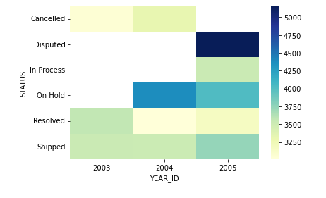
SALES: - Brighter colors correspond to higher sales for a given order status - Sales peaked in 2005 when the status was 'Disputed'

Slide 3
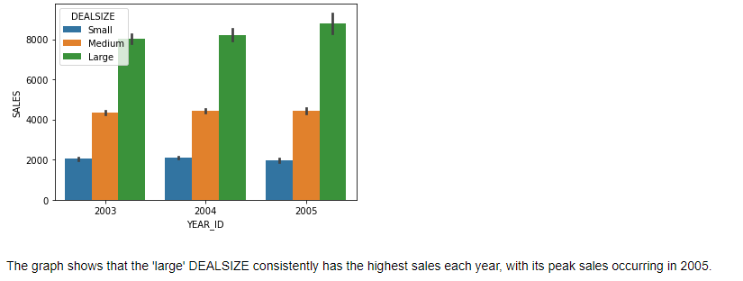
DEALSIZE - ‘Large' DEALSIZE consistently has the highest sales each year - Peak sales observed in 2005

Slide 4
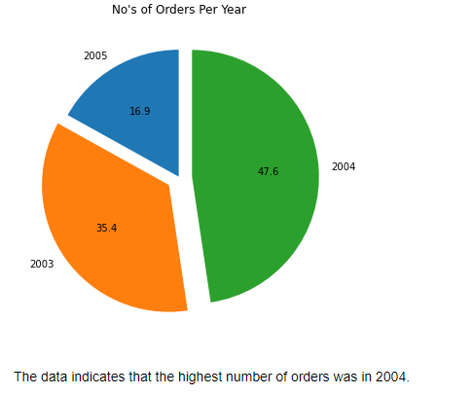
ORDER PER YEAR - Highest number of orders observed in 2004

Slide 5
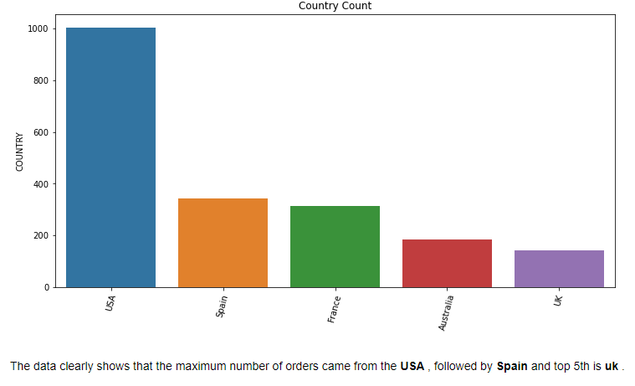
Top 5 countries with the highest number of orders - Maximum number of orders originated from the USA, followed by Spain, with the UK ranking fifth.

Slide 6
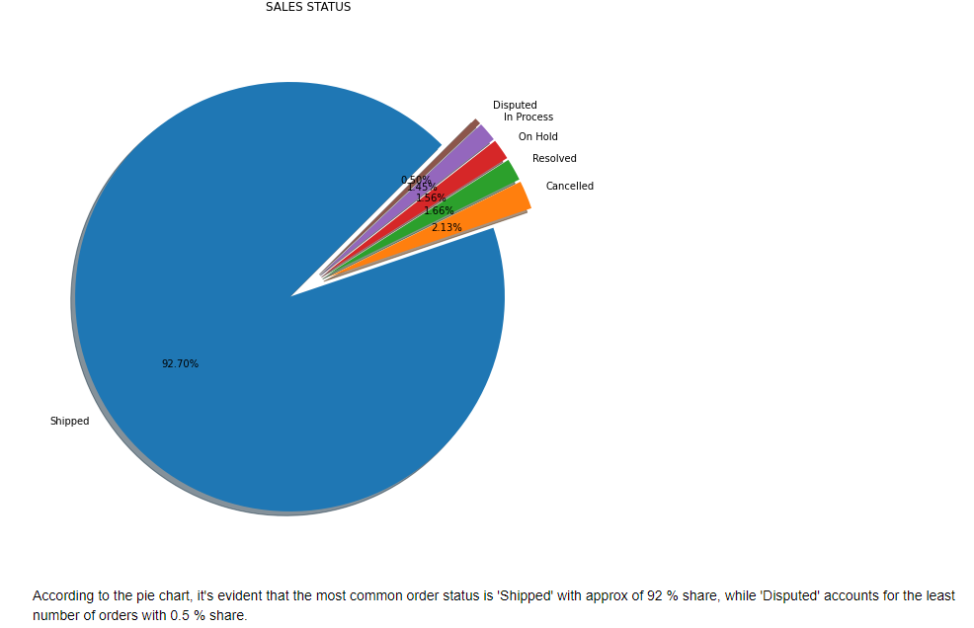
Sales Status Data - 'Shipped' status constitutes approximately 92% of orders, indicating the most common status. - 'Disputed' status represents the smallest portion, accounting for only 0.5% of orders. - Overall, the pie chart illustrates the distribution of order statuses, with 'Shipped' being the most prevalent and 'Disputed' being the least common.

Slide 7
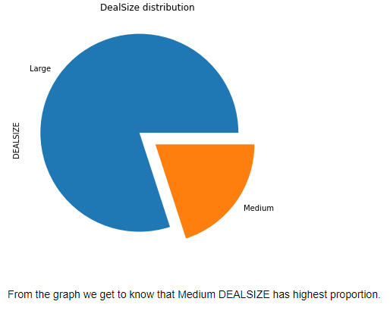
Deal Size distribution - Medium DEALSIZE exhibits the highest proportion in the graph. - This indicates a notable preference for deals categorized as 'Medium' in terms of sales distribution.

Slide 8
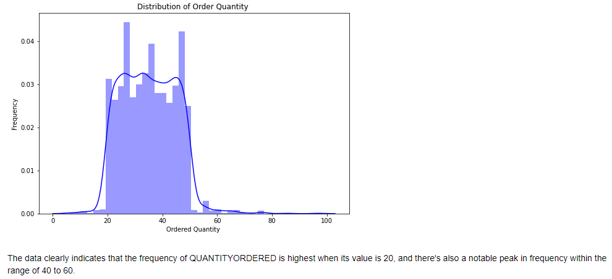
Distribution of Order Quantity - The frequency of QUANTITYORDERED peaks notably at a value of 20. - Additionally, there's a significant peak in frequency within the range of 40 to 60. - This insight suggests common ordering patterns concentrated around these quantity values.

Slide 9
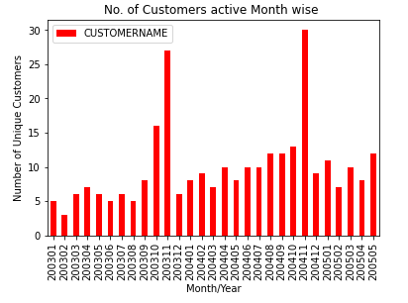
No. of Customers highly active Month wise - The highest number of active customers was observed in December 2004. - The second highest activity occurred in November 2003. - The lowest activity was recorded in February 2003.

Slide 10
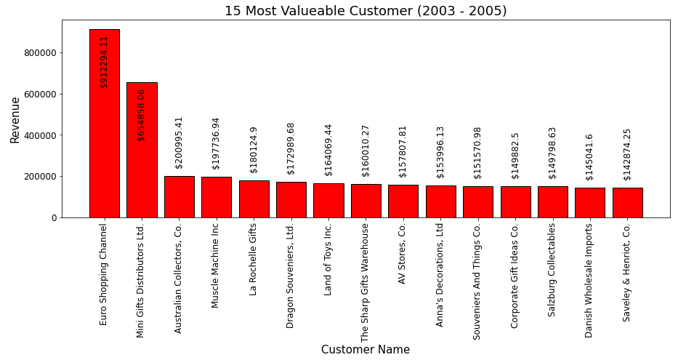
15 Most Valuable Customers - The most valuable customer is Euro Shopping Channel with the highest revenue of $912,294.11. - Following closely is Mini Gifts Distributors Ltd. - The 15th most valuable customer is Saveley & Henriot with a revenue of $142,874.25.

Slide 11
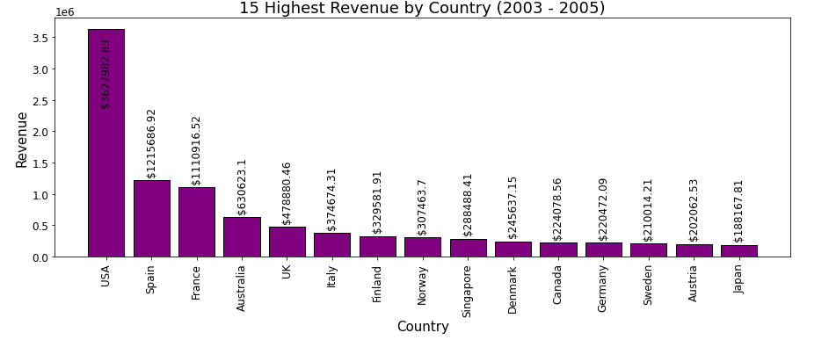
Top 15 Highest Revenue Countries - USA led the sales with $3,627,982.83, followed by Spain with $1,215,686.92, France with $1,110,916.52, and Australia with $630,623.10 in sales. - Japan rounds off the list with $188,167.81 in sales.

Slide 12
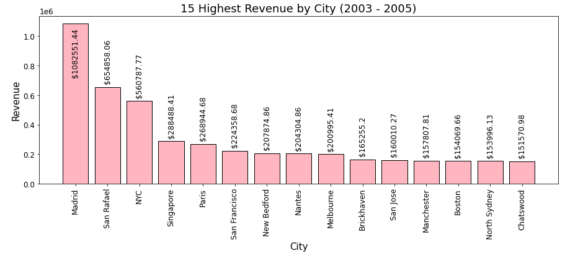
Top 15 Highest Revenue Cities - Madrid leads in city sales with $1,082,551.44, followed by San Rafael with $654,858.06, and NYC with $560,787.77. - Chatswood concludes the list with $151,570.98 in sales.

Slide 13
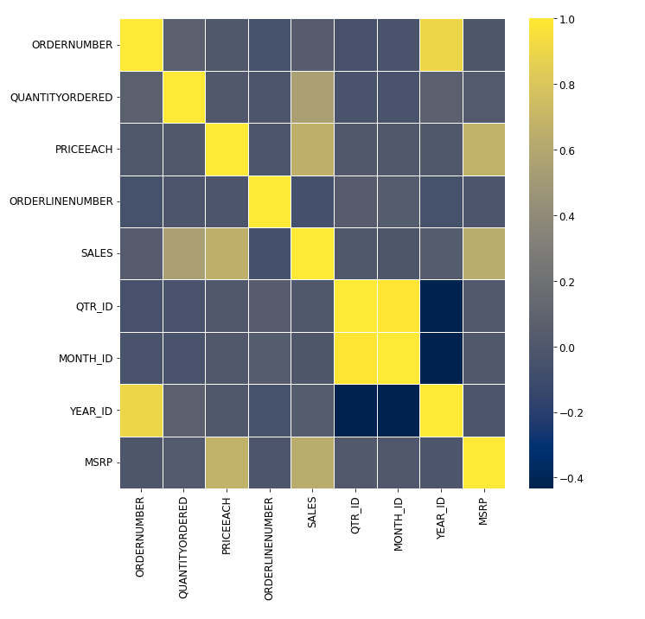
Correlation - Order numbers tend to increase with years, indicating a temporal ordering. - Quarters and months show a positive correlation, aligning with their sequential progression.

Slide 14
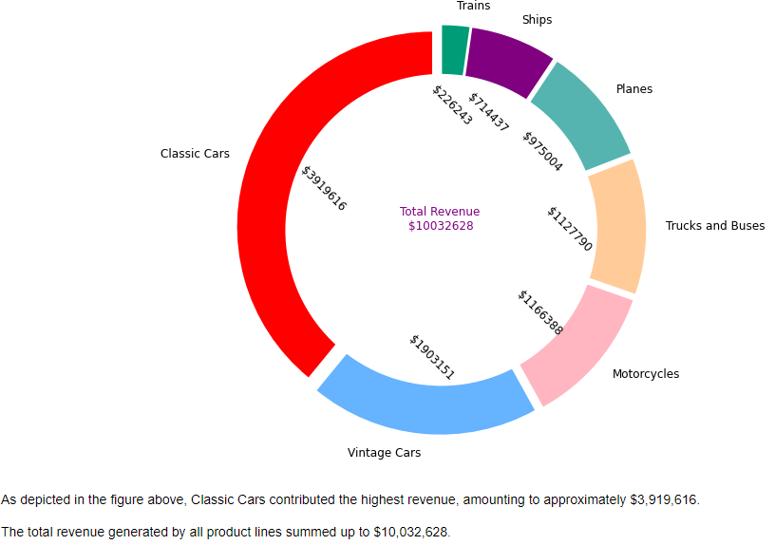
highest revenue by product - Classic Cars accounted for the highest revenue, approximately $3,919,616. - The total revenue from all product lines reached $10,032,628.

Slide 15
Thank You

