Slide 1
One Day Workshop for BCA students on PHP & MySQL at Department of MCA Siddaganga Institute of Technology, Tumkuru by Ankitkumar Velani Senior Consultant Deloitte India, Bangalore

Slide 2
Basic understanding with PHP (Hypertext Preprocessor)

Slide 3

What is PHP ?
PHP (recursive acronym for "PHP: Hypertext Preprocessor")
widely-used Open-Source general-purpose scripting language
PHP is well suited for web development
can be embedded into HTML
PHP is simple and easy to learn language.
PHP 8.1.1Latest released!
<html>
<head>
<title>Example</title>
</head>
<body>
<?php
echo "Hi, I'm a PHP script!";
?>
</body>
</html>

Slide 4

Advantages of PHP
Easy and Simple to Learn
Extremely Flexible
Easy Integration and Compatibility
Efficient Performance
Cost-Efficient
Gives Web Developer More Control

Slide 5

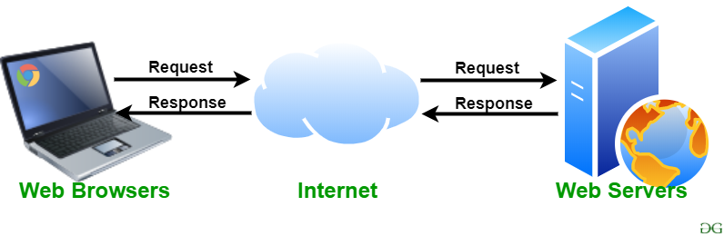
Web server
A web server is computer software and underlying hardware that accepts requests via HTTP (the network protocol created to distribute web content) or its secure variant HTTPS.

Slide 6
XAMPP Software stack
To work with PHP, we need a AMP (Apache, MySQL, PHP) software stack and it’s available for all the operating systems. There are many AMP options available in the market that are given below:
WAMP for Windows
LAMP for Linux
MAMP for Mac
SAMP for Solaris
FAMP for FreeBSD
XAMPP (Cross, Apache, MySQL, PHP, Perl) for Cross Platform: It includes some other components too such as FileZilla, OpenSSL, Webalizer, Mercury Mail, etc.

Slide 7
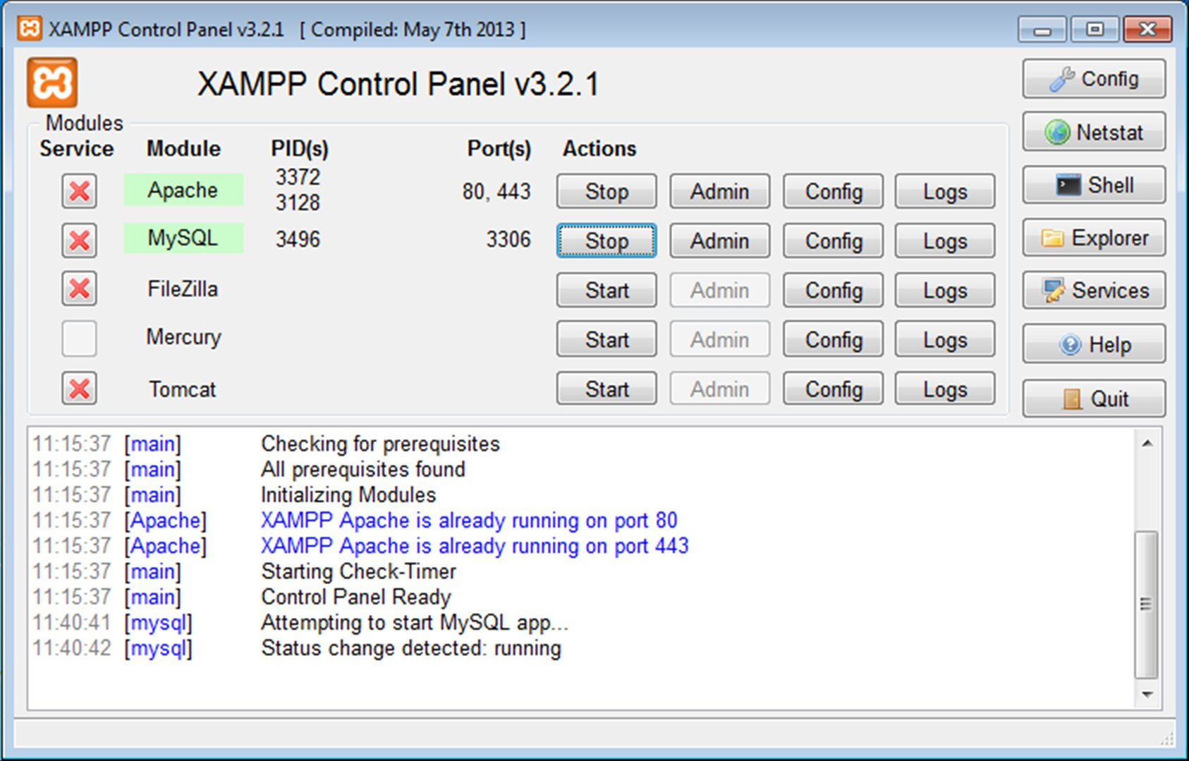
Installation
XAMPP
Step 1: Download executable file from XAMPP official website.
Step 2: Double click on executable file and click on Next…Next and Finish
Step 3: After successfully installed, open XAMPP control panel and start Apache for PHP & MySQL for MySQL database.
Step 4: access below URL in web browser
http://localhost/
OR
http://127.0.0.1/

Slide 8

PHP Code style
<?php
//php code here;
//php code here;
//php code here;
?>
PHP statements ends with semicolon (;).

Slide 9
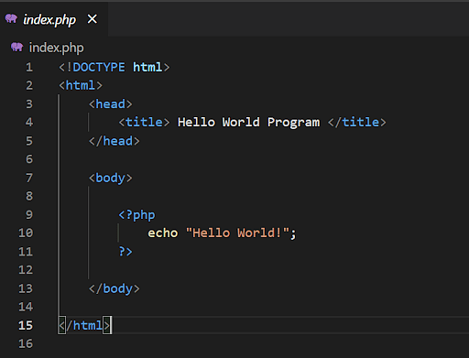
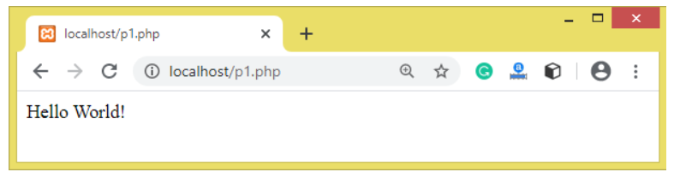
Execution in XAMPP
Step 1: create file with extention .php
(i.e hello.php, index.php, f1.php , p1.php …etc)
Step 2 : Save .php file in C:/xampp/htdocs
Step 3: Open XAMPP control panel and start Apache
Step 4: open web browser (chrome, IE, firefox ) type http://localhost/p1.php

Slide 10
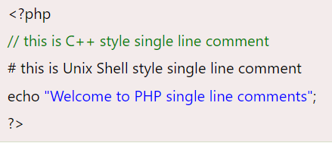

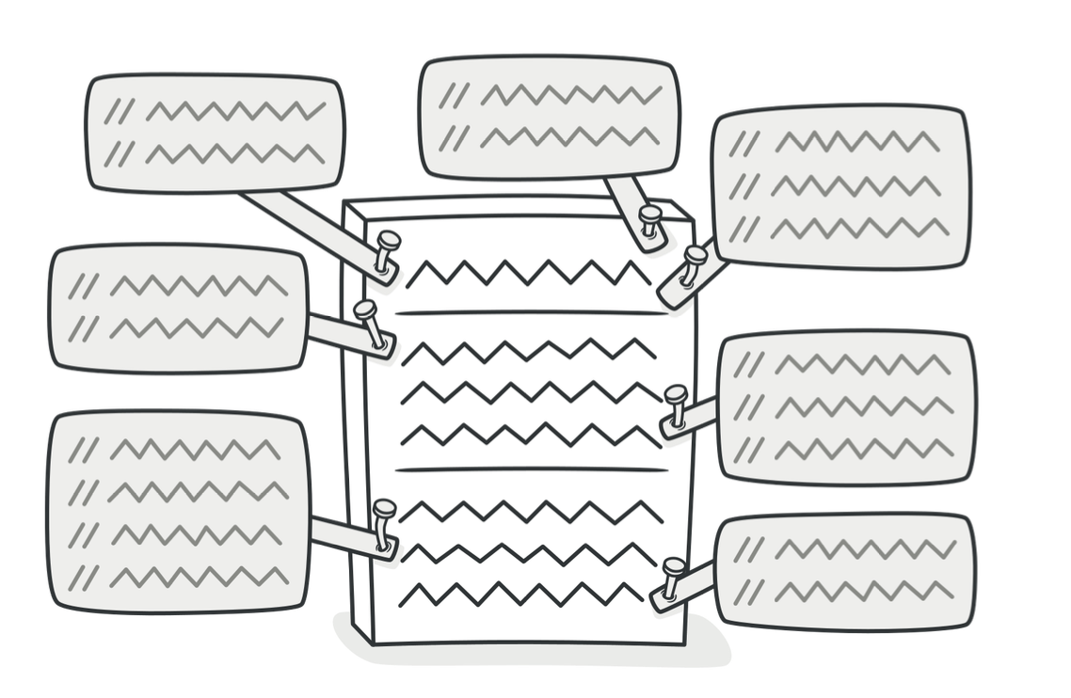
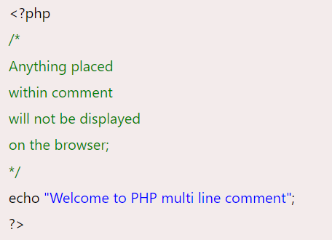
PHP Comments
PHP comments can be used to describe any line of code so that other developer can understand the code easily. It can also be used to hide any code.
PHP supports
Single line
Multiline
These comments are similar to C/C++ and Perl style (Unix shell style) comments.

Slide 11
ANY Questions ?
PHP
Advantages of PHP
Web Server
XAMPP installation
PHP Script execution
Hello World
PHP Comments

Slide 12

What is HTML?
HTML stands for Hyper Text Markup Language.
HTML is the language in which most websites are written. Is used to created pages and make them functional.
Hypertext means that document contains links that allow the reader to jump to other places in the document or to another document altogether.
A Markup Language is a way that computers speak to each other to control how text is processed and presented.
To do this HTML uses two things:
tags and attributes

Slide 13
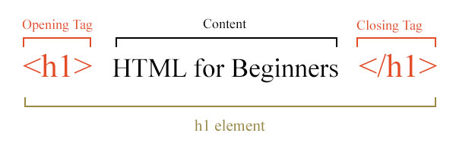
Tags
Tags are used to mark up the start of an HTML element and they are usually enclosed in angle brackets.
An example of a tag is:<h1>
Most tags must be opened <h1> and closed </h1>

Slide 14
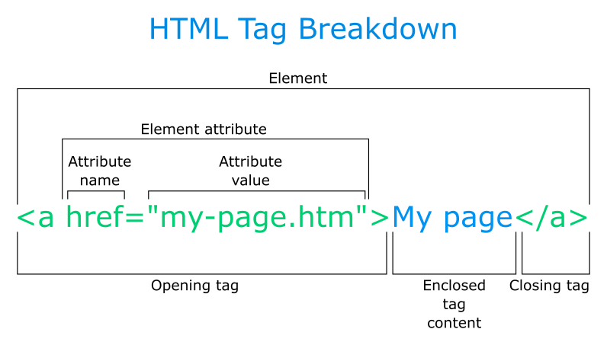
Attributes
Attributes contain additional pieces of information.
Attributes take the form of an opening tag and additional info is placed inside.

Slide 15
Basic HTML Tags
Tags | Description | Example
<p> …………… </p> | This tag allows you to create paragraphs | My name is Fred. I live in Medway
<h1> ………….. </h1> <h2> ………….. </h2> <h3> ………….. </h3> <h4> ………….. </h4> <h5> ………….. </h5> <h6> ………….. </h6> | Heading Text | Heading 1 Heading 2 Heading 3 Heading 4 Heading 5 Heading 6
<hr > | Horizontal line | ____________________
<br> | Break line | This is Break line tag
<b> , </i> | Bold , Italic | Bold text Italic text

Slide 16

HTML Table
HTML table tag is used to display data in tabular form (row * column). There can be many columns in a row.
We can create a table to display data in tabular form, using <table> element, with the help of <tr> , <td>, and <th> elements.
<!DOCTYPE>
<html>
<body>
<table border=‘1’>
<tr>
<th> First_Name </th>
<th> Last_Name </th>
<th> Marks </th>
</tr>
<tr>
<td> AAAA </td>
<td> BBBB </td>
<td> 60 </td>
</tr>
</table>
</body>
</html>
Output :

Slide 17
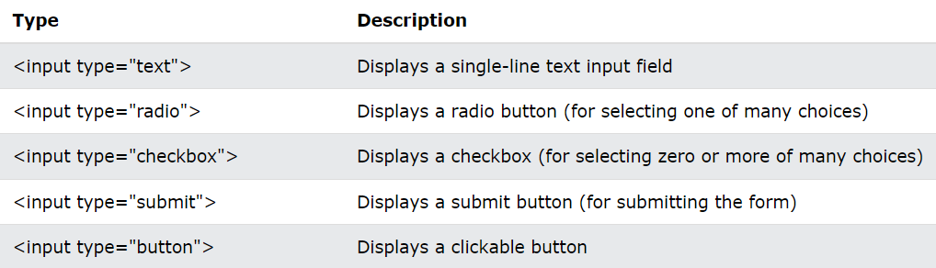
HTML Forms
An HTML form is used to collect user input. The user input is most often sent to a server for processing.
The <form> element is a container for different types of input elements, such as: text fields, checkboxes, radio buttons, submit buttons, etc.
The <input> Element
The HTML <input> element is the most used form element.
An <input> element can be displayed in many ways, depending on the type attribute.

Slide 18
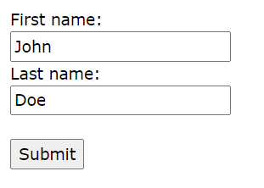
HTML Forms
<form>
<label for="fname">
First name:
</label>
<br>
<input type="text" id="fname" name="fname" value="John"><br>
<label for="lname">
Last name:
</label>
<br>
<input type="text" id="lname" name="lname" value="Doe">
<br><br>
<input type="submit" value="Submit">
</form>
Output :

Slide 19
Embedding HTML code with PHP
Step 1: Prepare HTML basic code & structures.
Step 2: Place <?php --------- ?> block in HTML wherever we wanted to embed.
Step 3: use echo or print function in PHP and enter HTML code within it.
Step 4: Save & View in browser.
<!Doctype Html>
<html>
<head>
<title>
Embed HTML code in PHP
</title>
</head>
<body>
<h1>
<?php
echo ”Hi!, This is message from PHP”;
?>
</h1>
</body>
</html>

Slide 20
ANY Questions ?
HTML
Tags & Attributes
Text , Table , Form Tags
Embedding HTML with PHP & vice versa

Slide 21
Thank you!

