Slide 1
One Day Workshop for BCA students on PHP & MySQL at Department of MCA Siddaganga Institute of Technology, Tumkuru by Ankitkumar Velani Senior Consultant Deloitte India, Bangalore

Slide 2
Programming with PHP & MySQL

Slide 3
Project: Student Information Management
Create Student Information Management
Students:
Student can register them self.
Student gets the notification from Faculty
Faculty:
Faculty can send notification/message/news to registered students.
Faculty can add/delete the notification
Faculty can see the list of registered students on portal.

Slide 4
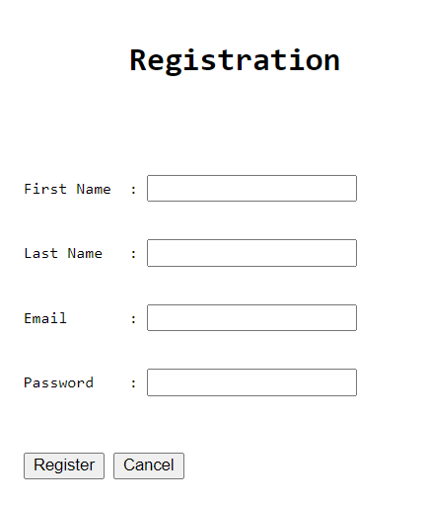
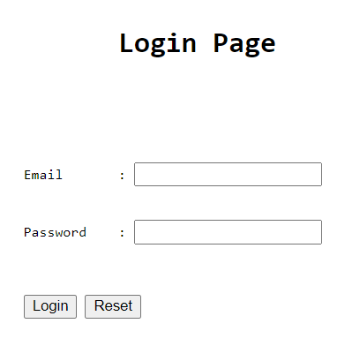
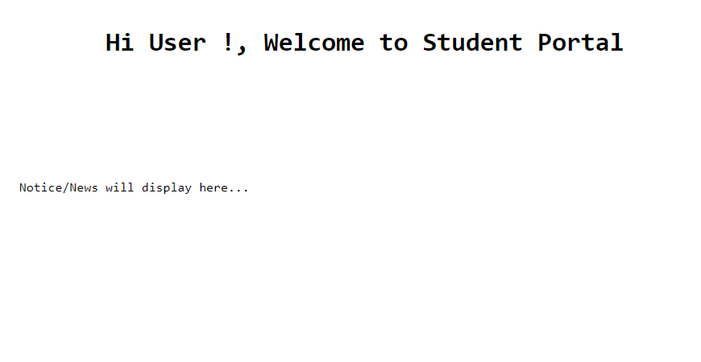
Project: Student Information Management
1
2
Students:
Pages to be design with HTML/PHP
Registration Page (1)
Login Page (2)
Home Page (3)
3

Slide 5
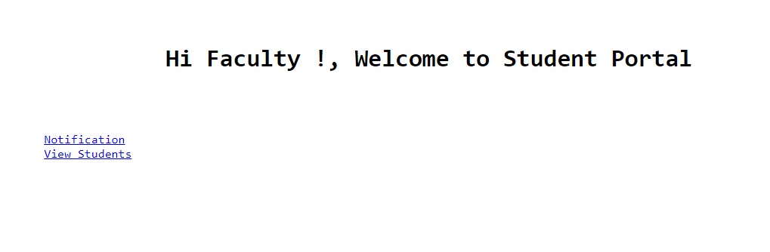
Project: Student Information Management
1
Faculty:
Pages to design with HTML/PHP
Login Page (1)
Home Page (2)
Notification
Student List
2

Slide 6
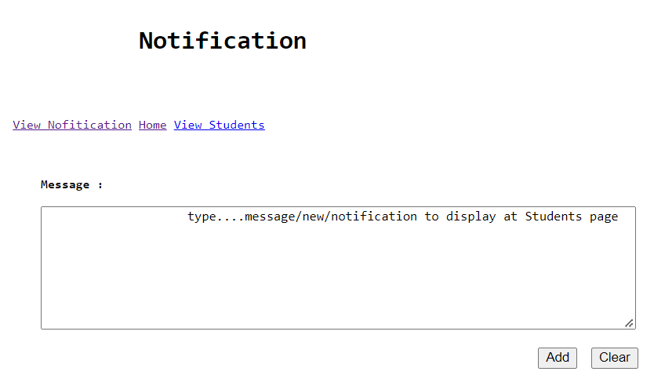
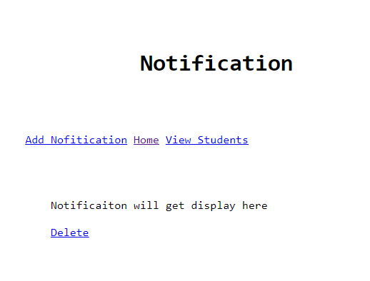
Project: Student Information Management
1
Faculty:
Pages to design with HTML/PHP
Login Page
Home Page
Notification
- Add Notification (1)
- View Notification (2)
Student List
2

Slide 7
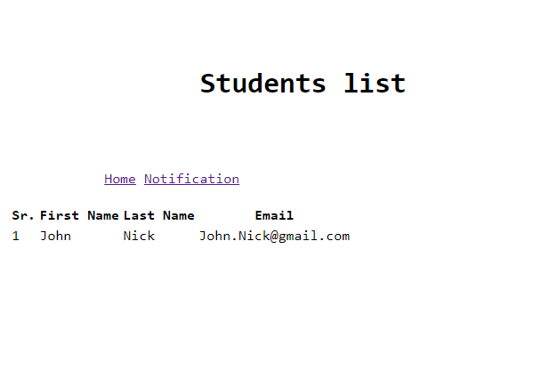
Project: Student Information Management
Faculty:
Pages to design with HTML/PHP
Login Page
Home Page
Notification
- Add Notification
- View Notification
Student List

