Slide 1

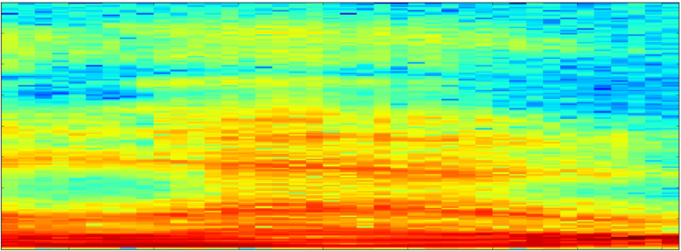
Wave File
Normalize
Down Sample
Spectrographs
Feature Building
[-1,+1]
VGGCNN
PCA
128
Quantize
0 - 255
Log Frequency
Log Amplitude
TensorFlow
Record
[Channel = 1,
Samples = 10*22.5k]
[Channel = 1,
Samples = 10*16k]
Trained Model
[Examples = 10, Features = 128]
[Examples = 10, Frames = 96,
Freq bins = 64]
Classifier
Training Set
[Happy, Sad, Scary, Angry]
Eval Set
Label
Prediction

