Slide 1
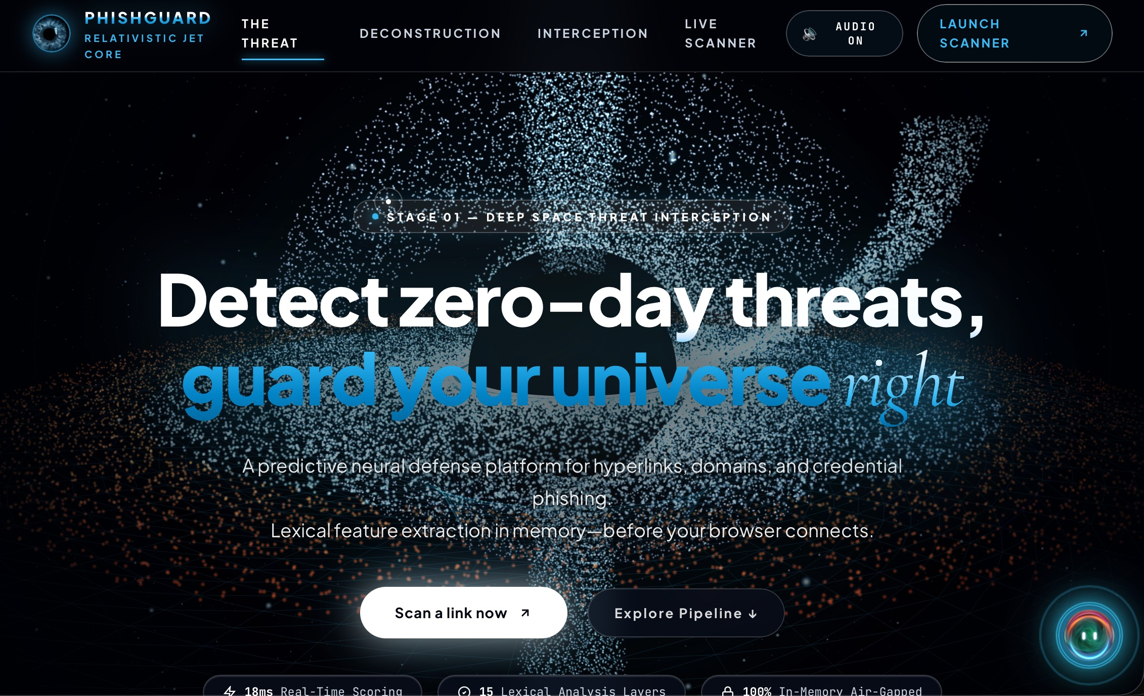



PhishGuard AI
Machine Learning Based Phishing URL Detection
Attackers create fake links faster than blacklists can update. One click can hand over a password.
What is phishing?
Fake sites that steal passwords & card details
Why detect phishing URLs?
Blacklists are too slow for brand-new links
Our deployed website
Objective
15 URL features
100 decision trees
0 sites visited
Classify any URL as phishing or legitimate
Suspicious URL
Analysis (ML model)
Phishing
Legitimate
Notes:
WHAT (introduce): Good morning. Our project is PhishGuard AI. It is a machine-learning system that looks at a web link (URL) and decides whether it is phishing or legitimate.
WHAT IS PHISHING: Phishing is a cyber-attack where the attacker builds a fake website or link that imitates something trusted, like a bank login page, so the user types in a password or card details.
WHY IT IS A PROBLEM: The usual defence is a blacklist, a database of known bad links. But blacklists are reactive. Attackers create new throw-away links every day, and a link can steal credentials and disappear before any blacklist is updated. This is called a zero-day or zero-hour phishing problem.
HOW WE APPROACH IT: Instead of looking the link up in a list, we analyse the structure of the URL string itself: how long it is, how many slashes and special characters it has, what domain ending it uses, whether it contains words like login, verify or bank. A trained model then decides. Importantly, we never open the link, so nobody is exposed to the malicious site.
OBJECTIVE: Build and deploy a fast machine-learning classifier that takes any URL, labels it phishing or legitimate, and also shows a confidence score and the reasons behind the decision.
The screenshot is our deployed website. The strip at the bottom is the whole project in one line: a suspicious URL goes in, the model analyses it, and a verdict comes out.

Slide 2






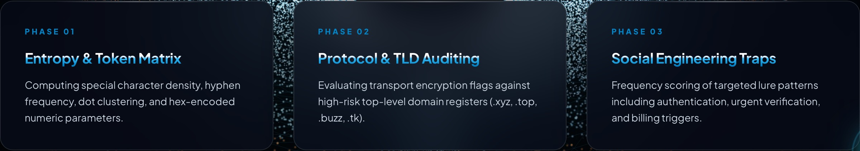



Proposed Solution & Methodology
User enters URL
URL Preprocessing
Feature Extraction
15 URL Features
Random Forest
Prediction
Risk + Confidence + Explainability
Why Random Forest?
Feature groups (from our website)
Tree 1
Tree 2
Tree 3
...
Tree 100
Majority vote
Top features by Gini importance (Random Forest)
Bagging reduces overfitting
Slash count
25.99%
Handles non-linear feature interactions
Suspicious keywords
15.42%
Path length
9.54%
Gini importance explains predictions
Domain length
7.47%
Python
Scikit-learn
Random Forest
100 decision trees
URL never visited
Notes:
Walk left to right along the pipeline.
STEP 1-2, INPUT AND PREPROCESSING. The user pastes a URL. We clean it up and split it into parts (protocol, domain, path) as a plain text string. The website is never opened or pinged. WHY: visiting a phishing site could download malware or alert the attacker, so analysing only the text is safer and faster.
STEP 3-4, FEATURE EXTRACTION.
What: converting the URL text into 15 numbers.
How: we compute lexical and structural measurements. Our site groups them in three families: token and character counts (special characters, hyphens, dots, numeric or hex patterns); protocol and domain-ending checks (HTTPS, risky endings like .xyz, .top, .buzz, .tk); and social-engineering words such as login, verify, billing. (Keep the exact list of your 15 features from the code ready, in case the examiner asks.)
Why: machine-learning models cannot read text, they need numbers, and phishing URLs tend to look different from normal ones in these measurements.
STEP 5, RANDOM FOREST.
What: a collection of 100 decision trees. Each tree is trained on a random sample of the data and sees random features.
How: every tree votes phishing or legitimate, and the majority wins. The share of votes gives the probability and confidence score.
Why we chose it: one tree can memorise the training data (overfitting); averaging 100 different trees reduces that. It handles non-linear relationships between features, and it gives feature importance, which supports our explainable-AI output. We also benchmarked Decision Tree and Logistic Regression, and Random Forest was selected as best. The bars on the right are real importance values from our site: slash count and suspicious keywords matter most.
STEP 6-7, OUTPUT. The model gives a prediction plus risk level, confidence, and the indicators that triggered the decision.
Tools: Python and scikit-learn.

Slide 3
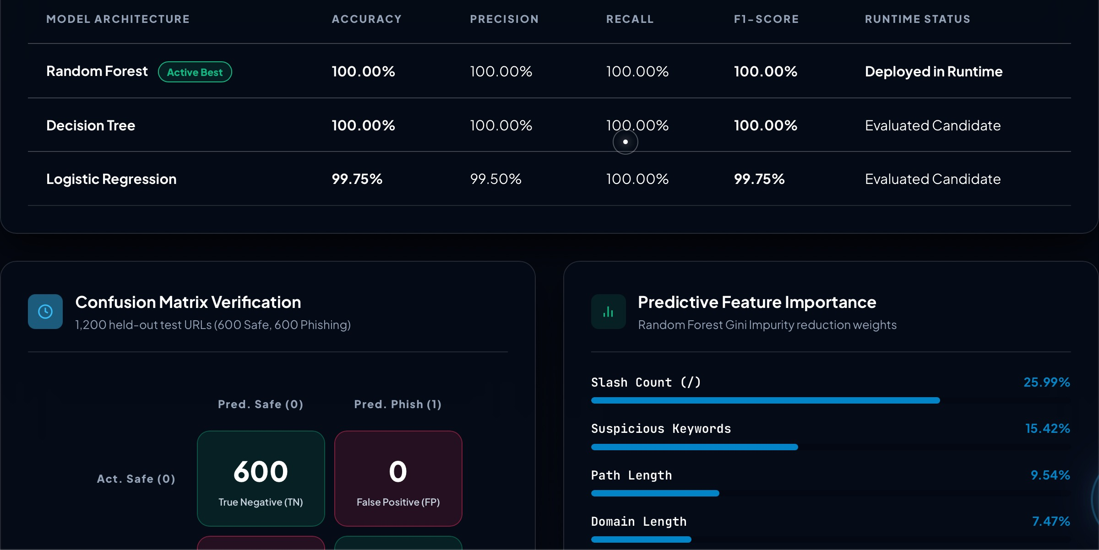

Implementation & Results
Random Forest on 1,200 held-out URLs
600 safe | 600 phishing
100%
Accuracy
100%
Precision
100%
Recall
100%
F1-score
Confusion matrix
Pred. Safe
Pred. Phish
Live site: model benchmark, confusion matrix, feature importance
Act. Safe
600
True Neg.
0
False Pos.
Live Scanner screenshot goes here
1 URL input
2 Verdict
3 Confidence
4 XAI
Act. Phish
0
False Neg.
600
True Pos.
The system analyzes the URL without directly visiting the target website.
Notes:
This slide shows the working website and how well the model performs.
THE DEMO (do this live if possible). Open the Live Scanner section. 1) Paste a URL or pick one of the preset test cases. 2) Click Check URL. 3) The site shows the verdict, phishing or legitimate. 4) It shows the confidence percentage and risk level, plus a phishing-probability meter with a 50% threshold. 5) Below that, the Explainable AI indicators list which structural anomalies triggered the decision, and a table shows the 15 extracted values. Remind the audience that the target URL is never opened.
THE RESULTS.
What: we measured the model on 1,200 URLs it had never seen during training, 600 safe and 600 phishing.
How: for Random Forest, accuracy, precision, recall and F1-score are all 100% on this test set. Decision Tree also scored 100%, and Logistic Regression scored 99.75% accuracy, so Random Forest was kept as the deployed model.
Confusion matrix: all 600 safe URLs were classified safe (true negatives), none were wrongly flagged (false positives = 0). Because recall is 100%, all 600 phishing URLs were caught (false negatives = 0, true positives = 600).
Why this matters: recall means how many real phishing links we catch; precision means how many of our alerts are truly phishing.
BE HONEST IF ASKED: a perfect score on one test set does not mean perfect detection in the real world. Our test set is limited, and attackers keep changing URL patterns. Treat it as strong evidence on our dataset, not a guarantee. Expect the question, is 100% overfitting? Answer: the 1,200 URLs were held out from training, and we also compared against two other models.

Slide 4



Conclusion & Future Scope
Advantages
Limitations
Future Scope
Fast URL analysis
No need to visit suspicious websites
Automated ML classification
Multiple URL characteristics
Explainable prediction
Mainly URL-based analysis
Cannot guarantee detection of every phishing URL
Attackers can change URL patterns
Performance depends on training data
Browser extension
Email phishing detection
Real-time threat intelligence
Domain reputation checking
Typosquatting detection
Continuous model retraining
Thank You | Questions?
Notes:
Summarise in about a minute and a half.
CONCLUSION. We built PhishGuard AI, a working, deployed web tool that classifies URLs as phishing or legitimate using a Random Forest of 100 trees trained on 15 URL features. It gives a verdict, confidence, risk level and explanation, and it never visits the link.
ADVANTAGES.
What: the strengths of the system. How/Why: it is fast because it only processes a short text string, in milliseconds. It is safe because the suspicious site is never opened. It is automated, so no manual blacklist updates. It uses many URL characteristics at once, and it is explainable, so the user can see which features raised the alarm instead of a black-box answer.
LIMITATIONS (be upfront, examiners value honesty).
It mainly looks at the URL text only, not page content. It cannot guarantee catching every phishing URL. Attackers can deliberately change URL patterns to look normal. And like any ML model, performance depends on the quality and variety of the training data.
FUTURE SCOPE.
A browser extension so links are checked automatically while browsing; email phishing detection by scanning links in incoming mail; real-time threat intelligence feeds and domain reputation checks to add information beyond the URL text; typosquatting detection for look-alike domains such as small spelling tricks; and continuous retraining so the model keeps up with new attack patterns.
Close: thank the audience and invite questions. Likely questions to prepare: why Random Forest, what are the 15 features, why does the model not visit the site, is 100% accuracy realistic, how would you handle new attack patterns.

