Slide 1

Introduction to
Java Programming, 4E
Y. Daniel Liang
Notes:
First Class: Introduction, Prerequisites, Advices, Syllabus
Lab 1: Create a Java Project, Compile, and Run.
Show syntax errors
Print program
Capture screen shots, and save it in Word, and print it.
Homework One: Check in the class randomly.

Slide 2
Introduction
Course Objectives
Organization of the Book

Slide 3
Course Objectives
Upon completing the course, you will understand
  Create, compile, and run Java programs
  Primitive data types
  Java control flow
  Methods
  Arrays (for teaching Java in two semesters, this could be the end)
  Object-oriented programming
  Core Java classes (Swing, exception, internationalization, multithreading, multimedia, I/O, networking, Java Collections Framework)

Slide 4
Course Objectives, cont.
You will be able to
  Develop programs using Forte
  Write simple programs using primitive data types, control statements, methods, and arrays.
  Create and use methods
  Develop a GUI interface and Java applets
  Write interesting projects
  Establish a firm foundation on Java concepts

Slide 5
Book Chapters
Part I: Fundamentals of Programming
  Chapter 1 Introduction to Java
  Chapter 2 Primitive Data Types and Operations
  Chapter 3 Control Statements
  Chapter 4 Methods
  Chapter 5 Arrays

Slide 6
Book Chapters, cont.
Part II: Object-Oriented Programming
  Chapter 6 Objects and Classes
  Chapter 7 Strings
  Chapter 8 Class Inheritance and Interfaces
  Chapter 9 Object-Oriented Software Development

Slide 7
Book Chapters, cont.
Part III: GUI Programming
  Chapter 10 Getting Started with GUI Programming
  Chapter 11 Creating User Interfaces
  Chapter 12 Applets and Advanced GUI

Slide 8
Book Chapters, cont.
Part IV: Developing Comprehensive Projects
  Chapter 13 Exception Handling
  Chapter 14 Internationalization
  Chapter 15 Multithreading
  Chapter 16 Multimedia
  Chapter 17 Input and Output
  Chapter 18 Networking
  Chapter 19 Java Data Structures

Slide 9
Chapter 1 Introduction to Java and Forte
What Is Java?
Getting Started With Java Programming
  Create, Compile and Running a Java Application

Slide 10
What Is Java?
History
Characteristics of Java

Slide 11
History
James Gosling and Sun Microsystems
Oak
Java, May 20, 1995, Sun World
HotJava
  The first Java-enabled Web browser
JDK Evolutions
J2SE, J2ME, and J2EE (not mentioned in the book, but could discuss here optionally)

Slide 12
Characteristics of Java
Java is simple
Java is object-oriented
Java is distributed
Java is interpreted
Java is robust
Java is secure
Java is architecture-neutral
Java is portable
Java’s performance
Java is multithreaded
Java is dynamic

Slide 13
JDK Versions
JDK 1.02 (1995)
JDK 1.1 (1996)
Java 2 SDK v 1.2 (a.k.a JDK 1.2, 1998)
Java 2 SDK v 1.3 (a.k.a JDK 1.3, 2000)
Java 2 SDK v 1.4 (a.k.a JDK 1.4, 2002)

Slide 14
JDK Editions
Java Standard Edition (J2SE)
  J2SE can be used to develop client-side standalone applications or applets.
Java Enterprise Edition (J2EE)
  J2EE can be used to develop server-side applications such as Java servlets and Java ServerPages.
Java Micro Edition (J2ME).
  J2ME can be used to develop applications for mobile devices such as cell phones.
This book uses J2SE to introduce Java programming.

Slide 15
Java IDE Tools
Forte by Sun MicroSystems
Borland JBuilder
Microsoft Visual J++
WebGain Café
IBM Visual Age for Java

Slide 16
Getting Started with Java Programming
A Simple Java Application
Compiling Programs
Executing Applications

Slide 17
A Simple Application
Example 1.1
//This application program prints Welcome
//to Java!
package chapter1;
public class Welcome {
public static void main(String[] args) {
System.out.println("Welcome to Java!");
}
}
Source
Run
NOTE: To run the program, install slide files on hard disk.

Slide 18
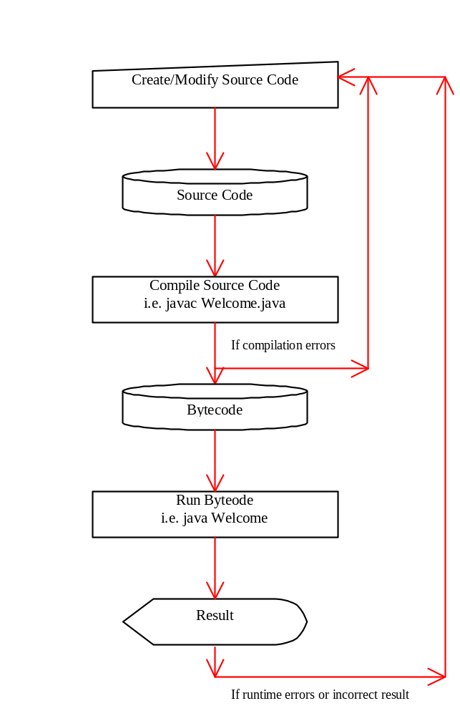
Creating and Compiling Programs
On command line
  javac file.java

Slide 19
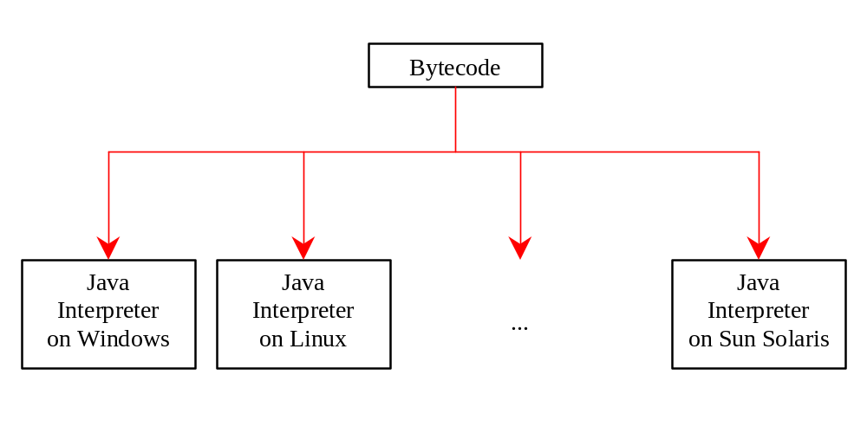
Executing Applications
On command line
  java classname

Slide 20
Example
javac Welcome.java
java Welcome
output:...

Slide 21
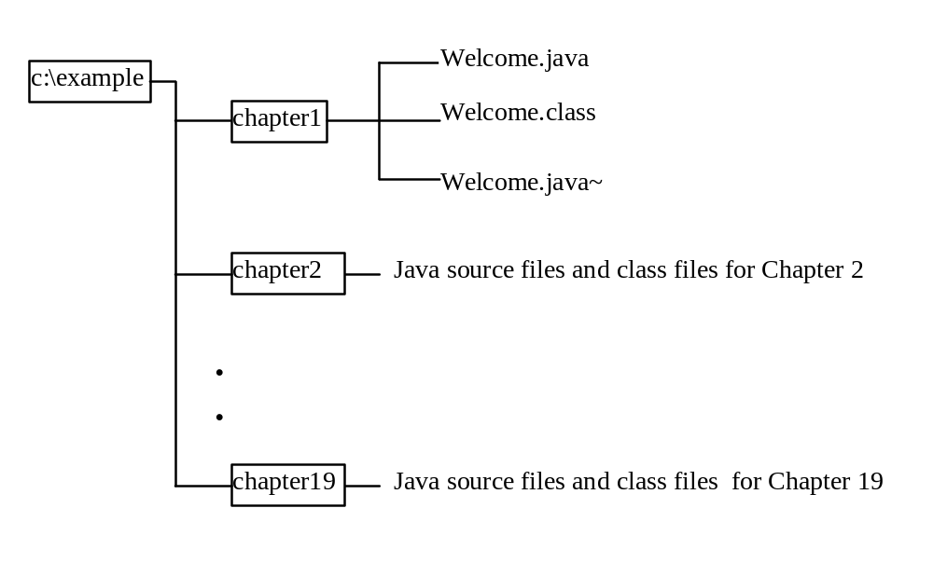
Compiling and Running a Program
Where are the files stored in the directory?

Slide 22
Anatomy of a Java Program
Comments
Package
Reserved words
Modifiers
Statements
Blocks
Classes
Methods
The main method

Slide 23
Comments
In Java, comments are preceded by two slashes (//) in a line, or enclosed between /* and */ in one or multiple lines. When the compiler sees //, it ignores all text after // in the same line. When it sees /*, it scans for the next */ and ignores any text between /* and */.

Slide 24
Package
The second line in the program (package chapter1;) specifies a package name, chapter1, for the class Welcome. Forte compiles the source code in Welcome.java, generates Welcome.class, and stores Welcome.class in the chapter1 folder.

Slide 25
Reserved Words
Reserved words or keywords are words that have a specific meaning to the compiler and cannot be used for other purposes in the program. For example, when the compiler sees the word class, it understands that the word after class is the name for the class. Other reserved words in Example 1.1 are public, static, and void. Their use will be introduced later in the book.

Slide 26
Modifiers
Java uses certain reserved words called modifiers that specify the properties of the data, methods, and classes and how they can be used. Examples of modifiers are public and static. Other modifiers are private, final, abstract, and protected. A public datum, method, or class can be accessed by other programs. A private datum or method cannot be accessed by other programs. Modifiers are discussed in Chapter 6, "Objects and Classes."

Slide 27
Statements
A statement represents an action or a sequence of actions. The statement System.out.println("Welcome to Java!") in the program in Example 1.1 is a statement to display the greeting "Welcome to Java!" Every statement in Java ends with a semicolon (;).

Slide 28

Blocks
A pair of braces in a program forms a block that groups components of a program.

Slide 29
Classes
The class is the essential Java construct. A class is a template or blueprint for objects. To program in Java, you must understand classes and be able to write and use them. The mystery of the class will continue to be unveiled throughout this book. For now, though, understand that a program is defined by using one or more classes.

Slide 30
Methods
What is System.out.println? It is a method: a collection of statements that performs a sequence of operations to display a message on the console. It can be used even without fully understanding the details of how it works. It is used by invoking a statement with a string argument. The string argument is enclosed within parentheses. In this case, the argument is "Welcome to Java!" You can call the same println method with a different argument to print a different message.

Slide 31
main Method
The main method provides the control of program flow. The Java interpreter executes the application by invoking the main method.
The main method looks like this:
public static void main(String[] args) {
// Statements;
}

Slide 32
Displaying Text in a Message Dialog Box
you can use the showMessageDialog method in the JOptionPane class. JOptionPane is one of the many predefined classes in the Java system, which can be reused rather than “reinventing the wheel.”
Source
Run

Slide 33
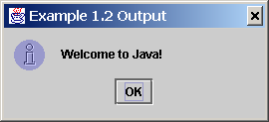
The showMessageDialog Method
JOptionPane.showMessageDialog(null, "Welcome to Java!",
"Example 1.2", JOptionPane.INFORMATION_MESSAGE));

Slide 34
The exit Method
Use Exit to terminate the program and stop all threads.
NOTE: When your program starts, a thread is spawned to run the program. When the showMessageDialog is invoked, a separate thread is spawned to run this method. The thread is not terminated even you close the dialog box. To terminate the thread, you have to invoke the exit method.

